Slide 1
DBAIT Lure
Lesson 1 Resources

Slide 2
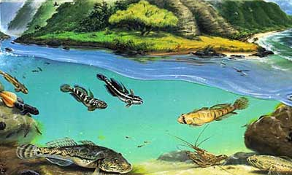
HI TRAILS
Intro Stations - Place, Water & DBAIT
Image credit: DLNR

Slide 3
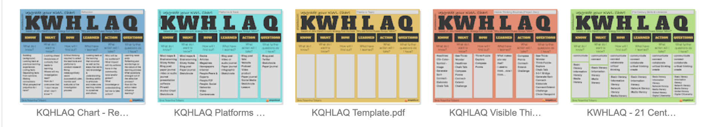
KWHLAQ
K - What do we think we know about the subject?
  Brainstorm
  Activate prior knowledge
  Discover misconceptions
W - What do we need to find out?
  Self-directed
  “Who owns the learning?”
H - How will we find out the answers to our questions?
  Curating information
  Traditional methods and more modern sources of information
L - What are we learning and what have we learned?
  Dewey – we learn from reflecting on the experience
  Look back, look ahead, make connections
A - What action will we take?
  How are learners applying what they learn?
  Put learning into context
Q - What new questions do we have?
  Learning is not done, continual process

Slide 4
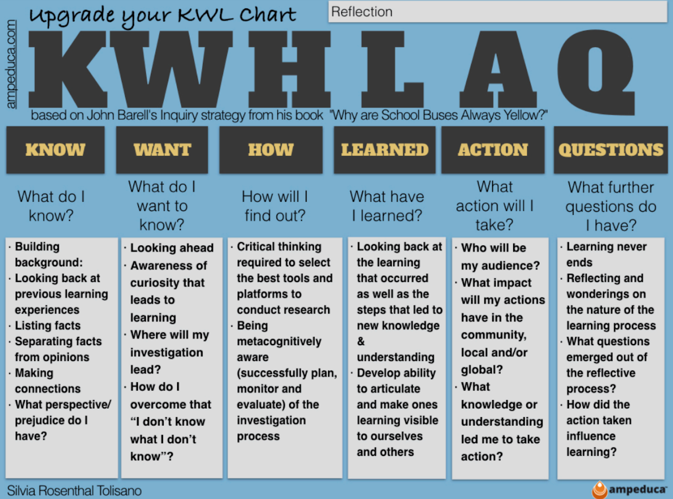
Reflection as part of the process
Building reflection into the process vs. just at the end, empowers, makes learning process more purposeful
Notes:
https://thelearnersway.net/ideas/2020/11/23/taking-a-reflective-stance

Slide 5
Instructions
Visit each station and observe the image and/or read the information
Think about the following questions as you engage with the material and each other at each station
  How do I relate to this image/definition/ʻōlelo noʻeau
  What do I know about the topic already? What manaʻo can I share?
  What more do I want to know about it?
  How will I learn what I want to know/learn?
  What new things have I learned after discussing the topic with my classmates, researching, exploring?
  What actions do I want to take related to this topic?
  What questions do I have now or after discussing/researching?
Fill in the best column(s) on the KWHLAQ chart as you rotate through the stations

Slide 6
KWHLAQ Chart
Know? | Want to know? | How will I learn what I want to know? | Learned? | Actions I will take? | Questions?
Notes:
https://www.inspiringinquiry.com/learningteaching/toolsstrategies/kwhlaq-chart

Slide 7
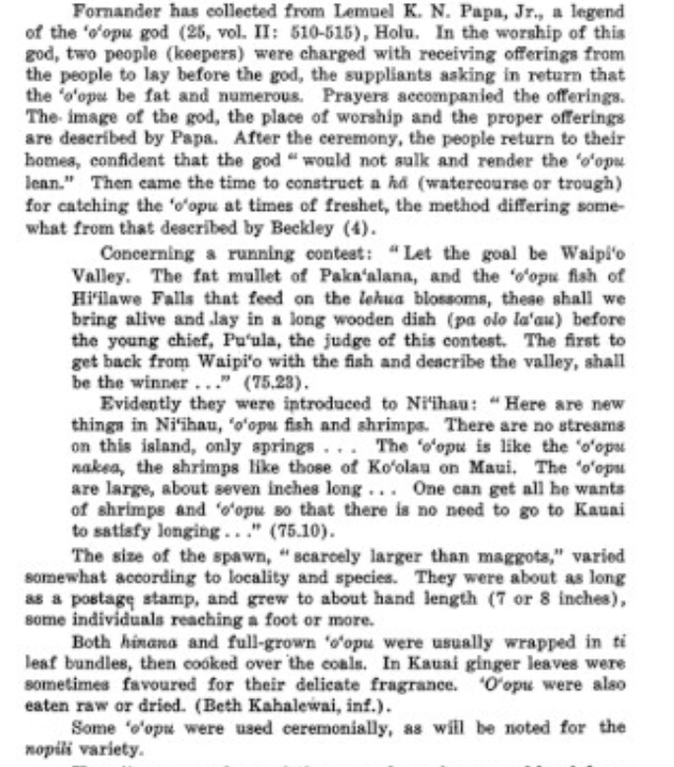
Station #1: Oʻopu Moʻolelo
Notes:
https://puke.ulukau.org/ulukau-books/?a=d&d=EBOOK-TITCOMB.2.4.69&e=-------en-20--1--txt-txPT-o%ca%bbopu----------

Slide 8
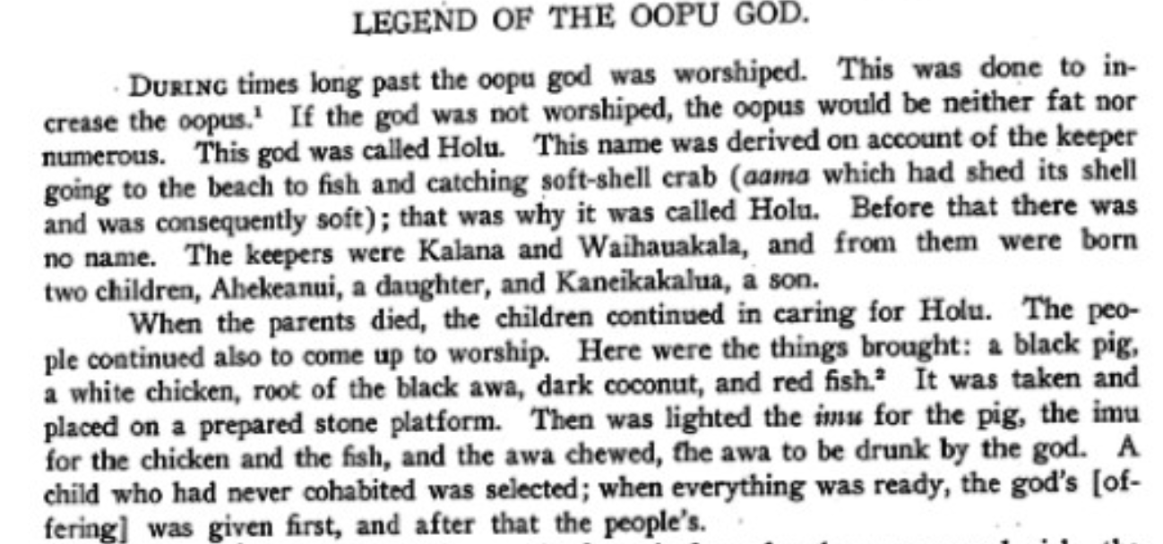
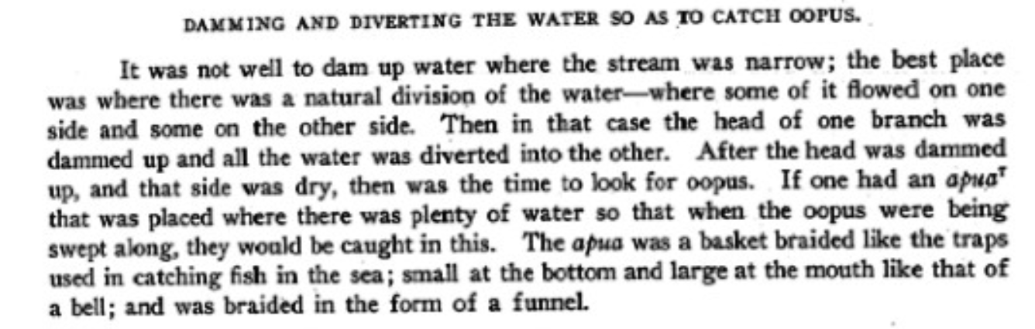
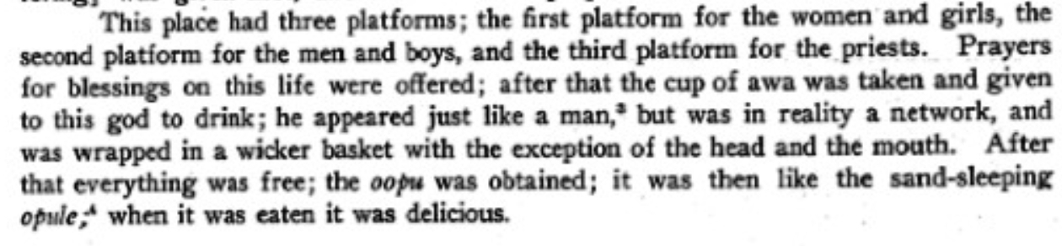
Station #1b: Oʻopu Moʻolelo
Notes:
https://puke.ulukau.org/ulukau-books/?a=d&d=EBOOK-FORNANDER5.2.4.2.5&e=-------en-20--1--txt-txPT-o%ca%bbopu+god----------

Slide 9
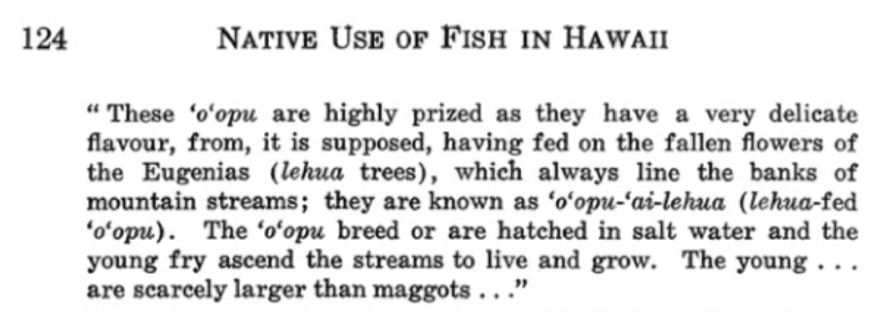
Station #2: Native Uses of Fish

Slide 10
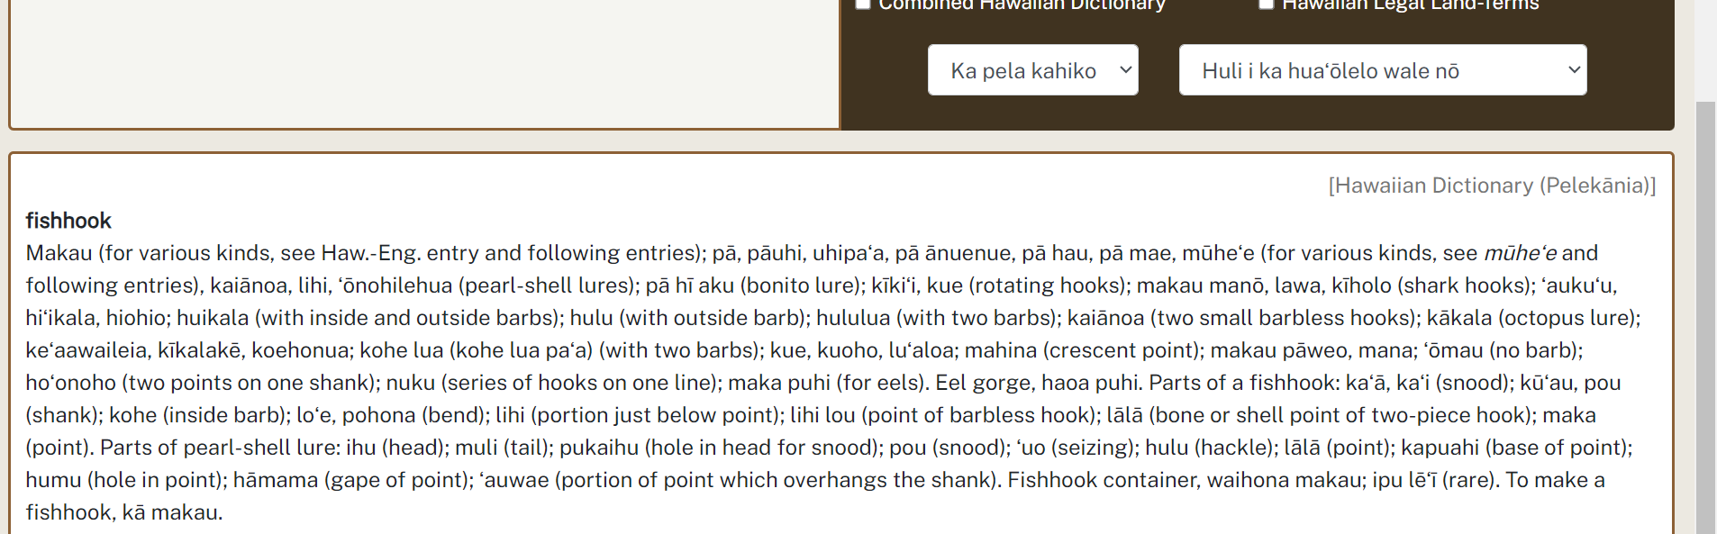
Station #3a: Definition of fishhook

Slide 11
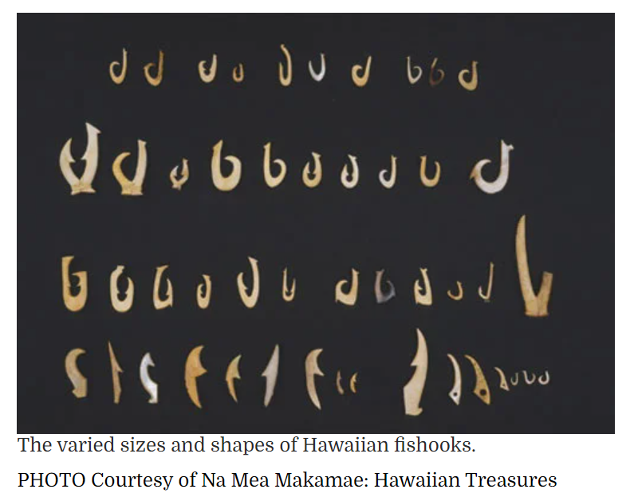
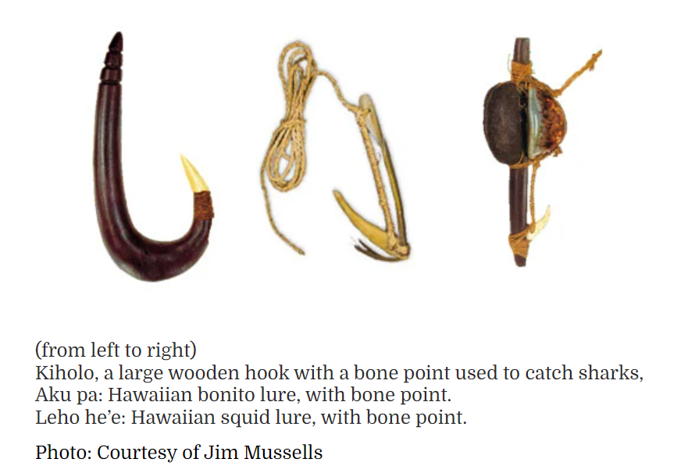
Station #3b: Fish hooks and Lures
Notes:
https://www.honolulumagazine.com/makau-hawaiian-fishhooks/

Slide 12
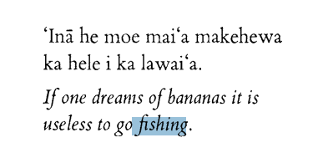
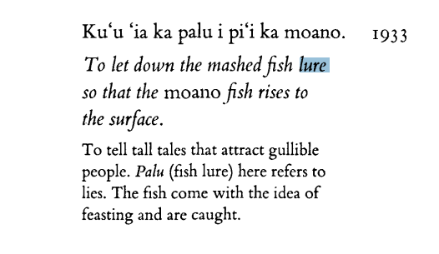
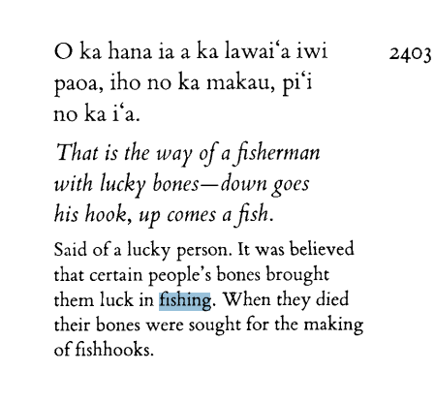
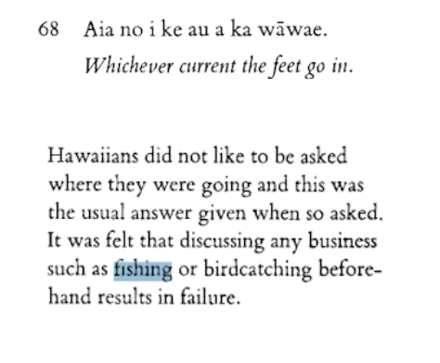
Station #3c: ʻōlelo noʻeau - Lure & fishing-related

Slide 13
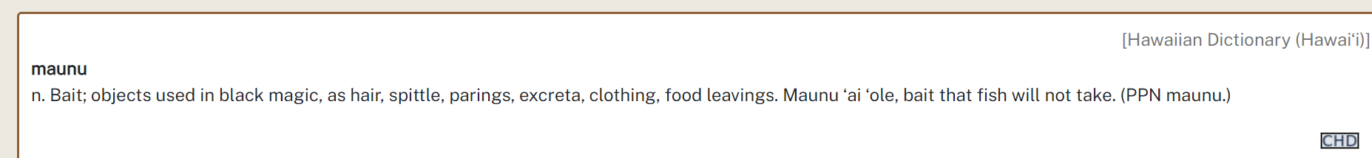
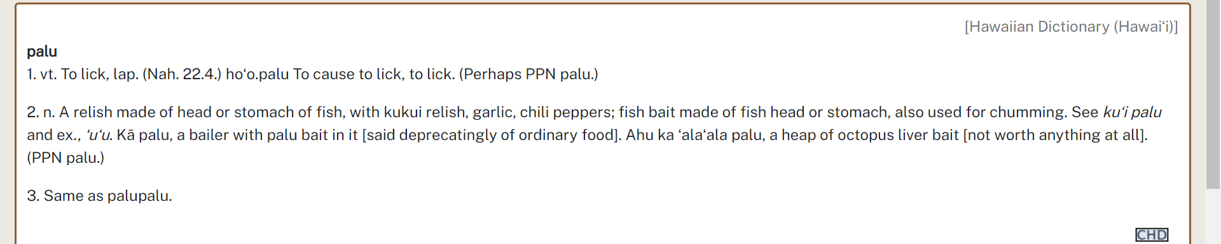
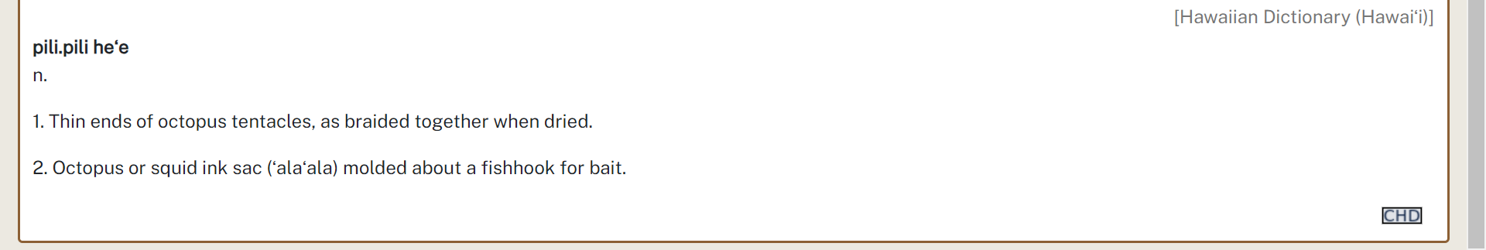
Station #3d: Definition of Bait

Slide 14
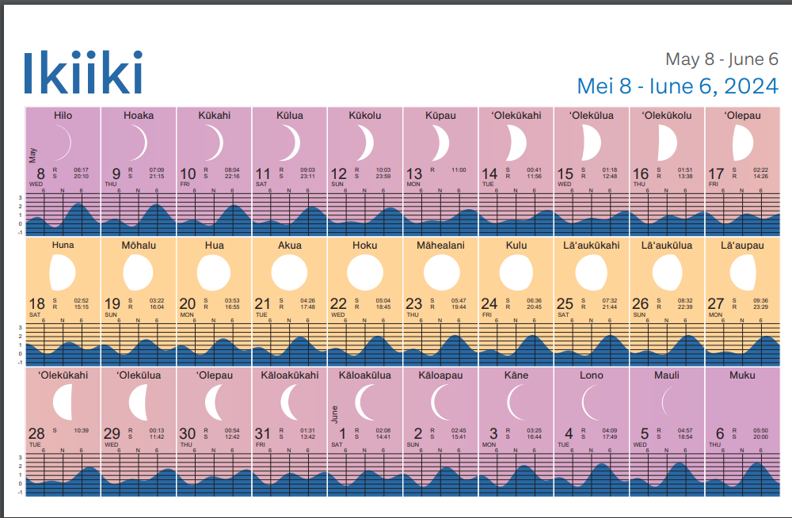
Station #4a: Hawaiian Moon Calendar
Notes:
https://www.wpcouncil.org/wp-content/uploads/2023/12/2024_Hawaii-LunarCalendar-Fishermen_WEB.pdf

Slide 15
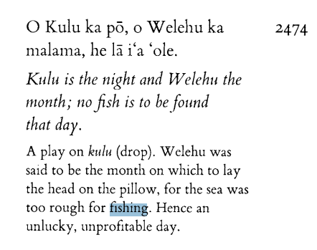
Station #4b: Moon Phases and Fishing
Notes:
https://kohalacenter.org/spawning-guide/culture-and-history/hawaiian-moon-phases#:~:text=The%20third%20through%20sixth%20moon,days%20also%20indicates%20good%20fishing.

Slide 16
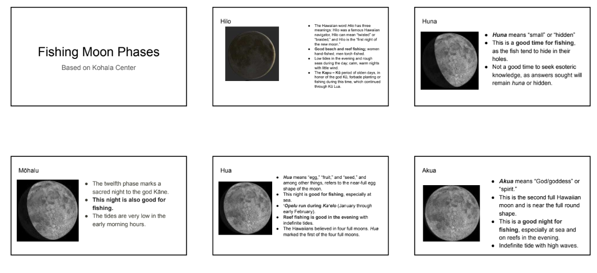
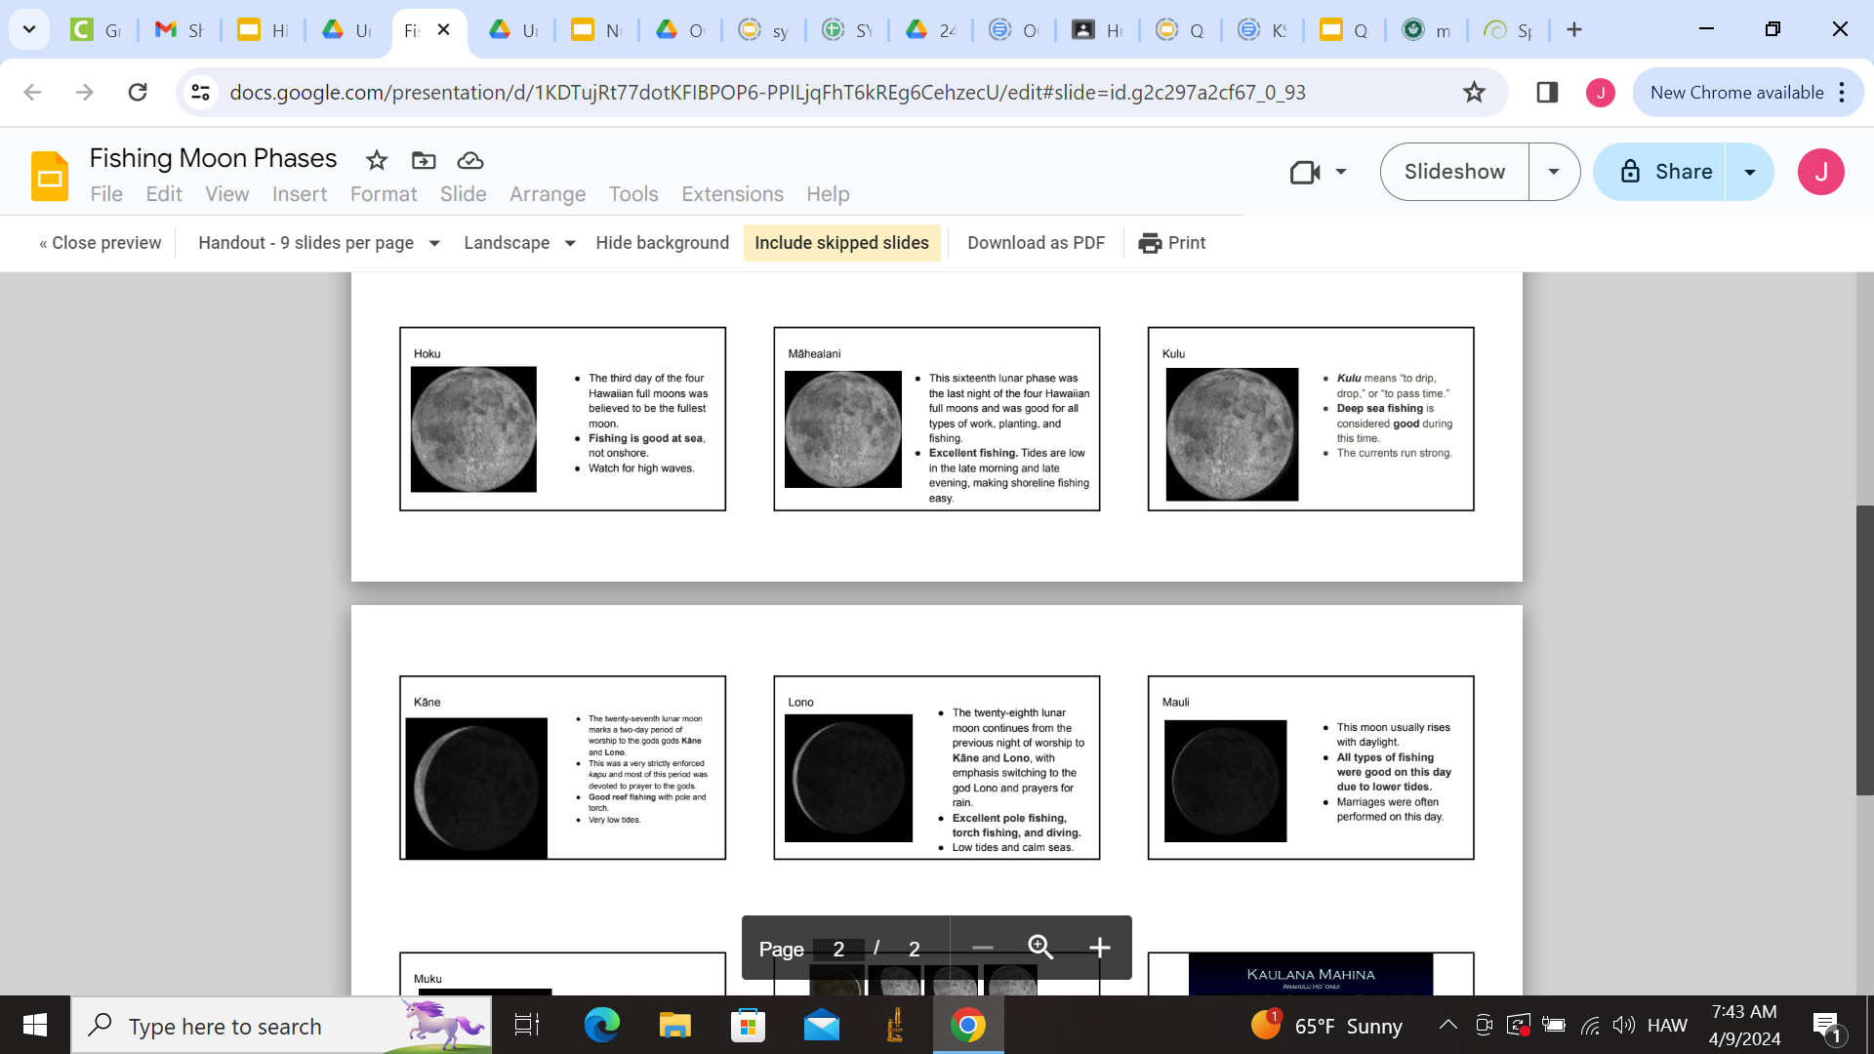
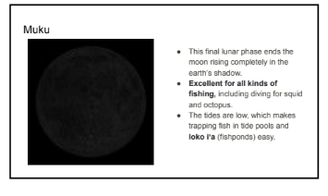

Slide 17
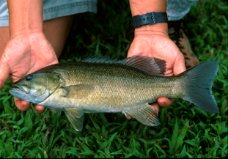
Station #5a: Smallmouth Bass
Photo credit: DLNR
Notes:
https://dlnr.hawaii.gov/ais/other-ais/smallmouth-bass/

Slide 18
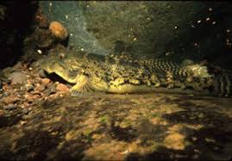
Station #5b: ʻOʻopu Nākea
Photo credit: DLNR
Notes:
https://dlnr.hawaii.gov/wildlife/files/2019/03/SWAP-2015-Awaous-oopu-nakea-Final-1.pdf

Slide 19
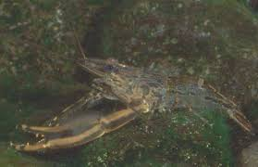
Station #5c: ʻopae ʻoehaʻa

Slide 20
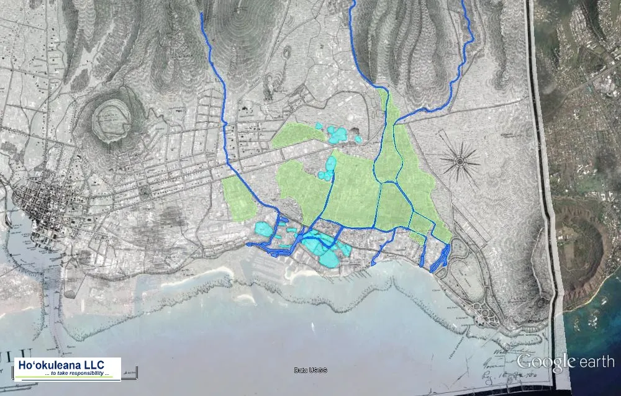
Station #6: Before the Ala Wai
Notes:
https://imagesofoldhawaii.com/before-the-ala-wai/

Slide 21
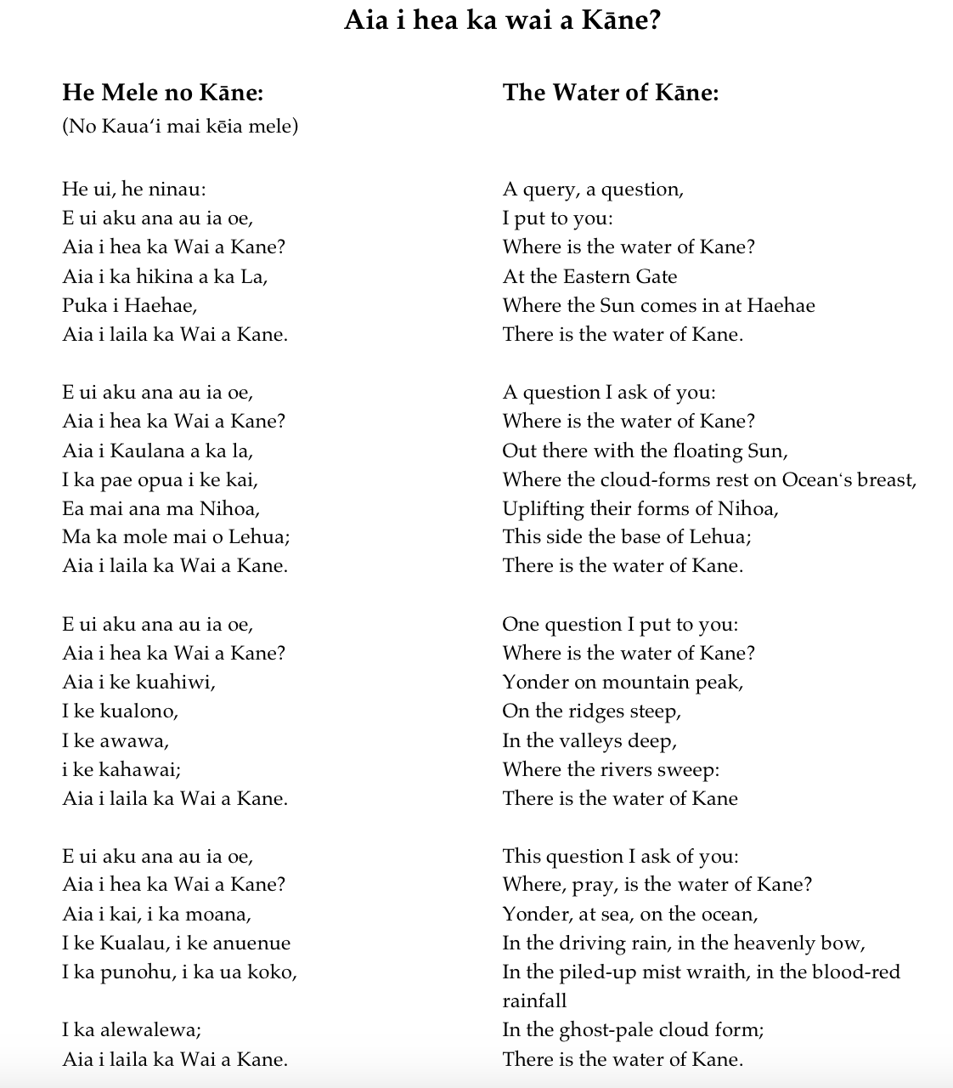
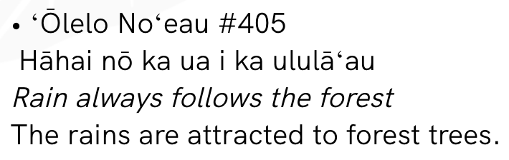

Station #6b
Notes:
https://www.kaainamomona.org/olelo-noeau-land

Slide 22
Data Analysis for potential lure design
Mānoa – Makiki – Pālolo Stream Comparison

Slide 23
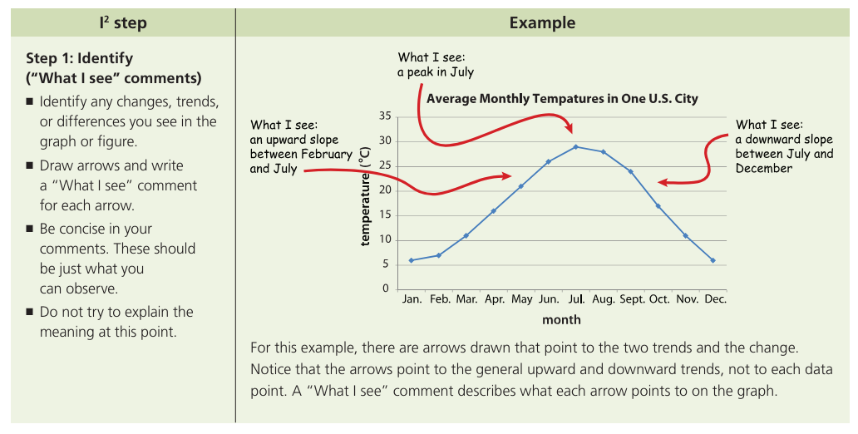
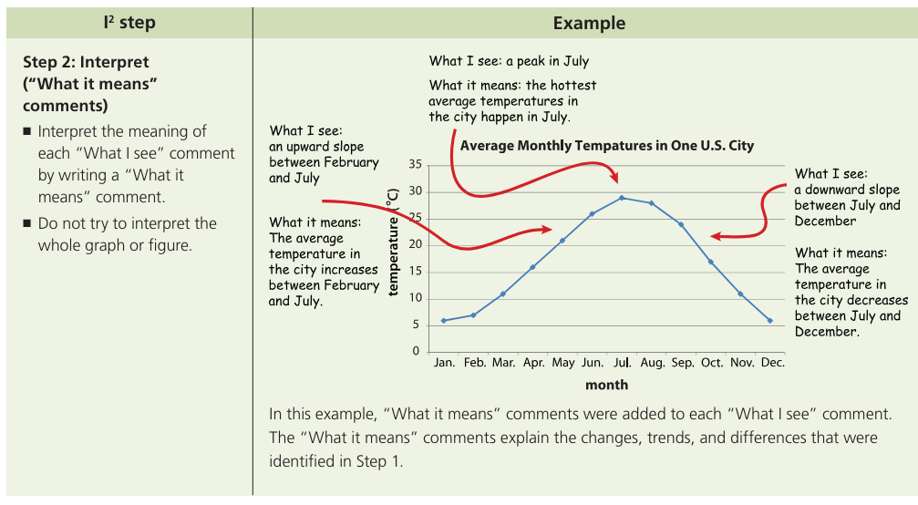
In case you are not familiar – I² Strategy - Identify & Interpret
Notes:
https://nhmu.utah.edu/sites/default/files/attachments/HO%202%20-%20I2%20Strategy.pdf

Slide 24
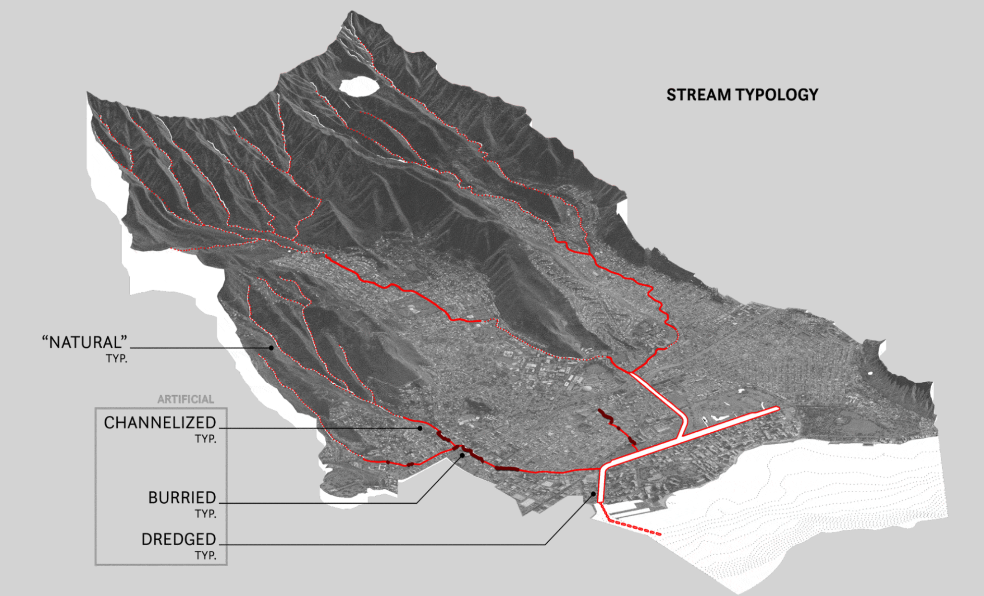
Notes:
https://www.alawaicentennial.org/ESSAY

Slide 25
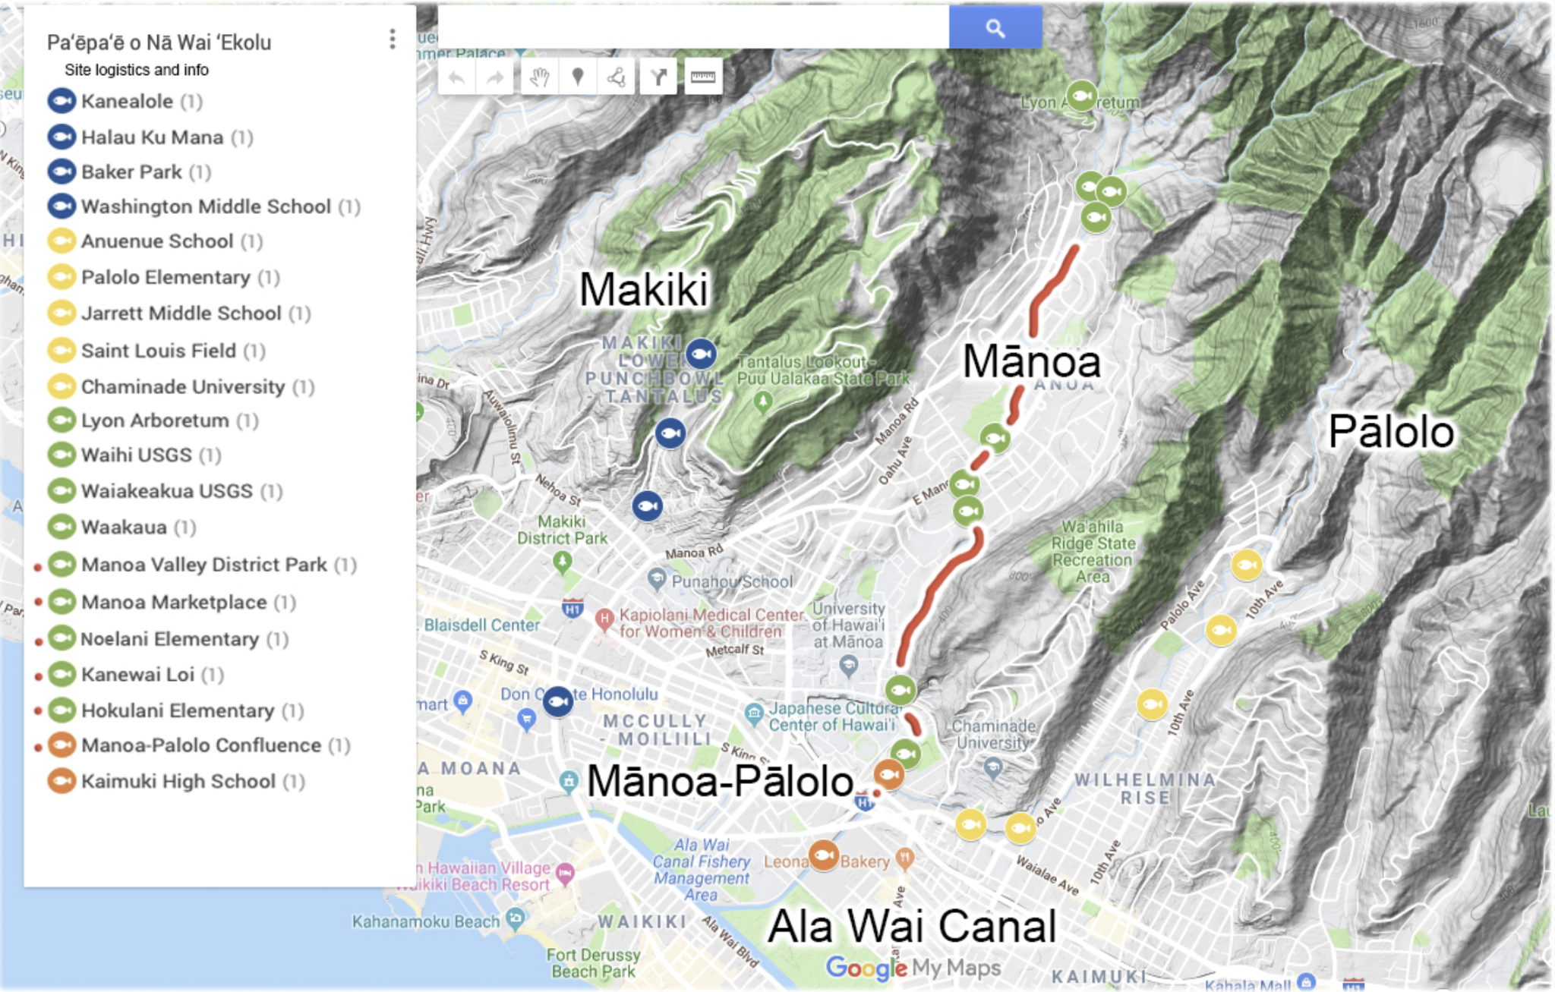

Slide 26
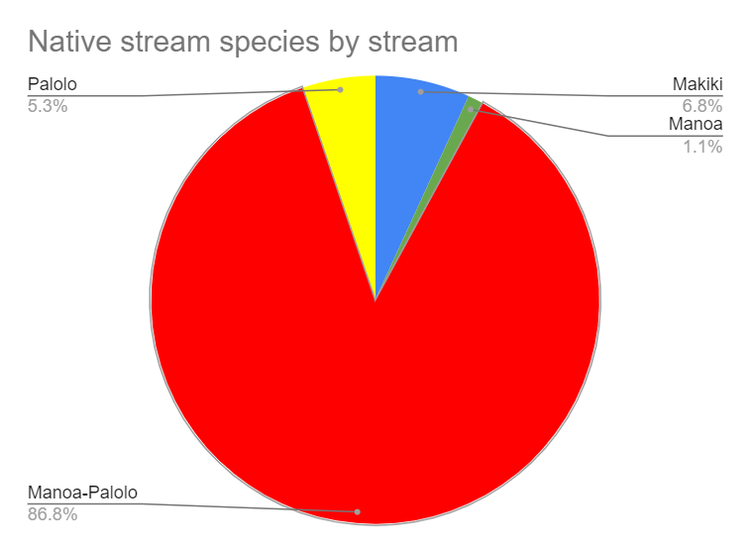

Slide 27
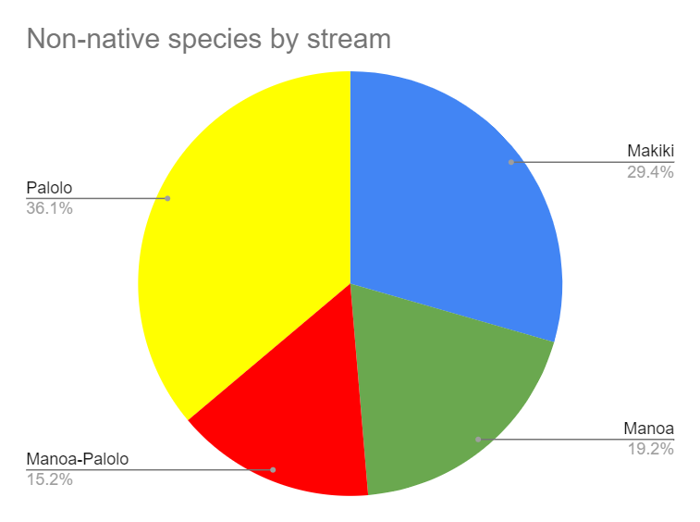

Slide 28
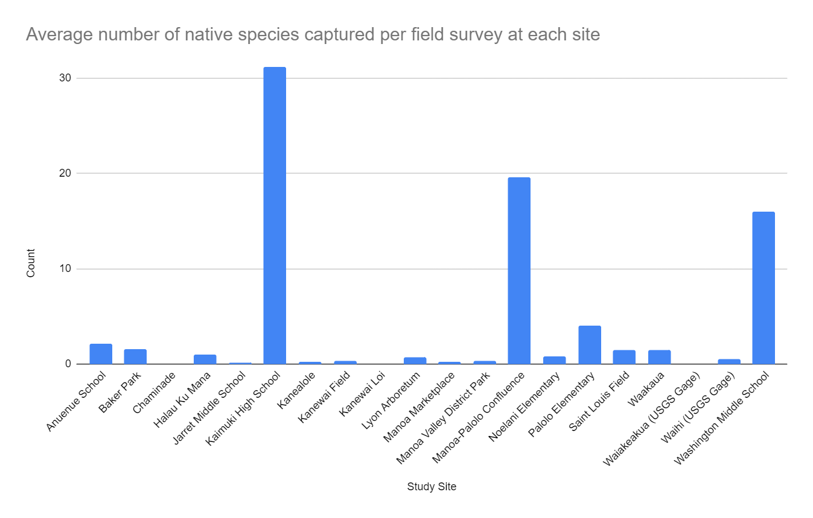

Slide 29
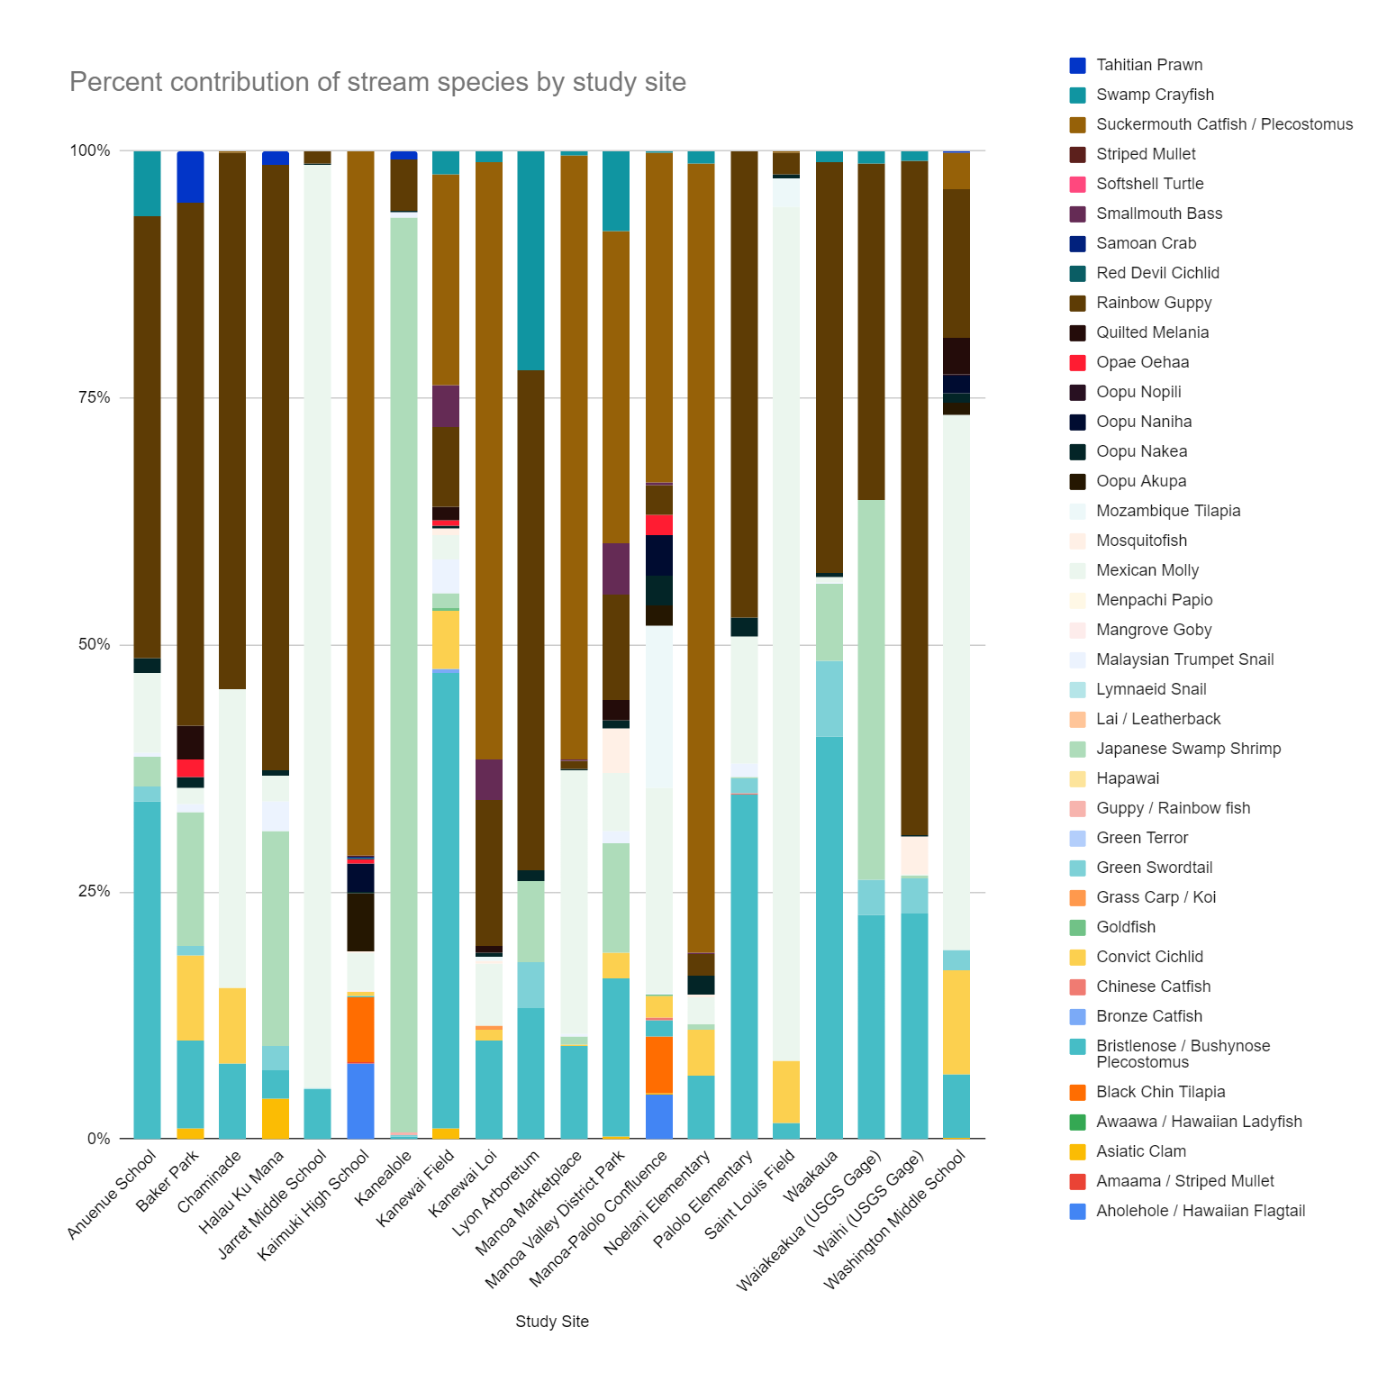

Slide 30
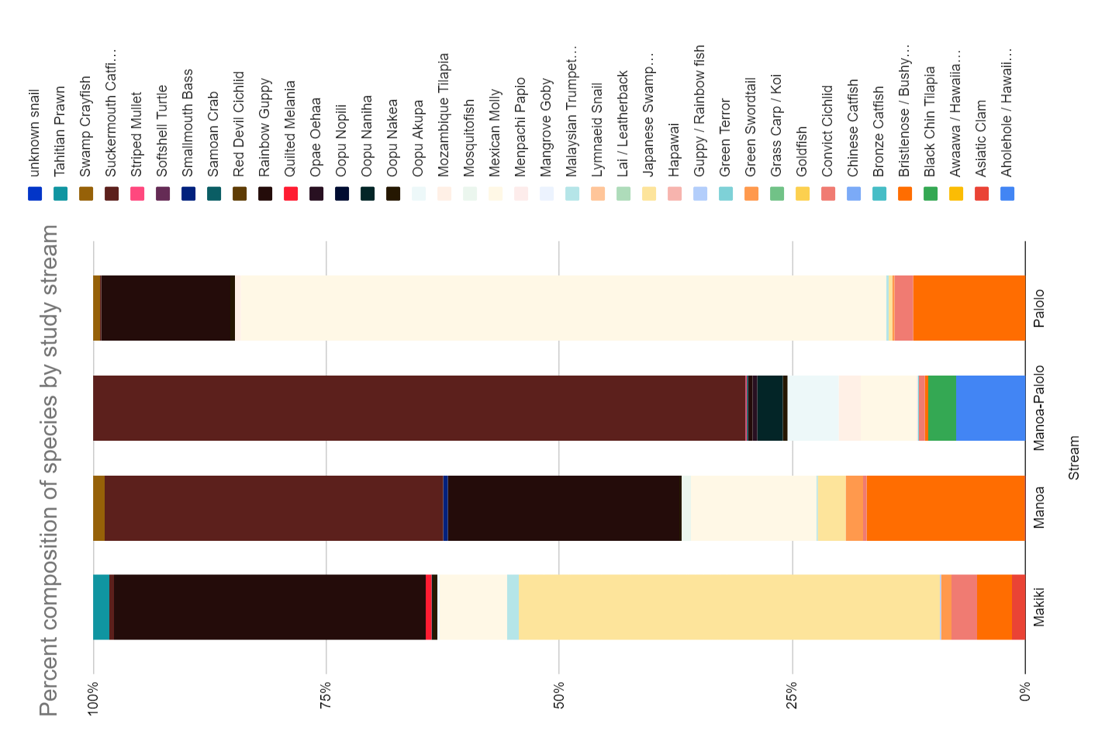

Slide 31
Mānoa vs Makiki vs Pālolo Stream
Presence of Native Species
  All streams
  Mānoa Mānoa Stream scored the lowest for average counts, density, and %HS-IBI
Barriers
Physical
  Pālolo Stream with the lowest score for physical stream habitat - highest temperature, pH, and turbidit
    Invasive species densities highest
Biological
  Smallmouth bass consume native species - DNA and visual stomach content analyses confirmed
  Low elevation/upper estuary – only study site to contain native prey items - prey selection by M. dolomieu is density dependent
  Mānoa - only stream with smallmouth bass – biggest potential for increase of native species and instream biological integrity
Notes:
BWET Grant Report – Cory Yap

Slide 32
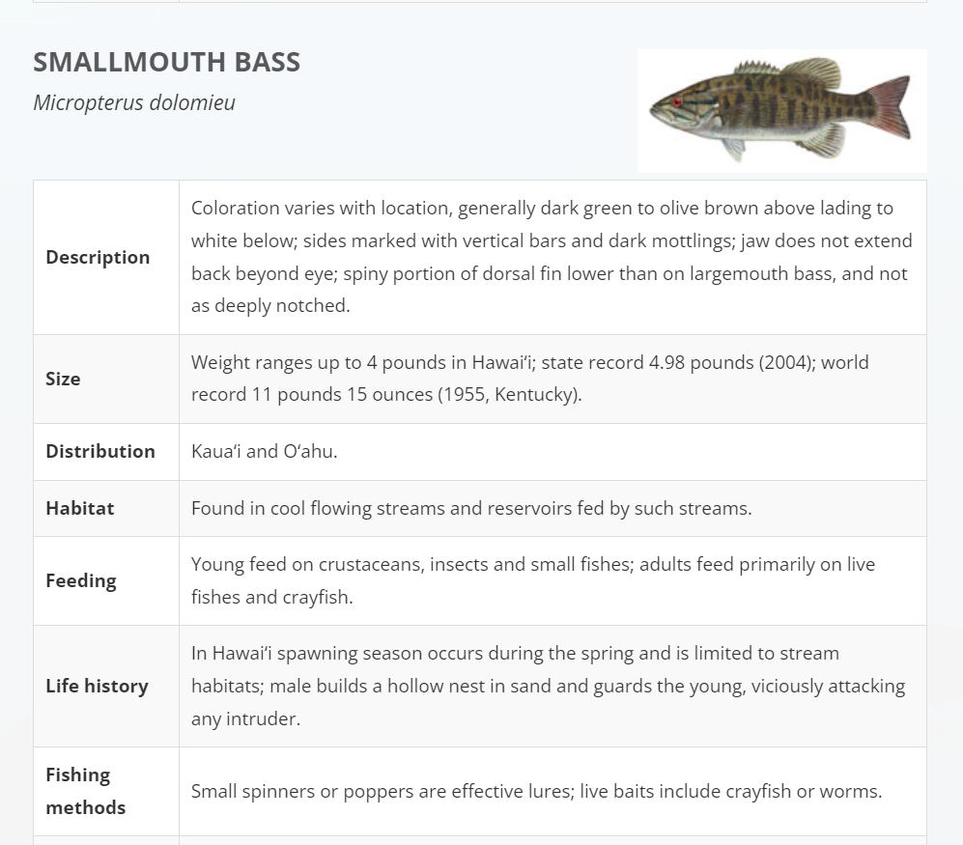
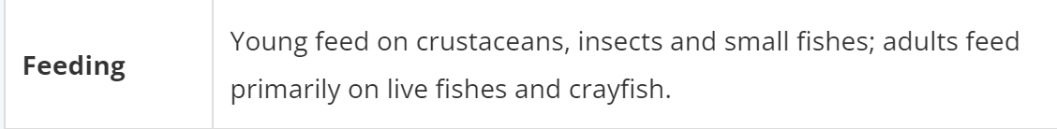
Implications for Potential Lure Design??
Smallmouth bass
Invasive species
Prohibits upstream movement of native amphidromous fish
Could we “lure” them out of the streams?
NOTE: Friday, Cory Yap will talk more about this
Notes:
https://dlnr.hawaii.gov/dar/fishing/freshwater-fishing/introduced-sport-fishes/

