Slide 1


Slicing
Turning CAD Designs into Real Parts

Slide 2
Software

Slide 3
Slicer
Most CAD software does not communicate directly with 3D printers
Additionally, printer manufacturers often have proprietary information/programming
A slicer converts solid geometry into machine instructions so that the part can be made
Cura (https://ultimaker.com/software/ultimaker-cura) is a widely-used, open-source slicer

Slide 4
Cura

Slide 5
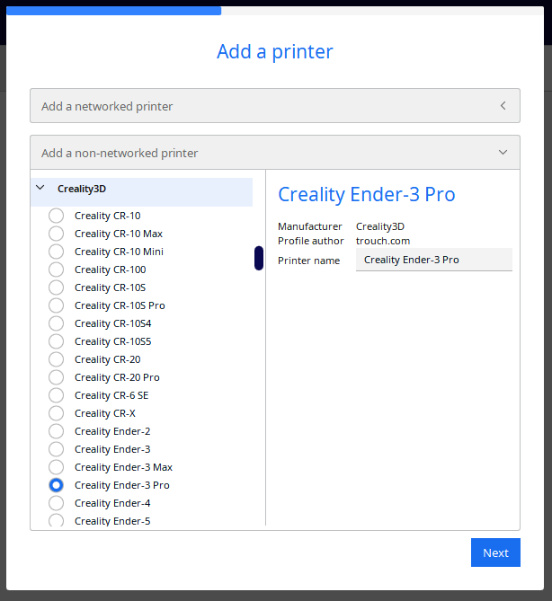
Setup
After downloading and installing the slicer, the first step is typically to set up the printer
Cura comes with many popular printer models built-in
If the printer is listed, the default settings are likely useable

Slide 6
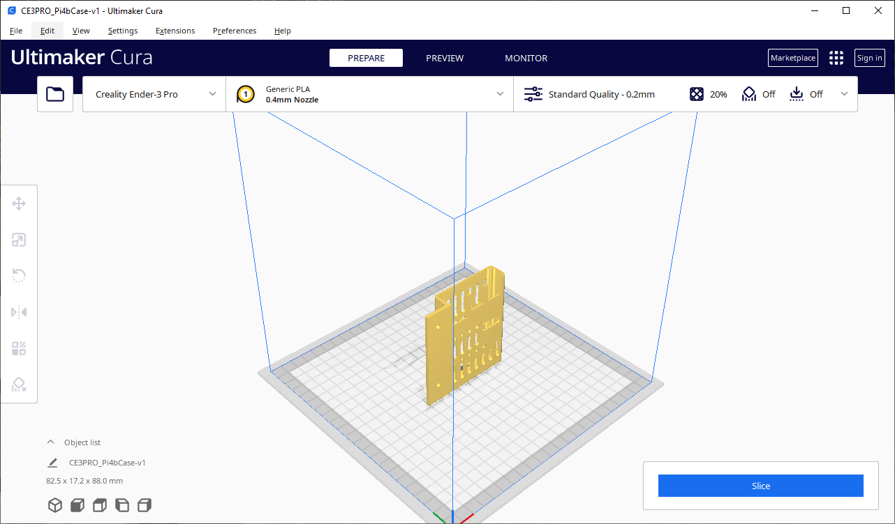
Use
Click LMB to select
Click and hold MMB to pan
Roll MMB to zoom
Click and hold RMB to orbit

Slide 7
Use
Adhesion
Add files
Add support
Move models
Scale models
Rotate models
Create slices

Slide 8
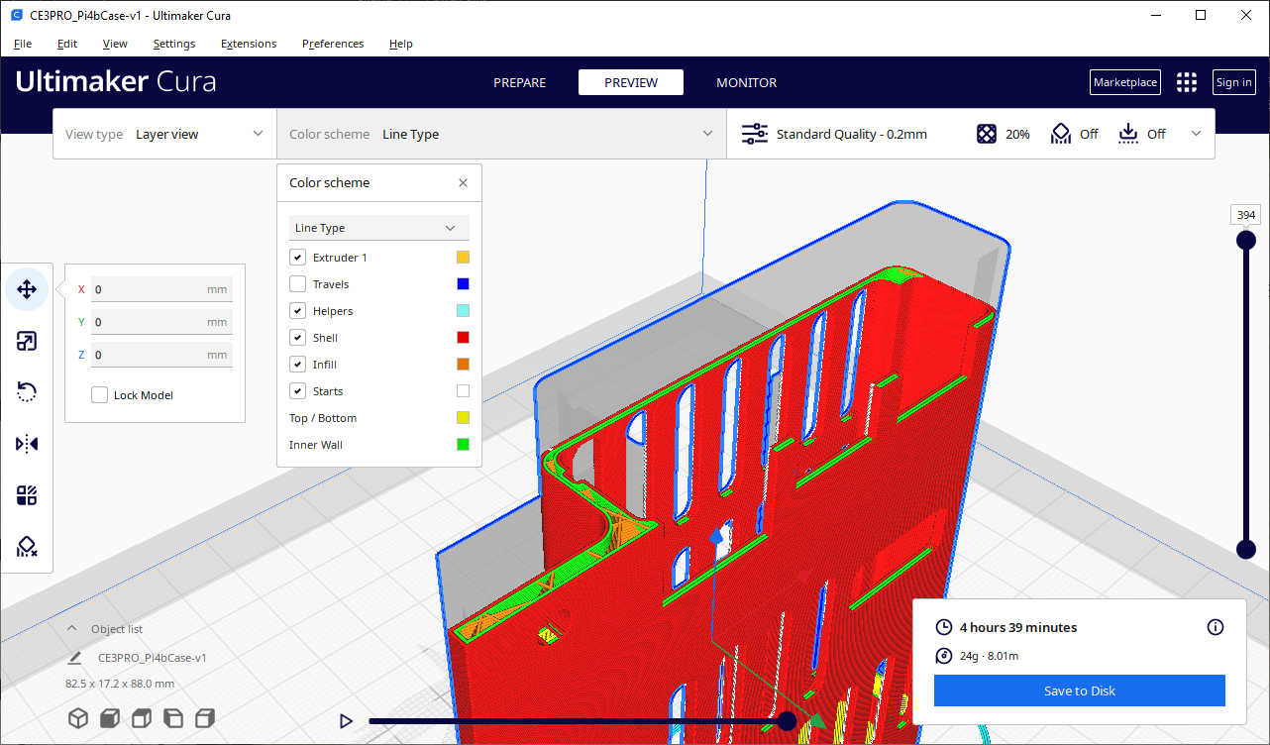
Use
Preview slices
Layer colors
Scroll through layer
Save to file (SD card)

