Slide 1
Standards
NGSS
HS-ESS3-2. Evaluate competing design solutions for developing, managing, and utilizing energy and mineral resources based on cost-benefit ratios.
HS-ESS3-4. Evaluate or refine a technological solution that reduces impacts of human activities on natural systems.
AP Units
Unit 7 Renewable Energy
STEM
STEM lessons focus on real-world issues and problems.
STEM lessons are guided by the engineering design process.
STEM lessons immerse students in hands-on inquiry and open-ended exploration.
STEM lessons involve students in productive teamwork.
STEM lessons apply rigorous math and science content your students are learning.
STEM lessons allow for multiple right answers and reframe failure as a necessary part of learning. Sometimes I designed my science labs so that all teams would replicate the same results or verify or refute a hypothesis. Students were studying specific science content and the whole idea was to provide insight into cause and effect by manipulating variables.

Slide 2
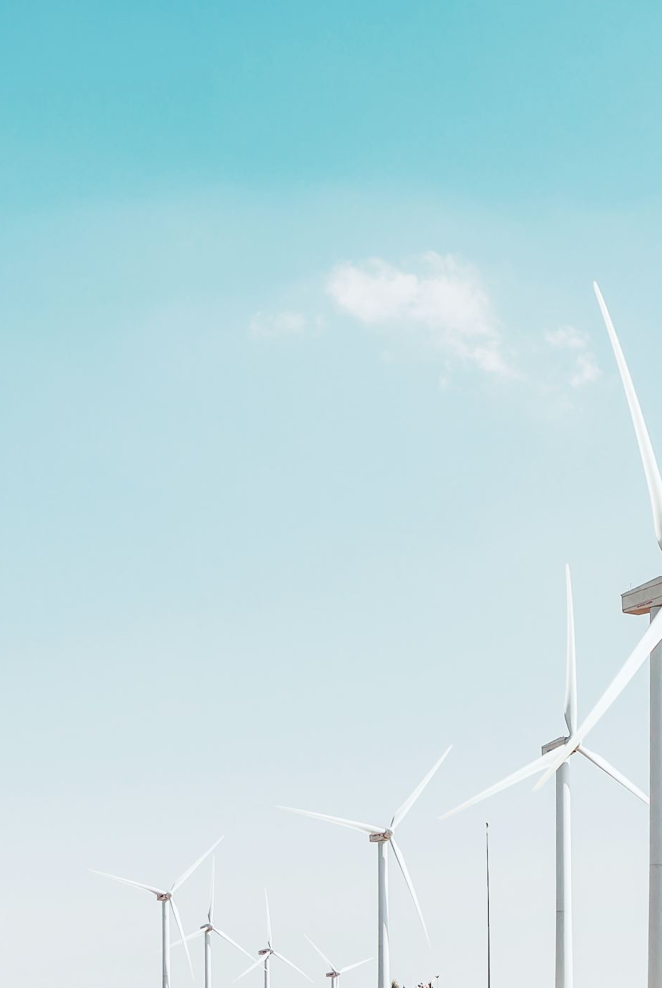
BUILD YOUR OWN WIND TURBINE

Slide 3
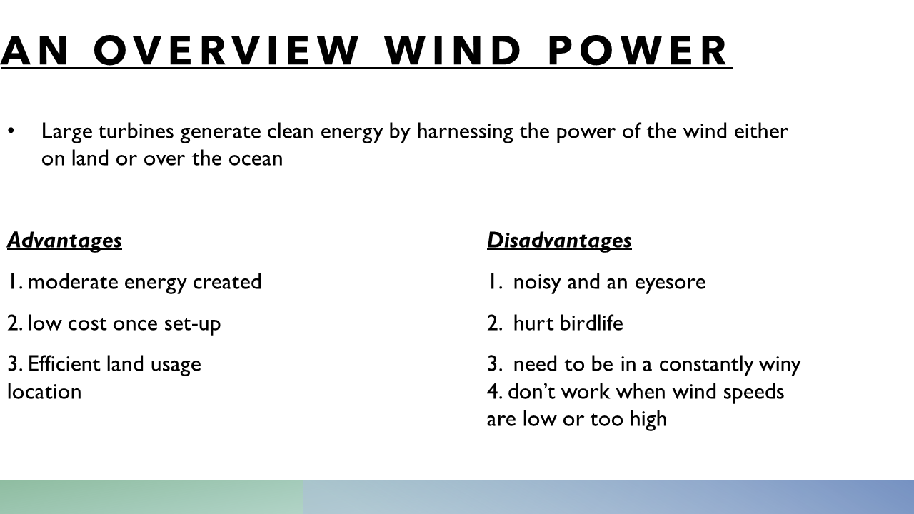

Slide 4
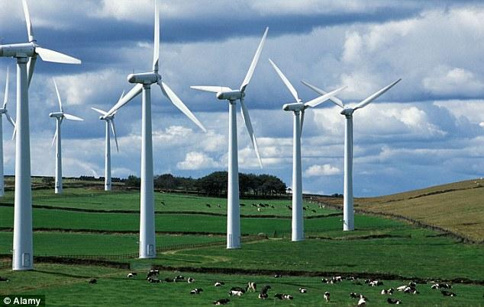
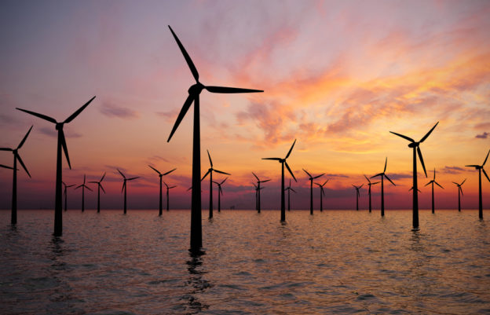
TYPES OF WIND POWER SETUPS
On land
Very versatile form of energy generation
In water

Slide 5
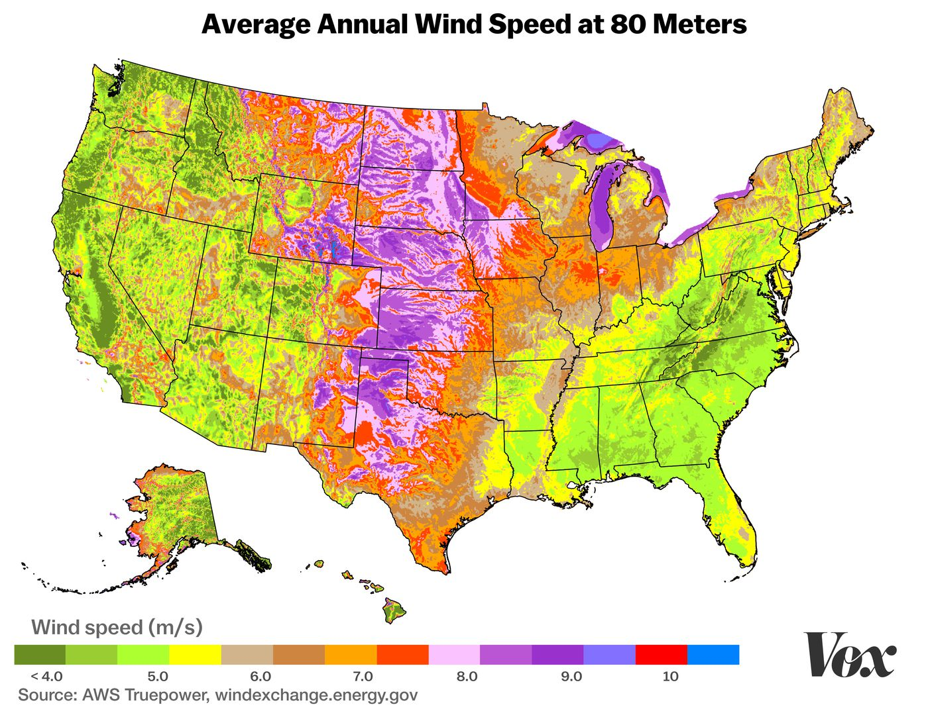
80 METERS HIGH IS THE AVERAGE HEIGHT OF AN ONSHORE WIND TURBINE
Is this the best choice for Maryland?

Slide 6
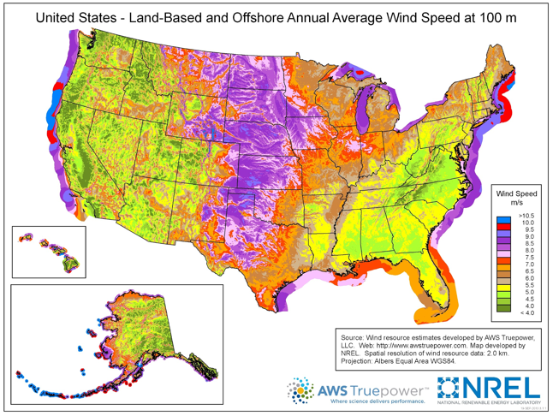
100 meters high is the average height of offshore wind turbines
9.2% of USA power is from wind!
Is this a better choice for Maryland?

Slide 7
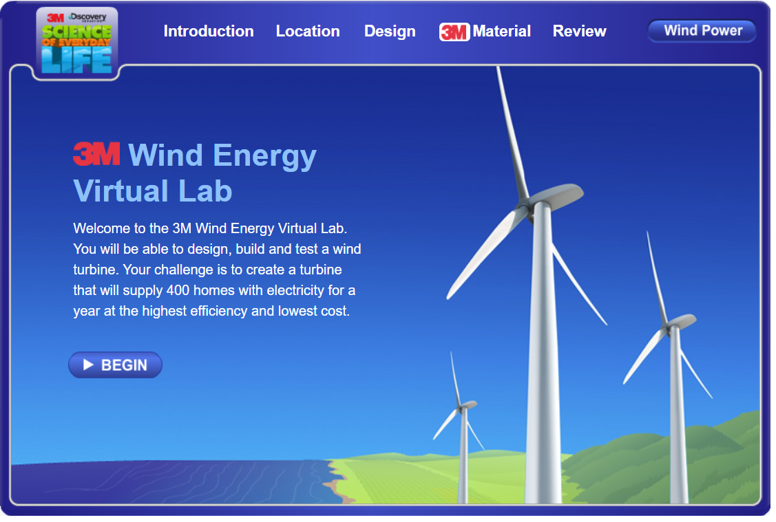
YOUR CHALLENGE
Today you are in charge!
Your job is to create a wind turbine that will be able to give clean power to at least 400 homes!
Do you have what it takes!
Use the information in the previous slides to help guide where and how you build!

Slide 8
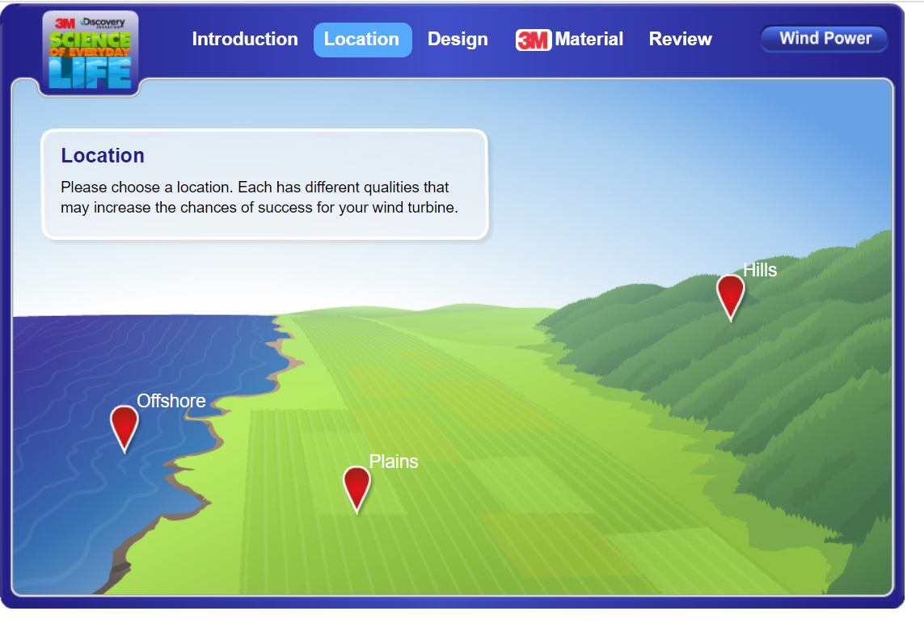
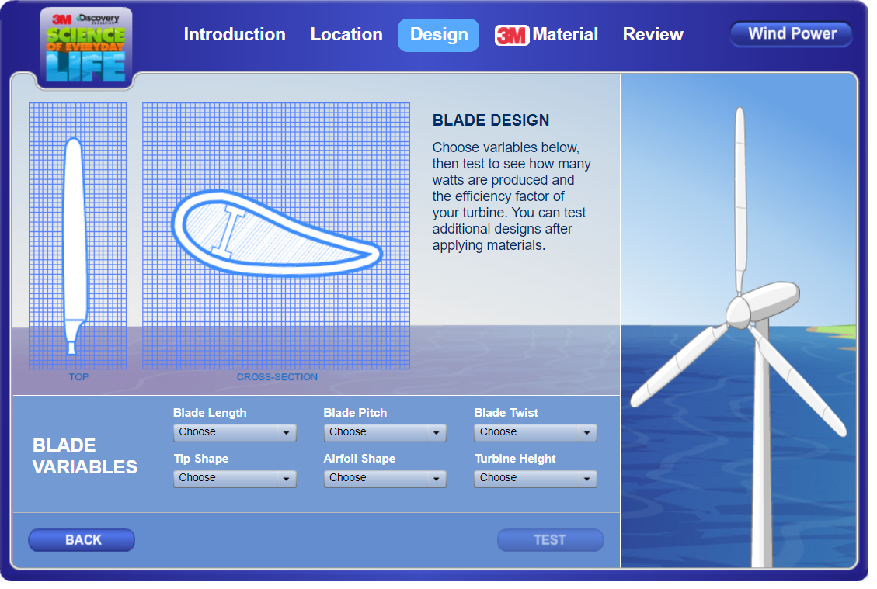
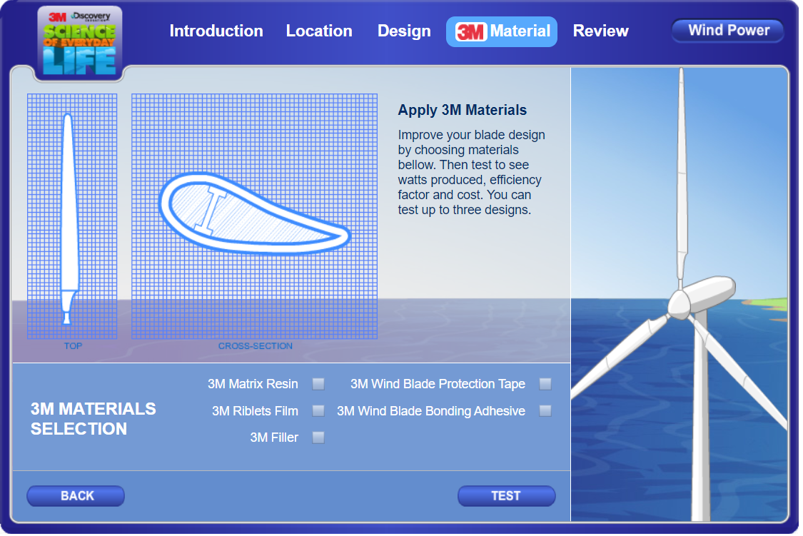
DIRECTIONS
Pick your location where you want to put your turbines
You must use this same location for all 3 trials
  Read carefully about each location, each spot has good and bad factors to consider before building
On the next slide you will be able to design your turbines. This is where you can modify your design to make it more efficient!
Do not apply 3M materials to
your design!
Good luck and have fun!
Click here to begin

Slide 9
DATA TABLE
Location | Blade Length | Blade Pitch | Tip Shape | Airfoil Shape | Turbine Height | Homes Powered | Best choice

Slide 10
ANALYSIS
What location did you choose?
What was the best choice for your area?
Why do you think it helped power the most homes?
Compare your data to your classmates, what design and location was best overall?

Slide 11
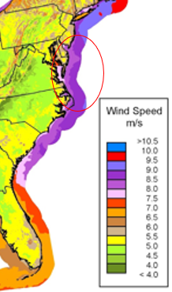
REAL WORLD SCENARIO
On the Eastern Shore (Maryland, Delaware, and Virginia), where is the best location for wind turbines?
Explain the pros and cons of placing a wind farm at this location?

Slide 12
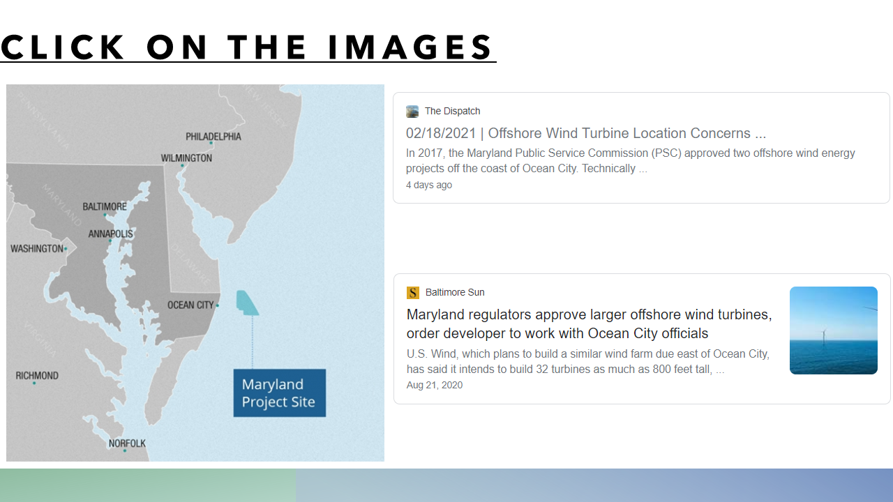
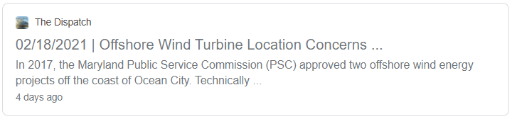
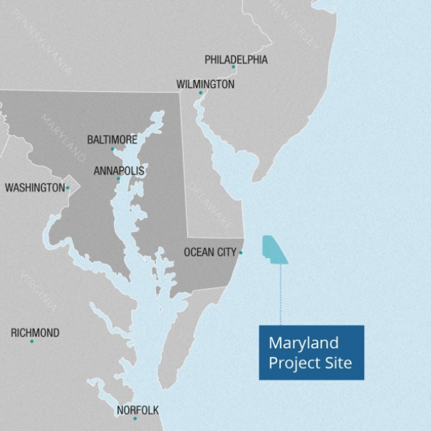
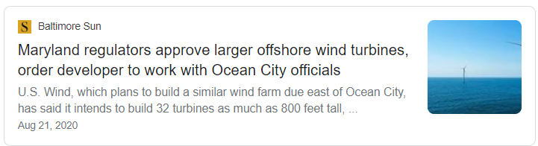
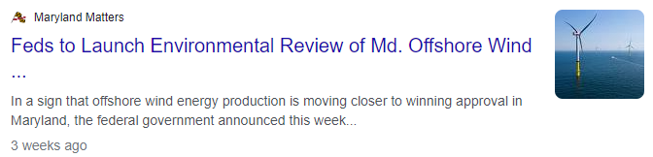
Wind Power in the News… click on the article to read (must pick 1)!

Slide 13
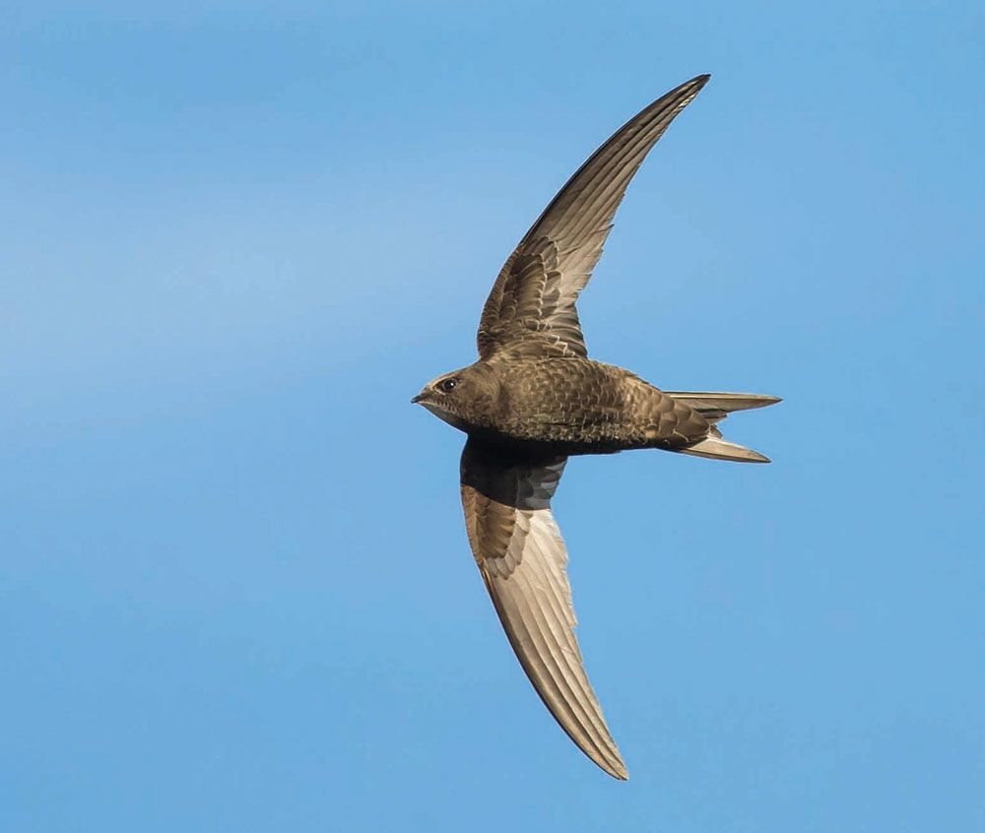
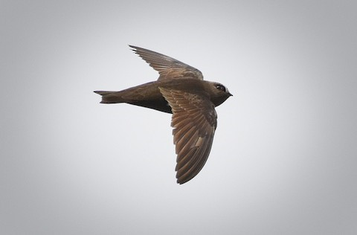
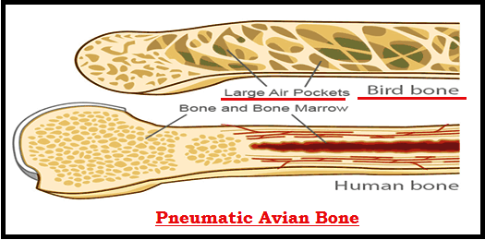
Nature as inspiration?
Helpful Hints:
Intro
Angle
Structure
Why do engineers and design teams use bird wings (shape, angle, length, and structure) to help build wind turbine blades?

