Slide 1
River Continuum Concept

Slide 2
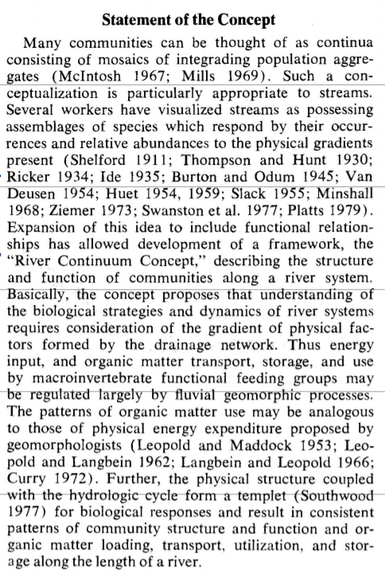
Statement of the Concept
Communities = multiple populations that live in the same area
Mosaics = systems made up of moving parts
Integrading population aggregates = different populations that make up a whole but can be viewed individually

Slide 3
Statement of the Concept
Conceptualization = idea or way of viewing things
Assemblages of species = groups of species
“…respond by their occurrences and relative abundance to the physical gradients present” = The amount of a species that exists in an area is determined by its physical environment

Slide 4
Statement of the Concept
Functional relationships = working relationships
“…understanding of the biological strategies and dynamics…” = how do species that live there survive and co-exist with others
“… consideration of the gradient of physical factors formed by the drainage network.” = we must consider the physical factors, including light, temperature, sediment, etc of the entire watershed

Slide 5
Statement of the Concept
Energy input = where does the energy come from (sunlight)
Organic matter = plant life
Macroinvertebrate functional feeding groups = different types of aquatic insects that perform different functions

Slide 6
Statement of the Concept
Physical structure = width, depth, bottom composition
“…consistent patterns of…” = we can use this to predict what will happen
Community structure = what organisms will be there and in what ratios
Organic matter loading, transport, utilization, and storage = how does organic matter get into the system, how does it move, how is it used, and how is it stored

Slide 7
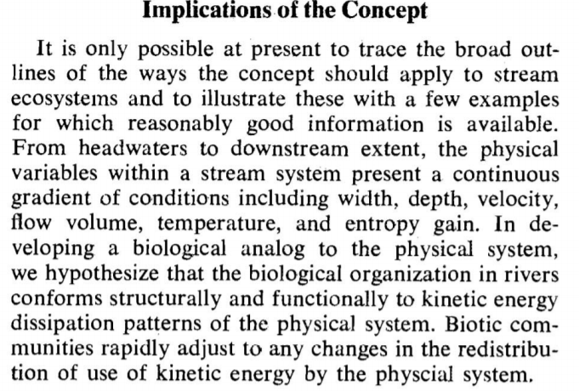
Implications of the Concept
Physical variables
Kinetic energy dissipation patterns of the physical system = how do organisms use energy and get rid of it
Rapidly adjust = when something changes, the species present will change

Slide 8
