Slide 1
Solar Panels and Electric Circuits

Slide 2
Basics of Electric Circuits
A circuit is:
A group of components connected together to perform a given task
We will be wiring together a circuit to make our solar panel product.

Slide 3
Basics of Electric Circuits
Think them like a water system to supply your house
with fresh water.
Current: The flow: This is how much water is going thru
the pipe.
Voltage: The push: This is how high the water tower is
compared to your home.
Resistance: The opposition to the flow: This is the diameter of the pipe.
Series: 1 pipe: If you had 1 pipe in your house that had a lot of faucets in series, turning off 1 faucet would have a effect on all the other faucets.
Parallel: Multiple pipes: Water can flow to each faucet individually and 1 faucet has no effect on the other.

Slide 4
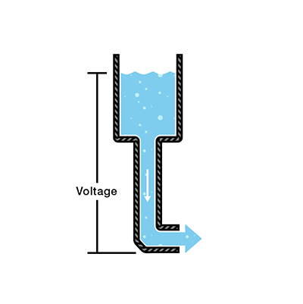
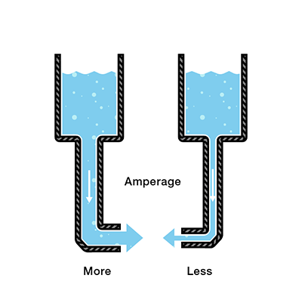
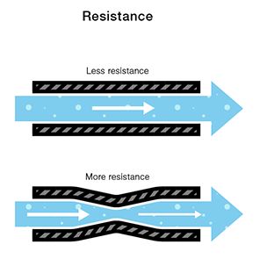
More potential energy =more voltage
=bigger battery
Same PE; bigger pipe
= more current
Same PE; smaller pipe
=less current
Bigger pipe
=less resistance
Smaller pipe
= more resistance

Slide 5
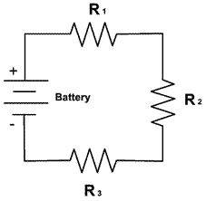
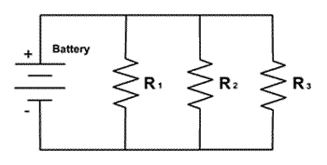
Series vs Parallel Circuits
Parallel circuits
maintain potential (voltage is constant)
Current is divided among components
If one light goes out, the others stay lit
Series circuits
maintain electrical flow (current is constant)
Voltage is divided among components
Easy to open circuit quickly

Slide 6
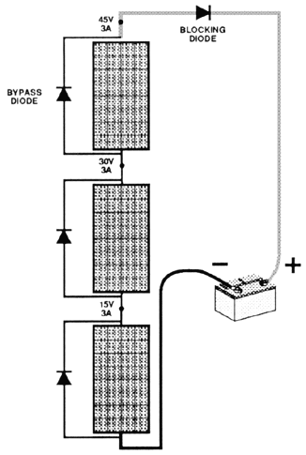
Loads/sources wired in series
  VOLTAGES ARE ADDITIVE
  CURRENT IS EQUAL
  ALLOWS FOR MORE POWER STORAGE AT HIGHER VOLTAGES

Slide 7
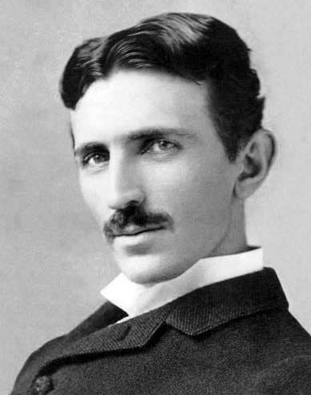
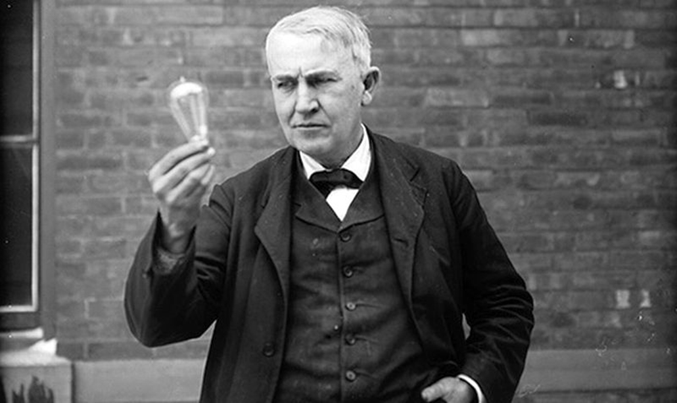
DC vs AC Current
Direct Current
This is the type of voltage you get from a battery or a photovoltaic cell
Used in this class and in handheld electronics.
Requires high voltage to transmit over a relatively small distance.
Alternating Current
This is the type of voltage that comes from your wall outlet.
Used in commercial and residential wiring.
Requires lower voltage to transmit over long distance.

Slide 8
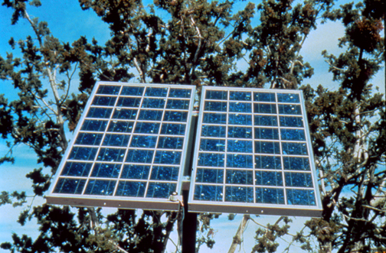
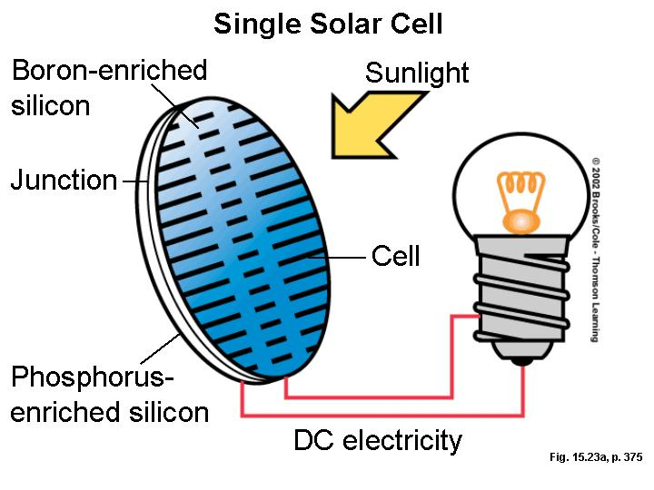
Photovoltaics
Photo+voltaic = convert light to electricity

Slide 9
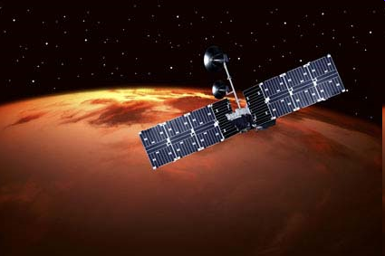
Driven by Space Applications in Early Days

Slide 10
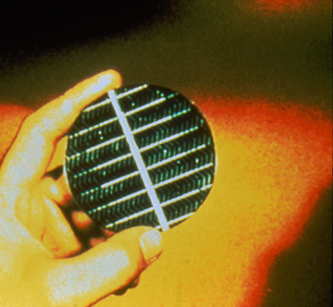
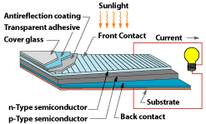
The heart of a photovoltaic system is a solid-state device called a solar cell.
How does it work

Slide 11
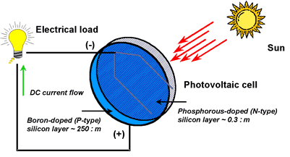
Photovoltaic Cells

Slide 12
How Do Solar Panels Work?

Slide 13
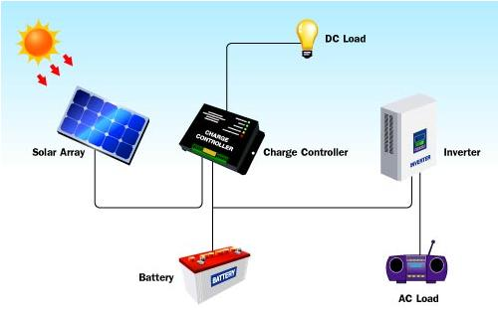
Photovoltaic System
Charge Controller = a piece of equipment that allows you to interface between a battery, a solar collector, and an energy load

Slide 14
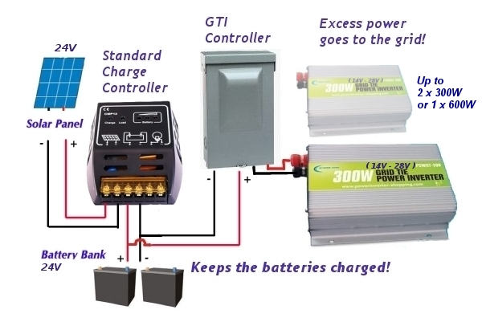
We are not using this

Slide 15
Advantages of Solar Power
Clean
Sustainable
Free
Provide electricity to remote places
No reliance on the power grid.

Slide 16
Disadvantages of Solar Power
Less efficient and costly
equipment
Part Time
Reliability Depends On Location
Environmental Impact of PV Cell Production

Slide 17
Why Do We Not Only Use Solar Panels?

Slide 18
References:
SparkFun Electronics
UC Berkley
Bucknell University

