Slide 1

Nature’s Origami

Slide 2
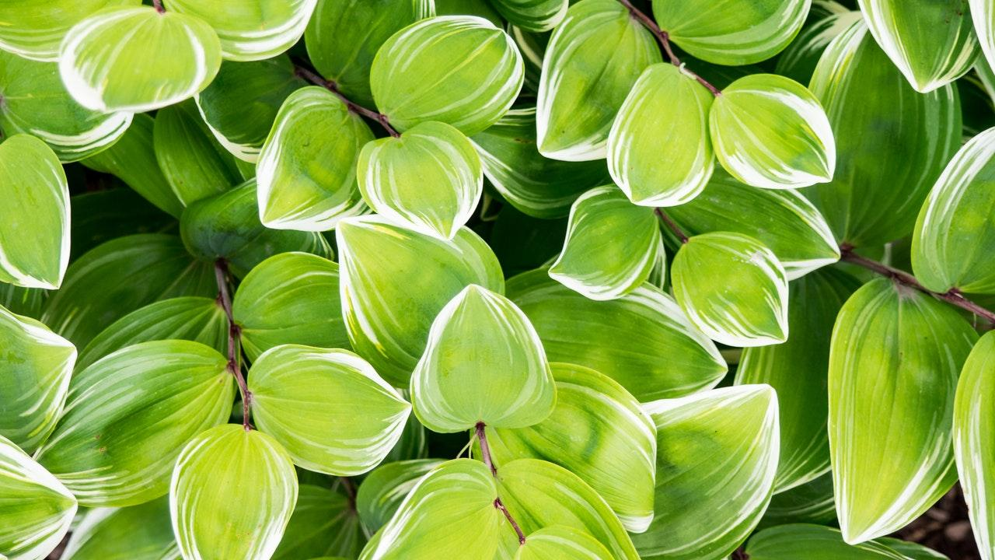
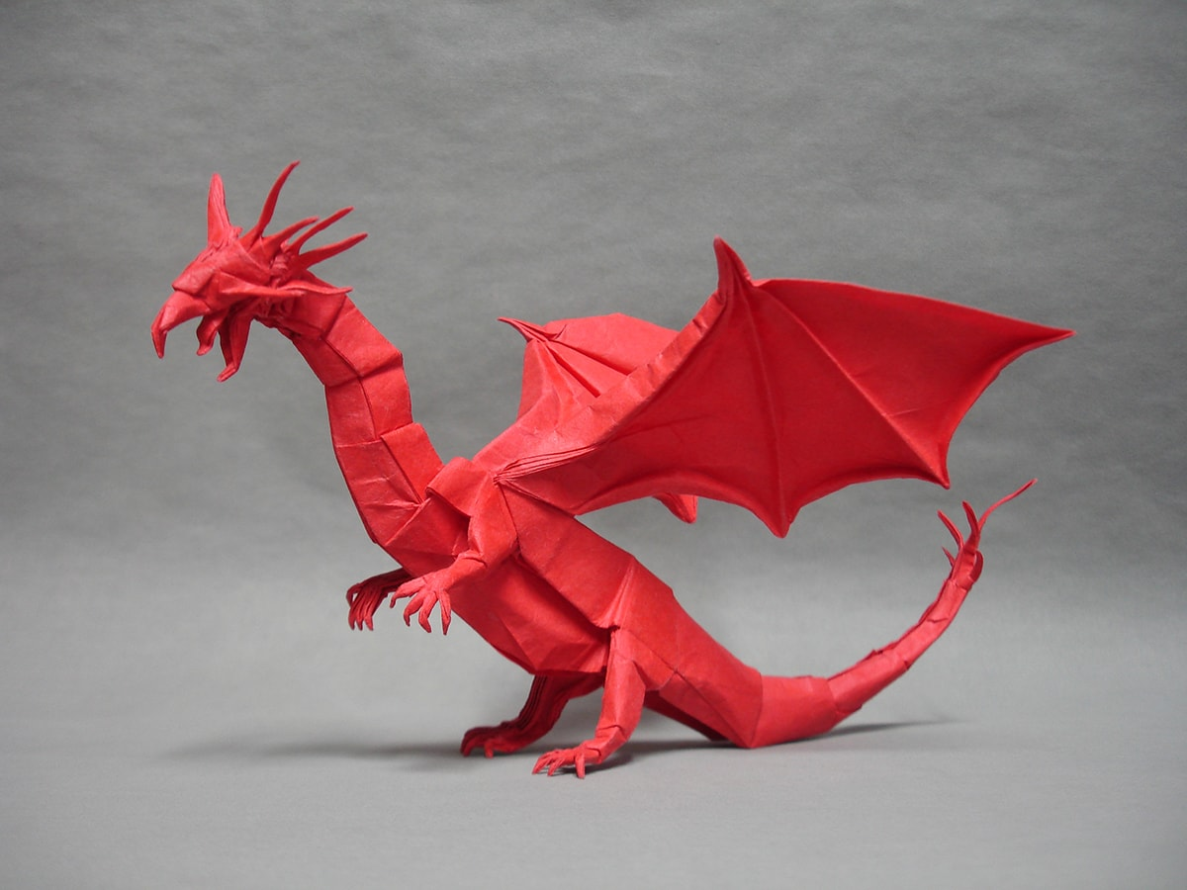

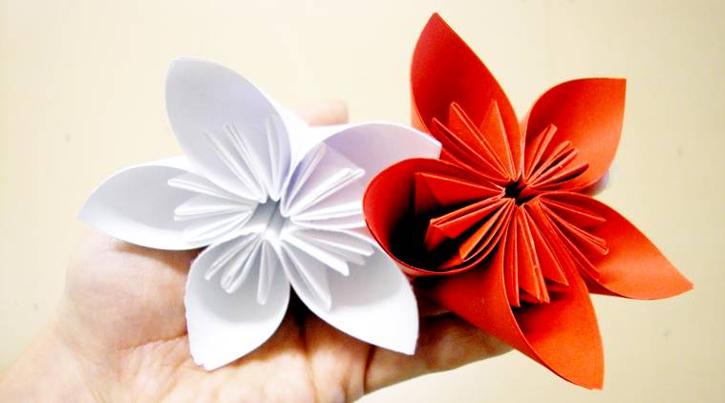
What is origami?
Japanese art of folding paper into decorative shapes and figures.

Slide 3
Why Origami?
Arises from powerful mathematical principles that work just as well in the world of metal and plastic as in paper.
With origami, it’s possible to create large structures that fold up for transportation or for squeezing into tiny spaces.
The intricate folding patterns can be used to make complex mechanical systems with movements that can be controlled by a single motor.

Slide 4

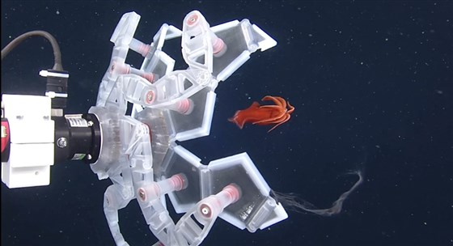
EXAMPLES
Deep-Sea Grabber
Harvard University roboticist Robert Wood recently used origami to design a grabber for catching delicate deep-sea creatures. The device’s five arms feature interconnected pentagons and triangles that fold to form a 12-sided container used to trap soft-bodied marine animals like jellyfish and octopuses without harming them
Notes:
Following examples and pictures borrowed from https://www.nbcnews.com/mach/science/6-ways-ancient-art-origami-bringing-us-future-ncna898731

Slide 5
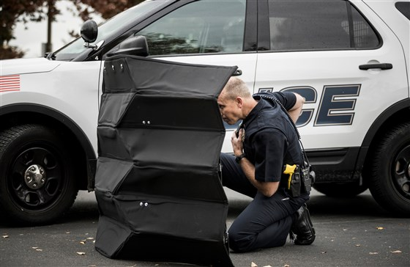
EXAMPLES
Bullet-proof shield
Conventional bulletproof shields used by police can weigh 90 pounds or more and provide protection for one person only. But a team of engineers at Brigham Young University used origami to design a 55-pound shield that is wide enough to protect several people and yet can be folded into a shape that fits easily into the trunk of a car.

Slide 6
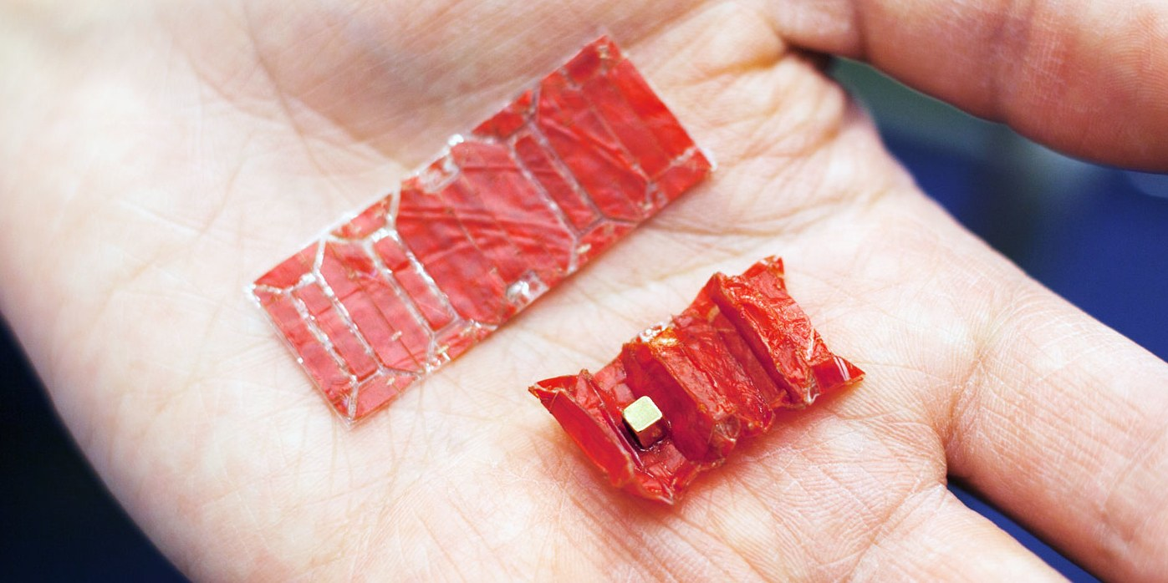
EXAMPLES
Tiny Ingestible Robots
What if you could swallow a robot that could move about inside your body to perform simple surgical procedures? Such a scenario might be closer to reality than you might imagine, now that researchers at MIT have created an origami-inspired bot that folds small enough to fit in a pill; once inside the body, it’s designed to unfurl and steer its way through the gut with help from external magnet

Slide 7
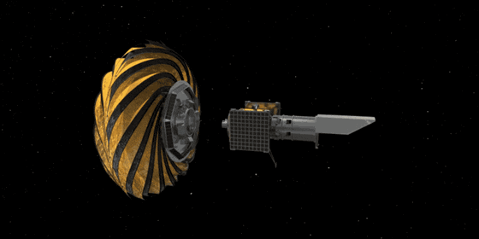
EXAMPLES
Star Shade
Engineers at the Jet Propulsion Lab are developing a giant flower-shaped shade designed for use with space telescopes. The shade would fold up during launch and then unfurl in space before being positioned in front of an orbiting space telescope to block starlight and permit detailed observations of exoplanets.

Slide 8
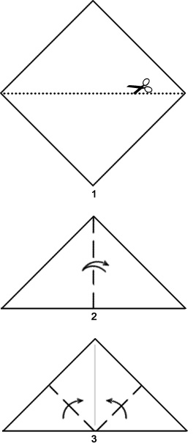
Simple Fly
Start with a square sheet of paper and cut it in half along the diagonal to get an isosceles triangle.
Fold in half and unfold.
Fold up the two bottom corners so the corners meet at the peak of the triangle.
Notes:
Pictures from origami-resource-center.com

Slide 9
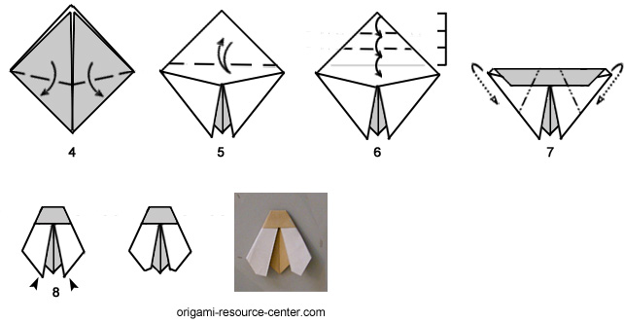
Simple Fly
4. Fold the two corners back down, except fold them at a bit of an angle so the corners are slightly away from one another like the wings of a bug.
5. Fold down the top of the triangle; don't fold down exactly in half, leave a small gap as shown. Unfold

Slide 10
Simple Fly
6. Fold down the top section of the triangle into thirds. Then fold down once more along the crease made above.
7, Fold back the left & right sides of the model to form the body of the fly.
8. Fold the tips of the wings a little so it is not so pointy

Slide 11
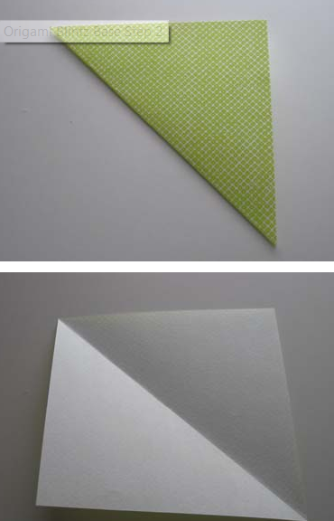
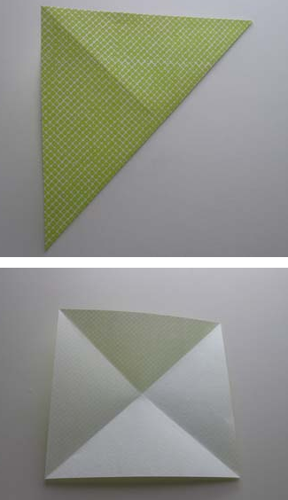
Lotus
Start with a square sheet of paper
Make a triangular fold from bottom left to top right. Crease and unfold.
Make a triangular fold from bottom right to top left. Crease and unfold.

Slide 12
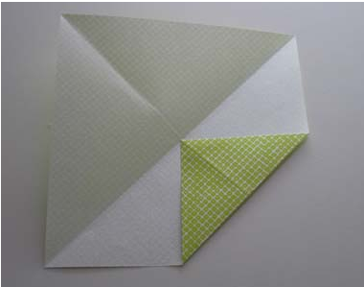
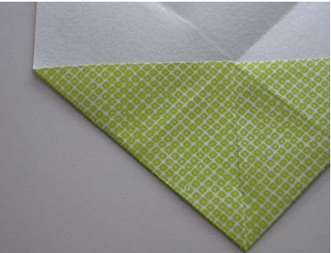
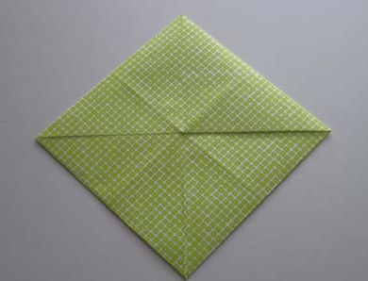
Lotus
4.Start with bottom right corner. Fold into center and crease.
5. Fold bottom left into center. Crease
6. Repeat with the remaining two corners.

Slide 13
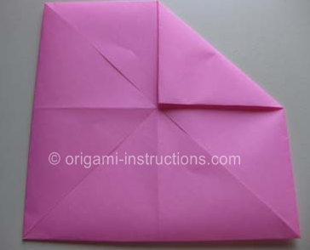
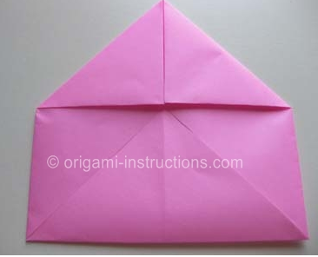
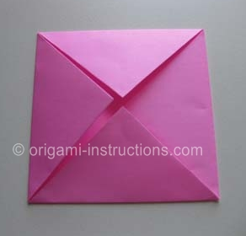
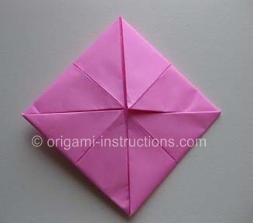
Lotus
7. Fold top right corner into center.
8. Repeat with other corners.
9. Flip over
10. Repeat steps 7 and 8 again.

Slide 14
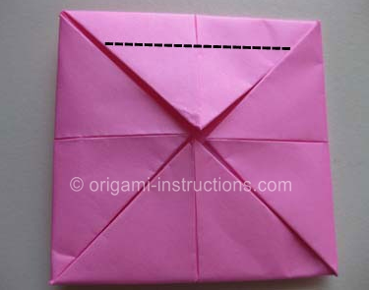
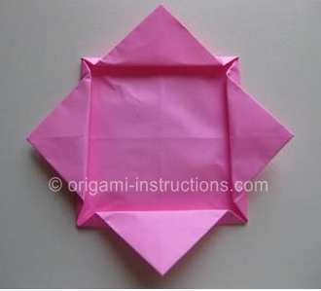
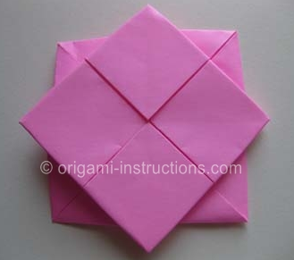
Lotus
11. Fold top flap along dotted line.
12. Repeat with other flaps.
13. Flip over

Slide 15
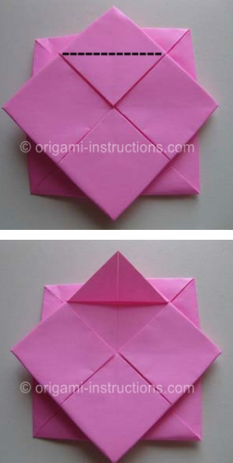
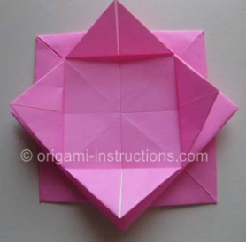
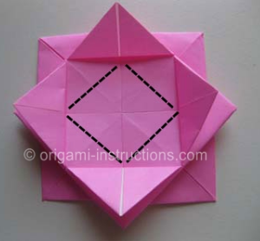
Lotus
14. Fold outer flap along dotted line.
15. Repeat on other 3 side.
16. Fold last flap up on dotted line.

Slide 16
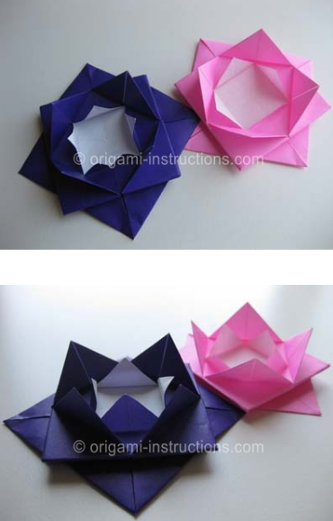
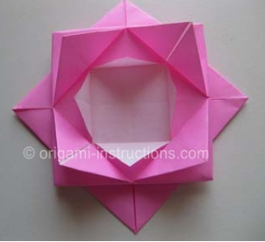
Lotus

Slide 17
Extra Credit
Go to the link online and make any of the other insects and bring to school and show me
Notes:
https://www.origami-resource-center.com/origami-insects.html

