Slide 1
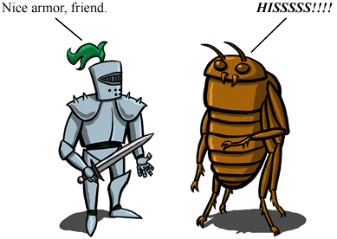
Insect Armor
Exoskeletons
Structure
Function
Nice armor!
Hisssssssss!

Slide 2
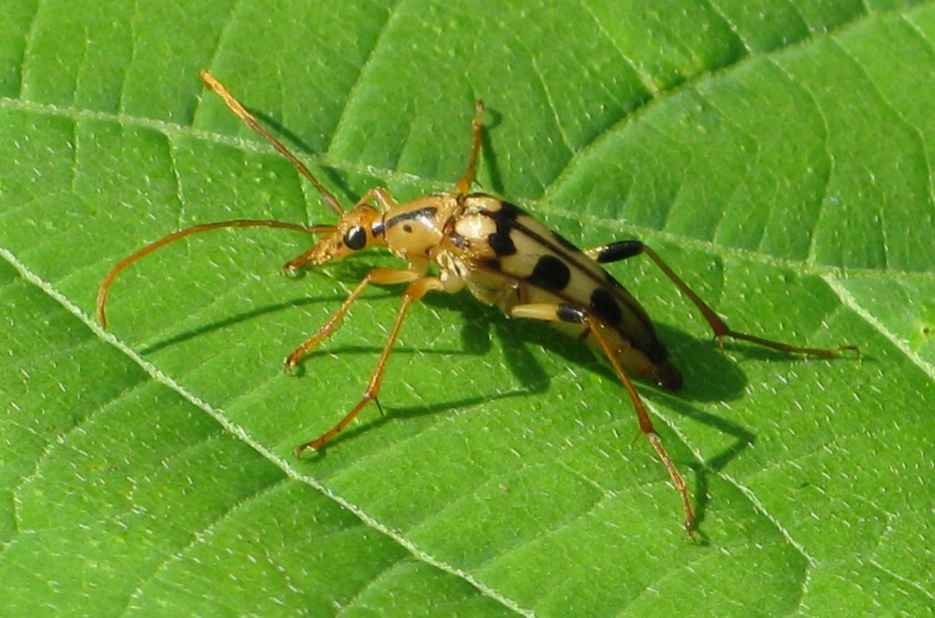
Exoskeleton - rigid external covering of many invertebrates
Functions
- Muscle attachment
- Protection
- Colors

Slide 3
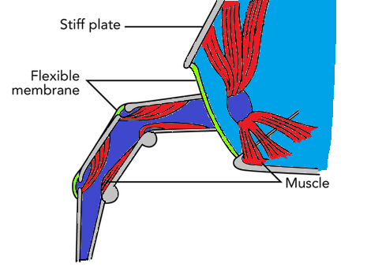
Muscles
Insect need lots more muscles to bend all their joints
Exoskeleton must be hard where muscles attach and flexible at joints

Slide 4
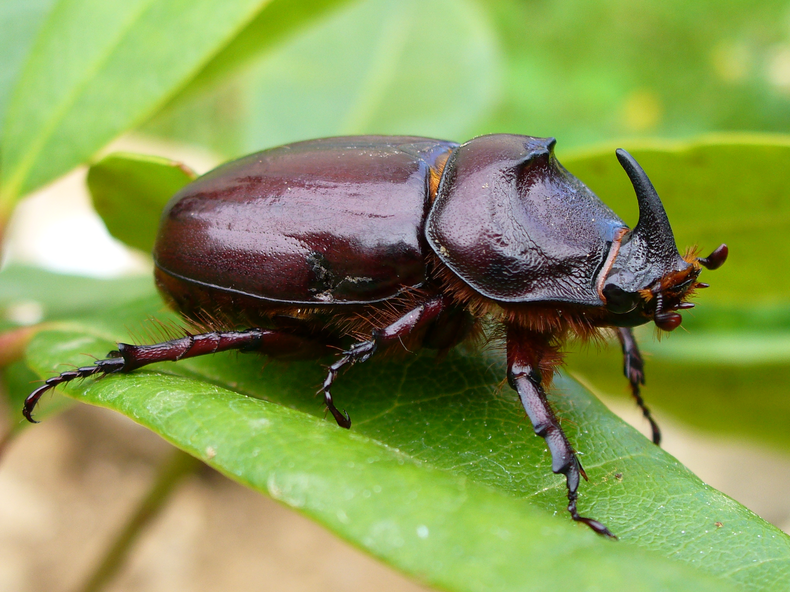
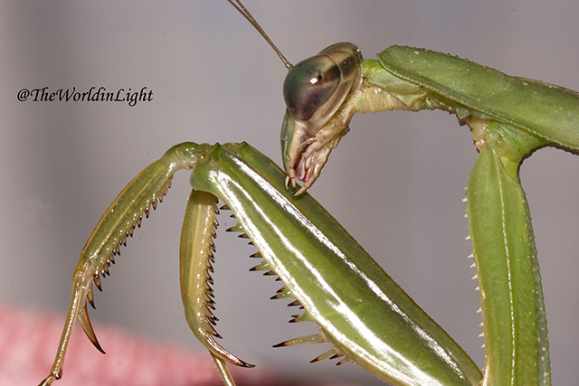
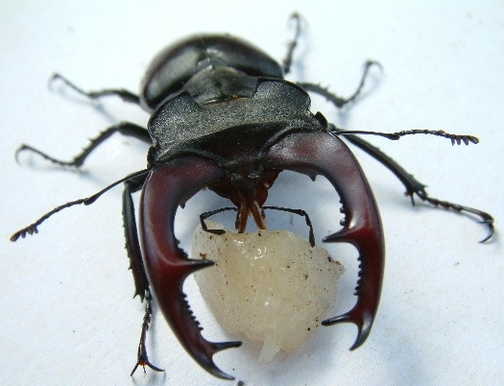
Protection
This is hard to protect against damage
Often has spikes to catch prey or discourage predators
It is waterproof to keep in moisture

Slide 5
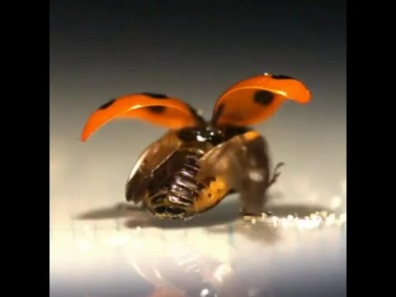
Could be used to protect softer equipment
https://www.youtube.com/watch?v=YNr-xee4UxE

Slide 6
Structure
Cuticle (secreted)
Epidermis (like skin
cells)
- The cuticle is made of proteins all woven together into a mesh that hardens when exposed to air

Slide 7
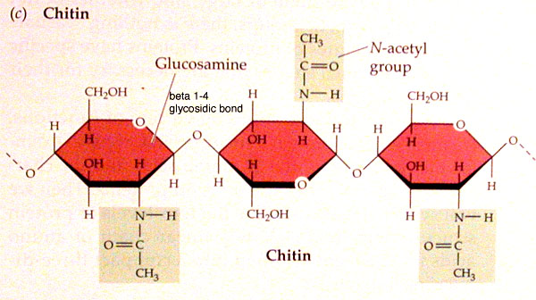
Chitin – the main protein/sugar complex in the exoskeleton

Slide 8
Sclerotin – harder protein in the matrix
- Acts like a hard plastic like our PLA
Resilin – flexible protein in
the matrix
- Acts like rubber

Slide 9
Cross-linked
Proteins
Cuticle
Proteins

Slide 10
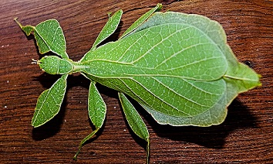
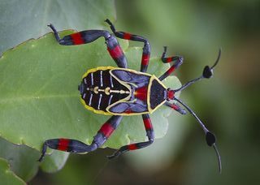
Colors
Colors can be for camouflage
Colors can attract mates
or warn predators

Slide 11
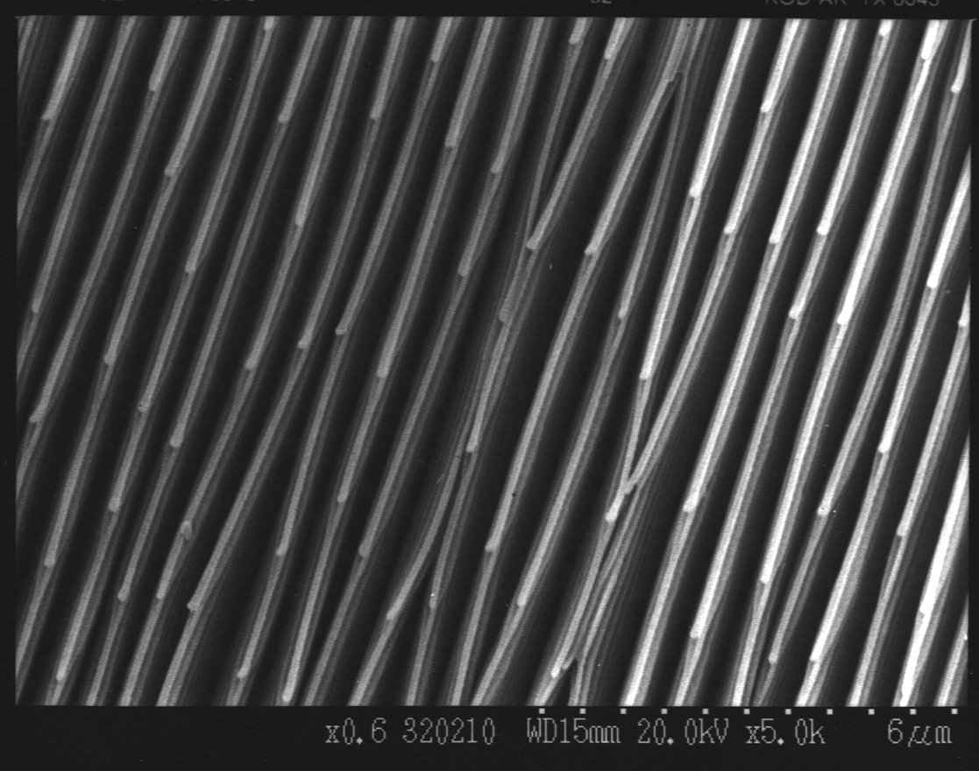
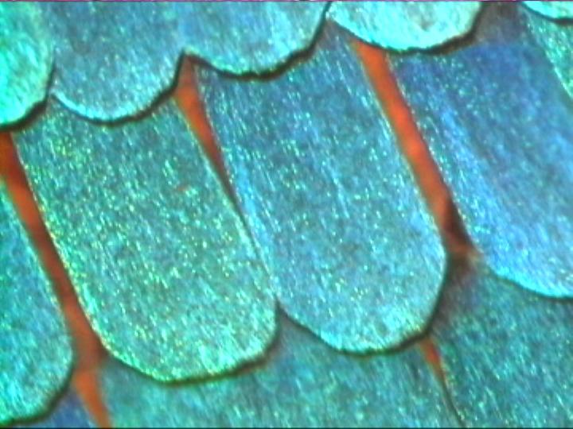
Colors are often determined by the
SHAPE of the exoskeleton reflecting
light like a CD
http://newton.ex.ac.uk/research/emag/butterflies/imagespage.htm
High Mag of Iridescent butterfly scale

