Slide 1
Brainstorming
Reasons
Types
Rules
Sketching
Project

Slide 2
Reason:
A group technique for solving problems, generating ideas, stimulating creative thinking, etc.
It involves collecting ideas without regard to feasibility.

Slide 3
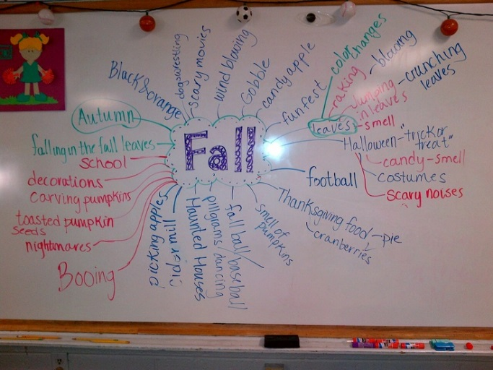
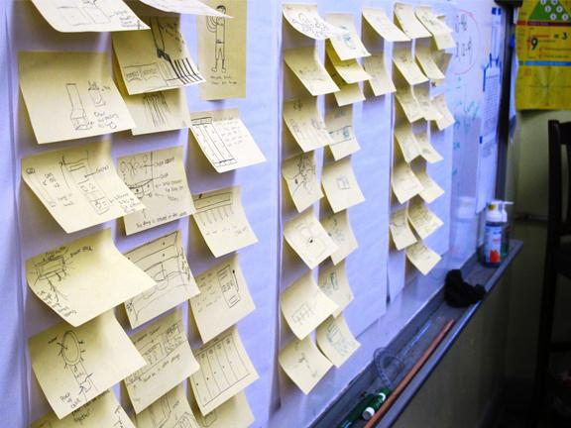
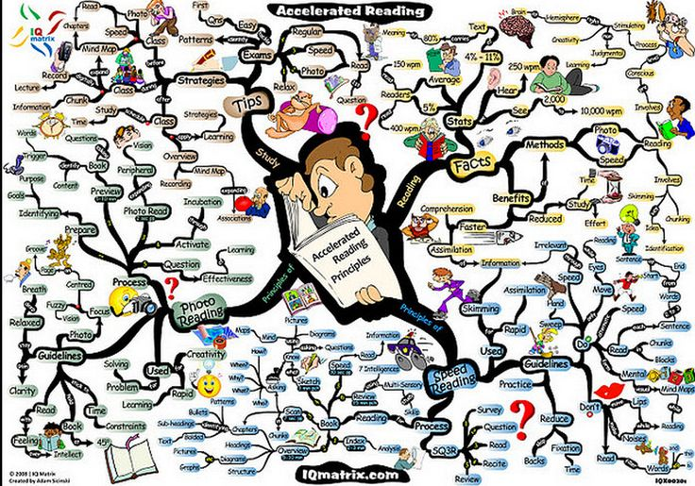
Types
Just a few:
Free for All
Free-Form
Forced Association
SCAMMPERR
Mind Mapping

Slide 4
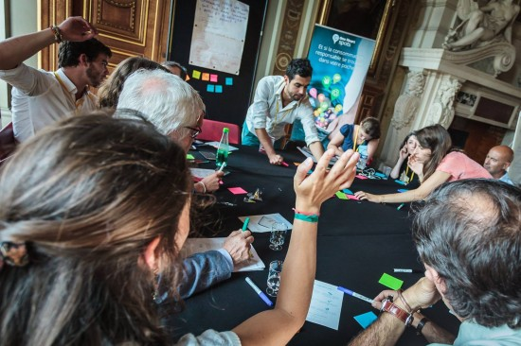
Rules:
No criticism allowed
Work for quantity
Welcome piling-on
Allow free-for-all

Slide 5
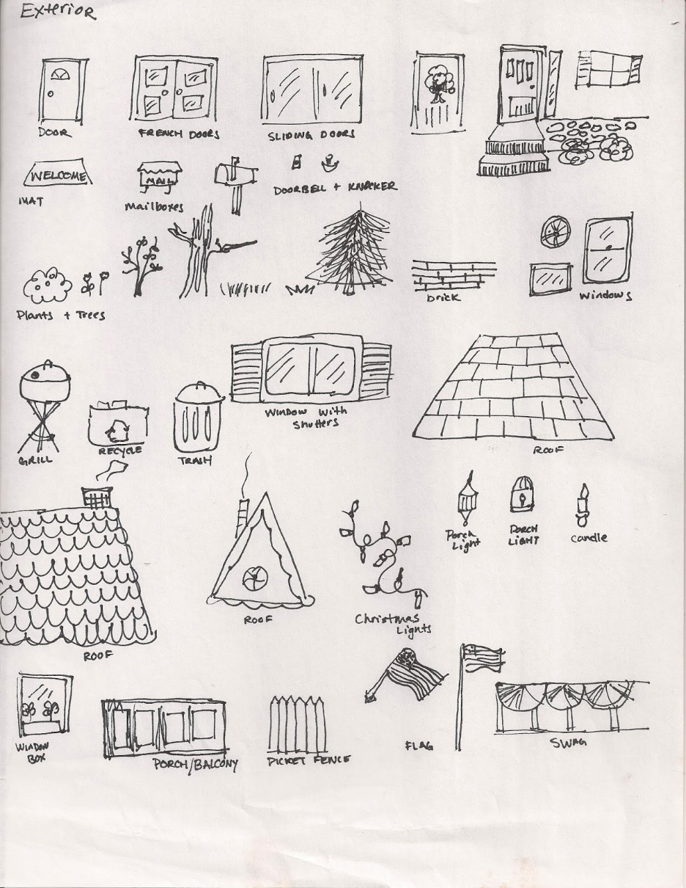
Sketching:
Often the BEST way to share ideas
Okay to use graphic sketches

Slide 6
Activity: The Tower of Benton
Build a tower 24" tall
Must stand for at least 60 seconds on its own
2" tolerance on height
Use only materials provided, spaghetti and marshmallows
5 minutes to brainstorm, sketches in notebook, final group sketch

Slide 7
Activity: The Tower of Benton
List the building procedure in steps to match the final sketch
Must show final sketch to get materials
10 minutes to collaboratively build tower
Test and revise during the 10 minutes
Tower must stand on table with no other supports

