Slide 1
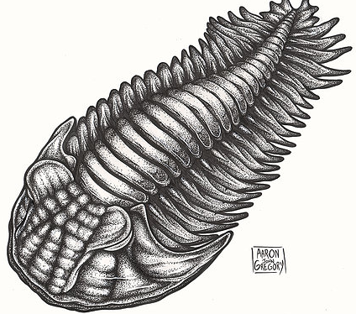
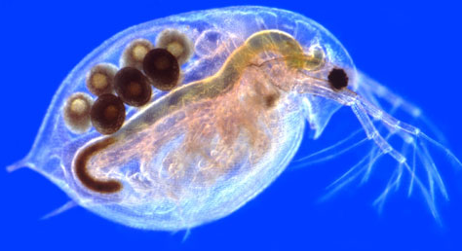
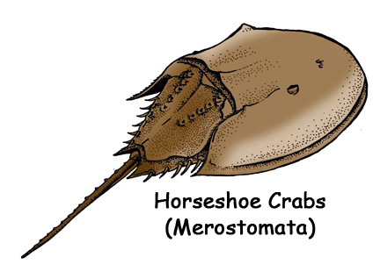
Subphylum Trilobita
(extinct)
Kingdom Animalia
Class Branchiopoda
Subphylum Crustacea
Phylum Arthropoda
Class Malacostraca
Subphylum Uniramia
Subphylum Chelicerata
Order Isopoda
(pillbugs & scuds)
Class Chilopoda
(centipedes)
Class Xiphosura
(Horseshoe crabs)
Class Arachnida
(spiders, mites, scorpions, ticks)
Order Decapoda
(Lobsters, crabs, crayfish, shrimp)
Class Diplopoda
(millipedes)
Class Insecta
Not all Insect orders shown
Order Mantodea
(praying mantis)
Order Diptera
(flies & mosquitoes)
Order Lepidoptera
(butterflies)
Order Hymenoptera
(bees, wasp, ants)
Order Ephemeroptera
(mayflies)
Order Orthoptera
(grasshoppers)
Order Coleoptera
(beetles)
Order Dermaptera
(earwigs)
Order Blattodea
(cockroaches & termites)

Slide 2
Subphylum Trilobita
(extinct)
Kingdom Animalia
Class Branchiopoda
Subphylum Crustacea
Phylum Arthropoda
Class Malacostraca
Subphylum Uniramia
Subphylum Chelicerata
Order Isopoda
(pillbugs & scuds)
Class Chilopoda
(centipedes)
Class Xiphosura
(Horseshoe crabs)
Class Arachnida
(spiders, mites, scorpions, ticks)
Order Decapoda
(Lobsters, crabs, crayfish, shrimp)
Class Diplopoda
(millipedes)
Class Insecta
Not all Insect orders shown
Order Mantodea
(praying mantis)
Order Diptera
(flies & mosquitoes)
Order Lepidoptera
(butterflies)
Order Hymenoptera
(bees, wasp, ants)
Order Ephemeroptera
(mayflies)
Order Orthoptera
(grasshoppers)
Order Coleoptera
(beetles)
Order Dermaptera
(earwigs)
Order Blattodea
(cockroaches & termites)

