Slide 1
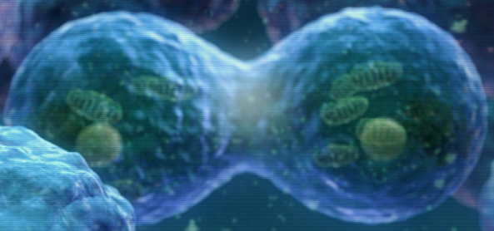
Body Cavities & Development
- Most animals start out as a single fertilized egg (one cell)
- This undergoes mitosis &
splits into more cells
- As the cells divide, they form a ball & then begin to differentiate – develop different structures & functions

Slide 2
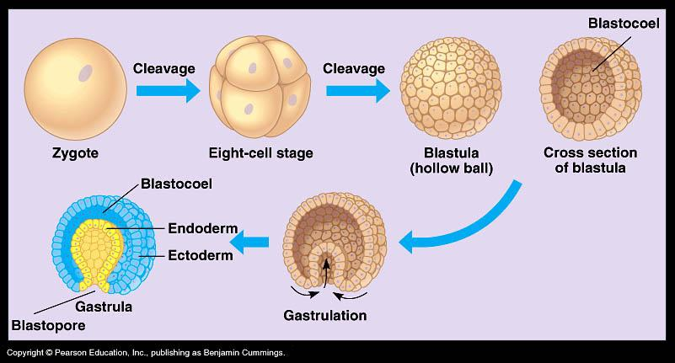

Slide 3
- Ectoderm – develops into skin, eyes, mouth & nervous system
- Mesoderm – develops into bones, muscles, & connective tissue
- Endoderm – develops into digestive & respiratory organs

Slide 4
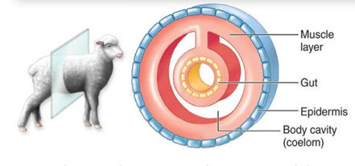
- Endoderm – develops into digestive & respiratory organs
Most animals have a fluid filled cavity between dermal layers

Slide 5
- Coelom – fluid filled body cavity
- Pronounced see-lum
- Acoelomate – an animal with no fluid filled cavity between
layers
- Pronounced
a-seal-uh-mate

Slide 6
- Pseudocoelomate – animal with a fluid filled cavity that is NOT completely lined with mesoderm
- Pronounced
sue-doe-seal-uh-mate

Slide 7
Coelomate – Animal with a fluid filled cavity that is completely lined with mesoderm
- Pronounced
seal-uh-mate

Slide 8
Orientations (directions)
Dorsal – towards the back or
spine side
2. Ventral – towards the bottom or
stomach side
3. Anterior – towards the head
4. Posterior – towards the tail
5. Medial – between/in the middle

Slide 9
3. Anterior – towards the head
4. Posterior – towards the tail
5. Medial – between/in the middle of
6. Proximal – right next to
7. Distal – distant from
Dorsal
Posterior
M
Anterior
Ventral

Slide 10
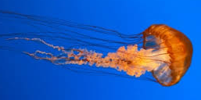
Animals are divided into invertebrates & vertebrates
Invertebrates – animals that lack support on the dorsal side
- All invertebrates are ectothermic – body is the same temperature as the environment.

Slide 11
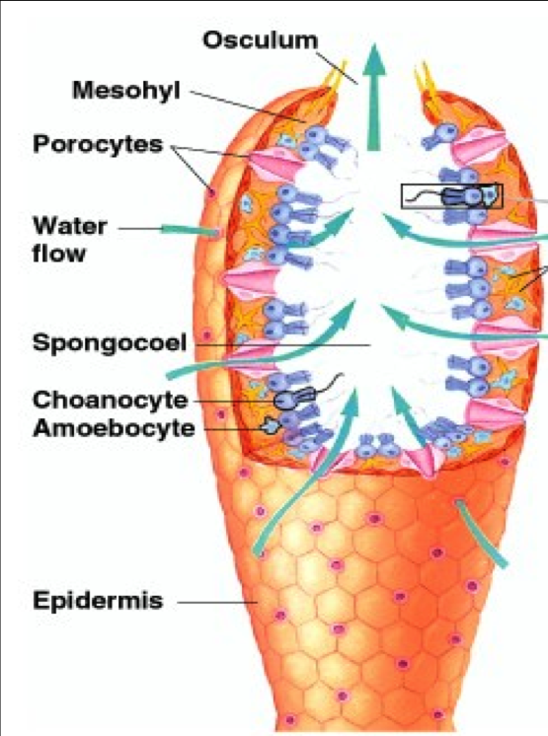
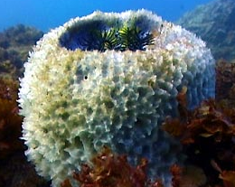
Types of Invertebrates
1. Sponges – simplest animals
- no tissues or organs
- only 2 cells thick

Slide 12
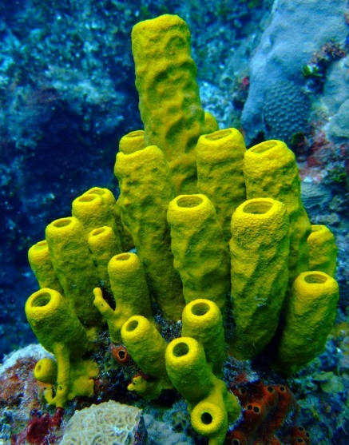
- no tissues or organs
- only two cells thick
- acoelomates
- Ex. demosponge

Slide 13
2. Cnidarians – invertebrates with stinging cells
- have tissues but no organs
- acoelomates
- Ex. Jellyfish, anemones & corals

Slide 14
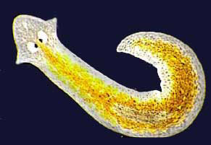
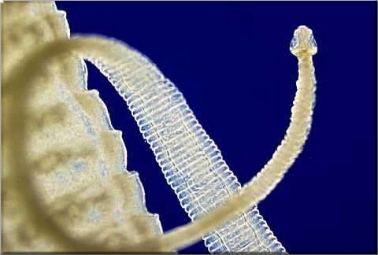
3. Flat worms– worms that are flat
- have tissues & organs
- acoelomates
- Ex. Tapeworm & planarians
- Simplest animal with cephalization – nerves & sense organs
concentrated at the anterior

Slide 15
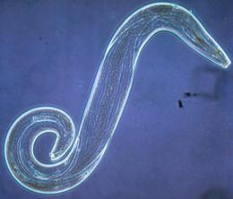
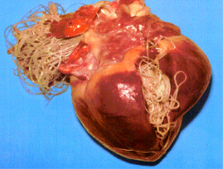
cephalization – nerves & sense organs
concentrated at the anterior
- Makes the organism better predator
4. Round worms– worms that are round & unsegmented
- pseudocoelomate
- Ex. Nematode & heart worm

Slide 16
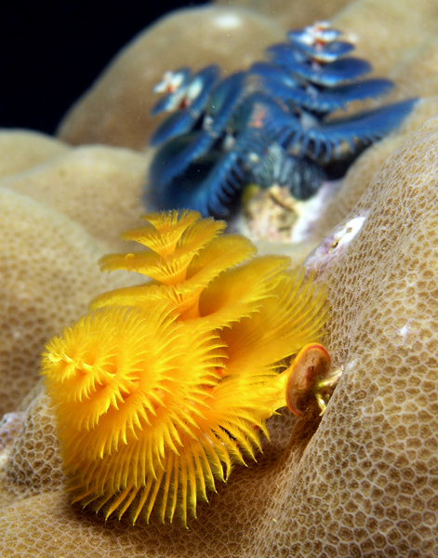
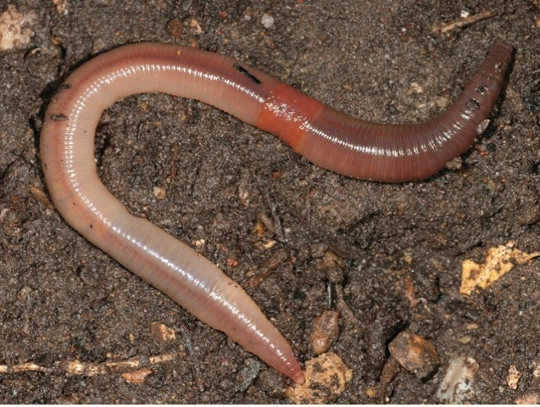
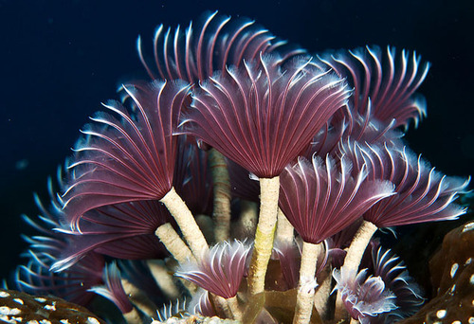
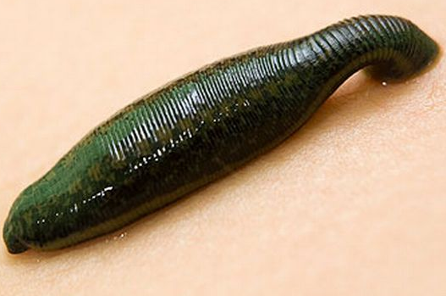
5. Annelids– worms that are round & segmented
- coelomate
- Ex. Earthworm, leech,
& tubeworm

Slide 17
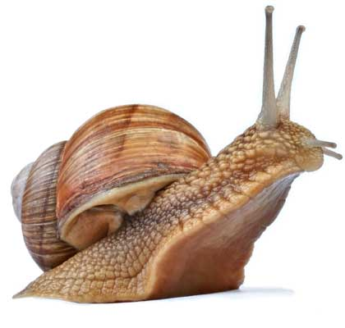
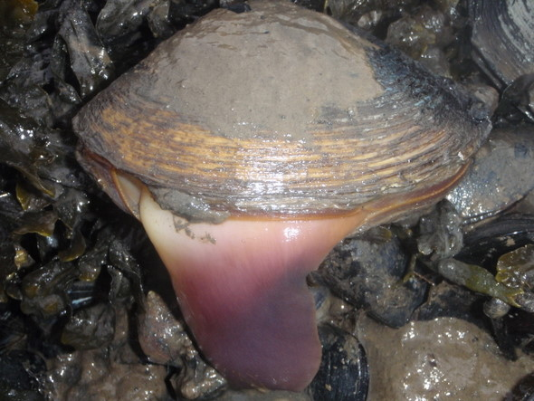
6. Mollusk– invertebrates with a soft body & often a shell
- coelomates
- Have a foot & mantle
- foot- used for movement
- mantle - makes the shell

Slide 18
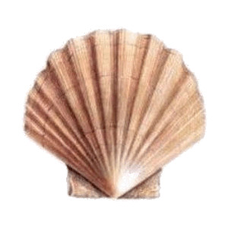
- foot- used for movement - mantle - makes the shell
Three types of Mollusks
- Bivalves– mollusks with two hinged shells

Slide 19
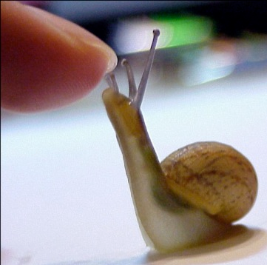
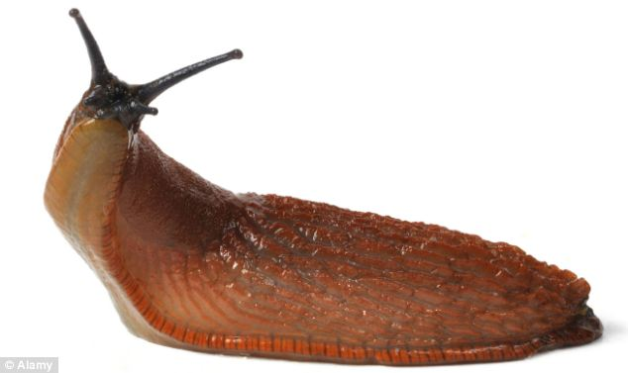
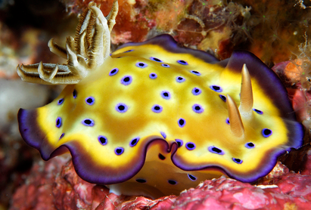
- Bivalves – mollusks with two hinged shells
- clams, oysters & mussels
- Gastropod – mollusk with a foot on the stomach side
- snails & slugs

Slide 20
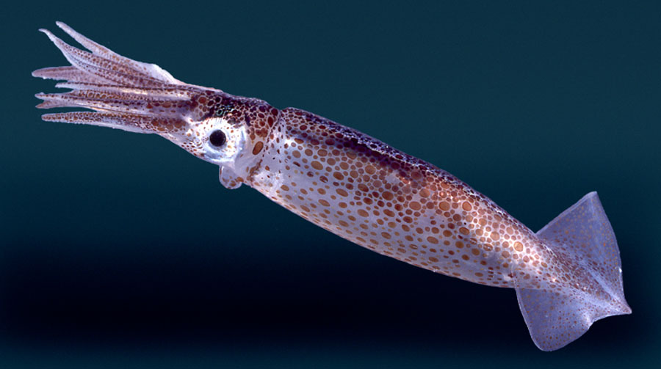
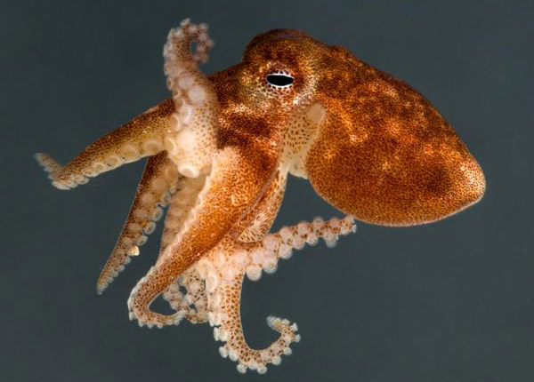
- Gastropod – mollusk with a foot on the stomach side
- snails & slugs
- Cephalopod – mollusk with tentacles attached to the head
- octopus, squid, nautilus, & cuttlefish

Slide 21
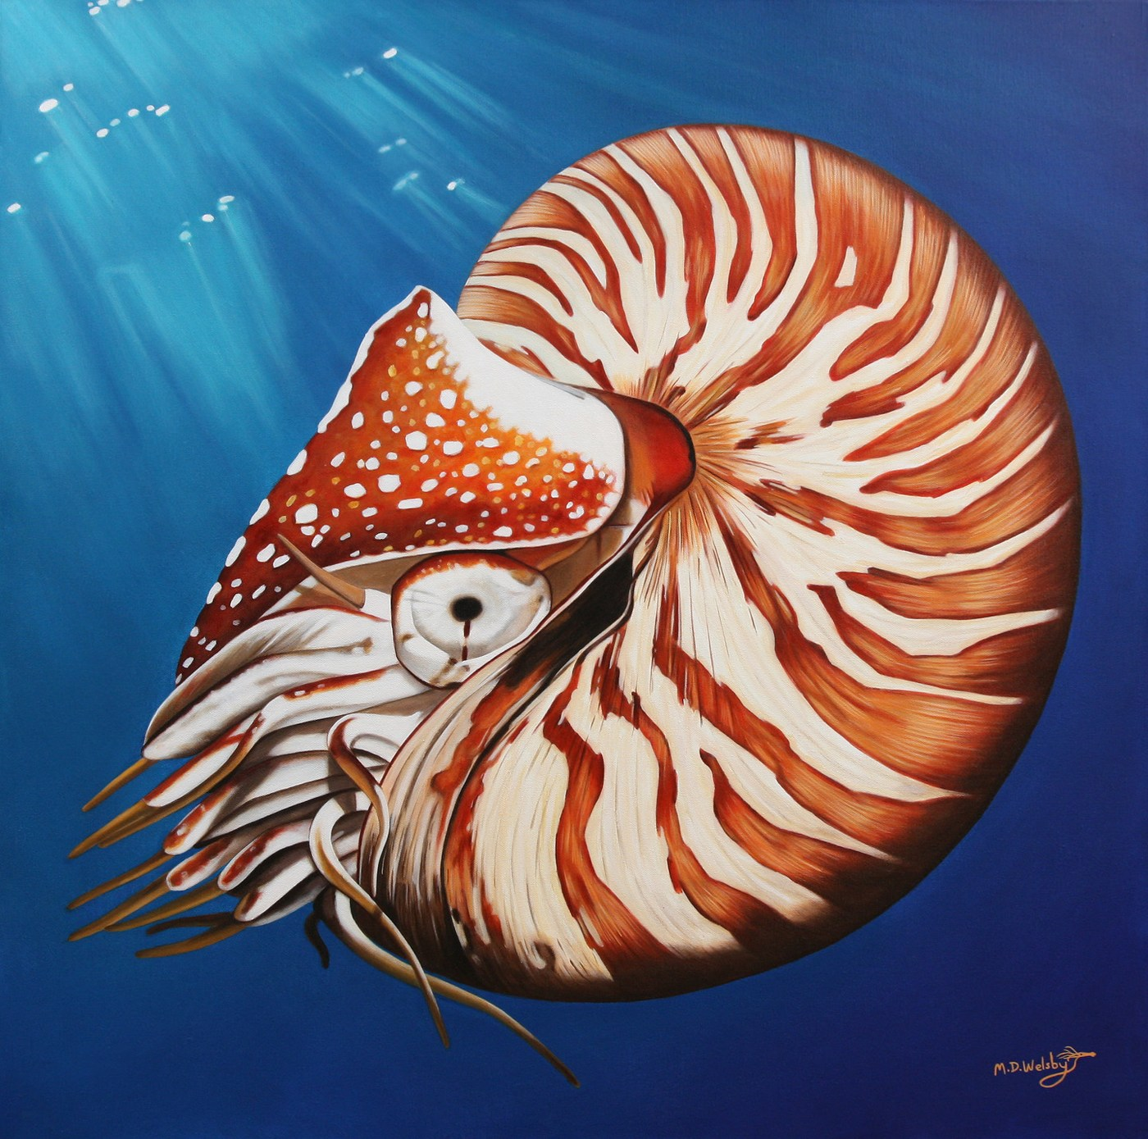
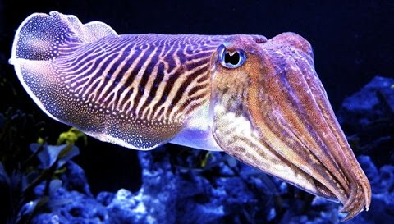
- Cephalopod – mollusk with tentacles attached to the head
- octopus, squid, nautilus, & cuttlefish

Slide 22
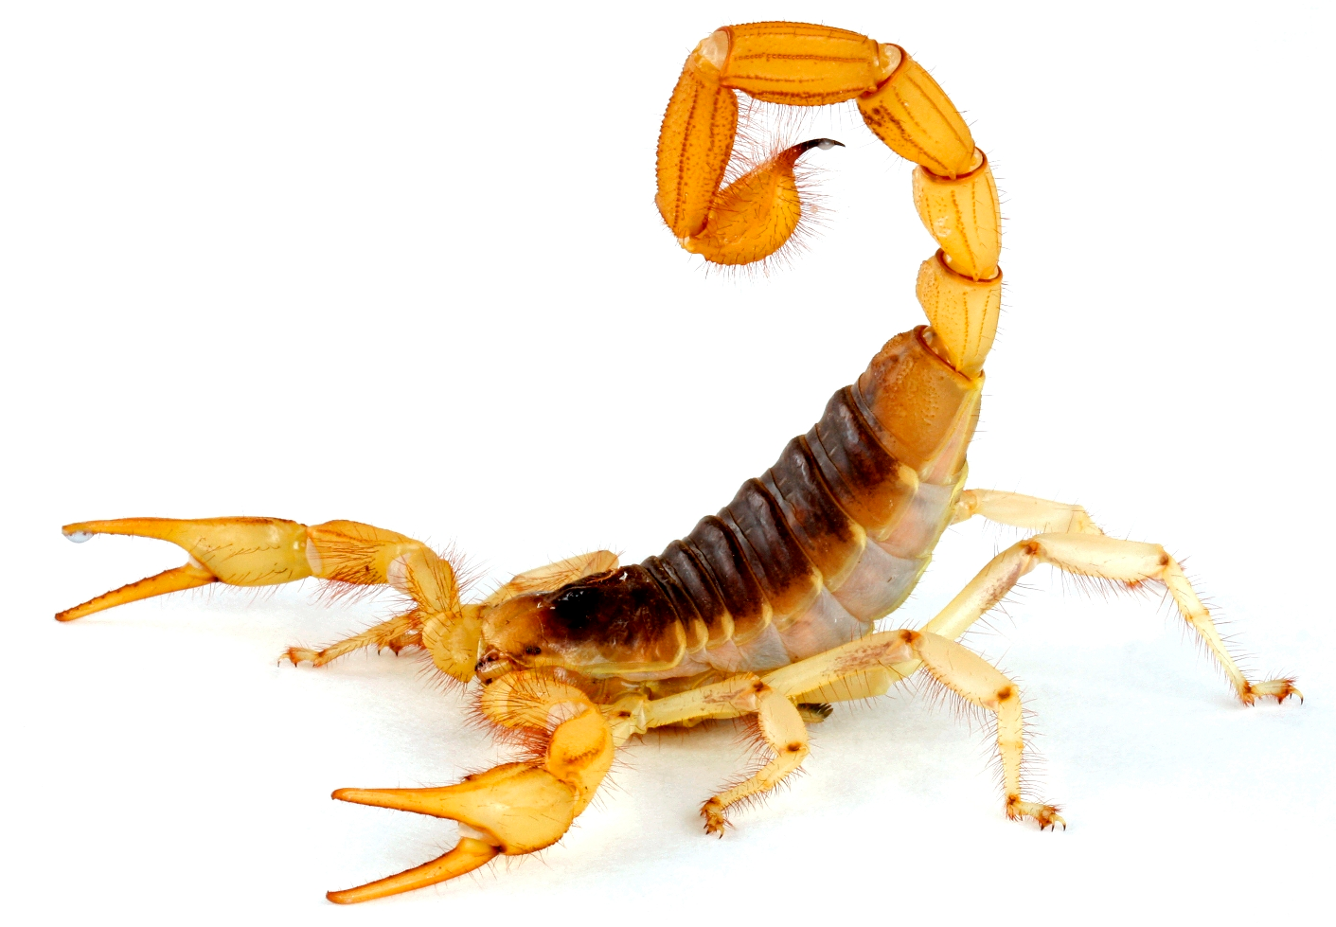
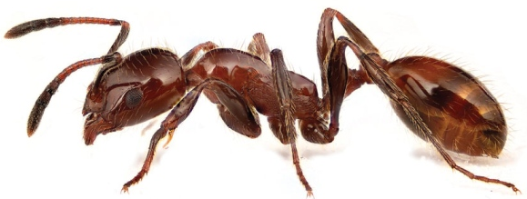
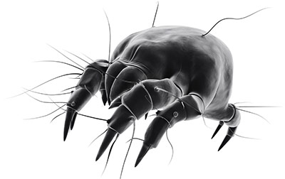
7. Arthropods– invertebrates with an exoskeleton & jointed legs
- Exoskeleton – crunchy support system on the outside
Ex. Ant, bees, scorpion, spider, crab & mites

Slide 23
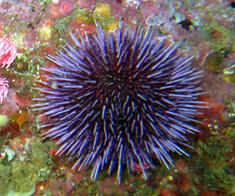
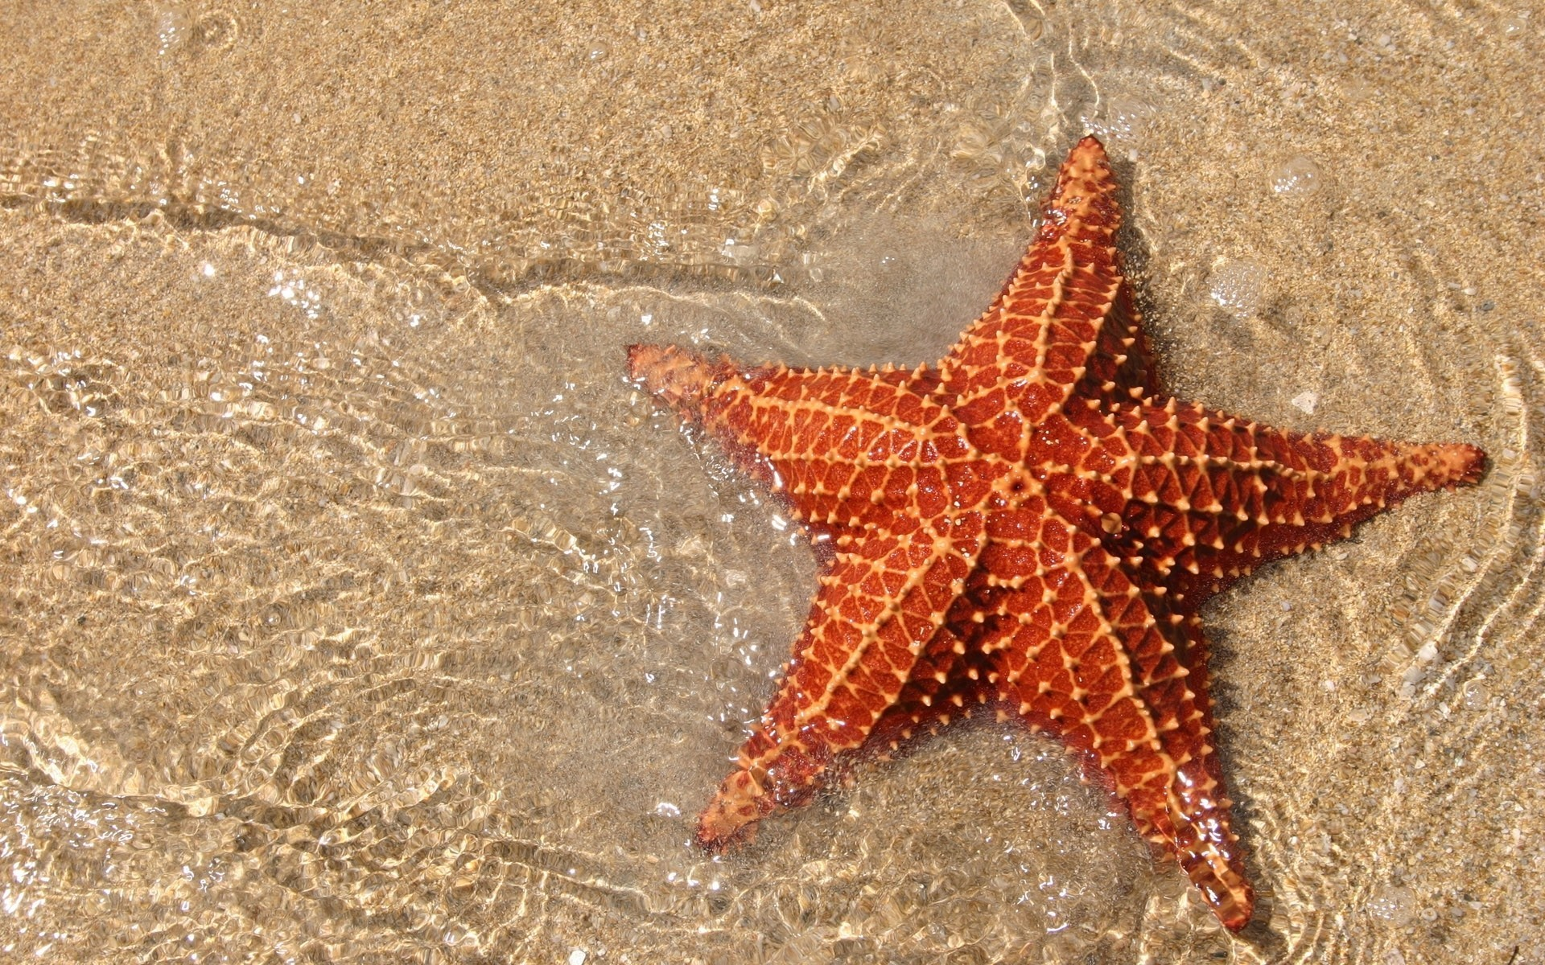
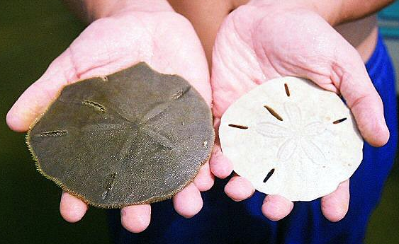
8. Echinoderms– invertebrates with spiny skin & an endoskeleton
- Endoskeleton –crunchy support system on the inside
- Ex. Sand dollars, starfish & sea urchins

Slide 24
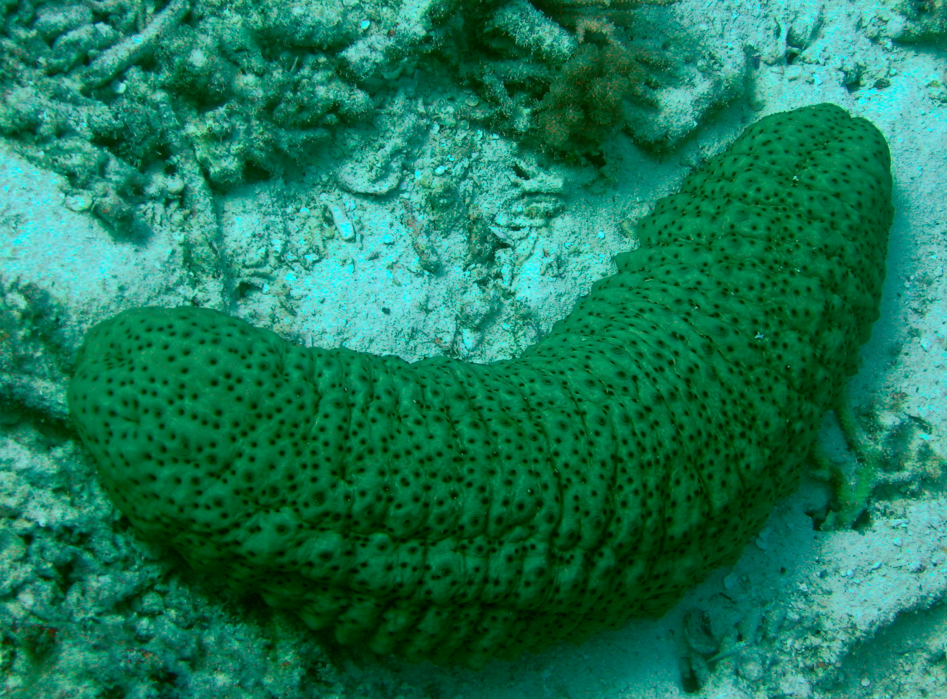
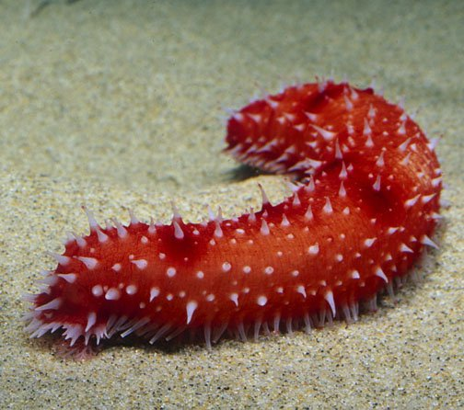
… and Sea cucumbers

