Slide 1

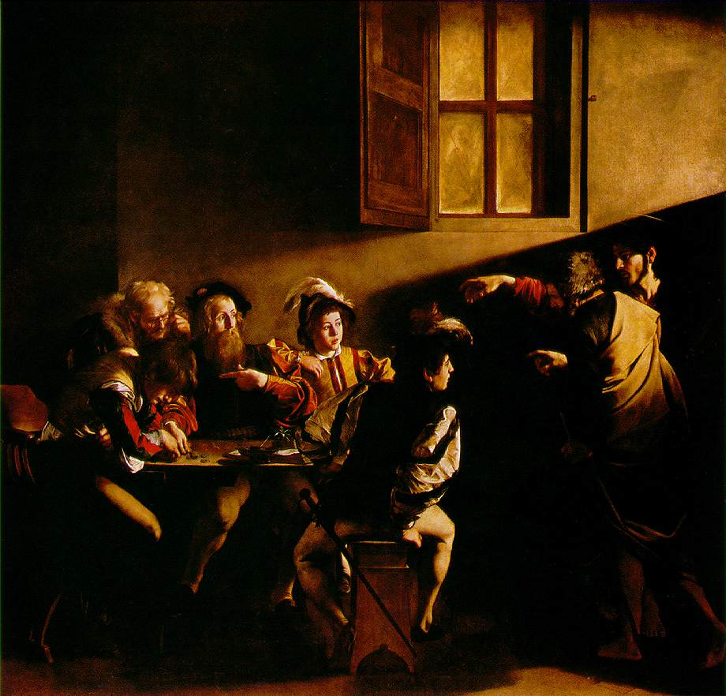
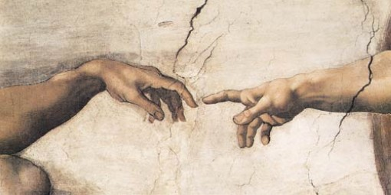
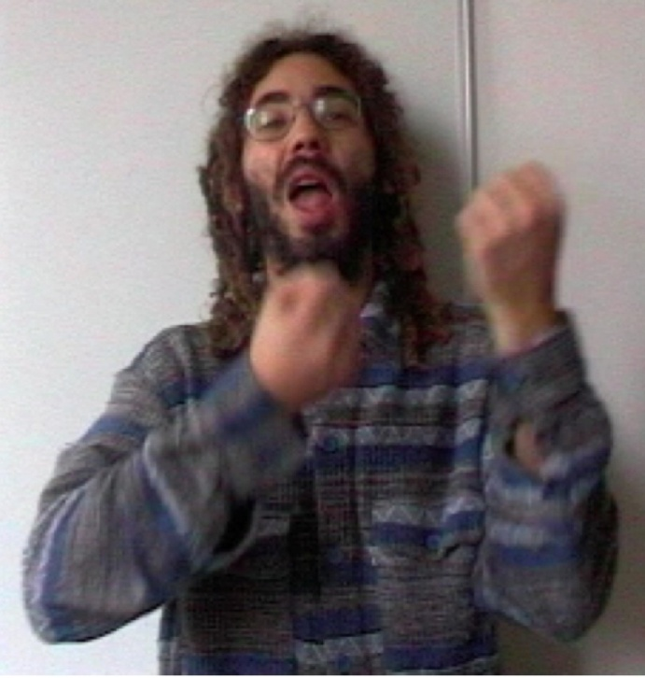
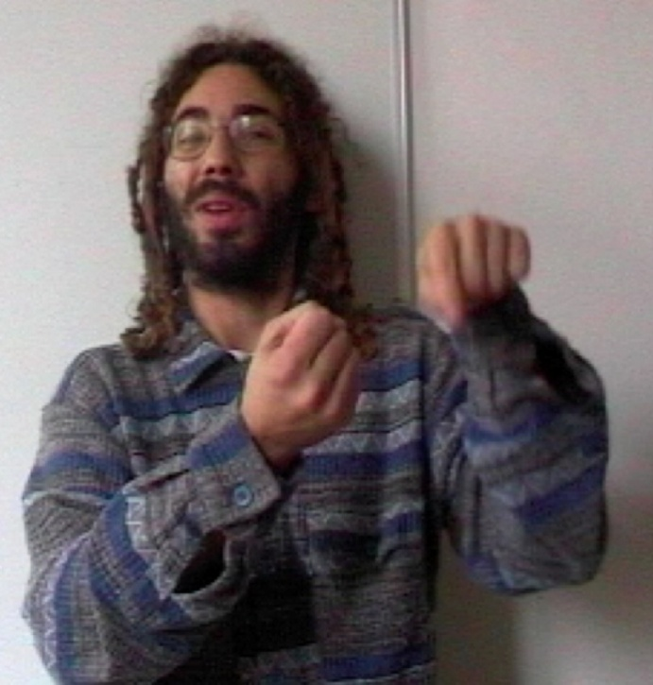
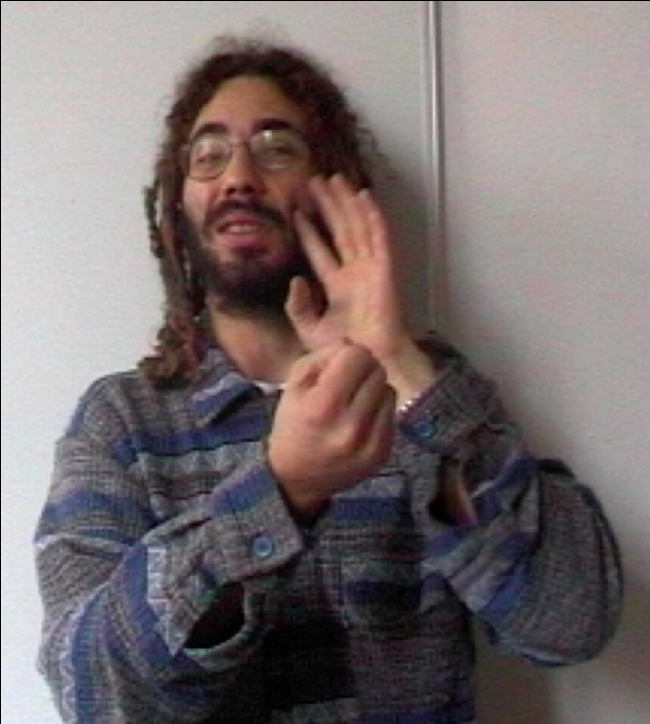
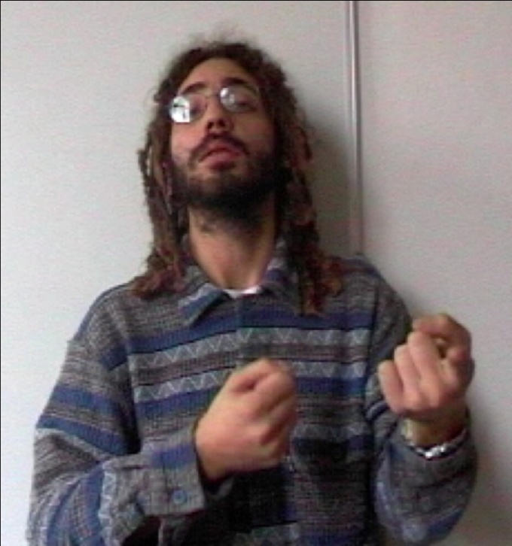
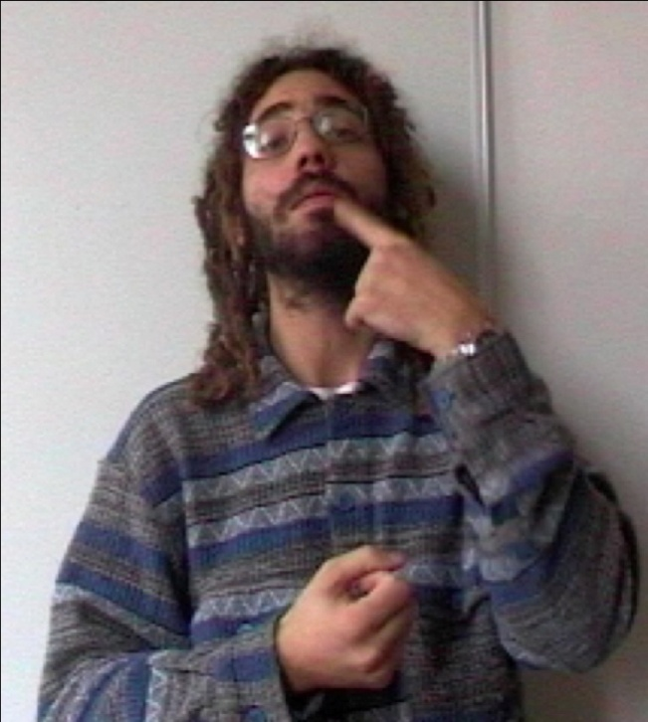
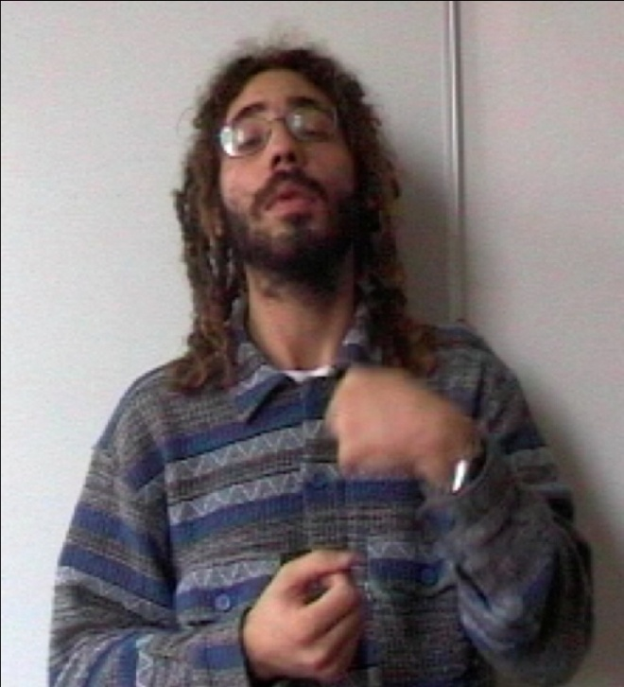
THE SYNTAX OF
PRONOMINAL POINTING SIGNS
IN ITALIAN SIGN LANGUAGE (LIS)
TISLR 10, Purdue University, September 30-October 2, 2010
Carmela Bertone and Anna Cardinaletti
Università Ca’ Foscari Venezia
POINTS OF SPACE AND ITS FEAUTURES
Participants: speaker(s), addressee(s)
1st person pronouns: Specific point on the speaker’s body [+prox]
2nd person pronouns: Specific point in the space identified by the speaker’s eye gaze [-prox]
Identified elements:
3rd person pronouns/demonstratives: Specific point in the space outside of the speaker’s eye gaze [+dist]
Non-identified element(s):
Impersonal pronouns: Neuter space (any point in the space outside of the speaker’s eye gaze) [-dist]
cf. Harley and Ritter (2002), Bertone (2007)
In sign languages, indications are a system to establish reference and co-reference.
They can belong to different categories: demonstratives, articles, and personal pronouns.
The pointing sign encodes the space features [±prox, ±dist] (i.e., proximality to or distality from the speaker and the addressee).
3rd
2nd
1st
gaze direction
THREE CLASSES OF PERSONAL PRONOUNS IN LIS
In the following sentence, the numbers on each indication are the rate of pronominal pointing signs:
Rate 1 corresponds to a strong pronoun (about 1/2 of second – 7-13 frames)*
Rate 2 corresponds to a weak pronoun (about 1/6 of second – 4 frames)*
Rate 3 corresponds to a clitic pronoun (about 1/12 of second – 1-2 frames)*
*The time is subjective, it differs from signer to signer. But in one and the same signer, it is possible to differentiate the time of holding the pointing. The programme I-movie counts 24 frames per second.
_{relative clause}
1 3 1 2 3 3
IX_{1p}OBLIGED TAXI IX_{1p} CATCH IX_{j} CAR-IX_{j}-MAN_{j} IX_{j}-TELL-IX_{1p} BUS ON-STRIKE
I was forced to take a taxi. The taxi driver told me that busses were on strike.
The indications “1p” refer to the 1st person. The indications “j” refer to the taxi driver (3rd person).
The rate 1 pronouns do not have an antecedent. They can be reduplicated.
The first indication (blue) is the subject of the first sentence; the third indication (purple) introduces a new referent: the following NP containing a reduced relative clause. (CAR_{j} IX_{j} MAN: non-manual expressions such as dimpled cheeks and squinted eyes found with full relative clauses). (See the figures)
The rate 3 pronouns are anaphoric: the second pronoun (pink) refers to the first occurrence of the 1st person pronoun; the fifth and the sixth pronouns (green) refer to the taxi driver and the first person, respectively.
They are adjacent to the verb: see the OSV order, where the object TAXI precedes the pointing sign.
These two pronouns are co-articulated with the verb: they share the handshape with TELL; furthermore, the movement starts from point (j), where the subject is located, pass on the lips, where it means TELL, and ends up on the signer’s body , that is the 1st person. (See the figures)
The rate 2 pronoun is contained in the complex expression CAR-IX-MAN.
Another occurrence of a rate 2 pronoun is in the following sentence:
_{Topic}
_{1 1 _2}
BOOK IX_{1p} GIVE PETER. BOOK, PE IX_{j}++, IX_{1p} PETER GIVE
This book, I have given to Peter
The indication “1p” refers to the 1st person. The indications “j” refers to the book (3rd person).
The rate 2 pronoun is anaphoric on the first occurrence of the first person pronoun and is separated from the verb by the object PETER.
To classify personal pronouns, we took into account:
their semantic properties: anaphoric vs. non-anaphoric pronouns;
their syntactic distribution;
their prosodic properties:
  - the pause between the indication and previous or following signs,
  - the possibility of reduplicating the pointing,
  the duration of indication, measured in the number of frames or fractions of seconds.
Strong pronouns:
can be non-anaphoric, i.e. they can introduce a new referent into discourse;
have the same distribution as full NPs and can be substituted by a proper noun or a NP;
a pause after the pointing sign can be present; reduplication is possible; long time of holding the pointing.
Clitic pronouns:
must be anaphoric;
have a special distribution: always adjacent to the verb;
no pause (are co-articulated with the verb); no reduplication; short time of holding the pointing (sometimes it is imperceptible).
Weak pronouns:
must be anaphoric;
have a special distribution, but need not be adjacent to the verb;
no pause; no reduplication; length intermediate between a clitic and a strong pronoun.
2 Relative clause
CAR IX_{j} MAN_{j}
₃ ₃
IX_{j} TELL IX_{1p}
THREE CLASSES OF PERSONAL PRONOUNS IN UNIVERSAL GRAMMAR
STRUCTURE WITH A STRONG PRONOUN
STRUCTURE WITH A WEAK PRONOUN
STRUCTURE WITH A CLITIC PRONOUN
Cardinaletti (1994), Cardinaletti & Starke (1999) distinguished three classes of pronouns in spoken languages:
strong: e.g. English him in coordination: I saw [him and his wife]
weak: e.g. English him and it, e.g. outside of coordination, where they can be reduced:
I saw’m
clitic: e.g. French le: je l’ai vu
INFL’’
TOP
INFL’’
DP
INFL’
TOP
…
NP
INFL’
INFL
VP
INFL’’
INFL
VP
₁
IX_{1p}
strong
OBLIGED
BOOK
NP
INFL’
₂
CAR IX_{J} MAN
Taxi driver
₃
IX_{J}
clitic
TELL
NEW PERSPECTIVES ON THE NULL ARGUMENT PARAMETER
₂
IX_{1p}
weak
INFL
VP
Non-agreeing verbs (contact with the signer’s body) must co-occur with pronominal pointing signs →no null arguments
With agreeing verbs, pronominal pointing sign can be absent → null arguments. (Lillo-Martin1991)
If space features can be considered as the extreme contraction of the pointing sign, we could suggest that agreeing verbs do not co-occur with null arguments but with clitic pronouns.
Morphological agreement on agreeing verbs is the movement component in their articulation.
Some evidence:
weather verbs can “agree” with the space upwards (i.e,, co-occur with a clitic) (2), towards which a possible pronominal pointing sign is directed (1); they may not “agree”, in which case we claim that no clitic pronoun is incorporated into the verb:
(1) IX_{pointing upwards} RAIN+++ (2) RAIN+++_{articulated upwards}
(3) RAIN+++ articulated in the space in front of the signer
PETER GIVE
References:
Bertone C. 2007. La struttura del sintagma determinante nella Lingua dei Segni Italiana (LIS). Doctoral thesis, University of Venice.
Cardinaletti A. 1994. On n the internal structure of pronominal DPs, The Linguistic Review 11, 195-219.
Cardinaletti A. and M. Starke 1999. The typology of structural deficiency: A case study of the three classes of pronouns, “feature article" in H. van Riemsdijk (ed.), Clitics in the Languages of Europe, EALT/EUROTYP 20-5, Mouton de Gruyter, 145-233.
Harley H. and E. Ritter 2002. Person and number in pronouns: A feature-geometric analysis, Language 78, 482-525.
Lillo-Martin 1991. Universal Grammar and American Sign Language. Dordrecht: Kluwer.

