Slide 1
Dimensions of Wellness
A Steps to Leaps Course in the Well-Being Pillar
Notes:
Welcome to today’s presentation on well-being and the dimensions of wellness that lead to security, health and prosperity. I’m [state your name and job/role]. The content for this presentation was prepared by Purdue Recreation and Wellness.

Slide 2
WELL-BEING – DIMENSIONS OF WELLNESS
Agenda
What is well-being?
Eight dimensions of wellness
Self-assessment
Reflection
Action plan
Notes:
Today we will talk about what is well-being and go over the eight dimensions, or types, of wellness. You’ll then take a self-assessment for each dimension, reflect on the results, then develop an action plan to focus on areas of wellness that you want to develop.

Slide 3
WELL-BEING – DIMENSIONS OF WELLNESS
What is Well-Being?
A good or satisfactory state of existence; a state characterized by health, happiness, and prosperity; welfare.
https://www.dictionary.com/browse/wellbeing
Notes:
Let’s start off by defining what is well-being.
Instructions:
Read the definition of well-being.
Ask participants “How would you define well-being?”
Pause for responses.

Slide 4
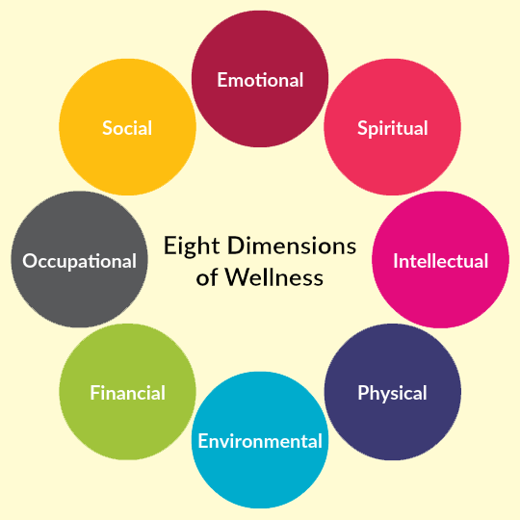
WELL-BEING – DIMENSIONS OF WELLNESS
Notes:
So, how do we achieve health, happiness and prosperity? The Eight Dimensions of Wellness provide a holistic framework for attaining a balanced and fulfilling life.
The dimensions are connected and when one or more isn’t working, it can impact our wellness and the balance in our lives. For example, if you feel financially stressed (financial dimension), you may become anxious (emotional dimension), which could lead to illness (physical dimension.)
Let’s go over a brief description for each dimension.

Slide 5
WELL-BEING – DIMENSIONS OF WELLNESS
Eight Dimensions of Wellness
Emotional Wellness
Coping effectively with life and creating satisfying relationships.
Spiritual Wellness
Expanding our sense of purpose and meaning in life.
Intellectual Wellness
Recognizing creative abilities and finding ways to expand knowledge and skills.
Physical Wellness
Recognizing the need for, and seeking out, good nutrition, sleep, and physical activity.
Notes:
*Animated slide.
Instructions:
Note each dimension, then click to animate the definition of each element.

Slide 6
WELL-BEING – DIMENSIONS OF WELLNESS
Eight Dimensions of Wellness
Environmental Wellness
Cultivating good health by occupying pleasant, stimulating environments that support well-being.
Financial Wellness
Satisfaction with current and future financial situations.
Occupational Wellness
Personal satisfaction and enrichment from one's work.
Social Wellness
Developing a sense of connection, belonging, and a well-developed support system.
Notes:
*Animated slide.
Instructions:
Note each dimension, then click to animate the definition of each element. Point out:
Environmental- Identify that this definition is referencing the physical space that they occupy at any given time, not conservation or green efforts.
Occupational - this does not just mean a formal job for which they are paid, being a student may be someone’s occupation
Social – Share information from networking modules and the importance of having quality relationships.
Ask participants what the definitions mean to them.

Slide 7
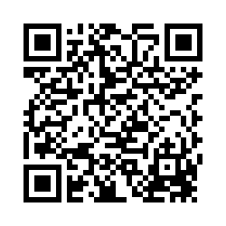
WELL-BEING – DIMENSIONS OF WELLNESS
Self-Assessment
Scan QR code or go to https://purdue.ca1.qualtrics.com/jfe/form/SV_3KpjbU5fC2NmBiS
Notes:
Now that you’re familiar with what each dimension is and how the dimensions are connected, you’re going to complete an assessment to help understand where you are regarding the different stages of your well-being. Complete the assessment for each category. Use the scores to determine your well-being in each dimension. The end of the assessment provides the scoring results.
Instructions:
Distribute the assessment
If distributing printed assessments, you can remove the QR code and text box from the slide.
Allow 10-15 minutes to complete it and review their results.
Let participants know you are available for questions and guidance as they complete the self-assessment.
Has everyone had a chance to finish their wellness assessment?

Slide 8
WELL-BEING – DIMENSIONS OF WELLNESS
Reflection
Were you surprised by your results? If so, why?
Which dimension of wellness needs work, and what is one change you want to make?
Who do you know who could keep you accountable?
Which dimension of wellness do you think would be the most difficult to improve?
Notes:
Let’s talk about what you discovered about yourself.
Instructions:
Ask the group the questions on the slide.
If students seem hesitant to share in the larger group, have them talk with a partner or smaller group at their table.
Those are some great thoughts and comments about the assessment results! By addressing each of these dimensions, you can work toward a well-rounded and fulfilling life, promoting overall health and happiness during your college journey and beyond. And that takes us to your action plan!

Slide 9
WELL-BEING – DIMENSIONS OF WELLNESS
Action Plan
Notes:
With the understanding of where you stand in each of the wellness dimensions from the self-assessment, think about which dimensions you want to improve and develop an action plan.
Instructions:
Distribute action plan.
Allow 10-15 minutes to complete it.
Let participants know you are available for questions and guidance as they complete the action plan.

Slide 10
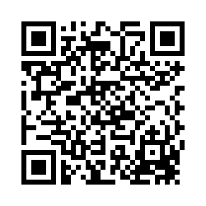
Thank You!
Scan and complete the survey!
For more information about Steps to Leaps visit: purdue.edu/stepstoleaps
Stay connected on Instagram:
@purduestepstoleaps
Notes:
Steps to Leaps offers a variety of resources designed to help you become your best Boilermaker! You can find information on improving your well-being, learning leadership skills, making an impact, building a network and developing grit/persistence at the Steps to Leaps webpage.
Before you leave today, please complete the course survey. It only takes about two minutes to complete, and it’s a great way for you to let us know what you liked about the course, or what could be improved. The survey is anonymous. Just scan the QR code to get started!
Instructions:
Wrap up the conversation and thank the participants for their participation.
Have participants complete survey by scanning the QR code on the slide.
Facilitator completes attendance and course evaluation survey in Brightspace within the “Course Documents” section.

