Slide 1

Updates on Campus Sustainability Self-Study Project
Michael Johnston, University Senate Sustainability Committee
Lynne Dahmen, Senior Managing Director, Institute for a Sustainable Future
2/17/2025

Slide 2
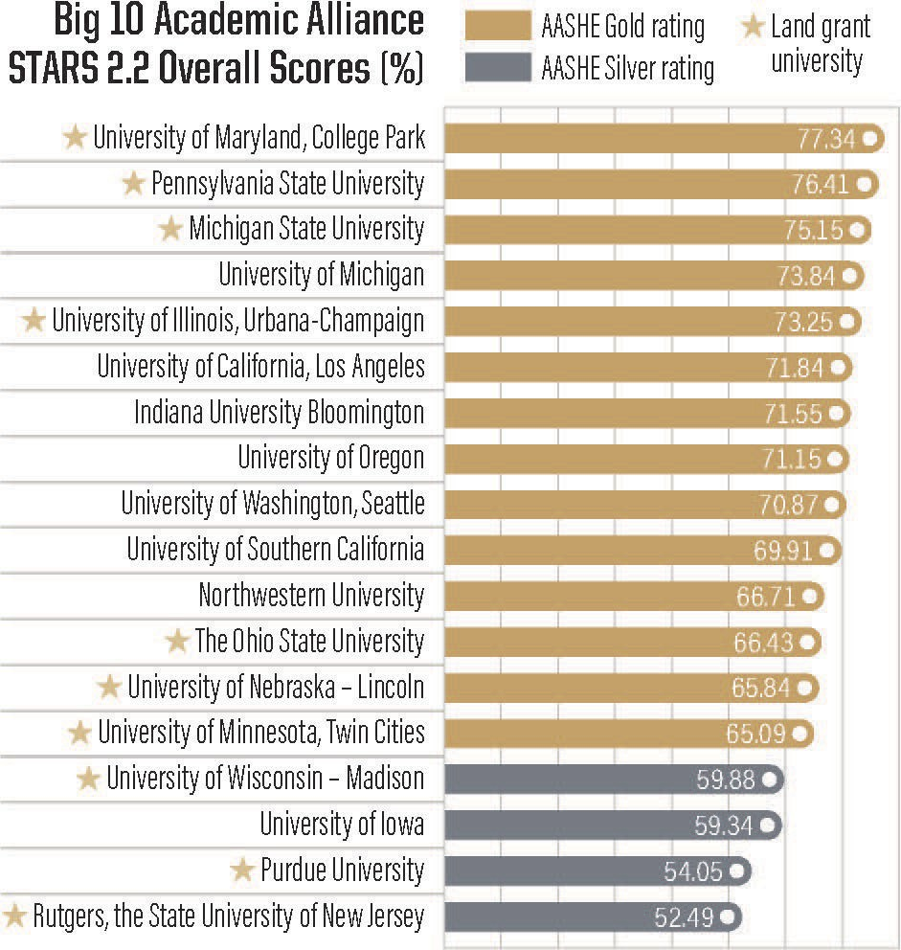
Motivation
Improve ranking among peers;
Explore opportunities and challenges;
Address campus concerns.
Research campus performance.

Slide 3
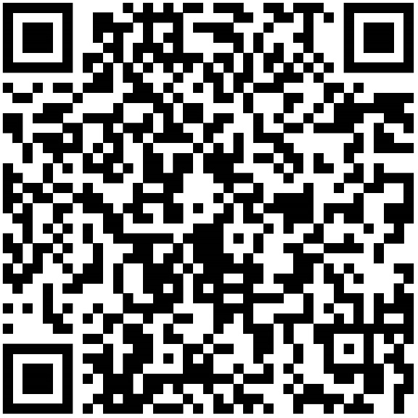
Sustainability Working Group
Core group: 13 representatives from various faculty, student, and staff groups
o o o o
Meet regularly Assess progress
Assign and accomplish tasks Sub-committees:
o o o
Faculty/sustainability education Student/sustainable living guide/events Staff/survey & training contents
SWG Webpage

Slide 4


Campus Sustainability Self-Study
Academic year 2024 - 2025
Obj. 1
Obj. 2
Obj. 3
Obj. 4
Obj. 5
Obj. 6
Establish a core Sustainability Working Group
Define protocols to collect and analyze data related to AASHE STARS 3.0
categories
Conduct a sustainability literacy and culture (SLAC) assessment
Promote awareness of efforts and opportunities
Conduct cost-benefit analysis of recommendations and research funding opportunities
Draft a 5-year roadmap

Slide 5




Parts of the Project
Large Outputs/Divisions:
Purdue’s STARS Performance Assessment (SPA)
Campus Sustainability Self-Study (CASS)
Additional “Along the Way” Outputs
  Surveys & datasets
  Events/activities for sustainable education
  Updated course listing for students
  Sustainable Living Guide
  Presentation for new hires
  “Getting to Gold” short report

Slide 6

Goals of SPA
Purdue’s STAR Performance Assessment
What do we well?
How do we compare to peers?
What information is not being captured?
What are the ‘low hanging fruit’
for rapid improvement?

Slide 7
Understanding AASHE’S Structure
Category | Subcategory
Academics (AC) | Curriculum, Research
Engagement (EN) | Campus Engagement, Public Engagement
Operations (OP) | Buildings & Grounds, Energy & Climate, Food & Dining, Procurement & Waste, Transportation
Planning & Administration (PA) | Coordination & Planning, Investment Social Equity, Wellbeing & Work
Innovation & Leadership

Slide 8
Sustainability Education
Academics (curriculum): biggest gap and potential to increase Purdue score
Student focused
Identify courses and programs
students attend
  Identify additional courses or modules and programs students
are interested in
  Provide resources to identify offerings at Purdue more easily
Faculty focused
Support faculty to integrate sustainability in the curriculum
Develop a plan and a community tailored to faculty need and interest
Facilitate interdisciplinary connections and partnerships

Slide 9
Sustainability Education Events
Let's Talk Sustainability Education at Purdue
January 23, 2025
K-12 Teaching of Sustainability aligned with Indiana Academic Standards in Science
Dr. Lynn Bryan (Purdue)
February 27, 2025
One-day workshop about teaching sustainability with keynote speaker Dr. Rebecca Watts Hull
(Georgia Tech) Presentations by faculty Workshop breakouts March 24, 2025
Goal: Familiarize faculty with concepts related to teaching sustainability and enable development of a plan supported by their interest.

Slide 10
Sustainability Literacy and Culture Assessment
Assess current state of campus sustainability behavior and knowledge at Purdue; establish a template to track progress over time
Undergraduate students (February 2025)
o o
Focus: knowledge and behavior
Goal: Identify strengths and gaps in students’ understanding to inform curriculum development and student engagement strategies; inform current sustainability efforts on campus
Faculty, staff and graduate students (March/April 2025)
o o
Focus: behavior
Goal: Understand perceptions, values, and practices to guide cultural initiatives on campus

Slide 11

Core working group
Presenter Notes
2025-02-17 21:50:38
--------------------------------------------
Member name | Member title | Department
Valentina Negri | Research Scientist | ISF
Lynne Dahmen | Senior Managing Director | ISF
Kayla Gurganus | PhD candidate | Poli Sci
Anthony Gillund | Director of Sustainability | AO
Patrick Brown | Sustainability Manager | AO
Michael Johnston | Professor | English
Lindsey Payne | Assistant Professor of Practice | EEE
Jonathon G. Day | Associate Professor | Hospitality and Tourism Management
Amanda Taylor | Executive Assistant to the Head | Statistics
Kuang Xin | PhD candidate | Energy Development and Sustainability
Marley White | Undergraduate Student | Natural Resources and Environmental Science (NRES) and Political Science
Sophia Maria D'Isabella | Undergraduate Student | Pharmacy
Olivia Williams | Undergraduate Student | Agriculture Economics (BS) and Spanish (BA)

Slide 12
Thank you!
Contact: Lynne Dahmen
ldahmen@purdue.edu

