Slide 1
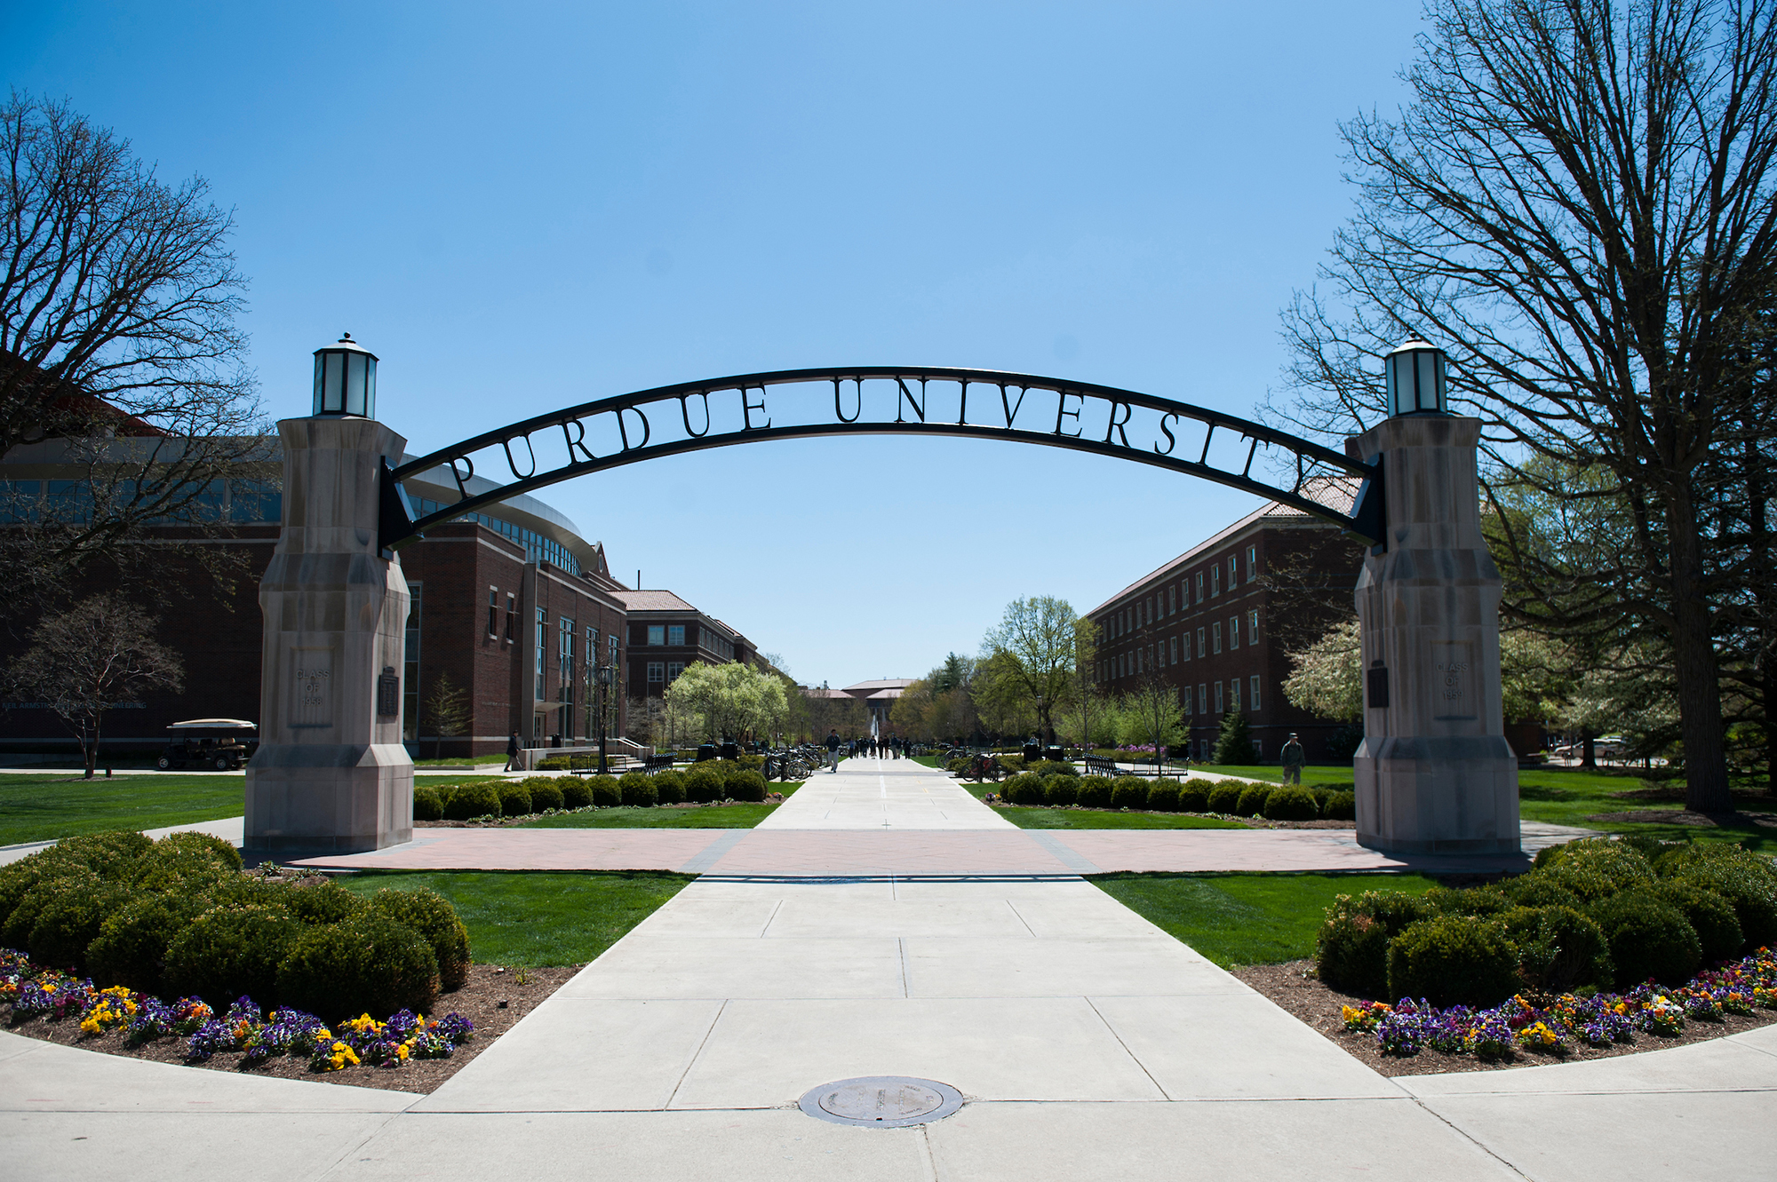

pURDUE ONLINE

Slide 2
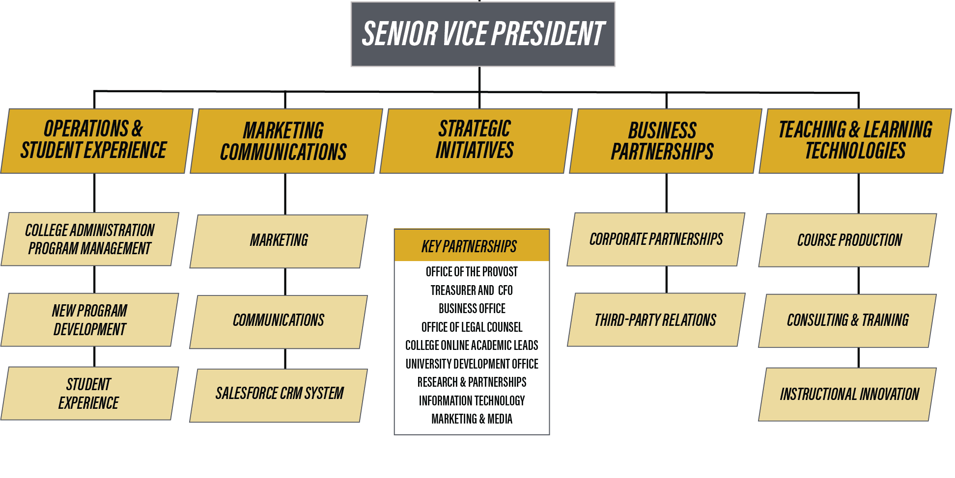

Slide 3
Purdue Online
Offer affordable Best in Class online education.
Increase accessibility to Purdue West Lafayette graduate degrees and certificates.
Provide business, industry, and individuals with upskilling, reskilling, and executive education through non-credit and credit offerings in partnership with OIP.
Grow revenue for the colleges through cost-effective Best in Class Online Program Management (OPM) operations – Purdue Online.

Slide 4

Best in Class Program Standards
Program Standards for Design
Program standards are defined and mapped before development, and program reviews are completed annually to identify areas for continued enhancement.
Course Design & Development
Each course in the program completes the Course Production development and Quality Matters review process.
Course Redesign
Each course in the program is fully redesigned every three years with annual review and revisions.
Instructional Support
Each section delivered in the program is provided instructional support.
Faculty Professional Development
Each program instructor completes professional development for development and delivery of online instruction.

Slide 5
Online Rankings
#3 America’s Top Online College, Newsweek (2022)
Engineering
#2 Online Engineering Graduate Program in the US, US News & World Report, 2023
#1 Online MS in Electrical Engineering
#1 Online MS in Industrial Engineering
#1 Online MS in Mechanical Engineering
#1 Online MS in Engineering Management
#2 Online MS in Civil Engineering
#4 Online engineering master’s programs for veterans
Communications
#1 Best Online Masters in Communications Program, Masters in Communications.org, 2023
Hospitality and Tourism Management
#1 Online master’s in Hospitality Management (University HQ 2023)

Slide 6
Online Rankings
Education (All from US News)
#3 Best Online Learning Schools (UW News and World Report, 2022)
#22 Best Online Master’s in Education, US News & World Report (2022)
#1 Online MS Education program in Indiana
#23 Online MS program in the US
#8 Instructional Media Design (the online Learning Design & technology program)
#14 Online MS Curriculum and Instruction
Master of Health Administration
#3, best online master’s degree program in Health Administration, Onlinemastersdegree.com (2022)
#1 online healthcare administration degree program, Edumed.org (2023)
#6 online master of health administration (MHA), Edumed.org (2023)
Vet Medicine
#1 Veterinary Technology Program, The BestColleges.org, 2023
Polytechnic Institute
#6 Best Online MS Degrees in Information Technology

Slide 7
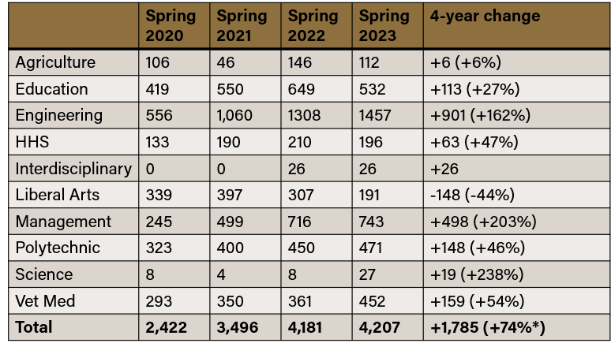
Enrollment – All Credit Students (PWL)
*Enrollments were +21% for graduate students in the same 4-year period.

Slide 8
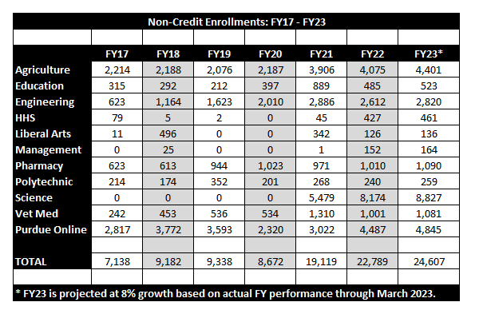
Enrollment – All Non-Credit Students (PWL)

Slide 9
Masters Program Enrollment at Census*
Online enrollment has grown 214% Between Spring 2017 and Spring 2023
Residential Enrollment grew 12% after having fallen in previous terms Between Spring 2017 and Spring 2023
Hybrid Enrollment has fallen by 35%
Between Spring 2017 and Spring 2023
* This data uses Data Digest official numbers (using Census) headcount and therefore will not match Purdue Moves official numbers (using Term End)

Slide 10
Undergraduate Online Courses Developed and Instructional Support Enrollment
Total Courses Developed – 133
Course Development Funding since FY 2017 - $386,078
Instructional Support funding provided to academic departments since Fall 2011 - $9,558,592
Cumulative enrollment since Fall 2011 – 67,895
*Headcount of students taking courses that received Instructional Support funding

Slide 11
Revenue
Based on all revenue earned from online courses

Slide 12
Total Gross Revenue
Four Year Trend for PWL

Slide 13
Revenue – All Credit Students (PWL)
 | FY 2019 | FY 2020 | FY 2021 | FY 2022
Agriculture | $829,546 | $1,491,353 | $1,208,602 | $1,802,534
Education | $5,930,363 | $5,273,327 | $5,670,039 | $6,129,879
Engineering | $6,865,204 | $7,949,027 | $10,853,599 | $12,527,785
HHS | $1,181,619 | $1,739,101 | $2,542,774 | $2,759,109
Liberal Arts | $4,812,092 | $4,261,317 | $4,621,961 | $3,773,686
Management | $4,819,181 | $5,434,389 | $9,784,291 | $13,069,054
Pharmacy | -- | -- | -- | --
PPI | $3,678,430 | $3,903,382 | $5,353,940 | $6,039,195
Science | -- | -- | -- | $7,470
Vet Med | $809,412 | $1,038,151 | $1,181,324 | $1,279,152
Total | $28,925,846 | $31,090,047 | $41,220,850 * | $47,592,500 *
Figure includes General Studies expenditures not allocated to a specific Academic Unit
Notes:
Compare to GR university

Slide 14
Revenue – All Noncredit Students (PWL)
 | FY 2019 | FY 2020 | FY 2021 | FY 2022
Agriculture | $872,064 | $751,578 | $1,239,906 | $1,378,314
Education | $4,850 | $16,725 | $17,500 | $20,500
Engineering | $3,353,736 | $3,771,420 | $4,738,693 | $4,543,827
HHS | $52,164 | $16,785 | $152,998 | $197,378
Liberal Arts | -- | -- | $100,042 | $153,296
Management | -- | $5,500 | -- | $7,240
Pharmacy | $6,082,286 | $6,232,964 | $5,175,227 | $5,666,888
PPI | $530,357 | $218,280 | $407,500 | $322,462
Purdue Online | $565,387 | $708,637 | $1,788,083 | $2,258,134
Science | -- | -- | $150,360 | $314,500
Vet Med | $1,001,776 | $882,675 | $1,158,181 | $1,175,554
Total | $12,462,620 | $12,604,564 | $14,928,489 | $16,038,093
Notes:
Compare to GR university

Slide 15
Revenue – All Students (PWL, PNW, PFW)
 | FY 2019 | FY 2020 | FY 2021 | FY 2022
PWL | $41,388,466 | $43,694,611 | $56,149,339 | $63,630,593
PNW | $8,702,000 | $8,444,000 | $8,620,047 | $7,017,528
PFW | $1,217,000 | $1,425,000 | $2,553,407 | $2,737,651
Total | $51,307,466 | $53,563,611 | $67,322,793 | $73,385,772

Slide 16
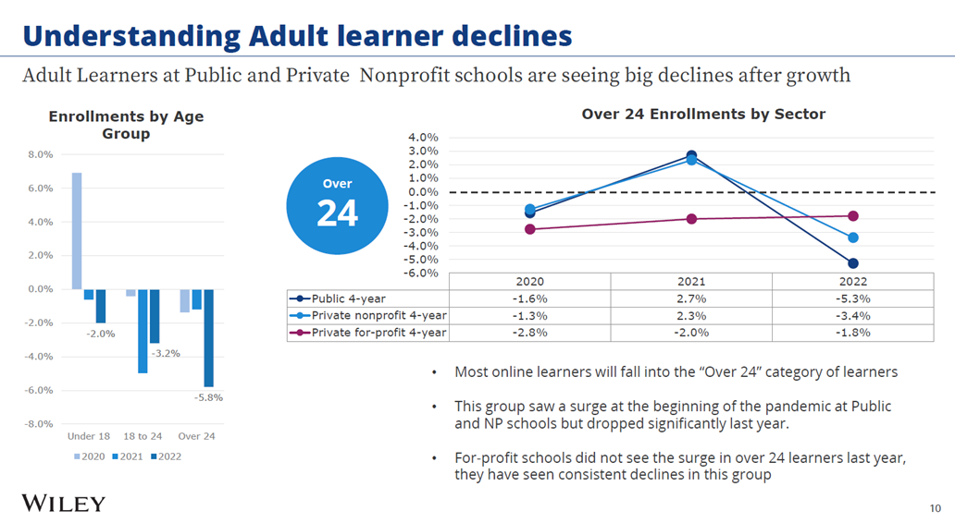
Adult learner decline is steep
Overall, adult learner enrollment at public universities was down 1.6% in 2020 and 5.3% in 2022.

Slide 17
Business Downturn – Invest in Business to Rebound
Examples of Improvements and Enhancements
Investments to quickly take advantage of rebound.
Built a best-in-class marketing team and improved operations and efficiencies.
Invested in improving our marketing research capabilities.
Focusing on the Purdue brand and the value of a Purdue degree.
40+ new hires that work remotely by hiring away from other university online programs.
With just 11% of our Fall 2022 cohort coming from Purdue Alumni, we are launching an awareness campaign for alumni and undergraduates.
We have joined together with Purdue for Life and Krannert in the Pan Purdue Salesforce project.
Developed a new lead communication strategy
Initial open rates are – 53.25% vs. the industry average of 28.5%!
New onboarding course for all online graduate students will be available by Summer 2023.
We are implementing a comprehensive plan supporting learners and programs for best-in-class experience.

Slide 18
Business Downturn – Invest in Business to Rebound
Created an IMPACT-like program to assist faculty in creating best-in-class online courses.
Created a new program to assist colleges in hiring continuing lecturers dedicated to growing and supporting online programs.
Piloting new student-facing technologies and processes
Artificial Intelligence (AI) ChatBot for real-time text experience
Motimatic motivational science approach to “unstick” inactive leads
Transcript request service to reduce “friction” for prospective learners
Restructured Student Experience team
Acquired talent and added a group focused on process improvement, talent development, and training; focus on Success Coaches.
With just 11% of our Fall 2022 cohort coming from Purdue Alumni, we are launching an awareness campaign for alumni and undergraduates.

Slide 19
Unit Risks & Opportunities
Risks
Systemic
Challenging National Enrollment Trends
Increased Market Competition
Risks to Growth
Faculty Capacity Limitations
Uneven Participation Across Colleges
Large Market Programs Have Been Tapped
OIP Overrepresentation of Purdue Global
Opportunities
Online Growth Opportunities w/Purdue Initiatives and Associated New Faculty Hires
Purdue Computes
School of Business
Purdue Indianapolis (including hybrid programs)
International Partnerships
3rd Party Partnerships

Slide 20
GOAL
$200,000,000
3X Gross Revenue by 2026
Increase to 30% ROI for the colleges

Slide 22
3X Growth Observations
Existing model of creating new programs is too restrictive/slow.
A disruptive action plan is needed if we target aggressive future growth. Specifically, PUO will need to evolve from an internal ‘OPM-like’ model to an agile academic/business unit that not only supports the College’s ideas, but also independently captures opportunities. Potential actions include hiring clinical faculty, SMEs, joint hiring of T/TT faculty with Colleges, etc.
The magnitude of the desired growth will require future investments in new technologies, innovative pedagogy, and staff/faculty.
We face headwinds. We need to strengthen our partnerships.
We already have wins in international programs (Taiwan, Egypt, India etc.) and industry (e.g., Cummins). However, growing them to the level needed now will require significant help from OIP. OIP will need to be fully on board.

Slide 23
Expand Existing Efforts to Reach 3X Revenue Growth
Work closely with all Colleges to identify top growth MS opportunities. Collaborate with the Provost and Deans to ensure these become strategic growth priorities.
Examples: Computer Science, AI, Cyber-security, Semiconductors, Systems Engineering, etc.
Identify and grow new international partnerships (like NCKU, EUI).
Expand programs with DoD (domestic and international).
Significantly increase workforce development programs by increasing proposal submission to funding agencies.
Expand the non-credit group in PUO to lead the evaluation of OIP-generated industry-based online opportunities.
Continue to improve PUO processes to increase ROI

Slide 24
Investigating Possible New Efforts
Aggressively grow non-credit efforts that cover high-school students, the general public, working professionals, and executives.
Examples: hybrid K-12 camps, ‘The future of X’ lecture series, micro-credentials, executive training, sector-based offering, such as Industry 4.0 for Manufacturing, Digital Transformation (AI, Data, IoT, cloud, VR and AR).
‘Tools’ that may be required: clinical faculty, SMEs
Focus on new domestic and international B2B partnerships with industry and PG.
Create new high-demand undergraduate programs that will be delivered through PG.
Intensify efforts on quality, innovation and efficiency; Use these to improve the quality and substantially accelerate the development of new programs
Examples: Personalized learning, AI-based education, Nanohub, virtual labs, etc.
Identify and grow certifications
Examples: Create mass appeal certifications, such as Scrum, Agile, Aerospace Engineering
Partner with colleges for research dissemination, engagement, broader impacts, and workforce development grants

Slide 25
Questions

