Slide 1
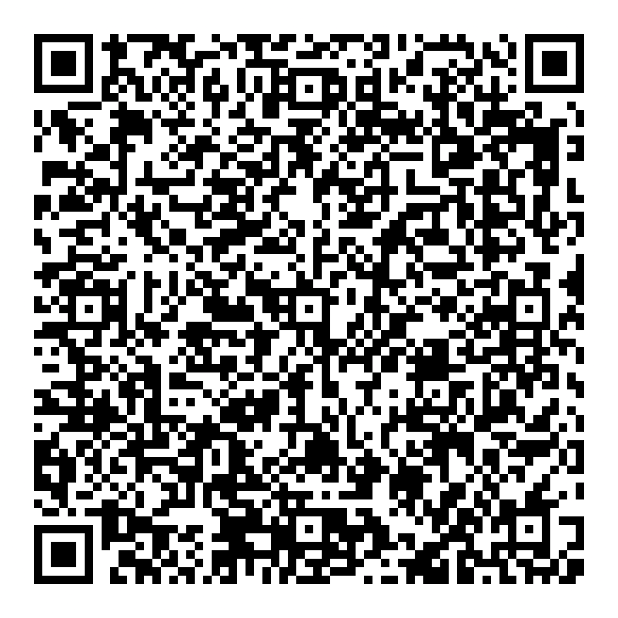
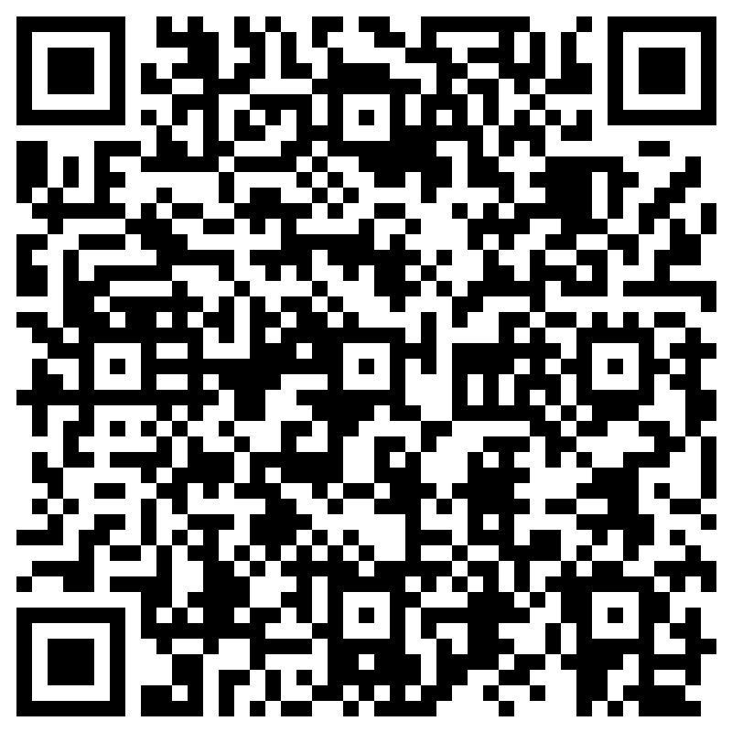
Purdue Indianapolis Strategy
9/14/26
PJ Wolfe, University Senate
Feedback & Questions
Coffee Hour Chats

Slide 2
Purdue’s long-term presence in Indianapolis
AUG. 12, 2022
AUG. 19, 2024
AUG. 25, 2025
IU and Purdue announce plans for Purdue and IU Indianapolis
First day of classes, with 760 new beginners
Purdue opens its newest student hub on Indiana Avenue
1969
JUN. 14, 2023
APR. 3, 2025
AUG. 24, 2026
IU and Purdue programs merge to form IUPUI
Purdue Trustees finalize arrangements
Purdue breaks ground on its first new building in Indianapolis
Purdue welcomes its third class of new beginners to Indianapolis
FROM A JOINT VENTURE TO PURDUE’S FIRST COMPREHENSIVE CITY PRESENCE

Slide 3
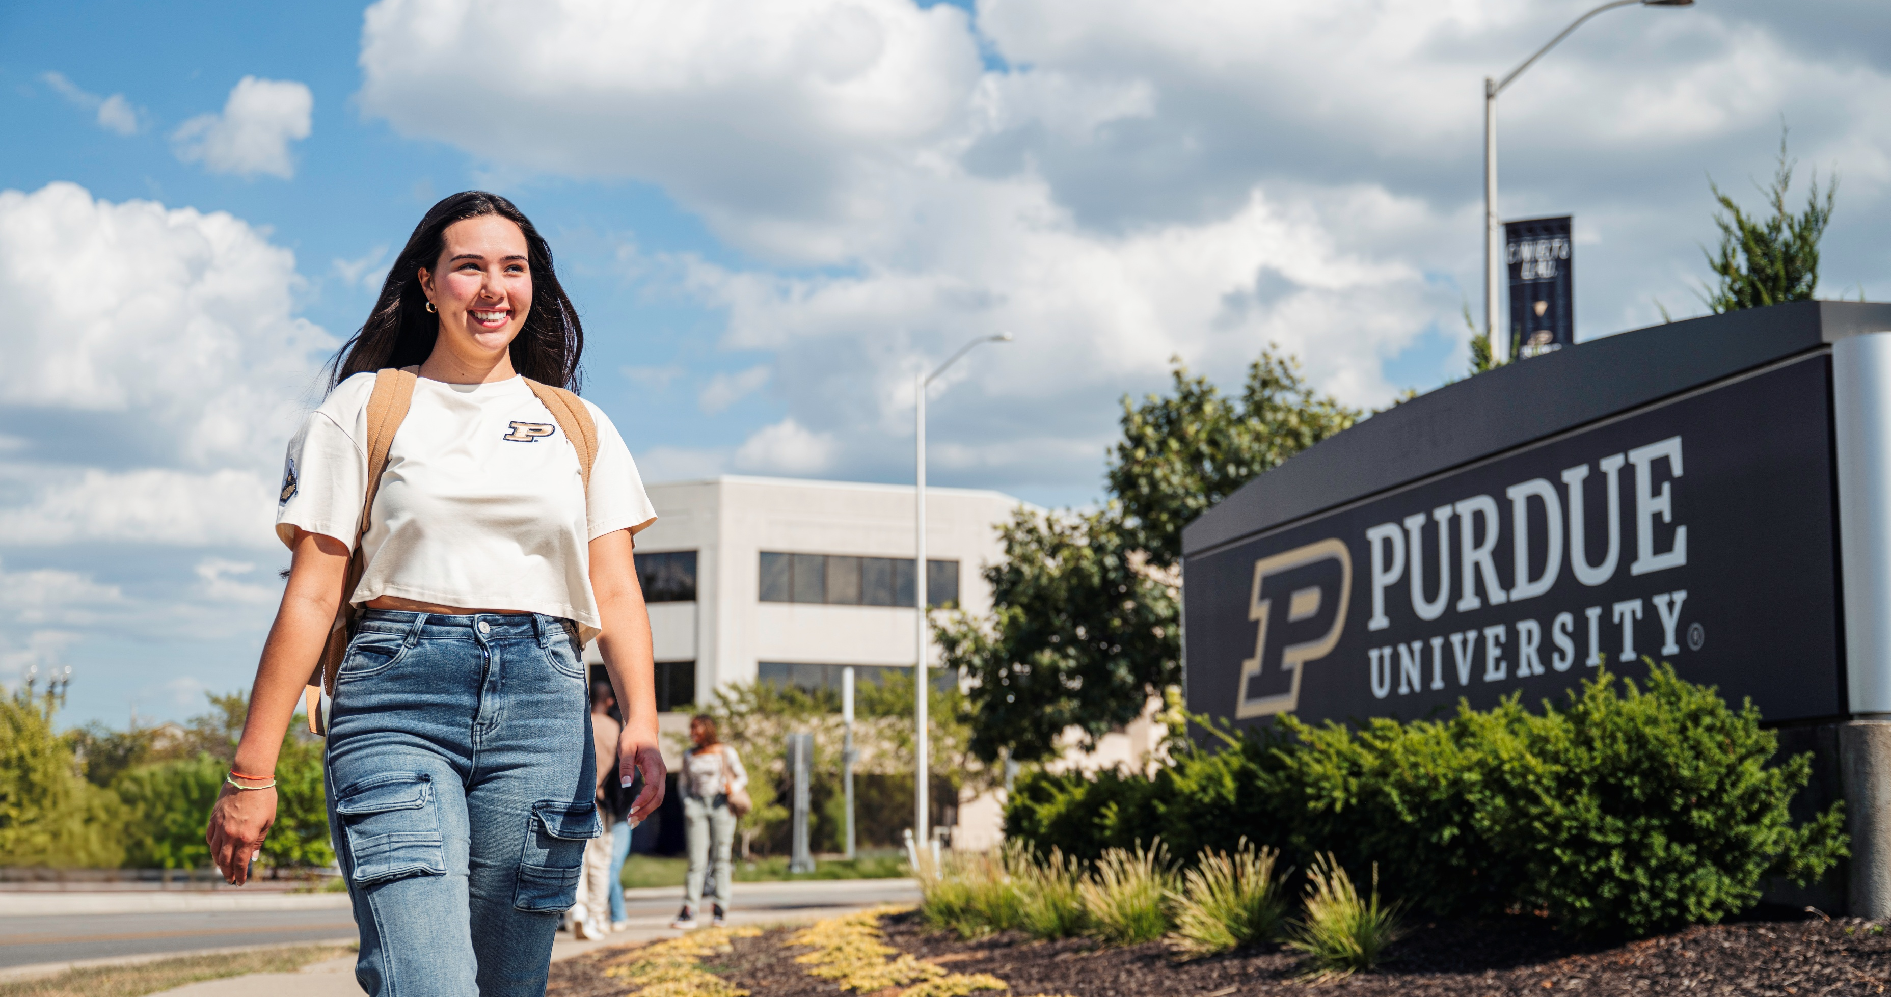
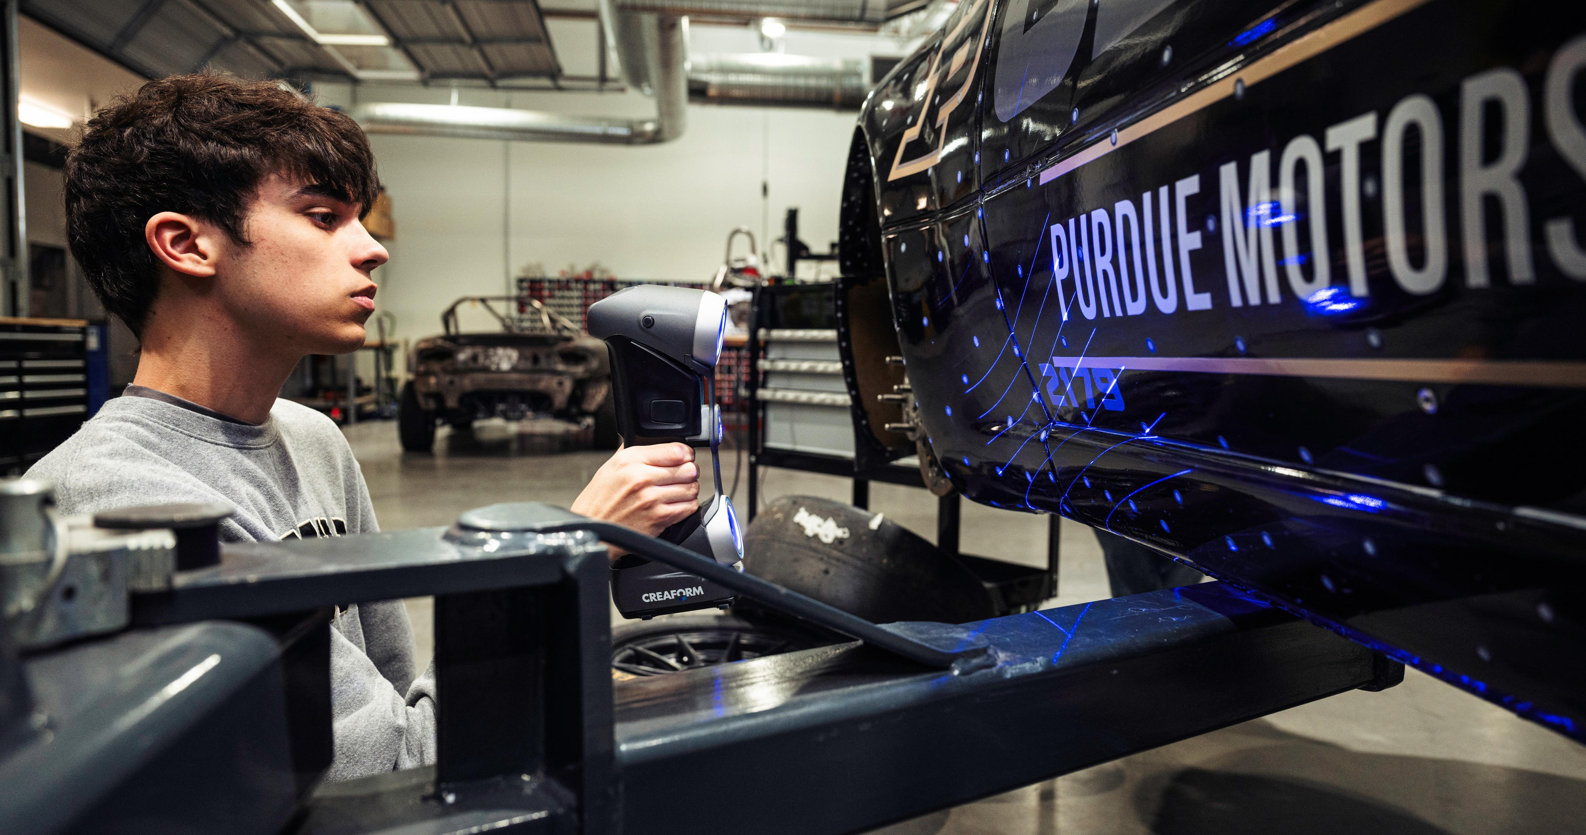
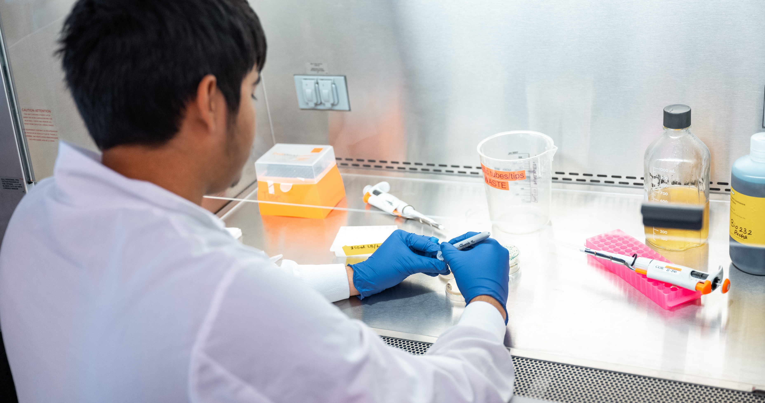
Indianapolis strategy – three planks
Bring Purdue’s core STEM strengths to Indianapolis
Grow distinctive programs across Engineering, Science & Business
Serve Indiana’s employers and students
Grow in alignment with Indiana’s workforce needs and regional industry foci
Build significant health-related strengths over time
Grow pre-med, pre-health, pre-vet & build research infrastructure

Slide 4
Steps underway to achieve
Student experience & distinctive sense of place
Invest in academics, student support & community
Expand housing, student activities & opportunities
Build on rigorous, career-connected Indianapolis identity
Industry and community connections
Expand employer and community partnerships
Connect students to careers through applied learning
Use industry insight to guide programs and curriculum
Academic programs and student pathways
Grow distinctive, Indianapolis-based programs
Expand employer-informed student pathways
Increase mobility between Indy ⟷ WL
Health and life sciences opportunity
Build on Purdue’s STEM + One Health strengths
Expand pre-medicine and health-focused pathways
Deepen healthcare, research & clinical partnerships

Slide 5
Ways for you to engage
Share feedback through the upcoming faculty growth & engagement survey
Engage through University Senate representatives & Senate governance channels
Discuss opportunities and needs with your department heads, deans & David Umulis (SVP Indy)
Participate in upcoming open forums & question-and-answer opportunities
Purdue Indianapolis Senators
Coffee Hour Chats
Feedback & Questions
Euzeli Cipriano Dos Santos edossant@purdue.edu Associate Professor ECE
Chris Rogers rogerscb@purdue.edu Assistant Dean PPI

Slide 6
Thank you

