Slide 1
REMARKS OF THE SENATE CHAIR

Slide 2
Disclaimer
The following remarks are my opinion, and do not represent the views of Purdue University or the Purdue University Senate.

Slide 3

Recent Request of Purdue

Slide 4
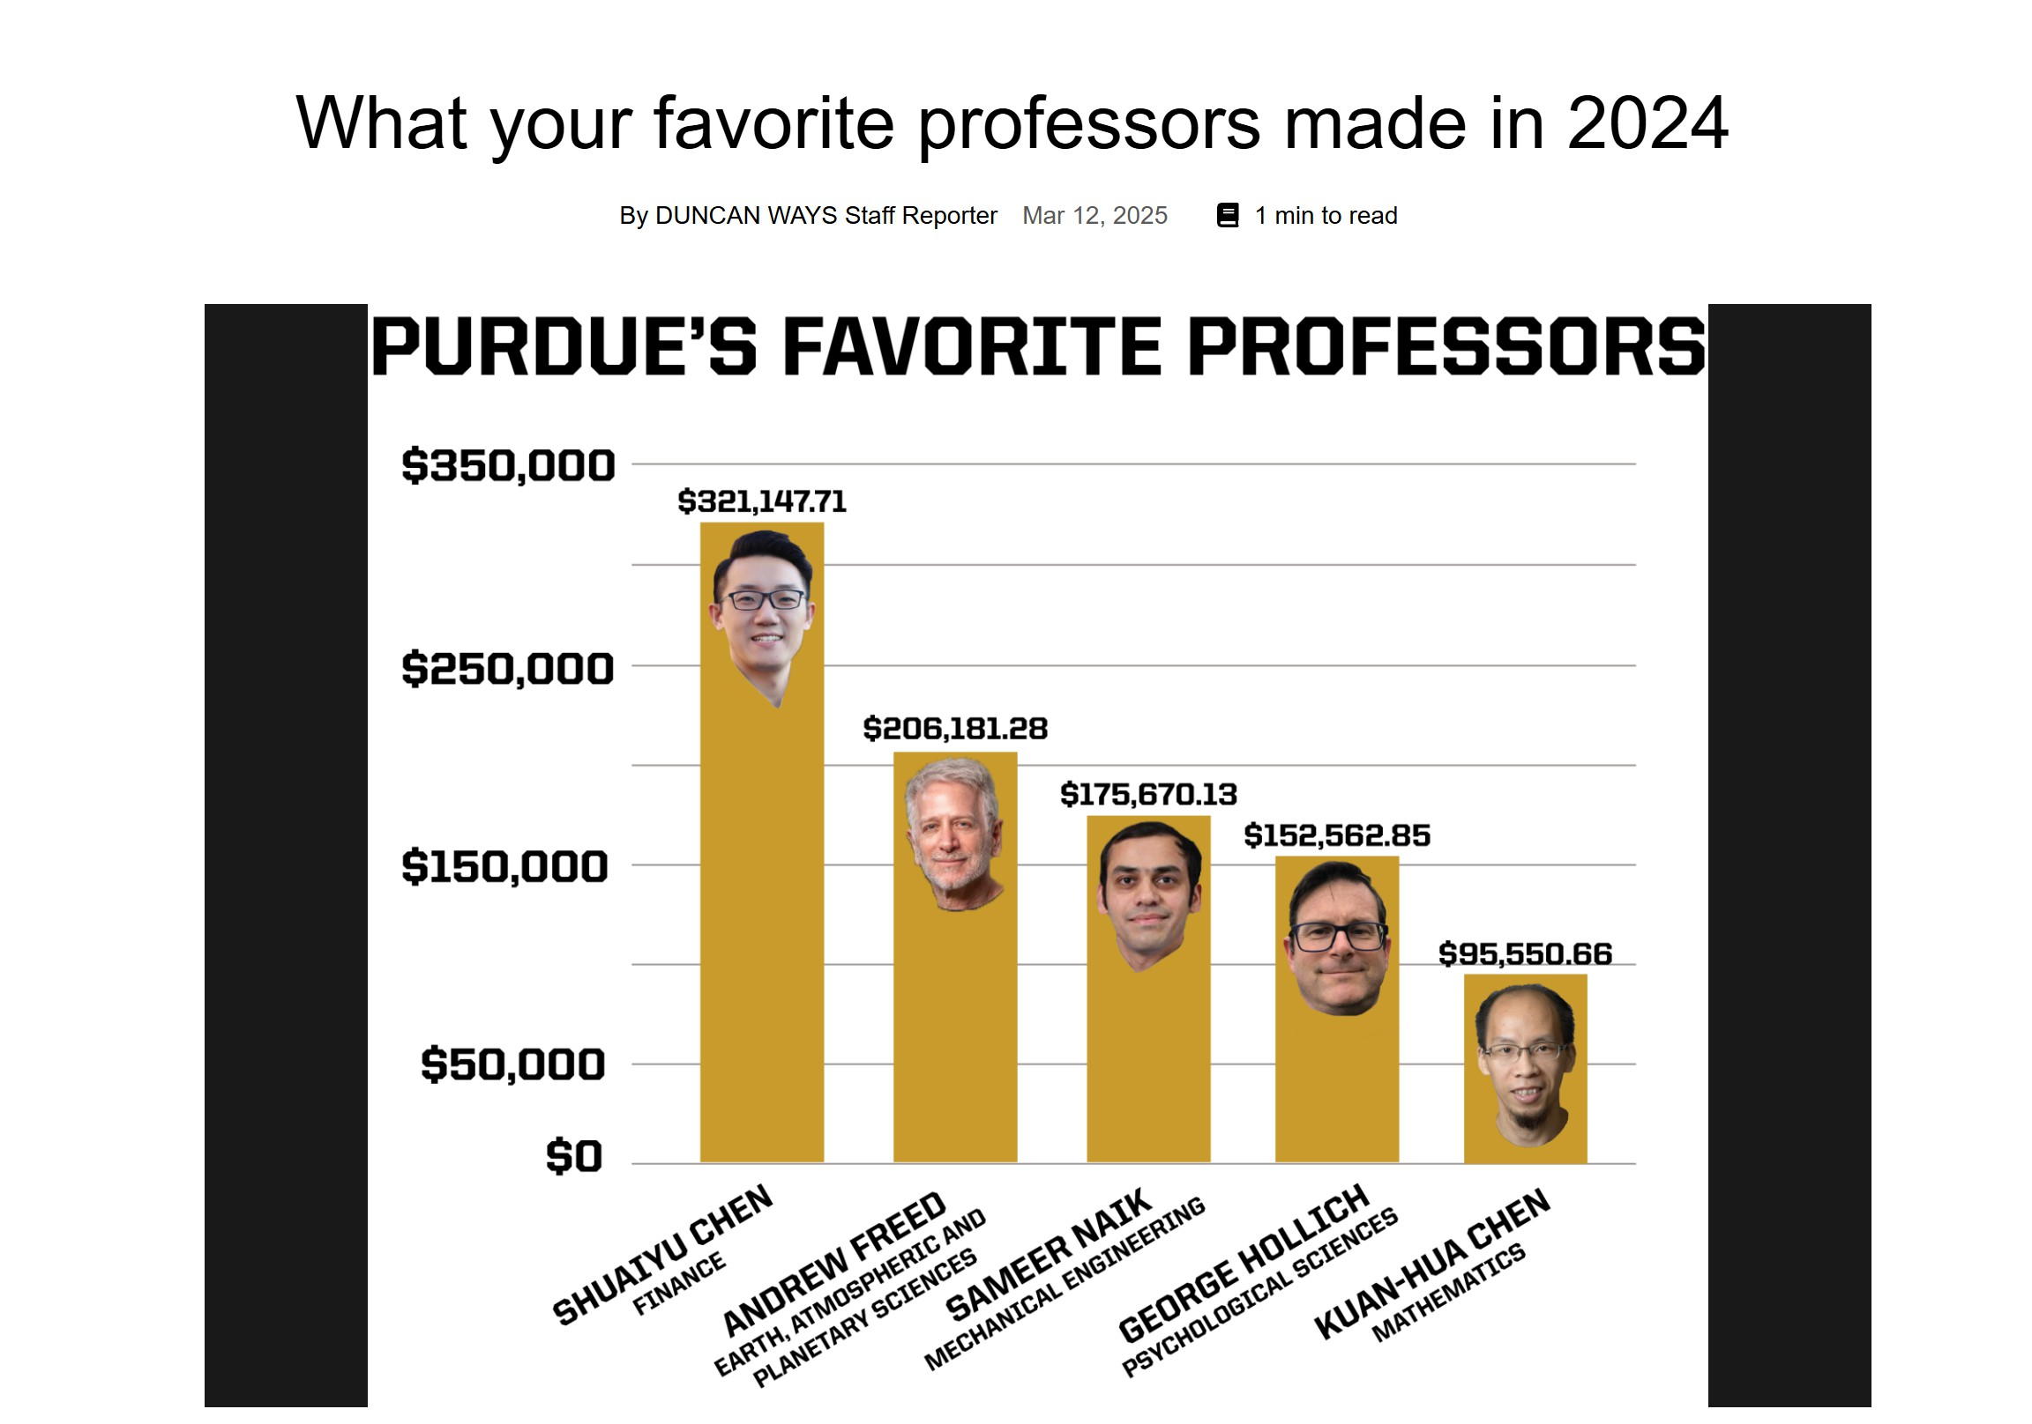
Appreciation for Teaching Prowess
Rewarding effective teaching reinforces the core mission of colleges: providing quality education that drives student success.

Slide 5

Gender Equity for Salaries
If we incentivize excellent teaching, then we must find a way to reduce bias in student evaluations.

Slide 6
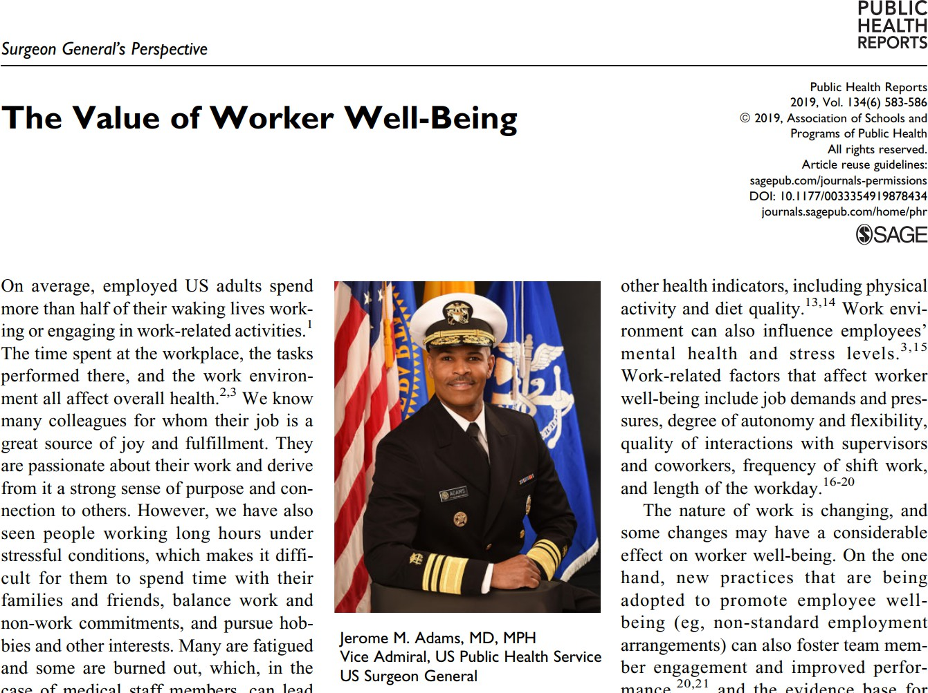
Worker Productivity and Feeling Valued
“Healthy and happy employees have a better quality of life, a lower risk of disease and injury, increased work productivity, and a greater likelihood of contributing to their communities than employees with poorer well-being…. Work environment can also influence employees’ mental health and stress levels.
“Strategies [to improve worker wellbeing] include the provision of adequate paid leave; support for workers returning to work after injury; good management of disabilities; opportunities for higher wages; greater autonomy, flexibility, and control over job tasks; improvements to the organization of work and to the way jobs are structured; improvements to the physical work environment; and access to health care coverage.”

Slide 7
THANK YOU!
senate-chair@purdue.edu

