Slide 1

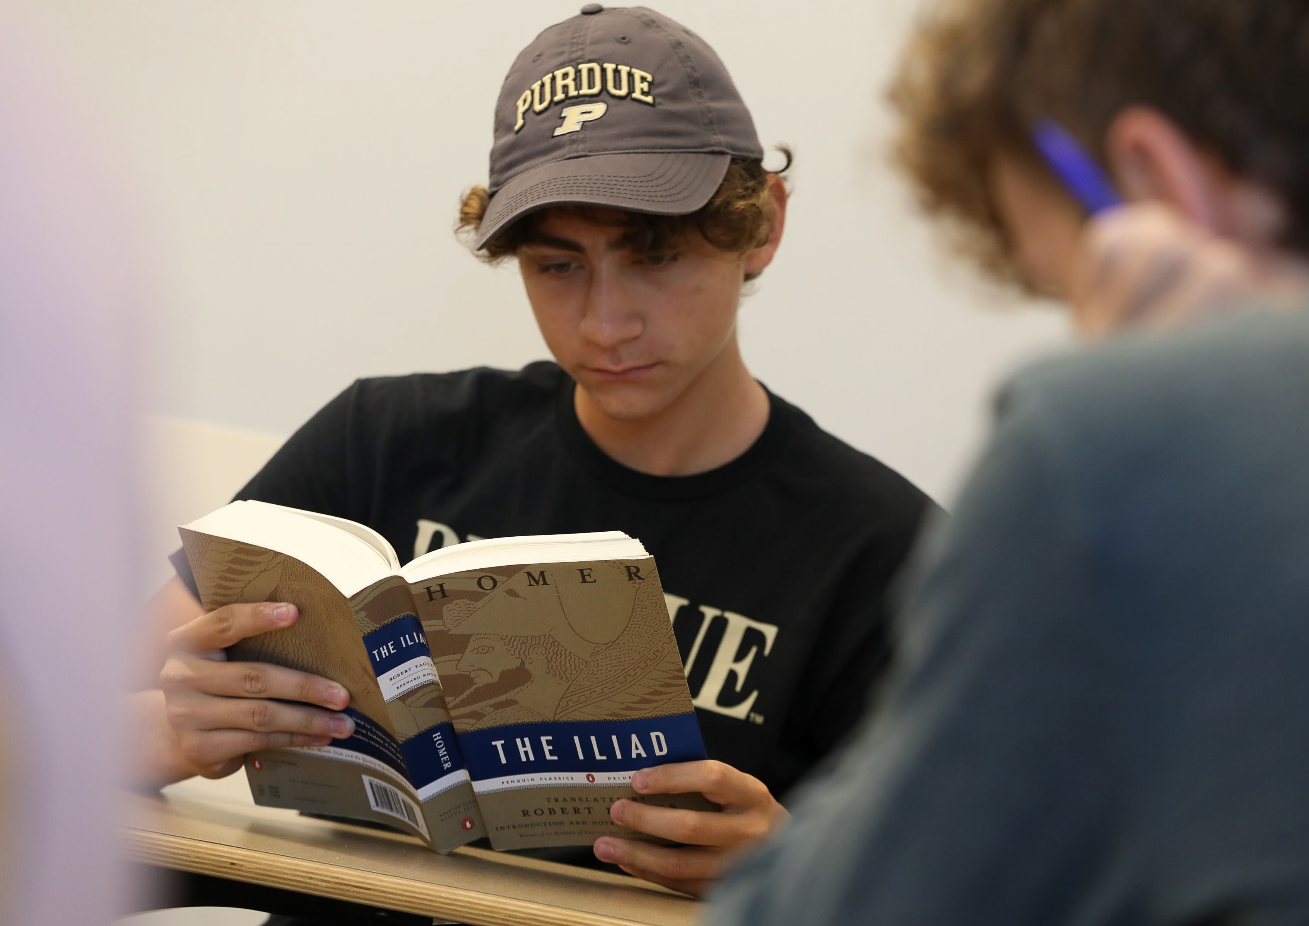
Cornerstone Integrated Liberal Arts
Melinda S. Zook,
Director, and Germaine Seelye Oesterle Professor of History
30 October 2025

Slide 2
Enrollments in “Transformative Texts” by Academic Year
2017-2025
12000
10170
10000
7830
8000
7212
6943
6000
4197
4000
3498
1956
2000
154
0
AY 17/18
AY 18/19
AY 19/20
AY 20/21
AY 21/22
AY 22/23
AY 23/24
AY 24/25

Slide 3
New Students by College, West Lafayette and Indianapolis, 2025
College of Education
139
College of Veterinary Medicine
164
College of Pharmacy
230
College of Liberal Arts
414
College of Agriculture
519
Exploratory Studies
644
College of Health and Human Sciences
916
Daniels School of Business
925
Polytechnic Institute
1,060
College of Science
1,755
College of Engineering
3,211
0
500
1,000
1,500
2,000
2,500
3,000
3,500

Slide 4
First-Year Students this Fall
Transformative Texts in West Lafayette
We are currently teaching 4,080 students this fall (1,649 are First-Year Engineering).
Transformative Texts in Indianapolis
Serving our Indianapolis campus, currently teaching 510 first-year students
Transformative Texts: Daniels Business School
Teaching first-year Business students the fundamentals of Political Economy, currently teaching 750 students this fall.
Total number of students in Transformative Texts this fall = 5,340

Slide 5
Transformative Texts I & II
First-year students enroll in two foundational courses in the College of Liberal Arts:
Transformative Texts (SCLA 101).
Critical Thinking and Communication I, from Antiquity to Modernity.
Fulfills the Written Communication and Information Literacy requirements of the University Core.
Transformative Texts (SCLA 102).
Critical Thinking and Communication II, Modern World.
Fulfills the Oral Communication requirement of the University Core.

Slide 6
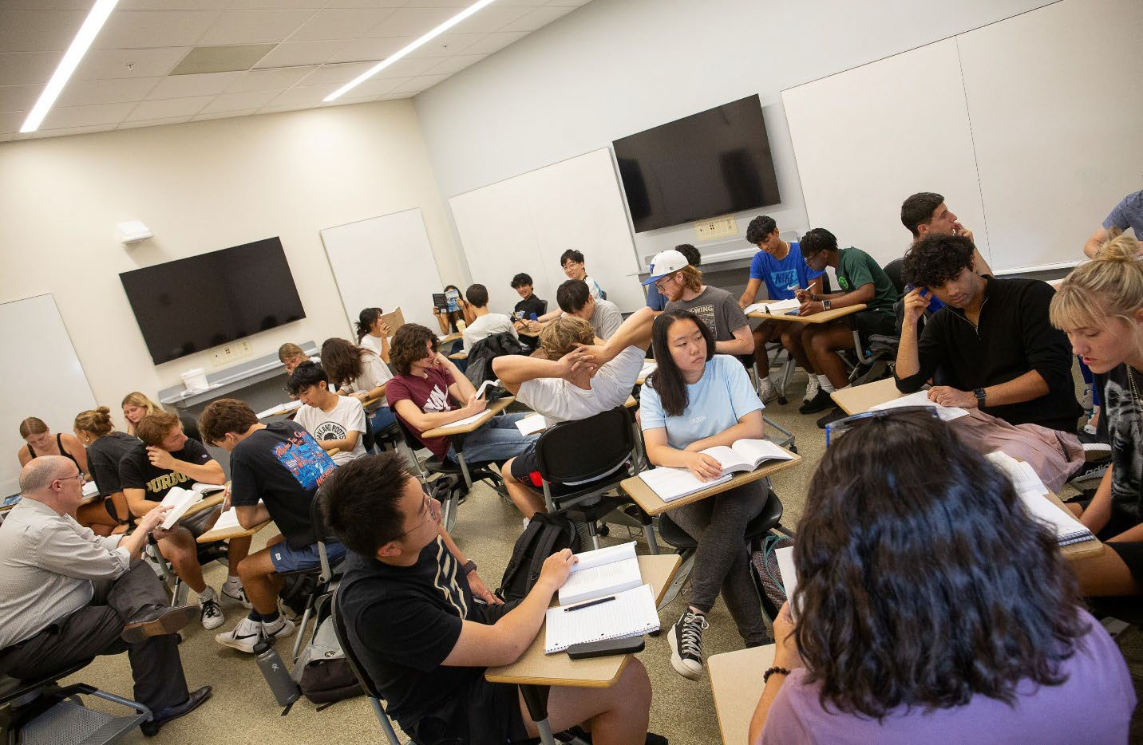
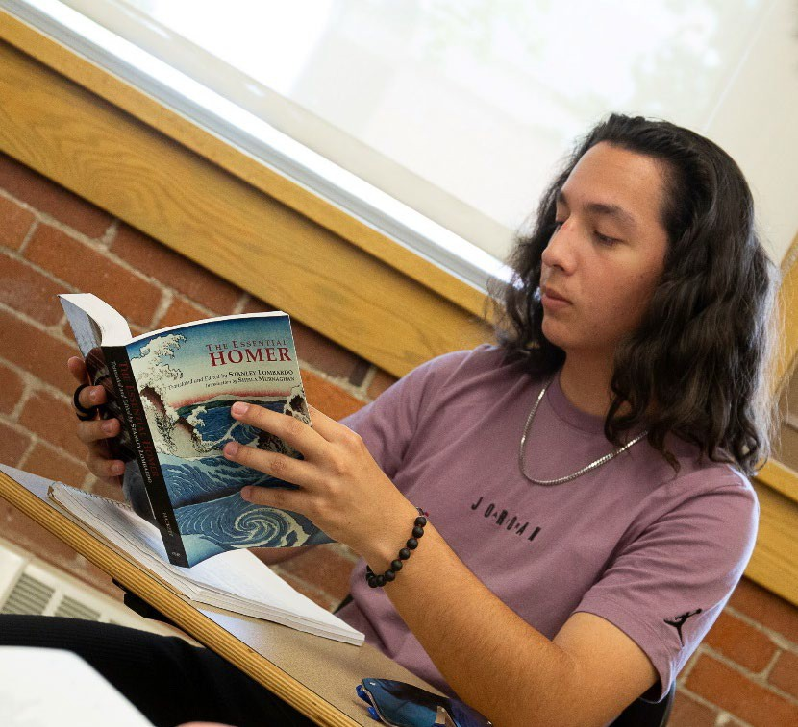
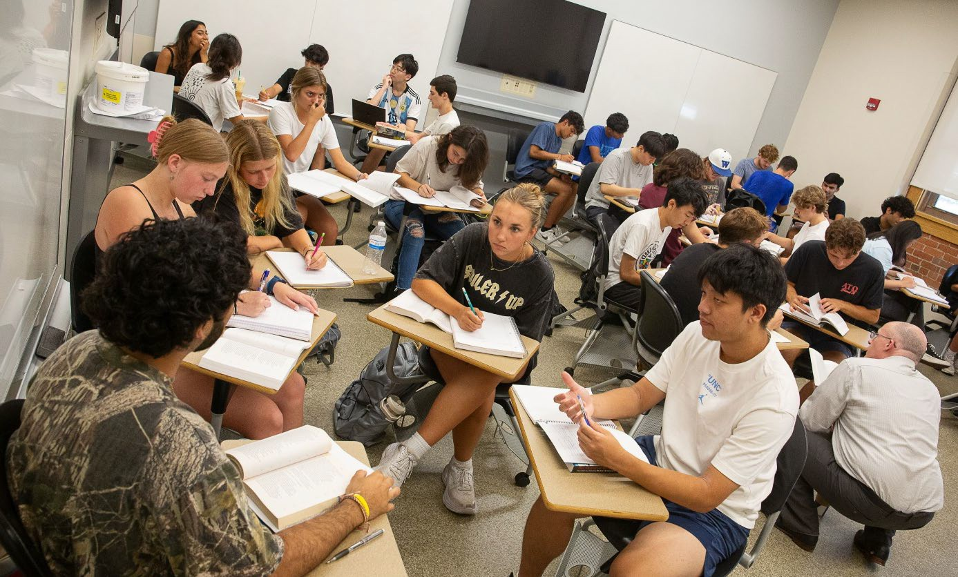
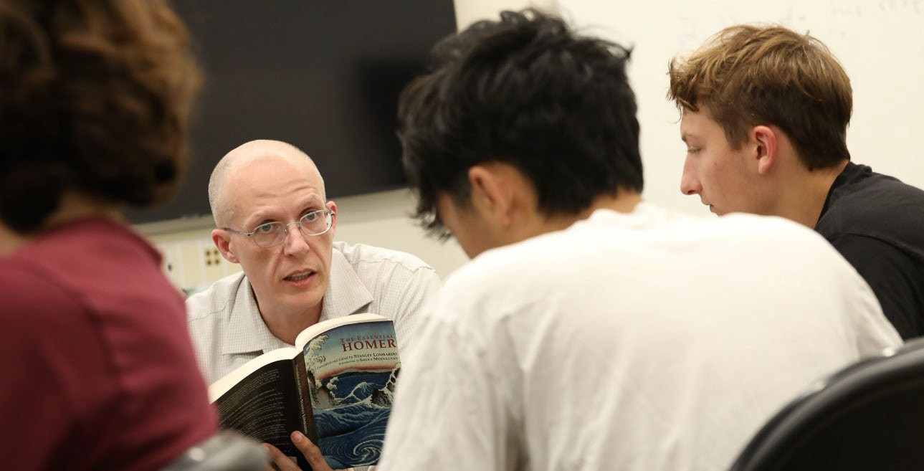
All Active Learning.
Professor David Riesbeck’s class reads Homer’s Iliad, and breaks into small groups.

Slide 7
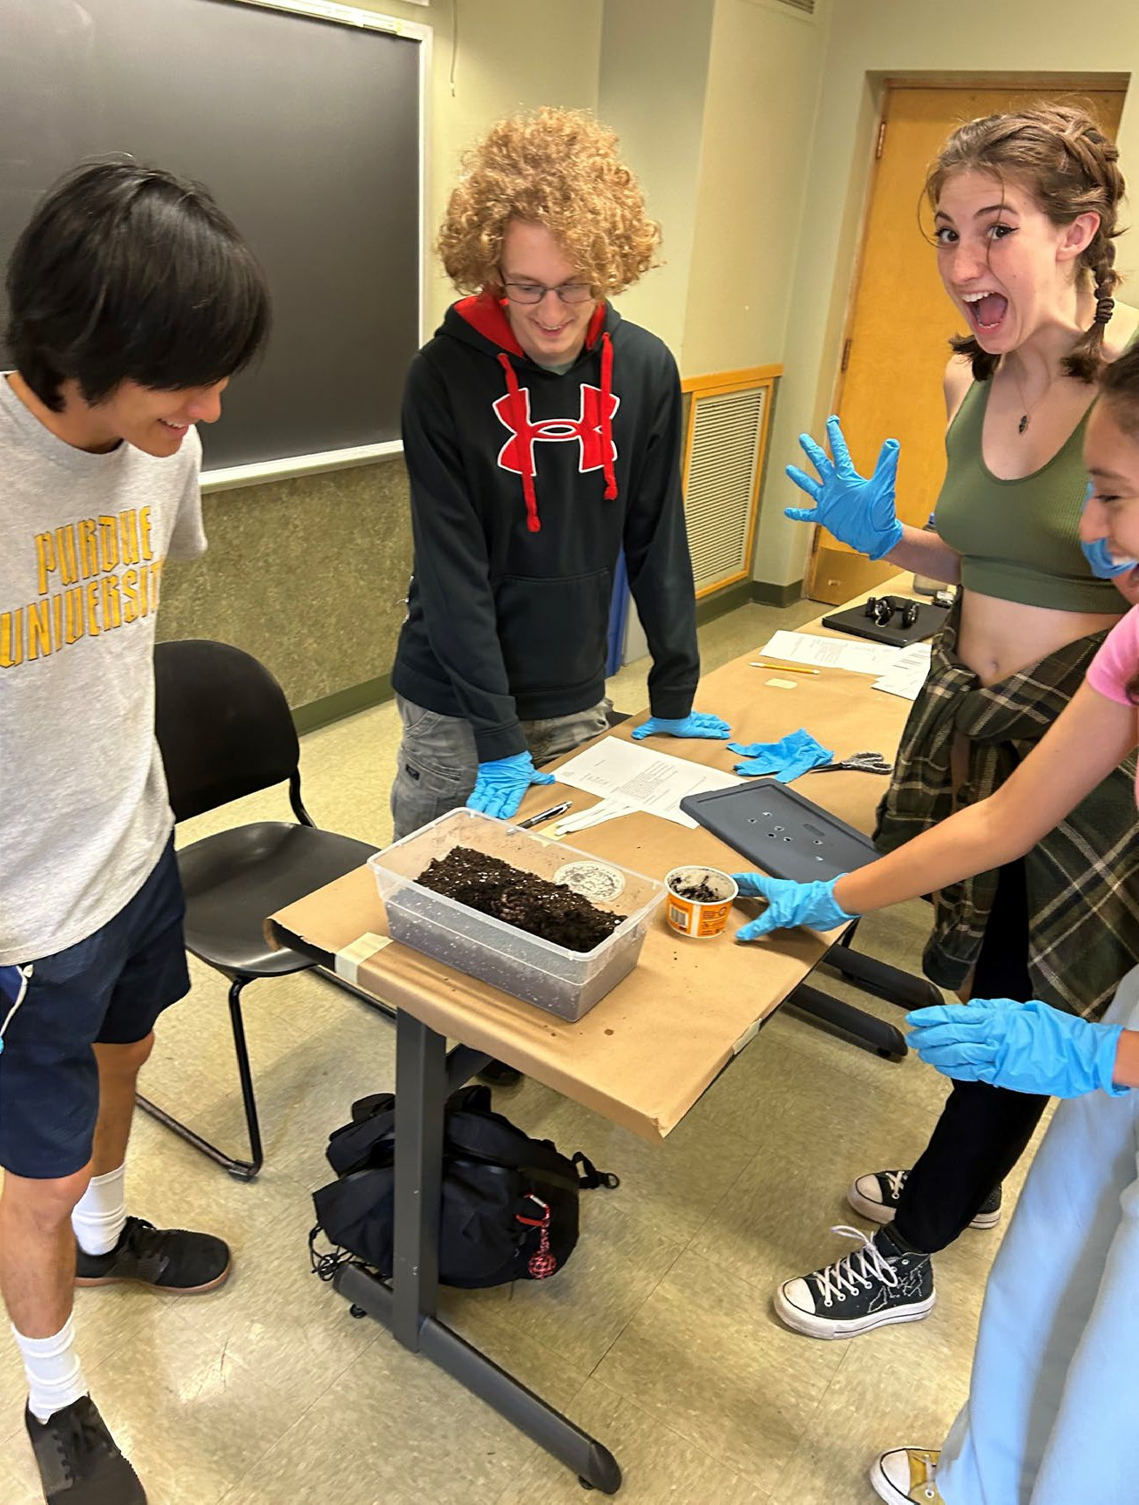
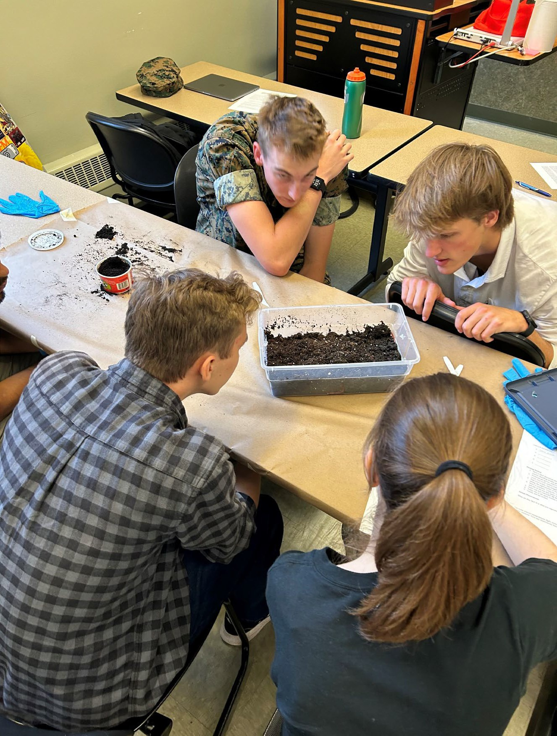
Experiential Learning: Darwin & Worms
Sometimes the worms are very quiet

Slide 8
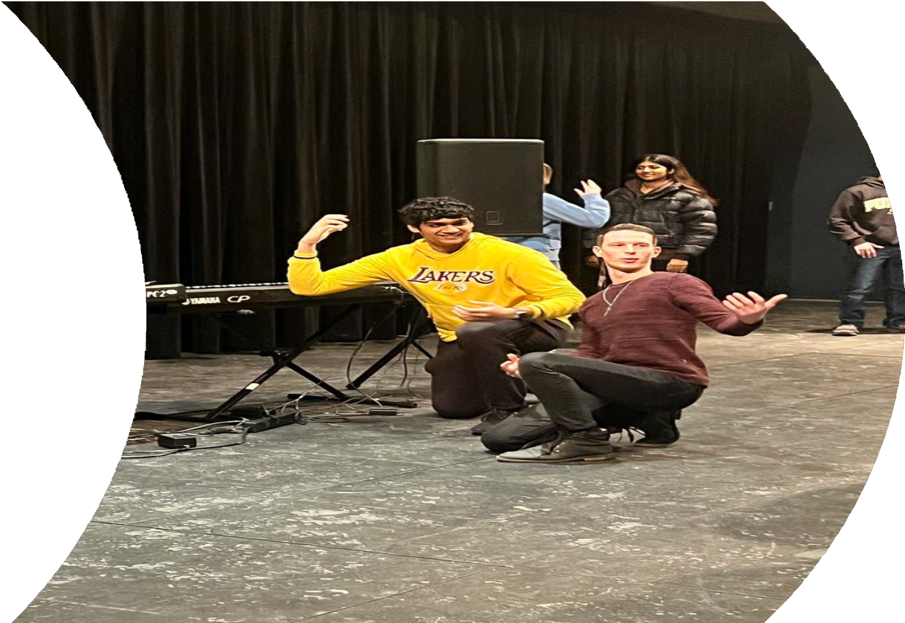
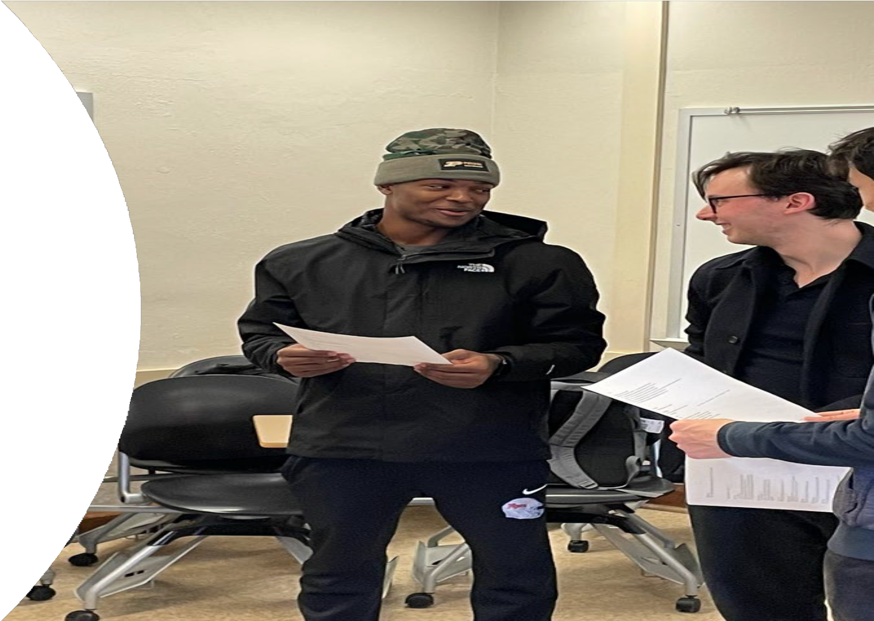
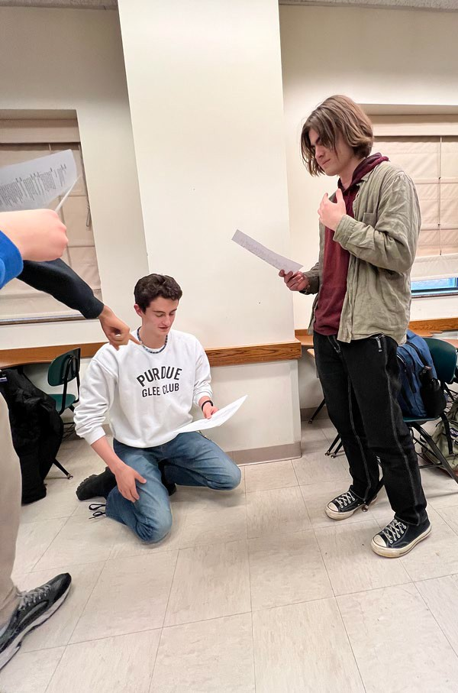
Reading & performing Hamlet with “Actors of the London Stage”

Slide 9
Some Special Topics in Transformative Texts this Fall:
Artificial Intelligence in the Loop: Humans in Charge Wealth, Society, and the Future
The Good Society
The Quest: Physical, Mental, and Spiritual Human versus Non-Human
Health, Disease, and Medicine
Utopian and Dystopian Narratives of Technology across Media Science, Society, and Imagination
Technology’s Help and Hindrance to Humankind’s Growth

Slide 10
The Cornerstone Integrated Liberal Arts Certificate
Students take three more Liberal Arts courses in a theme:
Science and Technology Environment and Sustainability Healthcare and Medicine Business and Management Democracy and Citizenship

Slide 11
The Growth of STEM & Business Double Majors in the Liberal Arts
700
611
624
600
552
500
474
Cornerstone
launched
400
368
300
249
200
102
112
100
0
2017
2018
2019
2020
2021
2022
2023
2024

Slide 12
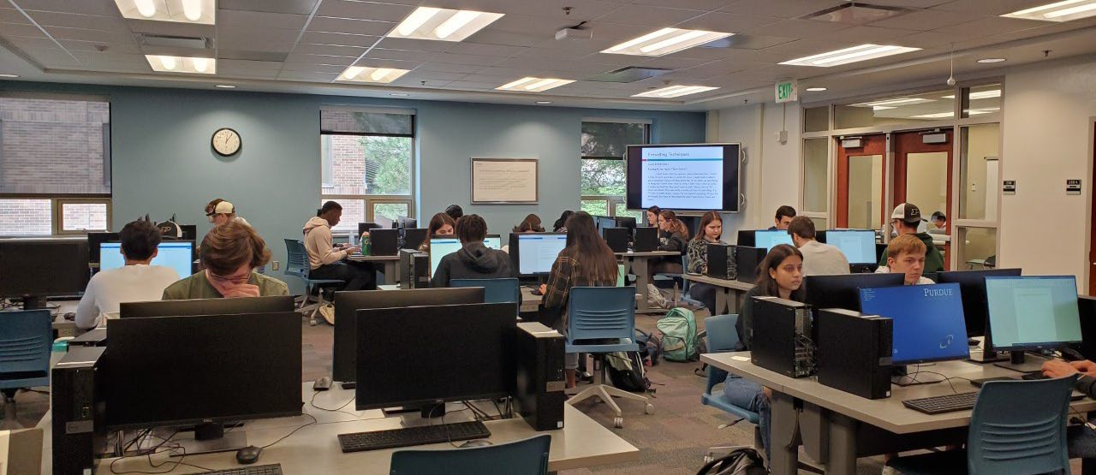
Adapting to AI: Learning AI Literacy & Ethics

Slide 13
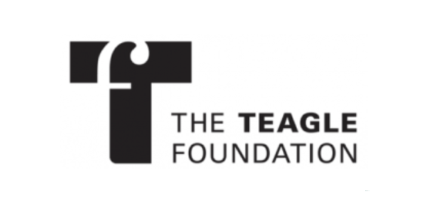
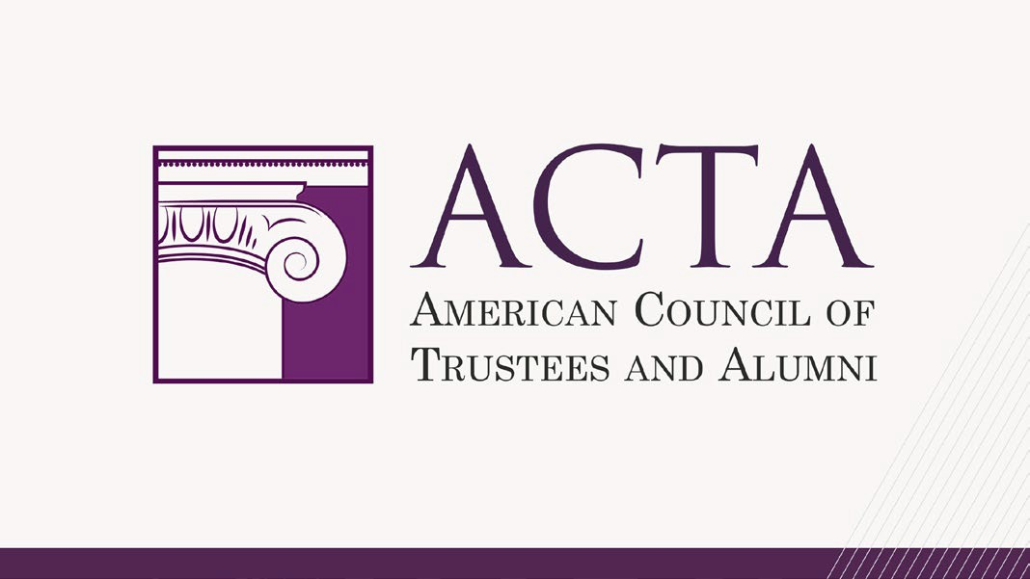
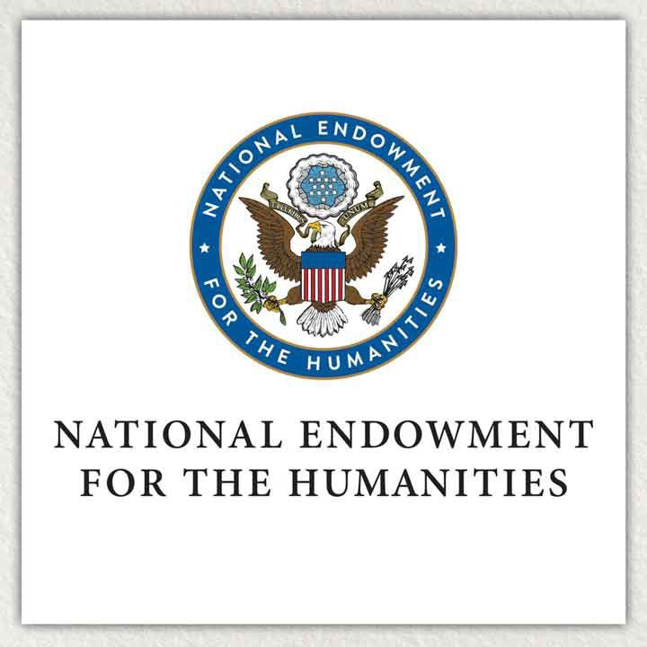


Sponsor logos

Slide 14
Universities and Colleges Implementing Cornerstone
American University, DC
Anne Arundel Community College, MD Augustana College, IL
Austin Community College, TX Bard College, NY
California State Polytechnic University, CA Catawba College, NC
Catholic University of America, DC Clark Atlanta University, GA Clemson University, SC
Colorado State University, CO Cooper Union for Science and Art, NY
CSU Maritime Academy, CA CUNY Baruch, NY Dillard University, LA Drexel University, PA
East Carolina University, NC Emory University, GA Fort Lewis College, CO
Georgetown University, DC Houston Community College, TX Howard University, DC
Indiana University of Pennsylvania, PA Lehman College, NY
Linn-Benton Community College, OR Lyon College, AK
Marshall University, WV Mercer County Community College, NJ
Norfolk State University, VA North Carolina State University, NC Northern Kentucky University, KY
Pennsylvania State University system, PA Pepperdine, CA
Rhodes College, TN Rochester Institute of Technology, NY
Rose State, OK
Saint Louis University, NC Seminole State, OK Sonoma State, CA Stanford University, CA SUNY Cortland, NY
SUNY Erie Community College, NY SUNY Onondaga Community College, NY Tennessee Board of Regents system, TN Texas A&M University system, TX Thomas Jefferson University, PA Transylvania University, KY
Trinity Washington University, DC
Tulsa Community College, OK Tuskegee University, AL
UC Santa Cruz, CA UConn, CT
University of Georgia, GA University of Massachusetts Amherst, MO
University of Michigan Flint, MI University of Montana, MT University of Nevada, Las Vegas, NV University of Nevada-Reno, NV University of North Dakota, ND University of Notre Dame, IN University of Puerto Rico, PR
University of Wisconsin Platteville, WI Ursinus College, PA
Ursuline College, OH Vanderbilt University, TN Victoria College, TX
Virginia Union University, VA
85 campuses in all

Slide 15
We teach the fundamentals of the learning process:
Reading: to read closely and critically with one’s full attention, valuing learning for its own sake.
Writing: to articulate one’s thoughts in an organized and clear manner that engages and values the reader.
Speaking: to speak with clarity and eloquence in a manner that engages and values the listener.
Listening: to listen with appreciation and curiosity to others and value their conversation.
Understanding: to appreciate the wisdom, feelings, and life experiences of others, seeking to learn from them.

Slide 16
And what else does Cornerstone do …
Student contests: two every semester based on essays, fiction, poetry, artwork, and videos in Transformative Texts (with cash awards).
Film screenings: two every semester, like Pride and Prejudice and Into the Wild,
modern adaptations of classic novels.
The Cornerstone Review and The Exchange: Literature, Art & Business. Two annual publications of student work.
Reading Allowed: Storytime with Cornerstone. Monthly story readings for students by our faculty in the Cornerstone Reading Room, HSSE Library.
Socrates Strategic Initiative. Cornerstone Award ($1000) for an Outstanding Student in Transformative Texts.
How I Teach this Text, collaborative faculty workshops several times a year on how to teach reading, writing, speaking, and listening.
Text & the City. A faculty book club, bringing Indianapolis and West Lafayette faculty together.

