Slide 1
REMARKS OF THE SENATE CHAIR

Slide 2
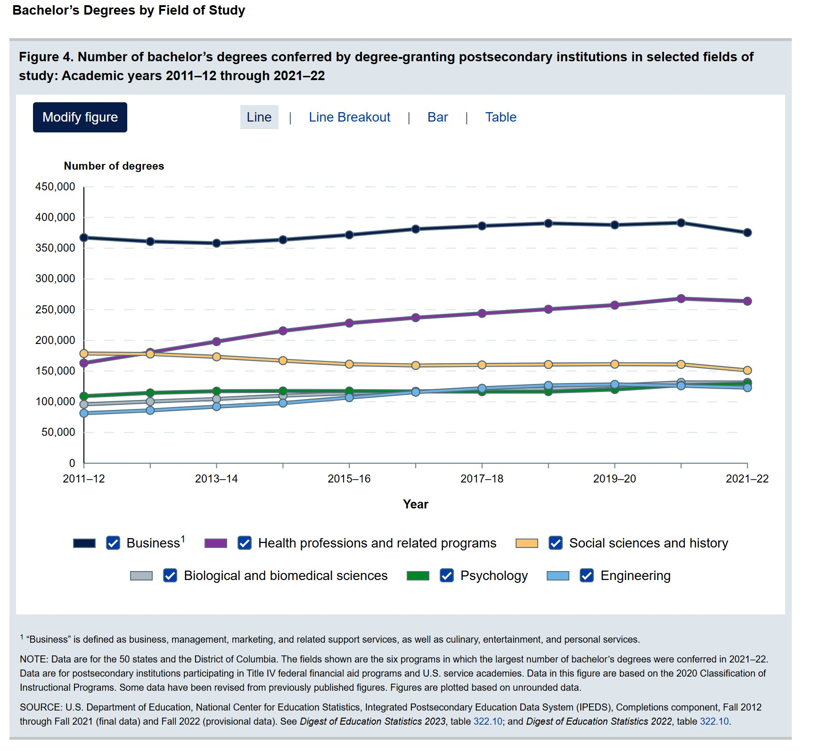
Most popular majors in higher education

Slide 3
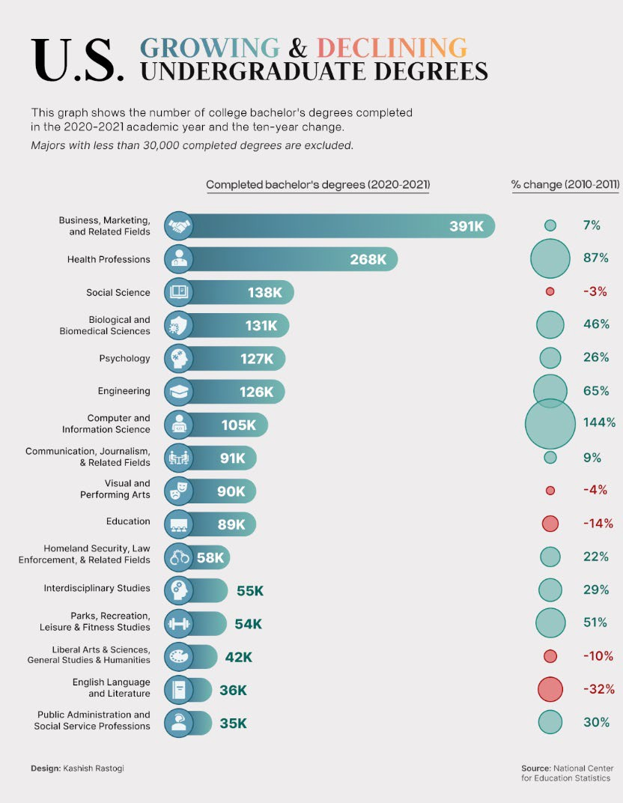
Growing and declining majors
Education

Slide 4
Death of Humanities—Greatly Exaggerated?
In 2023, first-year Berkeley students majoring in the arts and humanities — English, history, languages, philosophy and media studies — was up 121% over the previous year
University of Arizona: 76% increase in humanities majors since 2018
  "applied humanities“: a new, fast-growing department that includes programs in business administration, fashion studies, game studies and public health.
Virginia Tech: executive education program that imparts leadership skills to mid-career managers using humanities
Axios, 2023; Hechniger Report 2025
Value: critical thinking, communication, analysis of complex data and ideas
Axios, Feb 2023

Slide 5
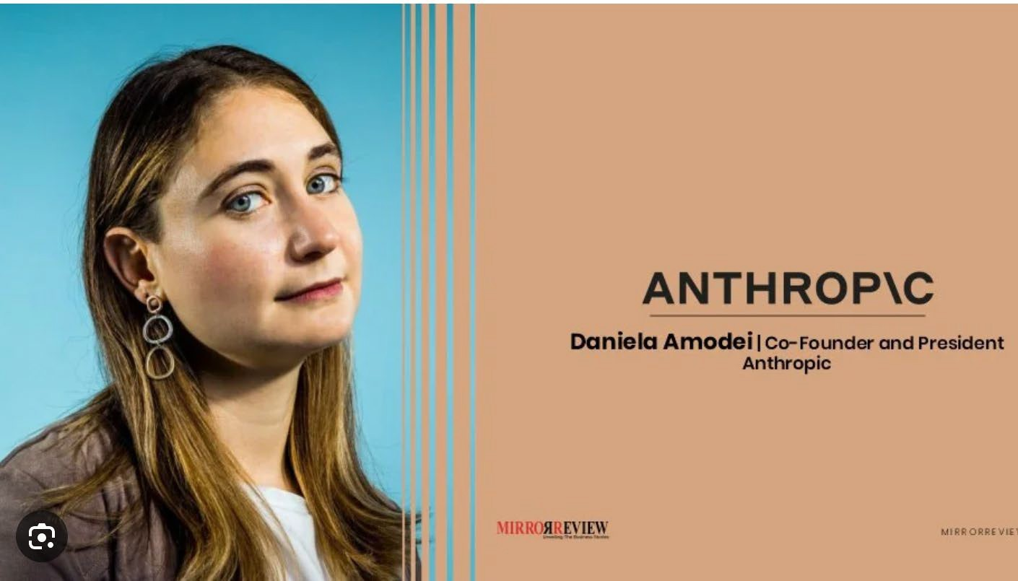
5

Slide 6
STEM and the Humanities: A False Dichotomy
“We should be careful not to let interdisciplinary jockeying make us cling to what we know best. Everything looks like a nail when you have a hammer, as the saying goes. Similarly, at how great a disadvantage might we put ourselves—and the world—if we force our minds to approach all problems the same way?”
  JM Olejarz

Slide 7
Finally, a request
Please stay for the report of the Ad-Hoc Committee:
  Purdue Global and Purdue University’s Online and Residential Graduate Programs Report

Slide 8
THANK YOU!
senate-chair@purdue.edu

