Slide 1
REMARKS OF THE SENATE CHAIR
21 April 2025

Slide 2
Disclaimer
The following remarks are my opinion, and do not represent the views of Purdue University or the Purdue University Senate.

Slide 3
Thank you
Immediate past Chair Bria n Leung
Vice Cha ir and incoming Cha ir Ma rk Zimpfer Secreta ry of Faculties Joe Camp
Sergeant of Arms Se’Andra Johns on
Senate committee chairs Vice Cha ir Ramirez

Slide 4
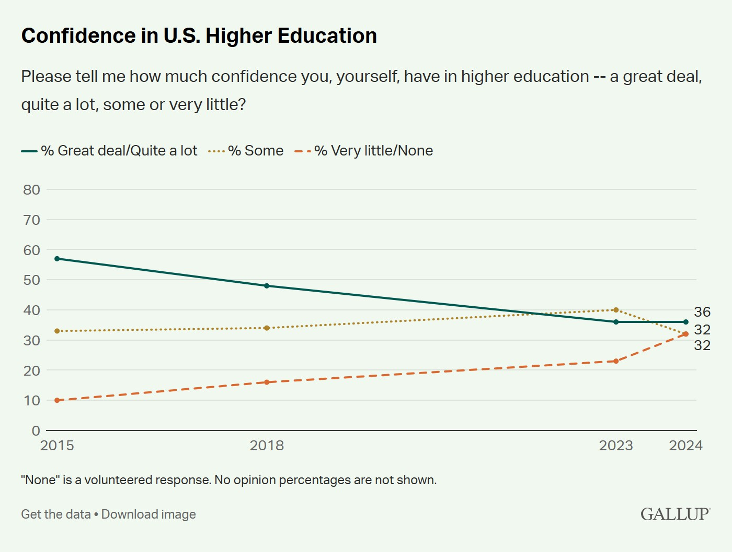
Final Thoughts in a Trouble Time
In 2015, nearly 60% of Am ericans expressed trust in colleges and universities, according to a Gallup poll. By 2024, that figu re had fallen to just one-third.

Slide 5
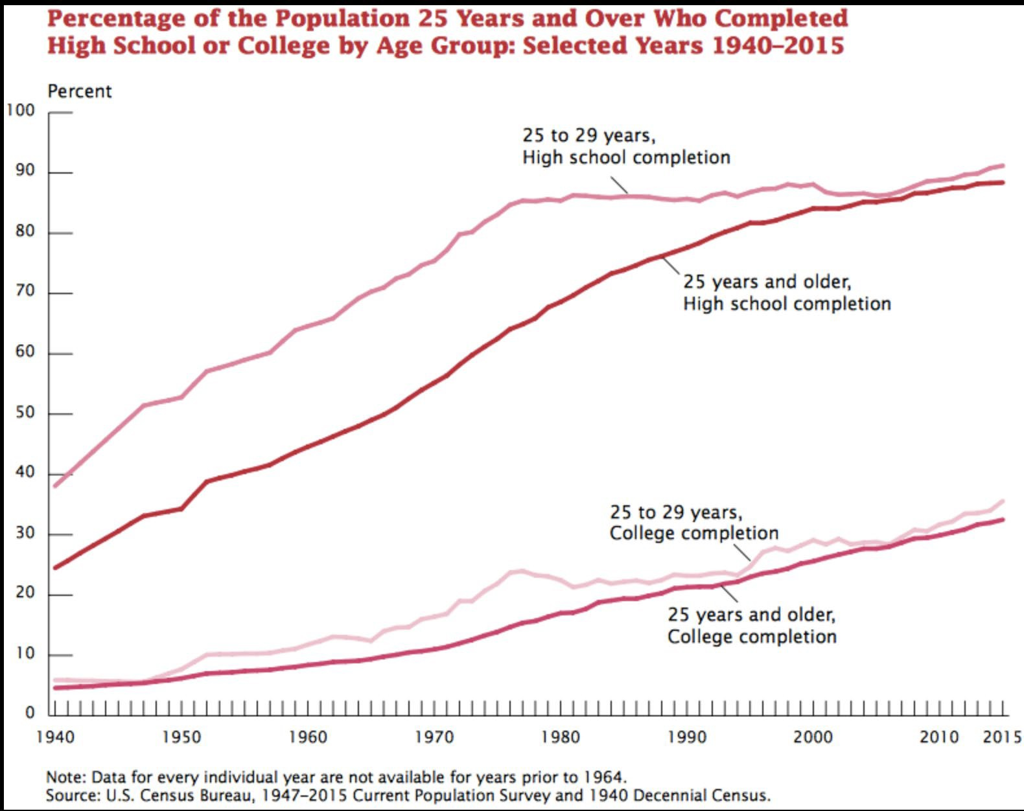
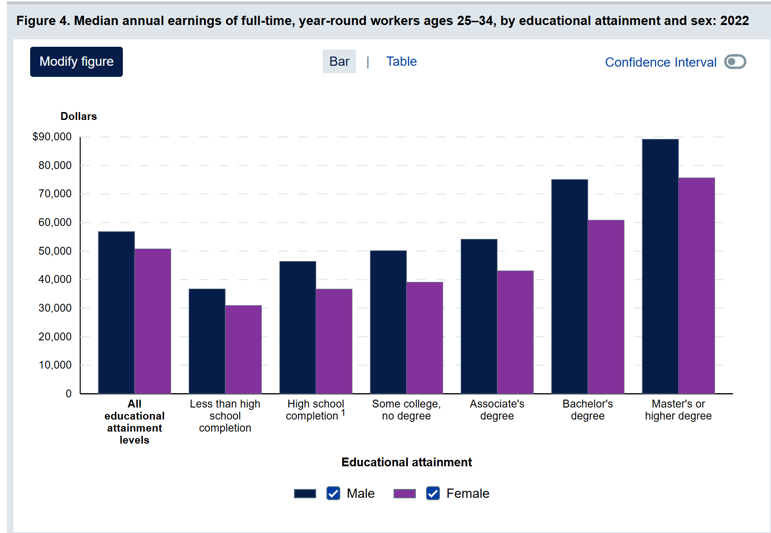
College Degree Attainment and Its Benefits

Slide 6
In my last few minutes….
The mission of higher education is and always has been important
Know that you are valued
Know that you are changing lives

Slide 7
THANK YOU!
senate-chair@purdue.edu

