Slide 1

ADMINISTRATIVE OPERATIONS OVERVIEW
Michael B. Cline, senior vice president
02/17/25

Slide 2
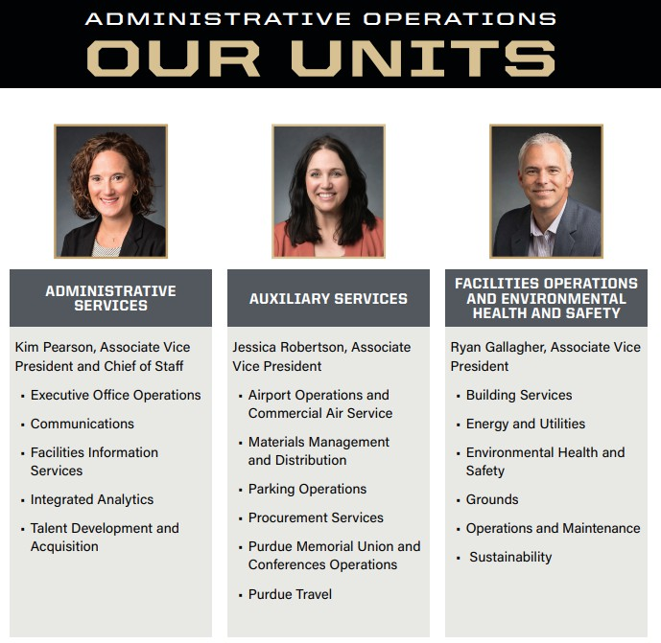
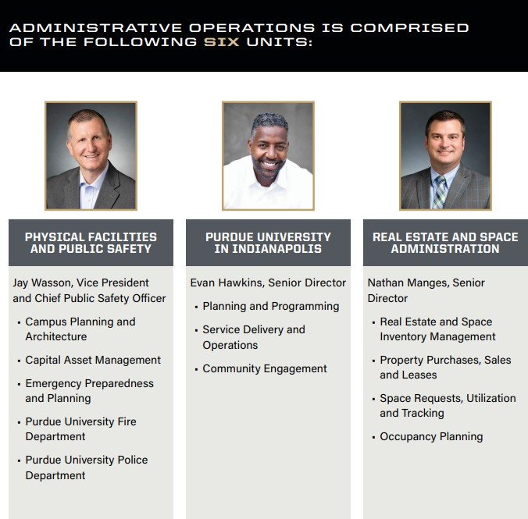
LEADERSHIP TEAM

Slide 3
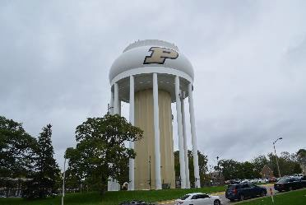
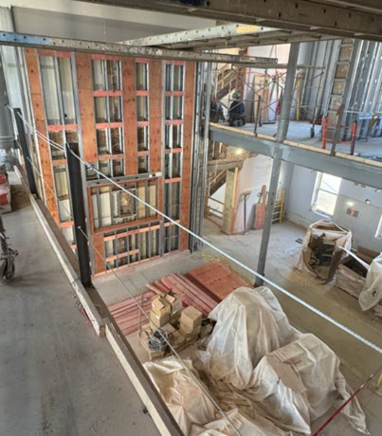
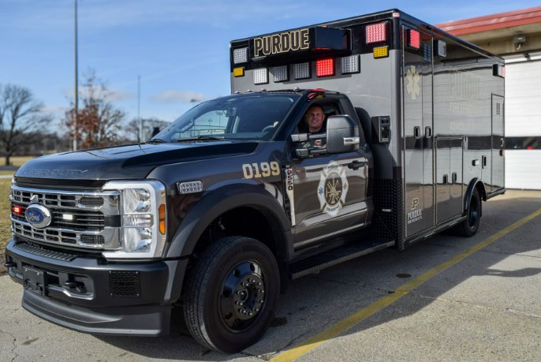
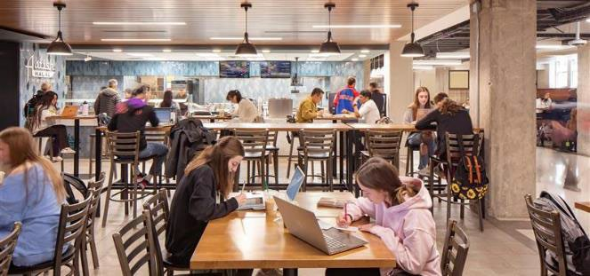
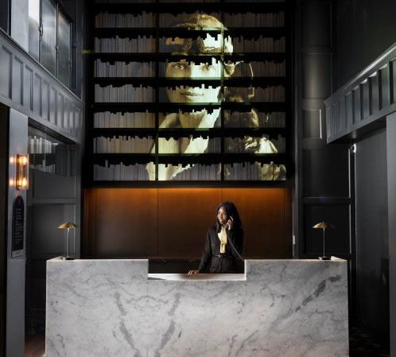
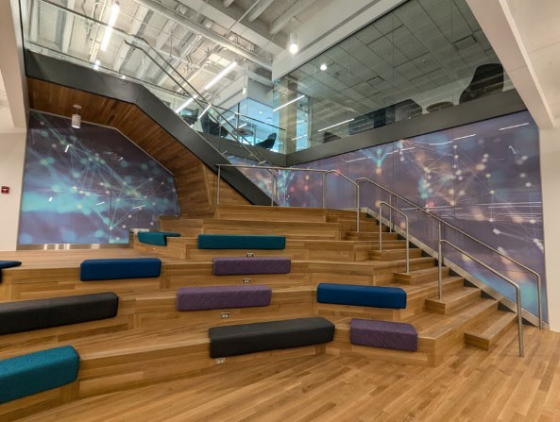
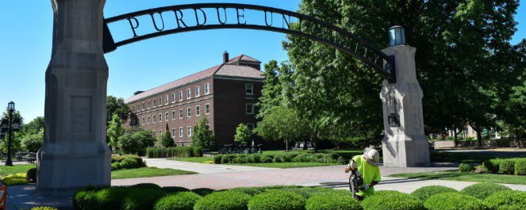
We Power Purdue
ENERGY AND UTILITIES
UNIVERSITY HALL
PUBLIC SAFETY
RETAIL DINING
GROUNDS
UNION CLUB HOTEL
DATA SCIENCE AND AI
3

Slide 4
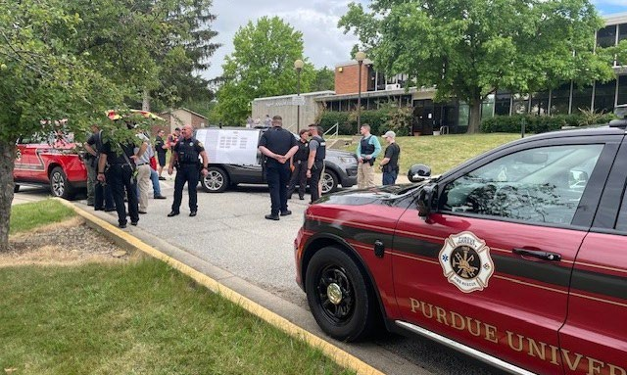
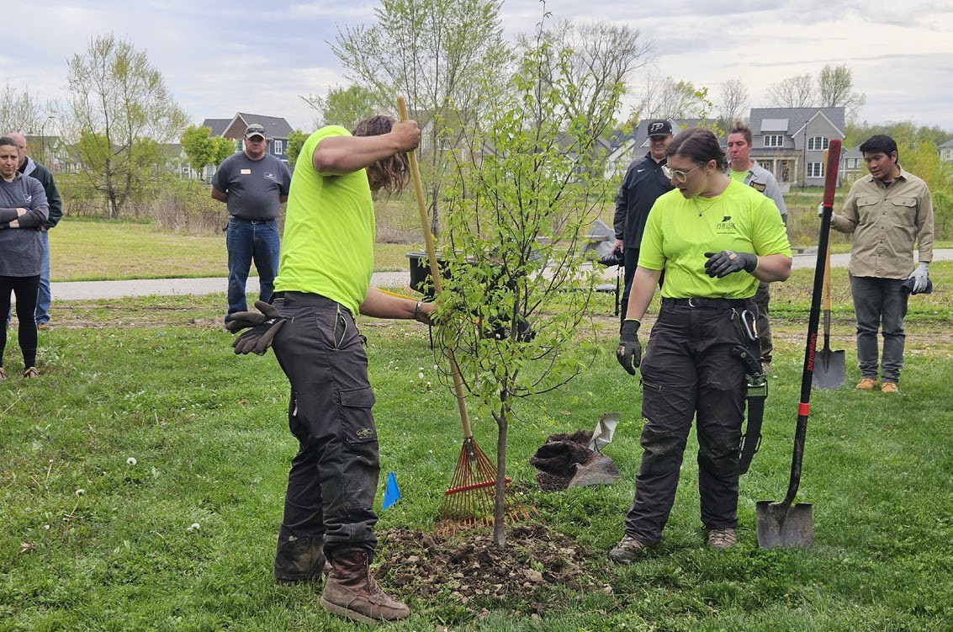


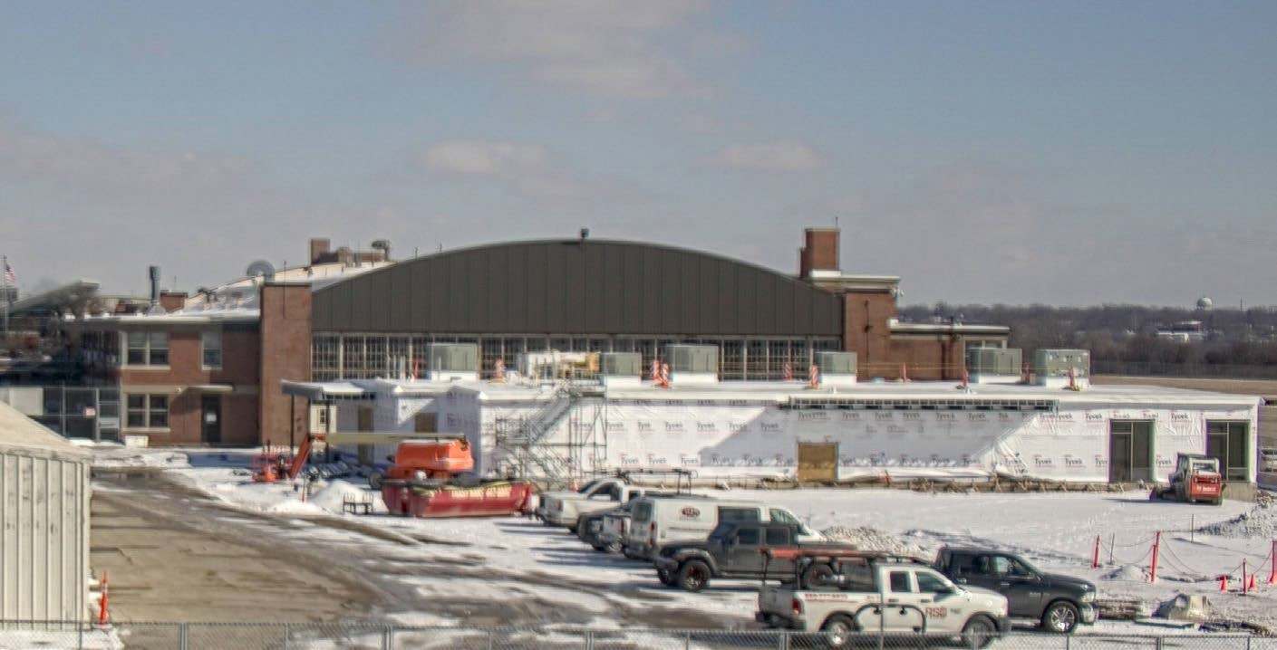
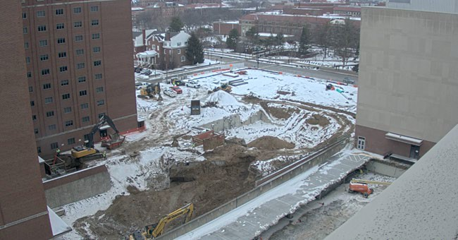
We Power Purdue
PUPD AND PUFD
TREE PLANTING
PUPD
SNOW REMOVAL
AMELIA EARHART TERMINAL
DANIELS SCHOOL OF BUSINESS
4

Slide 5
AO Initiatives
Driving performance in alignment with Purdue’s strategic initiatives
PLACE
We plan, construct, and operate a top-tier campus environment providing the necessities that enable Purdue to meet its academic, research and service missions.
OPERATIONAL PROCESSES
We develop, maintain, and improve processes and data utilization to better our operational performance, maintain student affordability and reduce enterprise risk.
WELCOMING + SAFE
We provide a hospitable, safe, and secure campus experience that includes amenities tailored to the needs of our customers.
ENERGY
We deliver reliable and affordable utility services to Purdue while pursuing innovative technologies for long-term clean energy solutions.
RECRUIT + RETAIN
We provide a culture that attracts, develops, and retains a quality workforce.
5

Slide 6
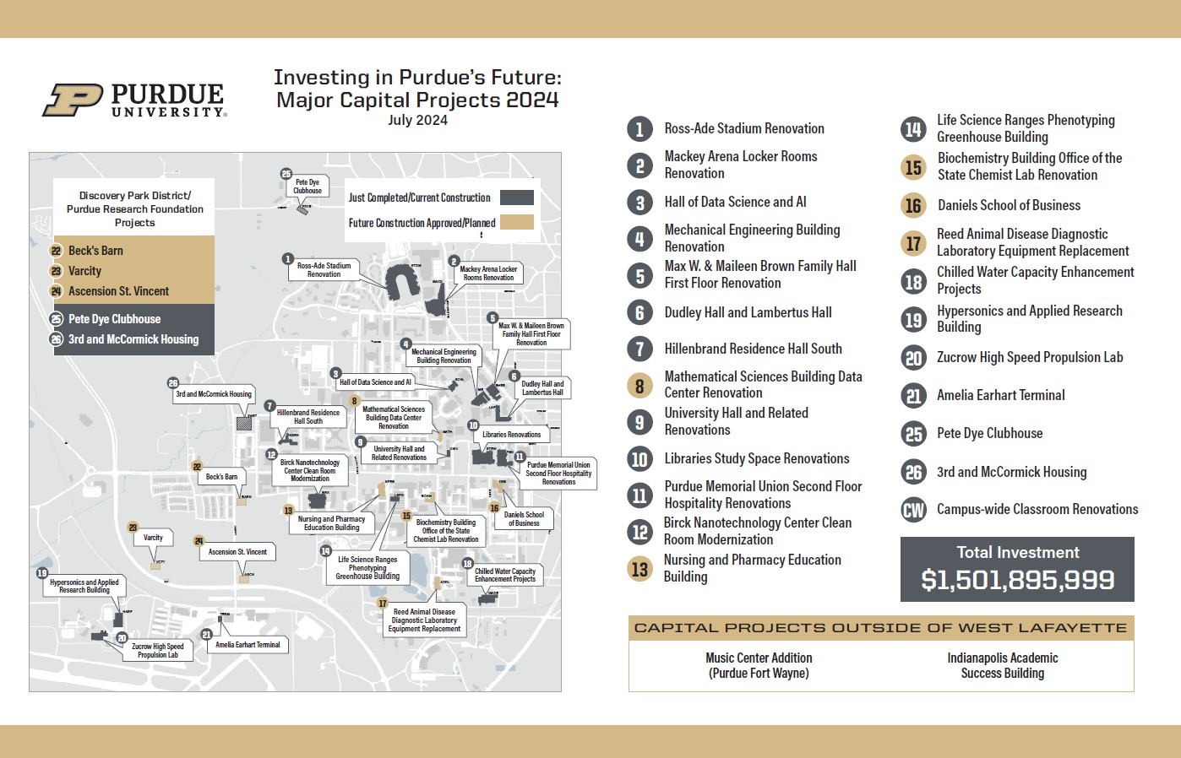
Investing in Purdue’s Future: Major Capital Projects 2024

Slide 7
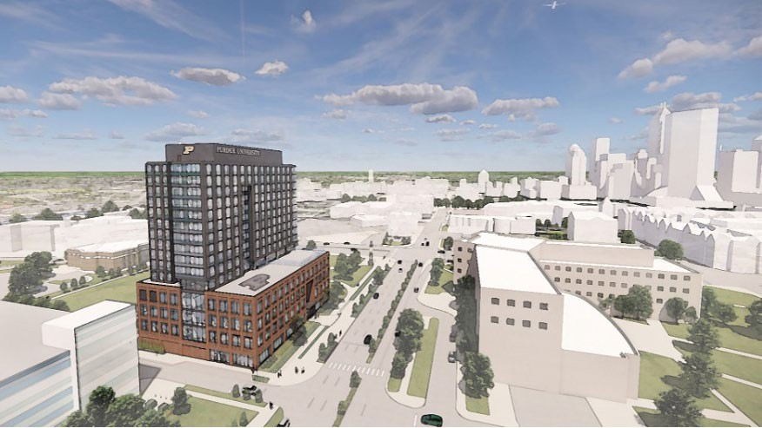
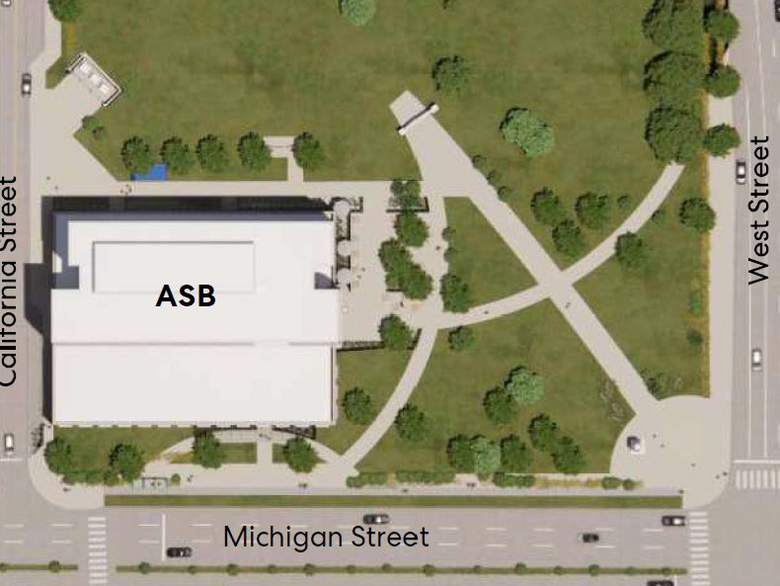
Academic Success Building
Presenter Notes
2025-02-14 18:18:18
--------------------------------------------
Confirm if rendering will be updated before 2/6 to shower larger ‘P’ on the building? If there is a rendering for construction fencing, add to appendix
Scope
A new 248,000 GSF student-focused hub near West and Michigan Streets. Includes classrooms, teaching labs, 500 beds, and a 400-seat dining area that will engage prospective students and the community.
Budget
$187M
  Non-Fee Replaced Debt – Aux Housing Dining & University Reserves:
$105M
  Capital Cash State Appropriation: $60M
  Gift Funds: $22M
Schedule
Board of Trustees Approval
Construction Start
Construction Complete
Occupancy
AE: Browning Day/Perkins & Will CM: Shiel Sexton
AO Project Manager: Rick Emery
June 7, 2024
April 2025
May 2027
July 2027
GROUNDBREAKING EVENT
April 2, 2025
Coordinated by Purdue for Life
High visibility Purdue project branding
7

Slide 8
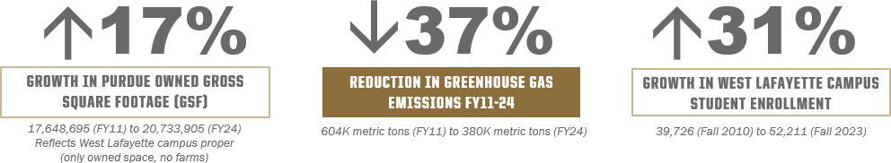
Sustainability
Recent Achievements
#5 in the Big Ten, #12 in the U.S and #74 globally for sustainability in higher education
(2025 QS World University Ranking)
Indiana Office of Energy Development Small Modular Reactor Study
Study concluded that SMRs present a viable opportunity for Indiana to transition to a cleaner, resilient and diversified energy future.
Current Activities
Working with Institute for a Sustainable Future on campus sustainability self assessment
Developing 2030 AO Sustainability Plan
GHG Emissions Reduction (FY11-24)
8

Slide 9
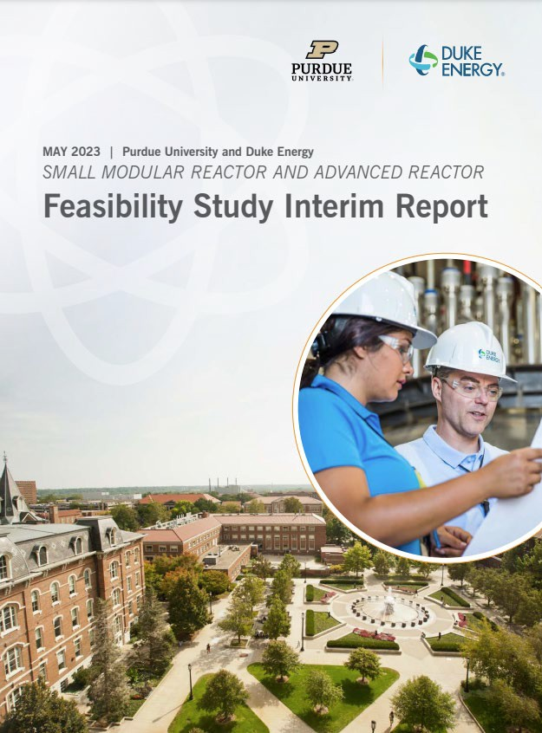
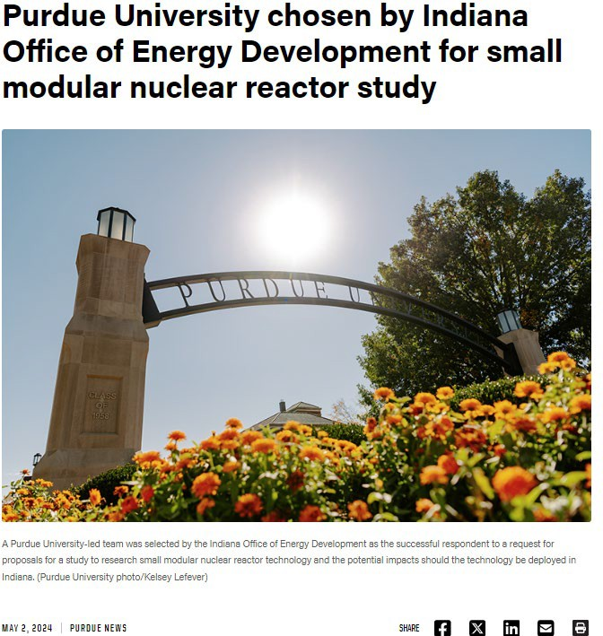
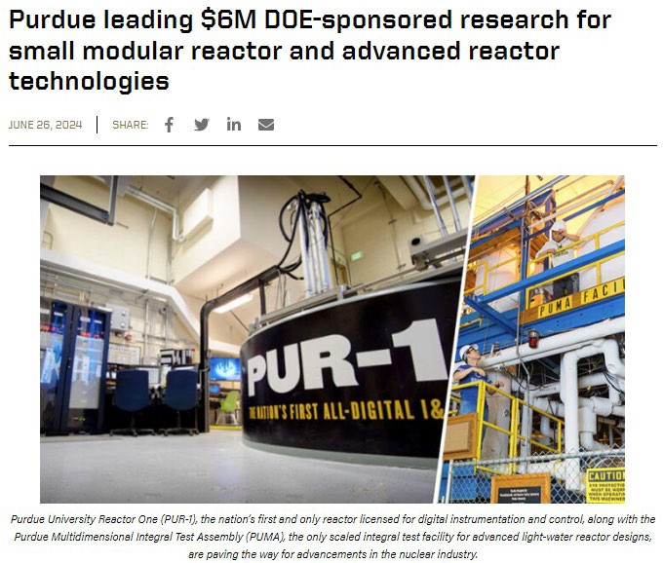
Small Modular Reactor
Advances in understanding around SMR and advanced reactor technologies
9

