Slide 1
Pedestrian & Micro-mobility Safety
Purdue University Faculty Senate Meeting
Jay Wasson, PE, MBA, MSCE
Vice President for Physical Facilities and Public Safety
9/14/2026

Slide 2
Comprehensive Safety - Our 3 E’s Framework
Goal – Safer Campus for All: Pursuing safety for pedestrians and micro-mobility users (bikes, e-scooters, skateboards, etc.)
“Three E’s” + Policy: Pillars = Education, Engineering, Enforcement, + new EMPV Policy for e-scooters/e-bikes
Shared Responsibility: Students, faculty, staff – everyone plays a role in campus safety
Safe Systems Design: Engineering campus for predictable, safe behaviors (good paths, signage, sensible rules working together)
Continuous Improvement: Ongoing evaluation and data-driven changes – never a one-and-done approach

Slide 3
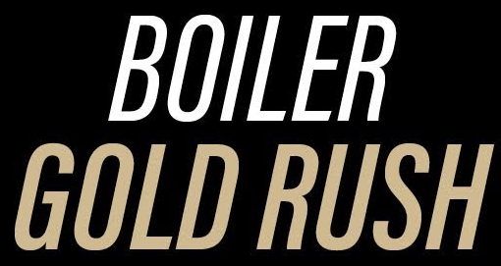



Education – Building a Safe Campus Culture
Boiler Gold Rush Orientation: All new students get traffic safety training during BGR (safe walking, biking, scooter use, campus “dos & don’ts”)
Required Online Module: Every incoming student must complete an online safety course covering campus rules + quiz
Year-Round Reinforcement: Ongoing awareness campaigns Purdue Police safety messages, social media tips, and events with helmet and bike-light giveaways to reinforce good habits
Peer Engagement: Student groups help promote safety
Purdue Cycling

Slide 4
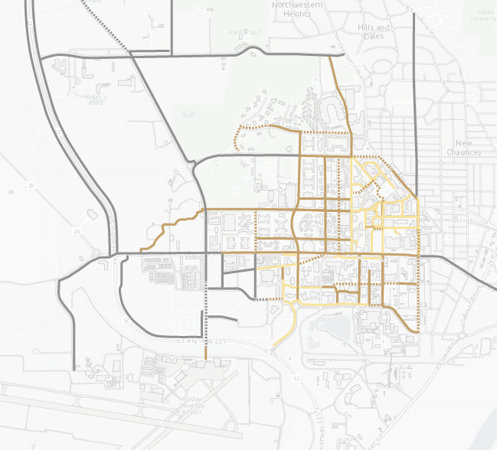
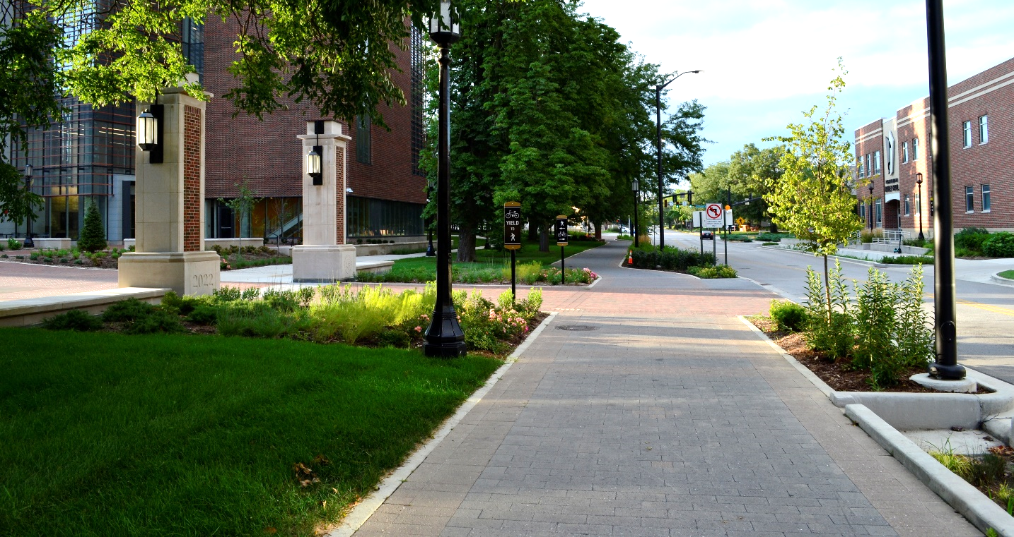
Engineering – Safer Streets & Paths
Facilities built between FY14-FY25
Sustainability Goal Total System Length: 12.5 mi
Total System Length Today: 14.55 mi
Sub-Total:
  Added: 8.96 mi
  Improved: 1.81 mi
  Removed: 0.66 mi
Photo Credit: Purdue Office of Campus Planning, Architecture and Sustainability, 2023
  BIKE FACILITY OWNERSHIP
  PURDUE (BUILT BETWEEN FY14-FY25)
  PURDUE (BUILT BEFORE FY14)
  CITY
  DASHED LINES INDICATE PROPOSED FACILITIES

Slide 5
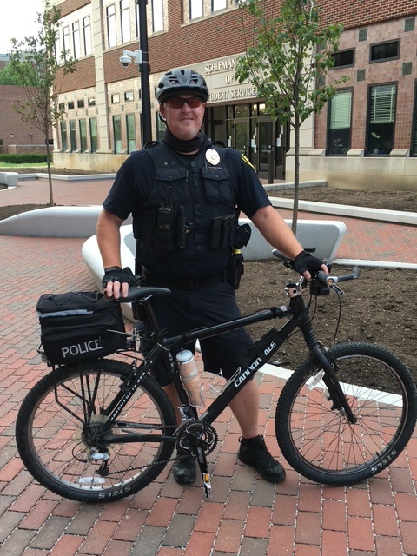
Enforcement – Targeted & Visible
Dedicated Bike Patrol: PUPD has 9 certified bicycle patrol officers
Behavior > Tickets: Focus on changing behavior, not meeting quota. Most stops lead to warnings or safety instructions; tickets are issued for serious or repeat violations.
Data-Driven Hotspots: Officers target high-risk spots and times
Active Enforcement: Last fall, PUPD made 228 stops of bike/scooter riders – often giving warnings on the spot and issuing citations for egregious cases.

Slide 6
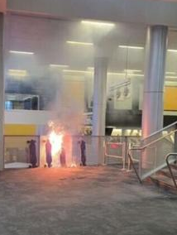
Policy – Managing E-Scooters & E-Bikes (EMPVs)
Why new rules? Addressing fire risks and blocked exits from e-devices, eliminating confusion from patchwork old policies
Campus-wide regulations (Fall ’25): No indoor e-scooters, e-bikes, or hoverboards use/charging/storage
Registration & parking: All personal EMPVs must be registered and must park at outdoors.
Enforcement effort: Purdue Parking monitors daytime; Purdue Fire Dept handles after-hours
Communication & training: Broad outreach before policy launch; ongoing education for staff
November 2024 | Co-Rec Skateboard Fire
Photo: Purdue Exponent, Charlie Stapleton

Slide 7
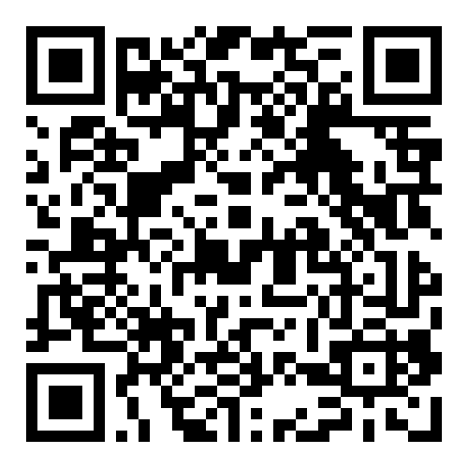
Next Steps & Continued Commitment
Finish Current Safety Projects: Complete near-term improvements underway, then advance the next priority projects
Pursue Key Future Improvements: Develop and seek funding for priority bike/ped projects
Evaluate & Adapt Continually: Keep analyzing crash/incident data and feedback each semester.
Engage the Community: Continue new student training; Maintain open channels for faculty, staff, and students to voice concerns and ideas.
Purdue University
Pedestrian Safety Training

Slide 8
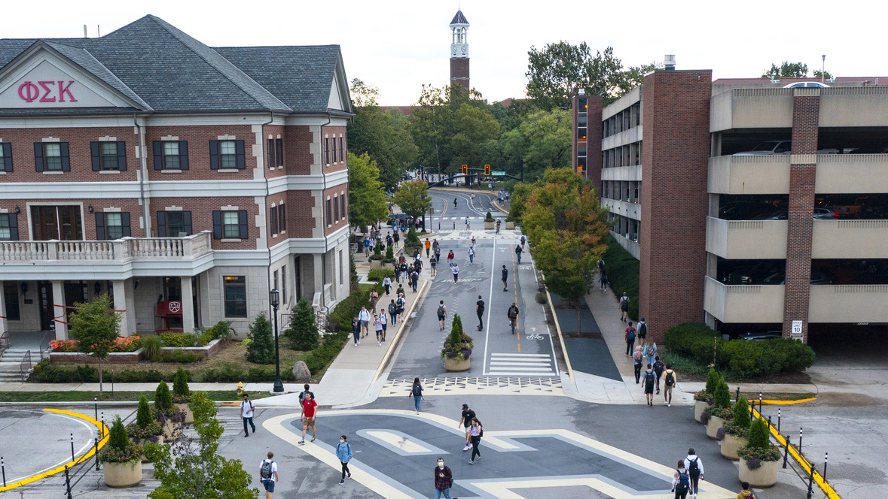
Third Street Student Success Corridor
Photo Credit: CJ Walker Photography

Slide 9
Thank You

