Slide 1
PURDUE ATHLETIC AFFAIRS COMMITTEE
Annual Report to the University Senate
September 14, 2026

Slide 2
Purdue Athletic Affairs Committee – Annual Report
General Information on the Committee
One facet of institutional control of Athletics
Ties to the beginnings (1895) of what is now known as the Big Ten Conference and the role of the faculty
  The Presidents of the original member institutions delegated oversight of Athletics to the faculty
Intended to represent the interests of the entire University community
  Faculty, students, alumni, community representatives, and senior administrators from Intercollegiate Athletics
To Develop Champions, Scholars, and Citizens

Slide 3
Purdue Athletic Affairs Committee – Annual Report Examples
Examples of Activities of AAC
Discuss topics related to the NCAA (including NIL and Revenue Sharing)
Discuss topics related to the Big Ten Conference (including conference membership)
Discuss the academic progress and well-being of student athletes
Discuss issues regarding the personal and professional development of student athletes in preparation for their post-graduate lives and careers
Through the chair, review and approve sport schedules, missed class time, and any needed academic recovery plans when waivers are granted
Study, review, and approve changes in Purdue rules and regulations affecting intercollegiate athletics
Select Purdue recipients of conference awards and honors

Slide 4
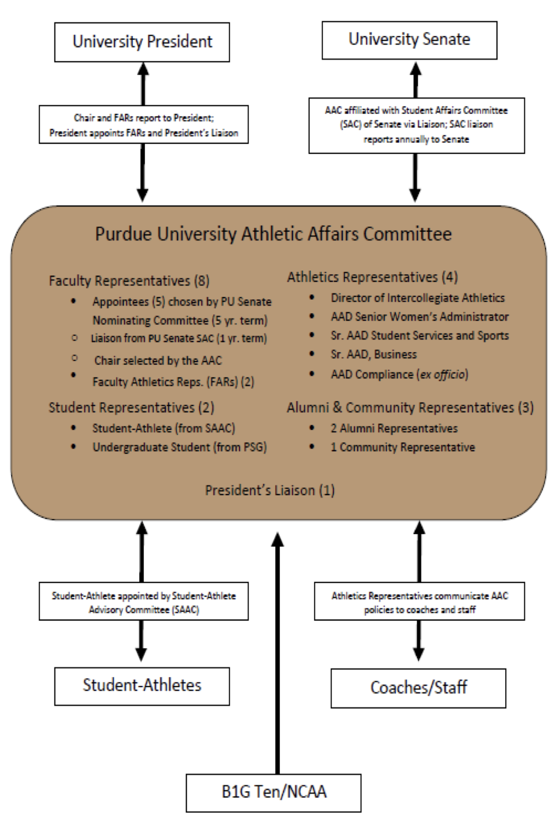
AAC Linkages
AAC Linkages

Slide 5
Purdue Athletic Affairs Committee – Annual Report (Membership)
AAC Membership
Five Faculty Members appointed by the University Senate Nominating Committee for five-year terms *
One Faculty Member Liaison from the Student Affairs Committee of the Senate *
Two Faculty Athletic Representatives appointed by the University President *
Two Student Members: one appointed by the University President with input from PSG (2-year terms) and one student athlete appointed by Intercollegiate Athletics *
One University Administrator appointed by the University President, ex-officio
Two Alumni Representatives appointed by Intercollegiate Athletics *
One Community Representative appointed by Intercollegiate Athletics *
Intercollegiate Athletics Administration Members
  Tommy McClelland (Vice President/Athletics Director) *
  Tiffini Grimes (Deputy Athletics Director / Senior Woman Administrator) *
  Ken Halpin (Deputy Athletics Director, Chief Operating Officer) *
  Ed Howat (Senior Associate Athletics Director, Student Services and Sports)
  Jacqueline McGill-Reed (Senior Associate Athletics Director, Compliance) *
  Calvin Williams (Associate Athletics Director, Sport Administration)
  Peyton Stovall (Associate Athletics Director, Student-Athlete Development)
  “*” = Voting Member

Slide 6
Purdue Athletic Affairs Committee – Annual Report (Current Members)
Current Faculty Membership
Chair (Senate Appointee): Kyle Haynes (Political Science Department)
Student Affairs Liaison: Michael Zoltowski (Computer & Electrical Engineering)
Senate Appointees:
  Rachel Clark (HHS)
  Eric Holloway (Engineering Practice)
  Kathy Martin (Education)
  Michael Sori (Earth, Atmospheric, and Planetary Sciences)
Faculty Athletic Representatives:
  Marcy Towns (Chemistry)
  Phillip VanFossen (Education)

Slide 7
Purdue Athletic Affairs Committee – Annual Report (Enrollment Data)
College or School | Fall 2025 | Spring 2026
Agriculture | 10 | 9
Education | 4 | 3
Engineering | 54 | 51
HHS | 157 | 164
Liberal Arts | 74 | 72
Daniels School of Business | 65 | 75
Science | 13 | 9
Polytechnic Institute | 34 | 31
Graduate School | 26 | 26
Exploratory Studies | 32 | 33
Athletics Enrollment Data by College/School

Slide 8
Purdue Athletic Affairs Committee – Annual Report (Performance)
 | Student-Athletes | Campus
Semester GPA | 3.22 | 3.29
Cumulative GPA | 3.25 | 3.34
Semester GPA ≥ 3.0 | 70.9% | 73.3%
Academic Honors | 38.8% | 52.2%
Semester 4.0 GPA | 7% | 12.1%
Placed on Academic Notice | 3.6% | 5%
Dropped from Purdue | 0% | 0.62%
Academic Performance – Spring 2026

Slide 9
Purdue Athletic Affairs Committee – Annual Report (Cumulative GPA)
Team | GPA
Baseball | 3.22
Football | 3.17
Men’s Basketball | 3.08
Men’s Cross Country | 3.53
Men’s Golf | 3.33
Men’s Swimming | 3.28
Men’s Tennis | 3.10
Men’s Track | 3.20
Soccer | 3.49
Softball | 3.15
Team | GPA
Volleyball | 3.25
Women’s Basketball | 3.28
Women’s Cross Country | 3.50
Women’s Golf | 3.69
Women’s Swimming | 3.45
Women’s Tennis | 3.48
Women’s Track | 3.16
Wrestling | 3.23
Student-Athlete Totals | 3.25
Student Body Totals | 3.34
Cumulative GPA By Team - Spring 2026

Slide 10
Purdue Athletic Affairs Committee – Annual Report (Graduation Success)
Team | NCAA | Purdue
Baseball | 90 | 85
Football | 81 | 83
Men’s Basketball | 85 | 75
Men’s Track / Cross Country | 84 | 81
Men’s Golf | 93 | 100
Men’s Swimming | 89 | 96
Men’s Tennis | 94 | 100
Men’s Wrestling | 87 | 89
Soccer | 96 | 100
Team | NCAA | Purdue
Softball | 94 | 85
Volleyball | 95 | 100
Women’s Basketball | 92 | 88
Women’s Track / Cross Country | 92 | 88
Women’s Golf | 96 | 100
Women’s Swimming | 97 | 100
Women’s Tennis | 96 | 100
Overall | 90 | 90
Student-Athlete Graduation Success Rates
Measures % graduation within 6 years

Slide 11
Purdue Athletic Affairs Committee – Annual Report (Additional Information)
Revenue Sharing / Name, Image, and Likeness
Revenue Sharing began with the approval of the House Settlement last summer.
Focus is on “Real” NIL – appropriate opportunities for work performed, pay commensurate with any other professional in that space.
Student-Athletes are provided with ongoing education in financial management and tax awareness. Lists of local resources (tax and financial management professionals) are compiled and regularly shared with Student-Athletes.
NIL and Revenue Sharing agreements are not considered “employment” on behalf of Purdue, and these items are considered FERPA-protected educational records.

Slide 12
Purdue Athletic Affairs Committee – Annual Report (Initiatives)
AAC Initiatives for 2026-27
Ensure the University is looking after the welfare and best interests of Student-Athletes
  Academic Support
  Name, Image, Likeness (NIL)
  Career Development
  Personal Support
Continue review of competition schedules and reviews of missed class time
  Ongoing discussions regarding the expansion of the Big Ten Conference
  Systematic data collection regarding missed class time pre & post expansion
Consistent Updates on Student-Athlete Personal and Professional Development Programming
Build constructive relationship with new Athletic Director
Updates on maintaining the positive public image of Purdue Athletics.

