Slide 1
PURDUE ATHLETIC AFFAIRS COMMITTEE
Annual Report to the University Senate
September 11, 2023

Slide 2
Purdue Athletic Affairs Committee – Annual Report
General Information on the Committee
One facet of institutional control of Athletics
Ties to the beginnings (1895) of what is now known as the Big Ten Conference and the role of the faculty
  The Presidents of the original member institutions delegated oversight of Athletics to the faculty
Intended to represent the interests of the entire University community
  Faculty, students, alumni, community representatives, and senior administrators from Intercollegiate Athletics
To Develop Champions, Scholars, and Citizens

Slide 3
Purdue Athletic Affairs Committee – Annual Report
Examples of Activities of AAC
Discuss topics related to the NCAA (including rule changes, NIL)
Discuss topics related to the Big Ten Conference (including conference membership)
Discuss the academic progress and well-being of student athletes
Discuss issues regarding the personal and professional development of student athletes in preparation for their post-graduate lives and careers
Through the chair, review and approve sport schedules, missed class time, and any needed academic recovery plans when waivers are granted
Study, review, and approve changes in Purdue rules and regulations affecting intercollegiate athletics
Select Purdue recipients of conference awards and honors

Slide 4
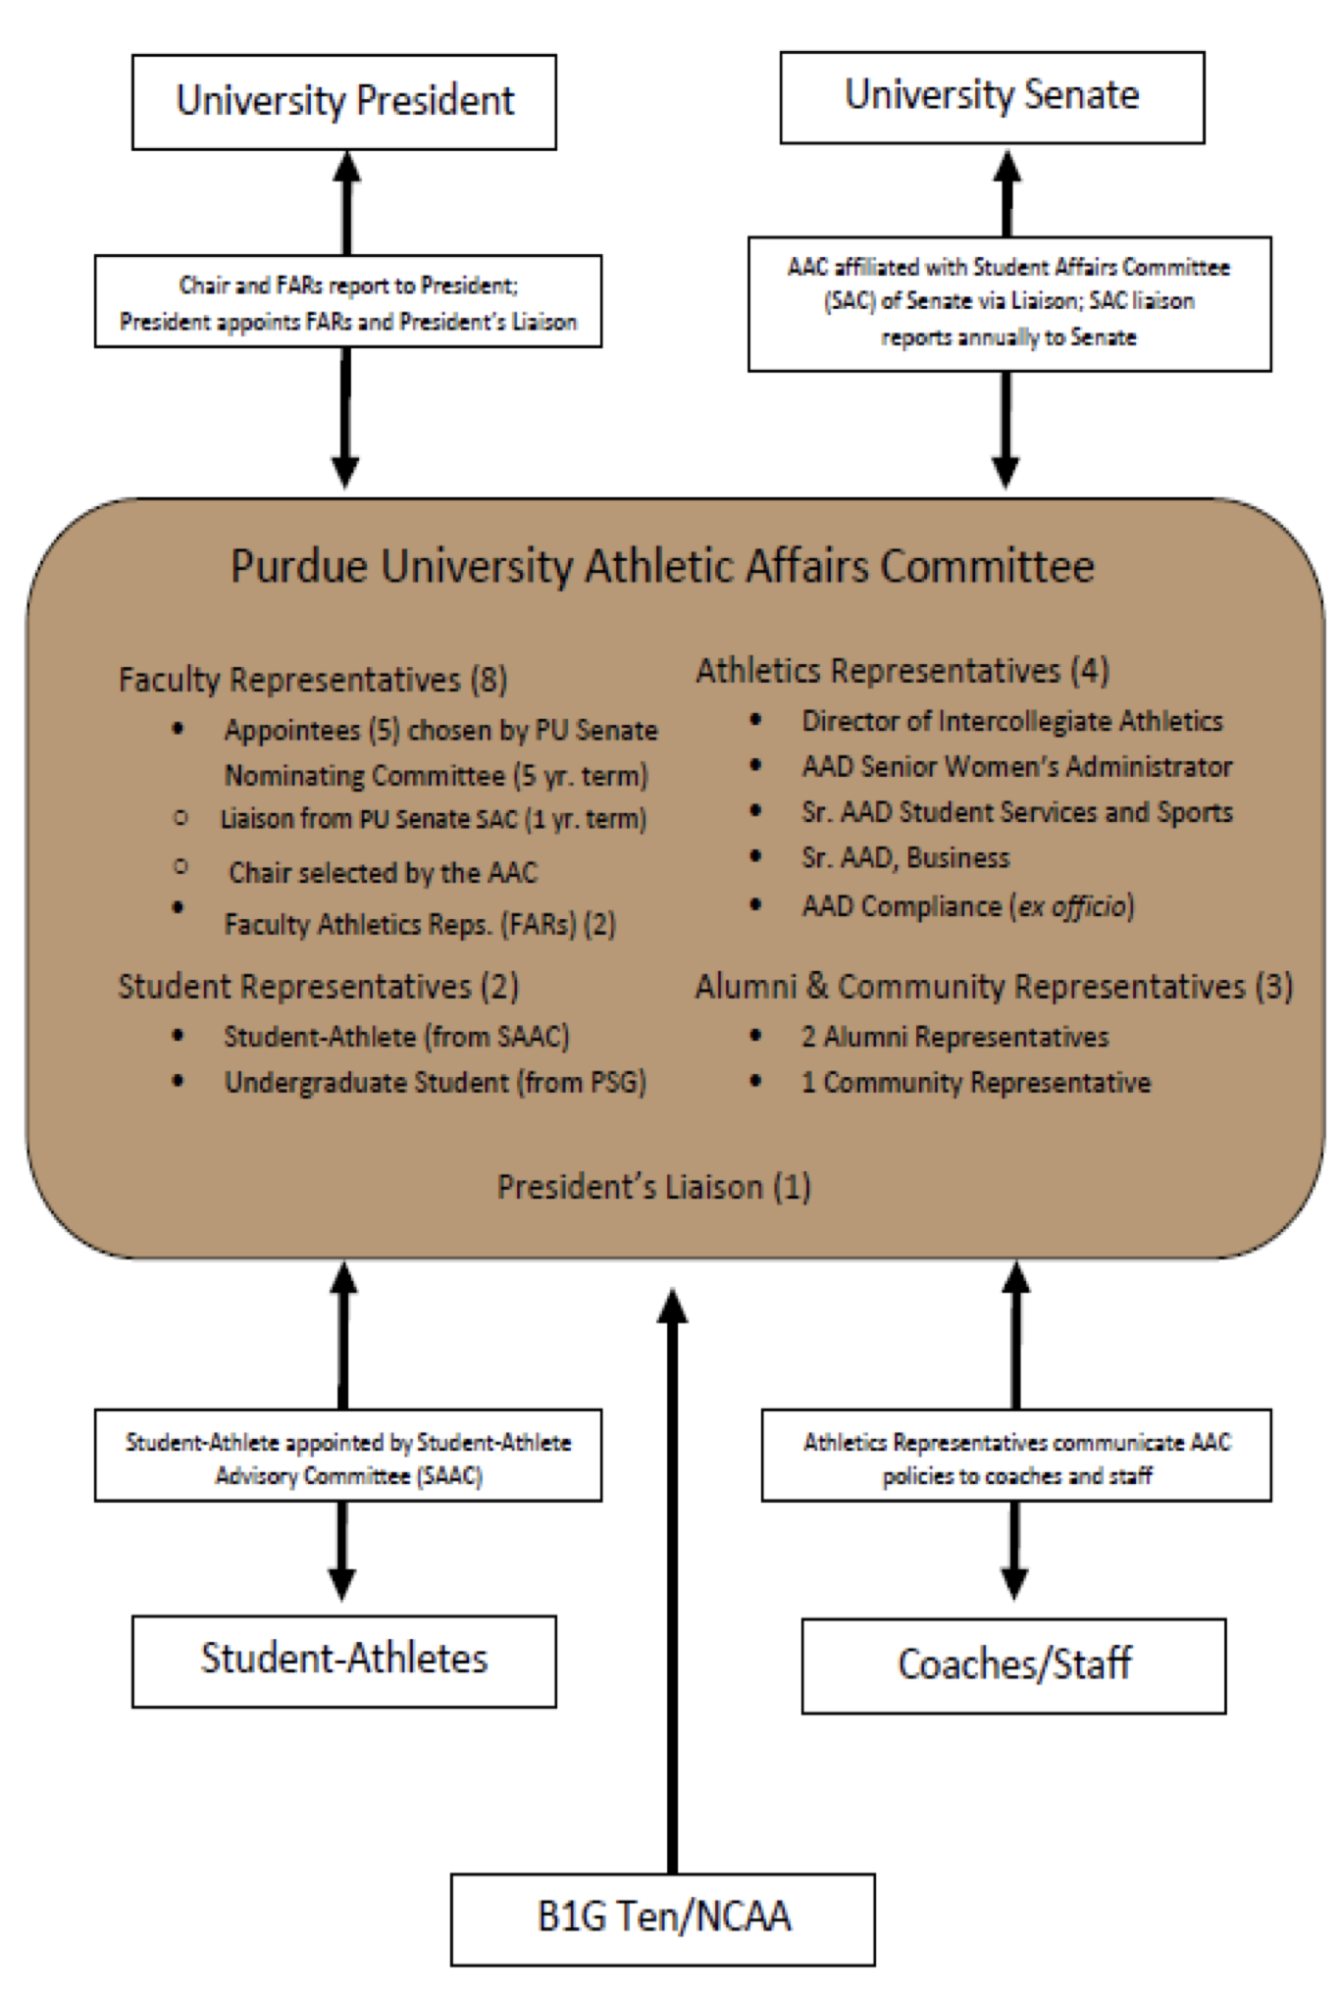
AAC Linkages

Slide 5
Purdue Athletic Affairs Committee – Annual Report
AAC Membership
Five Faculty Members appointed by the University Senate Nominating Committee for five-year terms *
One Faculty Member Liaison from the Student Affairs Committee of the Senate *
Two Faculty Athletic Representatives appointed by the University President *
Two Student Members: one appointed by the University President with input from PSG (2-year terms) and one student athlete appointed by Intercollegiate Athletics *
One University Administrator appointed by the University President, ex-officio
Two Alumni Representatives appointed by Intercollegiate Athletics *
One Community Representative appointed by Intercollegiate Athletics *
Intercollegiate Athletics Administration Members
  Michael Bobinski (Vice President/Athletics Director) *
  Tiffini Grimes (Deputy Athletics Director / Senior Woman Administrator) *
  Ken Halpin (Deputy Athletics Director, Chief Operating Officer) *
  Ed Howat (Senior Associate Athletics Director, Student Services)
  Tom Mitchell (Associate Athletics Director, Compliance) *
  Calvin Williams (Associate Athletics Director, Sport Administration)
  Peyton Stovall (Assistant Athletics Director, Student-Athlete Development)
  “*” = Voting Member

Slide 6
Purdue Athletic Affairs Committee – Annual Report
Current Faculty Membership
Chair: Kip Williams (HHS) (on sabbatical Fall ‘23)
Acting Chair: Matt Conaway (Bands/Orchestras)
Student Affairs Liaison: David Sanders (Biological Sciences)
Senate Appointees:
  Chip Blatchley (Civil Engineering)
  Rachel Clark (HHS)
  Kyle Haynes (Political Science)
Faculty Athletic Representatives:
  Marcy Towns (Chemistry)
  Phillip VanFossen (Education)

Slide 7
Purdue Athletic Affairs Committee – Annual Report
College or School | Fall 2022 | Spring 2023
Agriculture | 20 | 19
Education | 12 | 10
Engineering | 64 | 62
HHS | 149 | 145
Liberal Arts | 71 | 69
Management | 77 | 73
Pre-Pharmacy | 3 | 3
Pharmacy | 1 | 1
Science | 21 | 20
Polytechnic Institute | 48 | 44
Graduate School | 35 | 27
Exploratory Studies | 29 | 24
Athletics Enrollment Data by College/School

Slide 8
Purdue Athletic Affairs Committee – Annual Report
 | Student-Athletes | Campus
Semester GPA | 3.12 | 3.22
Cumulative GPA | 3.16 | 3.28
Semester GPA ≥ 3.0 | 59.9% | 70.1%
Academic Honors | 34.9% | 48.6%
Semester 4.0 GPA | 6.4% | 12.3%
Placed on Probation | 4.2% | 6.2%
Dropped from Purdue | 0.4% | 1.1%
Academic Performance – Spring 2023

Slide 9
Purdue Athletic Affairs Committee – Annual Report
Team | GPA
Baseball | 2.99
Football | 2.92
Men’s Basketball | 3.18
Men’s Cross Country | 3.38
Men’s Golf | 3.11
Men’s Swimming | 3.39
Men’s Tennis | 2.89
Men’s Track | 3.13
Soccer | 3.39
Softball | 3.03
Team | GPA
Volleyball | 3.39
Women’s Basketball | 3.04
Women’s Cross Country | 3.58
Women’s Golf | 3.41
Women’s Swimming | 3.51
Women’s Tennis | 3.23
Women’s Track | 3.23
Wrestling | 3.05
Student-Athlete Totals | 3.16
Student Body Totals | 3.28
Cumulative GPA By Team - Spring 2023

Slide 10
Purdue Athletic Affairs Committee – Annual Report
Team | NCAA | Purdue
Baseball | 87 | 93
Football | 80 | 81
Men’s Basketball | 84 | 75
Men’s Track / Cross Country | 84 | 80
Men’s Golf | 90 | 88
Men’s Swimming | 91 | 90
Men’s Tennis | 93 | 100
Men’s Wrestling | 84 | 84
Soccer | 95 | 95
Team | NCAA | Purdue
Softball | 94 | 87
Volleyball | 95 | 100
Women’s Basketball | 93 | 82
Women’s Track / Cross Country | 91 | 87
Women’s Golf | 96 | 100
Women’s Swimmimg | 96 | 96
Women’s Tennis | 97 | 100
Overall | 88 | 89
Student-Athlete Graduation Success Rates
Measures % graduation within 6 years

Slide 11
Purdue Athletic Affairs Committee – Annual Report
AAC Initiatives for 2023-24
Ensure the University is looking after the welfare and best interests of Student-Athletes
  Academic Support
  Name, Image, Likeness (NIL)
  Career Development
  Personal Support
Continue review of competition schedules and reviews of missed class time
  Ongoing discussions regarding the expansion of the Big Ten Conference
Consistent Updates on Student-Athlete Personal and Professional Development Programming
Updates on maintaining the positive public image of Purdue Athletics.

