Slide 1
Trends in Administrative Growth at Purdue University
Case Study: Information Technology
Headcounts
Budget
Context

Slide 2
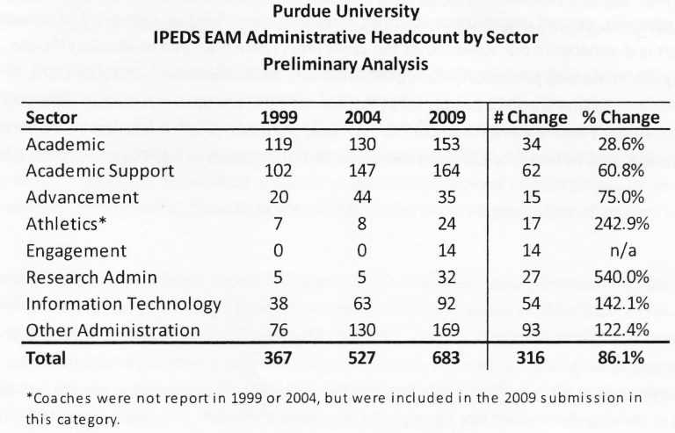
Trends in Administrative Growth at Purdue University as Reported to IPEDS January of 2011

Slide 3
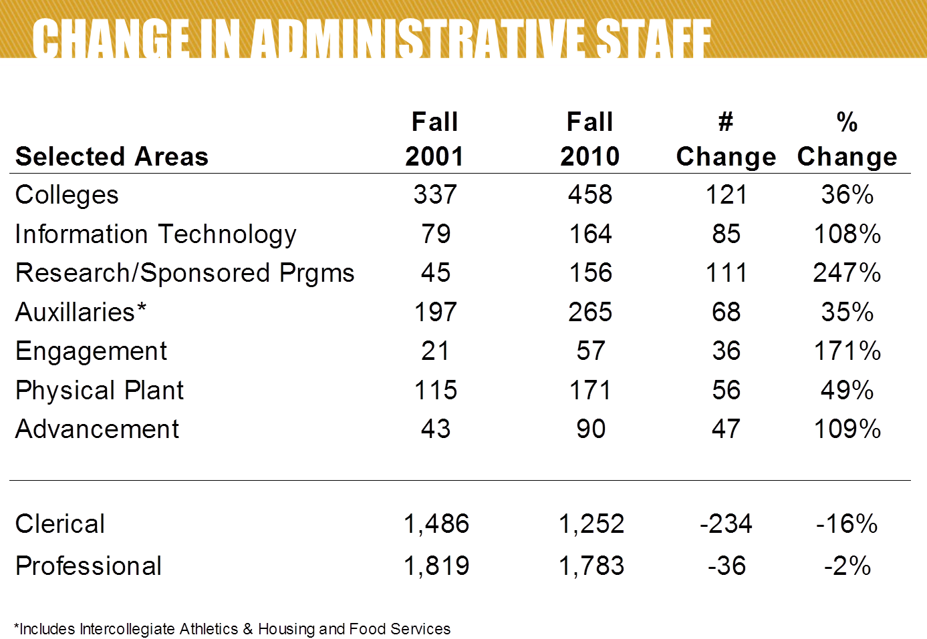
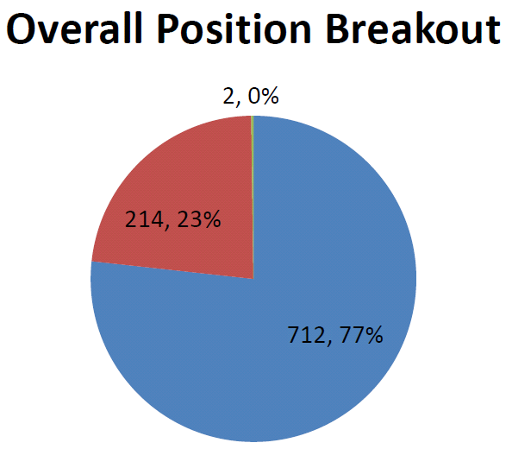
Presentation by Rab Mukerjea, Executive Director of Strategic Planning & Assessment to BIER committee
12 December 2012 entitled “Workforce Growth Analysis 2001-2010”
“Change in Workforce.pdf” 7 Feb 2012
Strategic Planning & Assessment

Slide 4
~89% increase in the General Fund budget 2002-2012
Data provided by Borgonah and McCartney, 6 April 2012
Does not include the amount budgeted for Information Technology at the college-level
Rough estimate of $25,000,000. Total IT budget at Purdue estimated ~ $ 90 M

Slide 5
Summary and Context
Information Technology Budget increased roughly 89% over the past 10 years
IT ‘Administrative Staff’ increased 108% from 2001 – 2010
Purdue has been highly strategic and successful with resources developed in Information Technology
Research Awards: In 2011 of the $401 M in total research awards, $182 M (45%) were leveraged with high performance computing
Purdue ranked as the #3 Top Research Computing Academic Institution; #1 in the Big 10
Developed Innovative Classroom Technologies
Hotseat; Jetpack, Course Signals

Slide 6
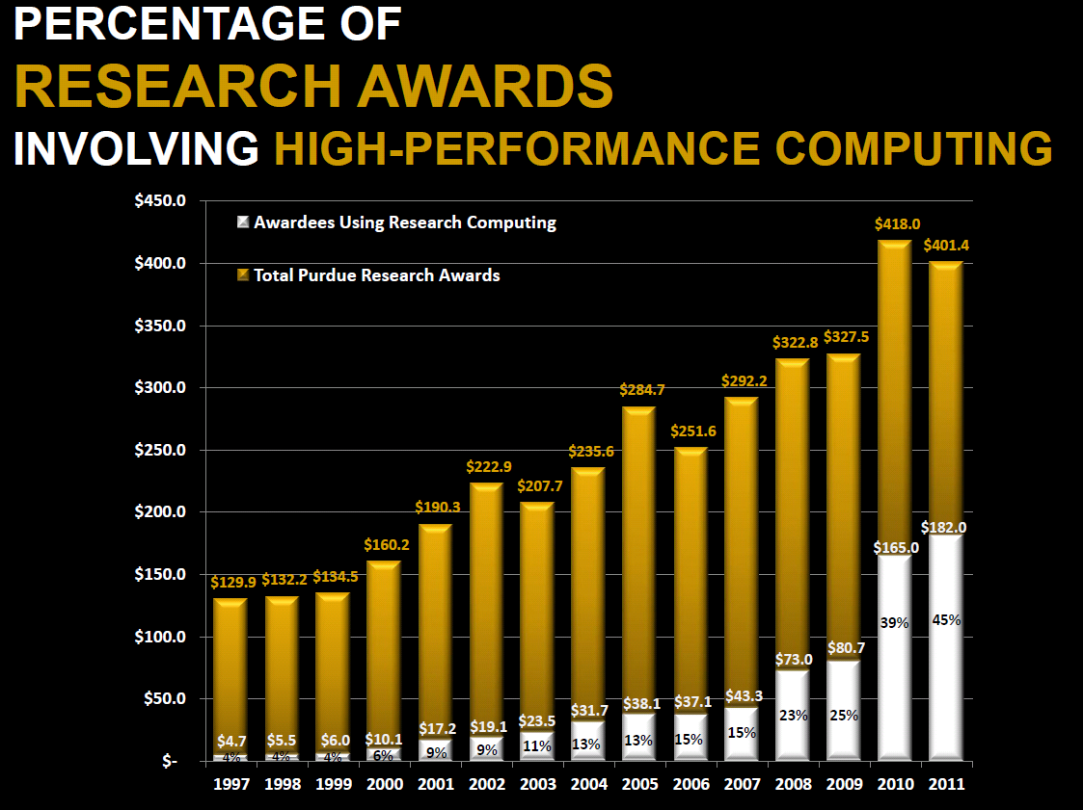
Purdue has been strategic and successful with resources developed in Information Technology Example: Research Awards

Slide 7
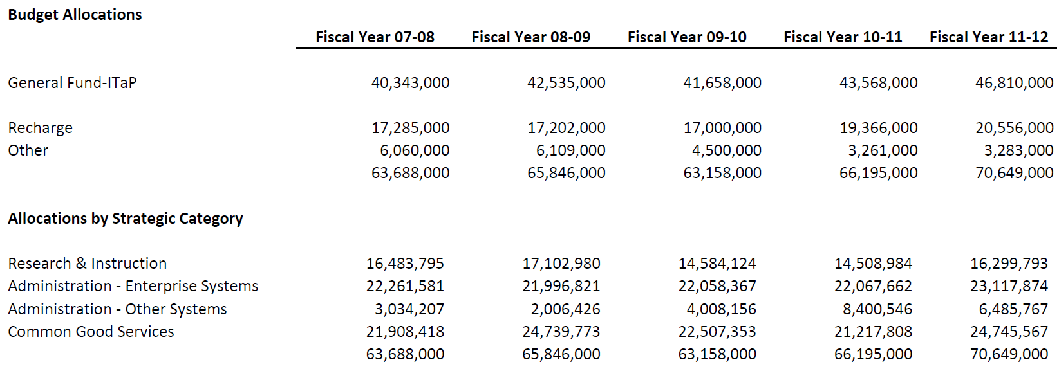
Information Technology at Purdue
Strategic Cost Analysis
Data provided by Borgonah and McCartney, 6 April 2012
Does not include ‘College-IT’ - Rough estimate of $25 M
One data point: College of Agriculture Budget is $1.1 M (Pat Smoker)

