Slide 1



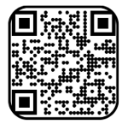
Purdue Center for Career Opportunities (CCO)
Carolyn Ersland, M.S.Ed, NCC
Director of Career Development
cersland@purdue.edu
765-494-3988

Slide 2
Center for Career Opportunities (CCO)
Comprehensive career center for West Lafayette campus as well as Purdue in Indianapolis
Provide services and resources for all students, all degree levels
Vision – Every Boilermaker Empowered for Lifelong Success
Career coaching and outreach
Employer engagement and campus recruiting support

Slide 3

What is your
CAREER DREAM?
Notes:
Ask about Career Dreams…what did they want to be when they were little? What do they want to be now?
Ask for input from the students
Where have their talents and strengths led them so far?
Concept of creating intentionality about formulating their dreams
What are aspects, talents, attributes that will help them be more successful?
Or that will help them consider other options or ideas?
Are they still motivated to pursue that Career Dream? Or has the Dream changed?

Slide 4
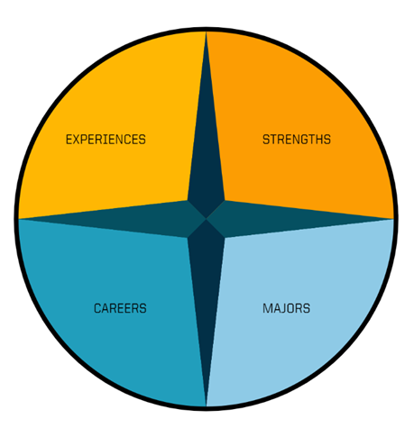

CCO Career Compass
Career
Exploration
Model
Notes:
When we meet with you, this is the compass we utilize to pinpoint a direction to take.

Slide 5
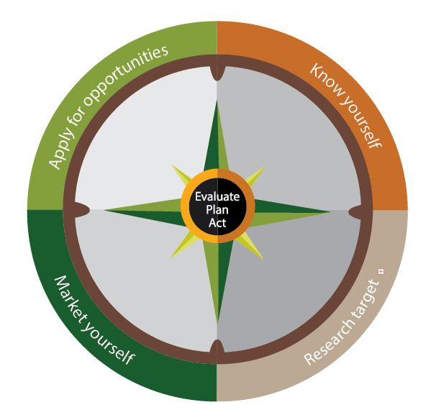
CCO
JOB SEARCH MODEL
Notes:
When we meet with you, this is the compass we utilize to pinpoint a direction to take.

Slide 6

Competencies Employers are Seeking
Time Management/ Detail Oriented
Problem Solving / Creativity
Oral & Written Communication
Organizational Ability
Analytical / Quantitative Skills
Adaptability/ Flexibility
Computer Skills
Technical Skills
Initiative / Strong Work Ethic
Leadership / Strategic Planning
Networking / Interpersonal Relationships
Source: National Association of Colleges and Employers, NACE’s Job Outlook 2023 related article, ”Key Skills/Competencies Employers Are Seeking”, April 27, 2023, naceweb.org
Teamwork / Collaboration
Notes:
Key Attributes –
Which do you possess?
Where, when, and how did you develop or obtain them?
What examples can you provide on your resume?

Slide 7
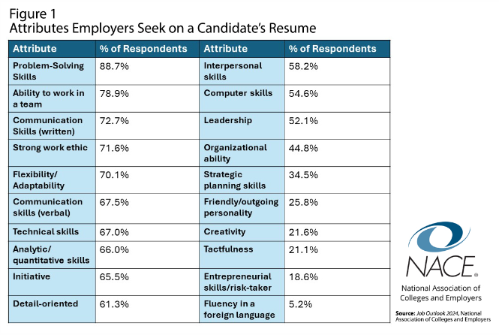
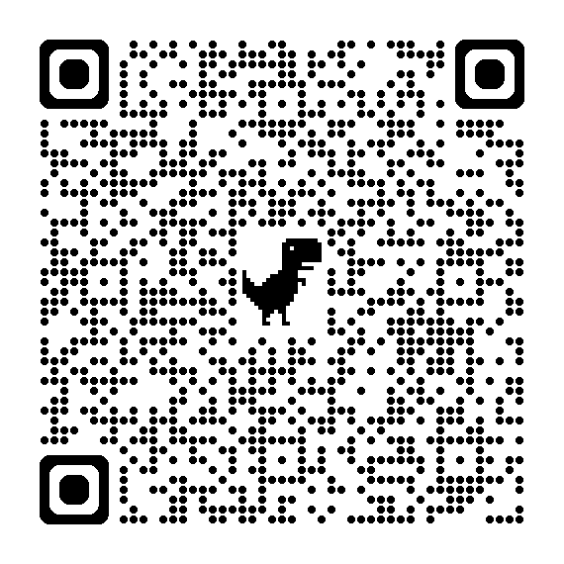
Job Outlook 2024 – Candidate Attributes
Notes:
Key Attributes –
Which do you possess?
Where, when, and how did you develop or obtain them?
What examples can you provide on your resume?

Slide 8
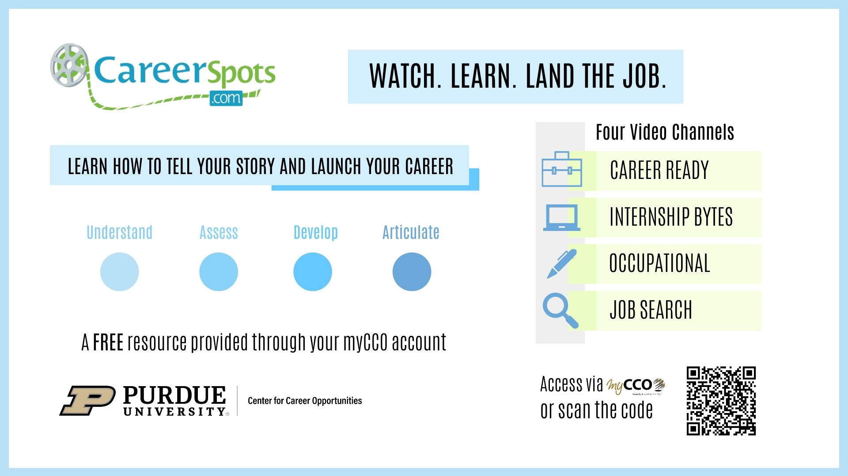

Slide 9



Notes:
BE FLEXIBLE, PATIENT, AND POSITIVE
Cast a wide net
Remember that waiting is inevitable
Stay optimistic – likeability & attitude matter

Slide 10

Action Steps
I am most motivated to follow up on…
One lingering question I have about career readiness would be…

