Slide 1
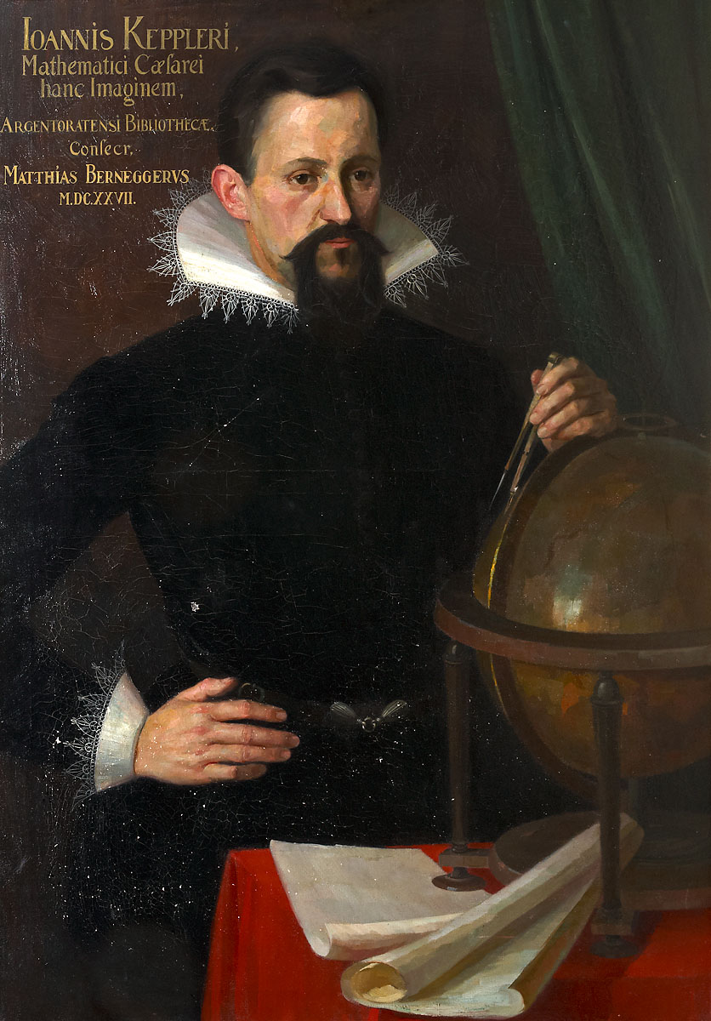
Notes:
Danish nobleman known for his accurate and comprehensive astronomical and planetary observations. Was given an island to conduct research. Tycho lost part of his nose in a sword duel against fellow Danish over the legitimacy of a mathematical formula, at a wedding dance. Proof that the heavens did change.

Slide 2
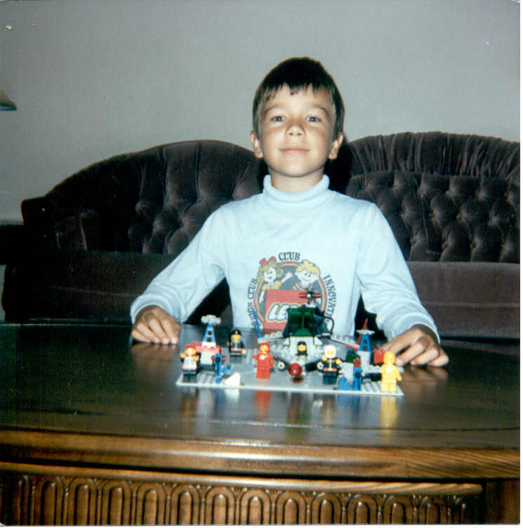
Notes:
Danish nobleman known for his accurate and comprehensive astronomical and planetary observations. Was given an island to conduct research. Tycho lost part of his nose in a sword duel against fellow Danish over the legitimacy of a mathematical formula, at a wedding dance. Proof that the heavens did change.

Slide 3
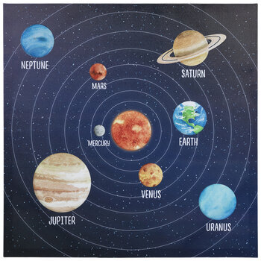

Slide 6
1 Astronomical Unit (AU) = Distance from Earth to Sun
93 millions miles (150 million kilometers)

Slide 7


eccentricity
focus
semi-major axis
$$e=\sqrt{1−\left(\frac{b^{2}}{a^{2}}\right)}$$
Ellipses
$$c^{2}=a^{2}−b^{2}$$
semi-minor axis
Pluto e = ??

Slide 9
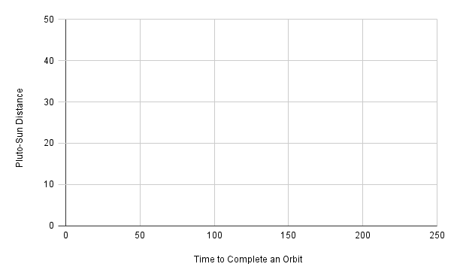

Slide 10
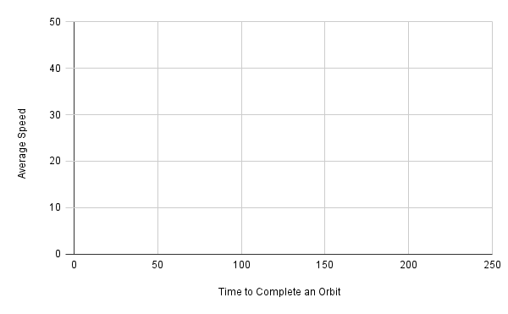

Slide 11
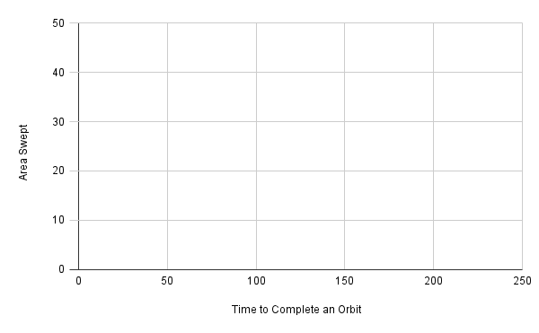

Slide 12
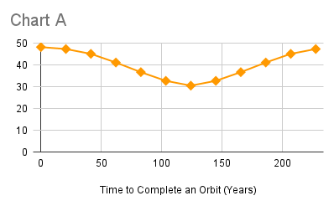
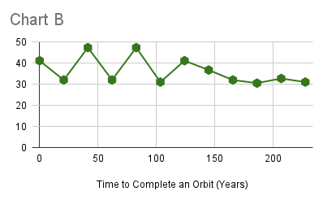
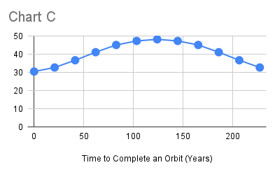
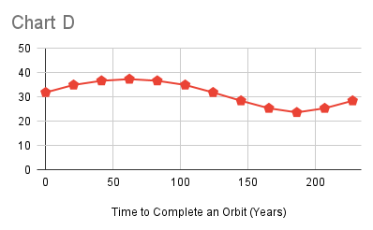
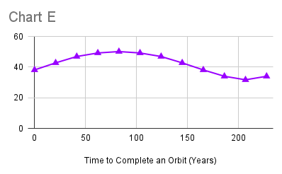
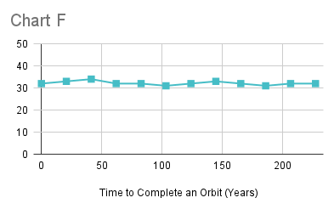

Slide 14
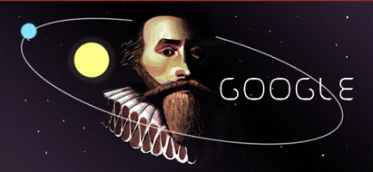
Notes:
Danish nobleman known for his accurate and comprehensive astronomical and planetary observations. Was given an island to conduct research. Tycho lost part of his nose in a sword duel against fellow Danish over the legitimacy of a mathematical formula, at a wedding dance. Proof that the heavens did change.

