Slide 1


Slide 2

Ralph W. and Grace M. Showalter Research Trust
Early Career Award
Perry Kirkham, Coordinator of NIH Research Development
Office of Research
Strategic Interdisciplinary Research
pkirkham@purdue.edu

Slide 3

The Ralph W. and Grace M. Showalter Trust grants program was established in 1975 to support research related to human health in the priority areas of:
Environmental research, including air and water pollution research
Research in the field of biochemistry and molecular biology
Research in the area of disease prevention, diagnosis, progression, treatment and control
Research in the area of new technologies for food production, preservation, distribution and safety
Research in the area of medical and biophysical instrumentation, including the analysis of large data sets

Slide 4
Showalter Trust priorities:
The stated mission of the Showalter Trust is to provide for medical and scientific research at Indiana University School of Medicine and Purdue University.
Although the Trust identifies broad areas of research as priority areas, the external Showalter Selection Committee assigns higher priority to projects with direct relevance to human health.
The benefactor’s will prohibits the use of funds to support research in psychiatry, sociology, or social studies.
Awards are limited to tenure-track and research faculty who hold the rank of assistant professor based on the West Lafayette or Indianapolis campus.

Slide 5
Overall timeline and review process:
Pre-proposals are due by 5:00 pm ET on October 27, 2025.
An Internal Selection Committee, primarily composed of Purdue Associate Deans for Research, reviews and selects the most meritorious pre-proposals for development into full proposals, which are due January 26, 2026.
Full proposals are reviewed and ranked by the internal selection committee plus selected ad hoc reviewers. This ranked list of full proposals are sent to the external Showalter Trust Selection Committee for review. The external review determines the final awarded proposals.
Announcement of final award decisions occurs in late May or early June.

Slide 6
What are the reviewers looking for?
Priority is given to projects that have a high potential to compete for or leverage federal funding and to create programs with a life span longer than the Showalter award.
A careful selection of one or two published or anticipated PA/RFAs can be very helpful but be strategic about these FOAs.
Stating that you will submit to ARPA-H, NIH, NSF, or another federal agency is not sufficient.
Example of specificity preferred: “I plan to use the data resulting from this Showalter as preliminary data for submission of an R01 to NIH PA-25-303, hopefully for the October 2026 cycle.”

Slide 7
What are the reviewers looking for?
The proposal must fit clearly within one or more of the five priority areas.
Although the Trust identifies broad areas of research as priority areas, the external Showalter Selection Committee assigns higher priority to projects with direct relevance to human health.
  Our experience is that this recommendation isn’t simply a priority, it is a necessity.
  Without a defined connection to showing an impact on human health, the research is unlikely to move forward in the competition.

Slide 8
Proposal writing tips:
Be very clear about specific aims for this proposal, your overall goal for this work, anticipated outcomes (including what data you plan to get from this work), and long-term plans.
Do not assume reviewers will understand how your proposal will improve human health. Be explicit, with a target system, pathological condition, or relevant and validated mechanism in mind. If you propose to investigate a new mechanism, ensure that the logic is rigorous and obvious.
Start and end with a statement or two directly addressing relevance to human health. Use active verbs to describe your aims/studies. “We need to understand x better” is not a sufficient goal.

Slide 9
Proposal writing tips:
Collaborators and/or consultants are allowed, and, in some cases, encouraged, where a gap in expertise or data access will be obvious. Letters of support and/or commitment of effort can be vital. Ensure that the type of support and enthusiasm is stated clearly in the letter(s).
The pre-proposal is limited to two pages of narrative. Use this judiciously in describing the relevance to human health and well-being. The details are not usually as important as the overall intent.

Slide 10
Budget:
Limited to a total of $75,000, including indirect costs calculated at a rate of 20% of total direct costs
Default award period is 13 months: July 1, 2026 - July 31, 2027
Limited to one month of total effort for faculty salary (for all faculty combined)
Postdoc, graduate, and undergraduate salary support is allowed
Proposed capital equipment must include a 75% cost share from another source.
Budget for travel is allowed but discouraged by the Showalter committee and must be well justified.
Within the budget justification: List supplies in general categories and provide justification for their inclusion.
  Animals: number and per diem rates should be stated and justified.
  Human Subjects: provide details and justification sufficient for reviewers to make informed decisions.

Slide 11
Pre-Proposal Application Details:
The deadline for preproposal submission is 5:00 P.M. on Monday, October 27.
Only one application is allowed per principal investigator.
Use the pre-proposal application template (link available on website)
Single-spaced, not to exceed two (2) pages in length
One-inch margins on all sides
Font: Arial 11
The following are required, but not included in the 2-page limit:
References
Standard NIH Biosketch (do not use a modified NSF CV)
List of current and pending support for the PI and each Co-PI
Outline budget and brief justification (please do not involve pre-award)
You may include a brief response to a previous critique (not included within the 2-page application).
Late applications will not be accepted.

Slide 12
Full Proposal Details:
If invited, the full proposal is due by 5:00 pm on January 26, 2026.
Full Scientific Proposal
(single-spaced, not to exceed 6 pages):
Specific Aims
Significance
Research Plan (can include preliminary data)
Future Directions
Cited Literature (not included in 6 pages)
Appendices:
One page status report for past Showalter awardees
Letter of support from department/school head
Letter of support from senior investigator, if applicant is research assistant professor
Letters of support from key collaborators
Additionally, an abstract (30-line limit), fully developed budget and budget justification, and NIH-style biosketches and current and pending report are required.
This proposal must be submitted by SPS pre-award. Do not wait until the last minute to notify their team.

Slide 13
Additional Details:
In a typical year, we receive 30-40 pre-proposals to review internally. Of these, 15-20 are invited to submit a full proposal.
The full proposals are reviewed and ranked by a committee of the ADRs and an equal number of Purdue faculty selected for their field expertise. Most, if not all, of these ad hoc faculty are previous or current Showalter awardees.
Usually, 10-11 of the proposals submitted to the external Showalter Committee will be funded.

Slide 14
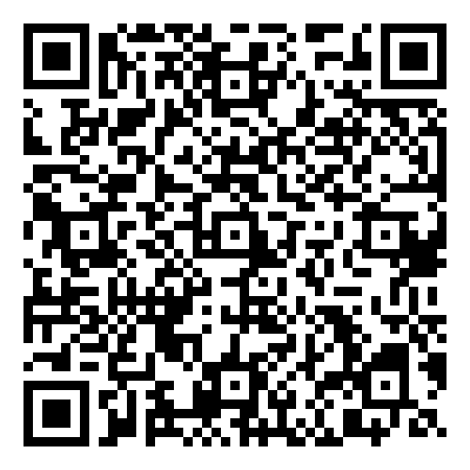
Questions?
Showalter webpage
https://www.purdue.edu/research/oevprp/funding-and-grant-writing/funding/showalter.php

