Slide 1
Sponsored Program Services
POST AWARD
Susan Corwin
Director, Post Award
Sponsored Program Services
November 13, 2018

Slide 2
SPONSORED PROGRAM SERVICES
POST AWARD
Sponsor Specific Areas
NSF/DHHS
Other Federal
Non-Federal
Ag Field Office
Notes:
Post Award activities are divided into sponsor specific areas.
Ag Field Office handles most international grants as well as several major projects that were awarded within the College of Agriculture.

Slide 3
Proposal is Submitted - What Now?
Agency sends Notice of Award
Directly to SPS
Directly to Faculty
Notice to Proceed (NTP) will allow you to start research before award is received.
NTP is a line of credit established to allow a project to begin prior to receipt of a fully executed award
Business Office will work with SPS to get you an account number
IMPORTANT: Regulatory approvals and Conflict of Interest (COI) disclosures must typically be in order prior to start of research.
Notes:
Once a proposal is chosen for funding, the granting agency will forward to award notice to SPS. Sometimes it is sent directly to a faculty member so if you receive a notice directly from the agency, please forward to awards@purdue.edu
An NTP can be established if the financial officer at the agency/company can confirm the project period and dollar amount of the project.
Human/Animal Subject Approval
FCOI certification for all sponsors must be complete
FCOI certification and training must be complete for PHS (Public Health Service), which includes DHHS (NIH)

Slide 4
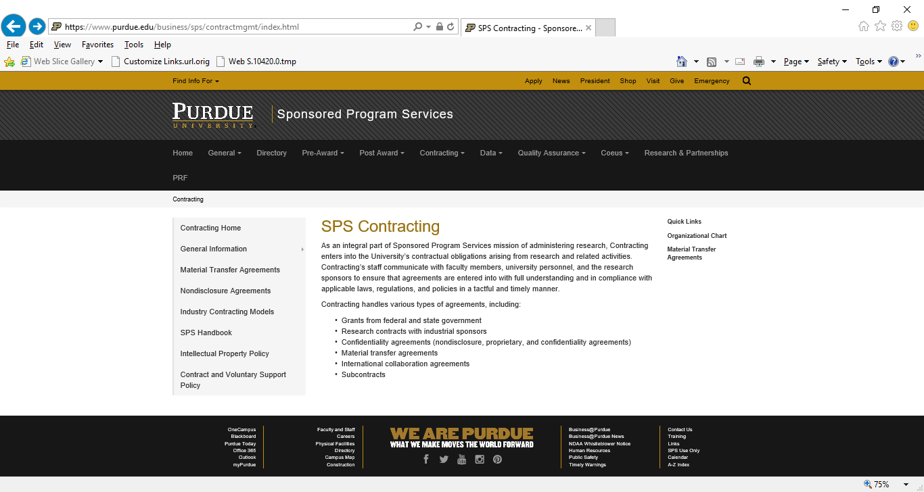
https://www.purdue.edu/business/sps/contractmgmt/index.html/

Slide 5
Sponsored Program Services
Contracting
Negotiate and process all contracts associated with sponsored programs
Services include, but are not limited to:
Read and review entire contract, including all attachments
Funding Agreements (Federal, State, Industrial/Non-profit)
Confidentiality Agreements (NDA’s, CDA’s)
Material Transfer Agreements (MTA’s)
Equipment Transfer/Loan Agreements
Miscellaneous Agreements (MOU, LOI, LOA’s, Etc.)
Identify terms not matching proposal (project term, deliverables, etc.)
Contact Proposal Specialist or PI for clarification/ verification
Ensure export control review is complete
Identify contractual terms not in compliance with University policy, federal requirements, state requirements, and state and federal law
Present redline to sponsor and negotiate
Contracting Email: spscontr@purdue.edu

Slide 6
Types of Awards
Spectrum of Sponsor Influence
No consideration
Gifts MOU/MOA Grant Contract
Membership
Agreements
Teaming
Agreements
Cooperative
Agreement
Notes:
The spectrum of sponsor influence on sponsored activity ranges from a gift where there is no expectation of deliverables through a contract where a sponsor will be very specific about what they must receive and the milestones for receiving the information.
Grants and Cooperative Agreements typically have standard terms and conditions
Contract has specific terms & conditions (along with deliverable) which don’t allow for much flexibility and it may take time to negotiate if there are items in the Contract which the University cannot agree to….IP rights and Licensing royalty rights

Slide 7
SPS Contracting
Role of Contract Analyst
Contract Analyst ensures:
The University can and should meet the obligations as written within agreement.
The award truly reflects the University’s understanding of the activity
Any contract/agreement entered into by the University is compliant with State and Federal law, and with University policy
Notes:
Signature delegation for signing sponsored contracts is limited to staff in SPS Contracting. They will review all contracts and awards that require an official University signature.
Contracting staff will also be involved with all awards that include a subcontract.

Slide 8
Award Arrives
What information is included?
Start/End Dates
Award Amount
Approved Budget
Agency Contacts
Payment Terms
Notation of Special Restrictions/Conditions
Cost Sharing
Limitations on Spending, Prior Approvals
Required Reports (Technical, Fiscal)
Intellectual Property Rights & Requirements (Industrial)
Licensing Royalty Rights (Industrial)
Publication Rights (Industrial)
Notes:
The award document will outline requirements Purdue and the sponsoring agency have agreed to such as project period, award amount, approved budget, etc. Most of these details will have been initiated through the pre-award process, however, other terms and conditions included in the contract such as special restrictions/conditions, limitations on spending, prior approvals, required reports, IP, Licensing Royalty Rights and Publication Rights will also be included in the final contract. Contracting will work with faculty members on any unique terms and conditions included in the final contract before fully executing the agreement.

Slide 9
Award Establishment
Communication is Key
Principal Investigator
Sponsor
Business Office
Research Professional Staff
Pre-Award
SPS Contracting
SPS Post Award
Notes:
Many staff interact throughout the life of the project. Pre-award will work with the faculty member to submit the award, contracting will assist with fully executing contracts, your business office and research professional staff will work with SPS Post Award to establish accounts and answer questions throughout the life of the project.

Slide 10
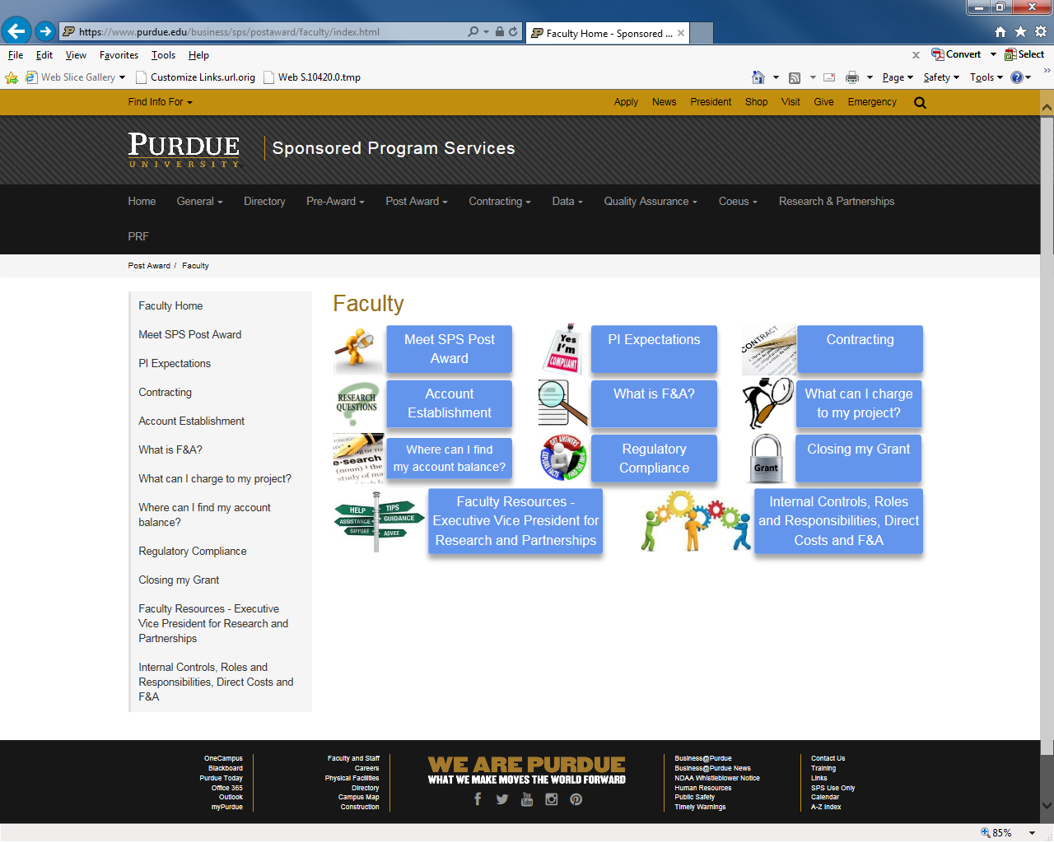
https://www.purdue.edu/business/sps/postaward/faculty/index.html/

Slide 11
Sponsored Program Services
Post Award
Support is provided through sponsor specific areas which include: NSF/DHHS, Other Federal, and Non-Federal
Services include, but are not limited to:
Award establishment, management, and closeout
Serve as resource for faculty, researchers, and business offices
Provide guidance on sponsor specific guidelines and regulations
Ensure all regulatory requirements and export control issues are identified and contain appropriate disclosures and approvals
Review award document for requirements and highlight key issues for faculty and business offices
Work with partnering institutions to secure all subcontract documentation
Facilitate the establishment of agreements with and the payment of sub recipients
Manage collection of sponsor income, including draws under the federal letters of credit
Prepare and submit financial and property reports
Assist with electronic submission of technical reports

Slide 12
Cost Allocation
Time to start spending!
First Point of Contact:
Departmental Business Office
Human Resources
Purchasing
Account Numbers (Startup/Discretionary funds)
Travel
Account Management
Notes:
Your business office will be your first point of contact for hiring new staff, paying existing staff and/or students from the project as well as assisting with purchasing, travel and account management (projections).

Slide 13
Award Establishment
Post Award
Awarded budget may be divided internally into multiple sponsored program accounts:
Multiple Investigators
Unique categories (tasks, projects, sub-projects) & reporting requirements
Incremental funding
Specific budgetary restrictions
Cost share
Notes:
An award may be divided internally within Purdue’s system to allow for more effective management. The grant can have multiple Sponsored Programs/Internal Orders for various reasons, such as those listed.
PIs and Business Offices are notified via email from Post Award when accounts are completely established.

Slide 14
Cost Allocation
Roles of the Principal Investigator
As PI, what is my role in allocating costs?
Must assure charge is:
Reasonable and necessary
Incurred within the project period
Allowable in accordance with sponsor guidelines
Allocated on the basis of benefit to the project
Notes:
Allowable? Business Offices and Post Award can assist with this determination.
Allocable? Is the cost beneficial to the project…you and your staff assist with this determination
Reasonable? Proper stewardship
If the cost is allocated across multiple funding sources, is it easy to understand the allocation method?

Slide 15
Managing the Award
Roles of the Principal Investigator
Direct the work
Within project period
Within budget authorized by sponsor
Determine Staffing
Project should be staffed according to budget unless something has changed
Communicate with Business Office
Work closely with business office if changes to budget categories are needed; sponsor prior approval may be required
Notes:
Changes to what was originally proposed may require sponsor approval. Let your Business Office or Post Award AM know if there is a change at award time.

Slide 16
Managing the Award
Prior Approval
Items that may require prior approval:
Change in Scope
Changes in Key Personnel
New/Additional Subcontracts
Foreign Travel
Capital Equipment
PI absence exceeding 3 months
PI reduction of effort exceeding 25%
Extension of time
Notes:
Prior Approval requirements vary by sponsor and also by type of agreement (grant v. contract)
Business Office and Post Award can assist you with determining if any of these changes require sponsor prior approval.

Slide 17
Managing the Award
Technical Reports
Principal Investigators are responsible for the timely submission of all technical reports
Due dates are in award document
Information available in Grants Management (GM) Account Information Management System (AIMS)
Contact SPS Research Administration Specialist with questions
Why be timely?
Proper stewardship
Requirement (as part of terms & conditions)
Incremental or future funding may depend upon receipt of the report
Notes:
Will address GM AIMS in following slides
Incremental/future funding for yourself and others at Purdue is dependent on timely submission of reports

Slide 18
Managing the Award
Financial Reports
GM AIMS provides:
Real-time tracking of grant budgets and expenditures
Expenditure details such as PO numbers, vendors and item descriptions
Information on technical reports
When due
Where & how to send
Balance trends charts
Projection tool to estimate future balances
GM AIMS is accessible via the GM AIMS Faculty Portal https://www.purdue.edu/apps/account/cas/login?service=https%3A%2F%2Fwww.purdue.edu%2Fapps%2Faccount%2Fcasclient%2Flogin
Notes:
AIMS (Acct Info Mgmt System)
Web-based application tool that provides faculty with a set of tools to assist in financially managing grant funds
Will provide DAILY updates
Will include all due dates of technical reports for projects where you are the PI
Will provide budget/expenditure/balance information on accounts where you are listed as the co-PI
You can request that other staff who work for you also get access to your grants in AIMS.

Slide 19
After Close-Out of Award
Record Retention
Terms and Conditions of Award allow auditors the right of access to all University records associated with a project
PI Responsibilities:
Scientific records and data
Regulatory material (if applicable)
Maintain for THREE years after completion/submission of final report
May be contacted by auditors regarding certification of effort and other items
Notes:
There is always a chance that your project could be chosen for an audit. In the case of an audit, your responsibility as a PI is to maintain:
Scientific records and data
Regulatory material (if applicable)
Maintain for THREE years after completion/submission of final report
May be contacted by auditors regarding certification of effort and other items

Slide 20
Sponsored Program Services
Contact Information
Ken Sandel
Senior Director, SPS
49-41063
sandel@purdue.edu
Earl Knight, III
Director, Contracting
49-41059
knight79@purdue.edu
Susan Corwin
Director, Post Award
49-41052
postawd@purdue.edu
Beth Siple
Assistant Director, Ag Sponsored Programs
49-48464
sipleb@purdue.edu

Slide 21
Managing Your Award: Research Regulatory Affairs
Ianthe “Cookie” Bryant-Gawthrop
Director, Research Regulatory Affairs and Human Research Protection Program

Slide 22
PIs Have Many Regulatory Responsibilities
Keep up with sponsor-specific human/animal/rDNA/RCR requirements
Apply to committees applicable to your research
Train staff and keep records of training
Develop strategies that allow your research team to fulfill regulatory requirements
As a PI, you are responsible for the research study from its design through its implementation, and the maintenance of study data and records.
The Regulatory Affairs staff can assist you with the right path. Today, we will briefly cover regulatory requirements and how they relate to your proposals and awards for sponsored funds.

Slide 23
Regulatory Acronyms
IBC-Institutional Biosafety Committee
rDNA, unfixed human blood
IRB- Institutional Review Board
Human subjects, surveys, existing datasets,
P(I)ACUC-Purdue (Institutional) Animal Care and Use Committee
Vertebrate Animals
RCR - Responsible Conduct of Research
RCR Training is required by some federal sponsors
FCoI - Financial Conflict of Interest

Slide 24
Regulatory Training
Each area requires relevant training prior to approval of a research protocol
Most areas require training through the CITI Program (CITI), external to Purdue
CITI refers to the name of the program, several courses are offered in topics like Human Subjects research, Biosafety, etc. You and/or your research team may need to take more than one course to complete the correct requirement.
See https://www.purdue.edu/research/publications-data/infographics/pdfs/citi%20program.pdf

Slide 25
Sponsor Specific Training-- Responsible Conduct of Research (RCR)
Certain federal sponsors require RCR training (NSF, NIFA/USDA, some NIH) Requirements differ between agencies
Consists of online training course and may include discussion based learning (seminar, course, etc.)
NSF requires all trainees (postdoctoral fellows, graduate students and undergraduate students) to have training in RCR matters.
NIFA (USDA) requires all research personnel, including PIs and research staff to complete training.
Some NIH fellowship programs also require training in RCR matters.

Slide 26
Financial Conflict of Interest
A Conflict of Interest(COI) is any interest, financial or professional that would bias, or appear to bias, objectivity in research, scholarship, and other professional activities.
Financial COI: Occurs when an individual's financial interest influences their professional actions, decisions, or judgment, in pursuing research, scholarship, other professional activities.
The EVPRP Office, through its FCoI staff assists and helps researchers manage research-related FCoI.
If necessary, the FCoI staff will assist the investigator in preparing a management plan.
The process is dependent on investigator disclosure of any interests at the time of proposal submission. Investigators answer questions from the online Proposal Disclosure Database (PDD).

Slide 27
Research with Human Subjects
The Human Research Protection Program implements Purdue’s commitment to protect participants in research.
An IRB is a committee that performs ethical review of proposed research with human subjects.
An IRB must have at least five members, with varying backgrounds to promote complete and adequate review of research activities commonly conducted by the institution.
There are three types of review conducted based on risk to the participant. Exempt, Expedited and Full Board.
Purdue has two Institutional Review Boards who review based on research area
Social Science
Biomedical IRB
Sponsors of research involving human subjects will require documentation of IRB approval at some point prior to an award.

Slide 28
Questions to Help Begin the IRB Review Process
Is it Human Subject Research?
Is it eligible for exemption through PROPEL? (Common category- examples)
Exempt 2, surveys, interviews, observation of public behavior
Exempt 4, pre-existing data
Does it qualify for Expedited review? (no greater than minimal risk).
Data collected by non-invasive procedures
Collection of data from voice, video, digital , or image recordings
Does the potential risk to the participant require that the entire IRB meet and review the study?
Full board meets monthly, submission deadline 2 weeks before meeting.
New to Purdue IRB Pre-Review project coming soon.

Slide 29
Submitting Documents to the IRB
www.irb.purdue.edu
A step by step walk through of the forms and considerations to make when designing your IRB submission.
Forms and instructions to use after your study is approved by the IRB.
A link to the submission portal. Enter your Purdue Career Account to access. Then follow the directions to attach forms and submit directly to the IRB/HRPP staff.

Slide 30
Clinical Trials
Some research with human subjects may be considered a clinical trial under recently revised definitions.
Trials funded by NIH require registration and updated results to be submitted to Clinicaltrials.gov
If your study could potentially be considered a clinical trial under this definition, additional training and record management requirements will apply.
“A research study in which one or more human subjects are prospectively assigned to one or more interventions (which may include placebo or other control) to evaluate the effects of those interventions on health-related biomedical or behavioral outcomes.”
*Note- this applies to behavioral interventions, not just those of a biomedical nature.*

Slide 31
Research with Vertebrate Animals
The Purdue Animal Care and Use Committee (PACUC) oversees all review of research conducted with vertebrate animals as required by the US Dept. of Health & Human Services Office of Laboratory Animal Welfare (OLAW).
In addition, the Purdue Laboratory Animal Program (LAP) provides veterinary care, housing, and other required practices to ensure animal well being in research, testing and teaching.
PACUC applications are submitted through the COEUS system. Proper qualifications and training are required prior to authorization to conduct research with vertebrate animals.
There are two types of review conducted by the PACUC based on risk. (Designated or Full Board)
Sponsors of research involving vertebrate animals will require documentation of IACUC approval at some point prior to an award.

Slide 32
Research with Biohazards, Synthetic or Recombinant Nucleic Acids
Research involving any of the biohazardous materials or those regulated by the NIH Guidelines requires review by the Institutional Biosafety Committee (IBC).
An IBC protocol requires a PI to detail the use, personnel, containment, and disposal procedures to protect the safety of the research team and surrounding community.
Apply to the IBC early. Training and lab inspections are required prior to a protocol approval.
Sponsored research awards related to biohazards or rDNA research are not accessible until the IBC approval is complete.

Slide 33
Grant to Protocol Review Process
GRANT/AWARD
Sponsor (NIH, NSF, I/F, etc).
Proposal submitted
Sponsor funds activity
We review and document that these two items are congruent
PROTOCOL
Protocol application describes specific elements of research with humans/animals/ rDNA
Campus Committee (IRB, IACUC, IBC)
Committee provides determination

Slide 34
Regulatory Check Points Occur at Various Stages in the Lifetime of an Award
JIT- (Just In Time) Prior to Award Determination
Is the sponsor asking for IRB/IACUC or approvals training certs
Contract Terms
Is a sponsor trying to bind us to non-standard terms?
approving a protocol or mandating a date where a protocol must be approved
accepting alternate protections outside US protections (45 CFR 46, “Common Rule”, DHHS regs, etc.)
Protect human research data in a particular prescribed manner
Notices To Proceed (NTP)
Account Set-Up
Incremental fund distribution, Increase/Decrease
Verify work in progress reports or changes to procedures.
Changes in Scope or PI
No-Cost Extensions
Unanticipated Human or Animal Charges
Proposal Submission
Pre-Award
Award Negotiation/Acceptance
Contracting
Award Management
Post-Award
Award Closeout

Slide 35
Tips
Read the request for proposal (RFP) and note the requirements for your IRB, IACUC or other regulatory affairs commitments.
Review the terms of a contract or award.
Prepare regulatory submissions early! Federal Sponsors use “Just in Time” practices to collect regulatory information. Many now require protections of human subjects/ vertebrate animals to be part of the proposal.
Answer all questions about your proposal with your Pre-Award center
Consider building time within the project period to acquire all regulatory approvals and funds within the budget to cover regulatory considerations
Many sponsors require titles of IRB/IACUC protocols to match the award exactly.
Subscribe to and read the EVPRP Dimensions of Discovery publication. https://www.purdue.edu/research/publications-data/discovery-dimensions.php

Slide 36
Helpful Links and Contacts
Research Regulatory Affairs Area | Contact See (https://www.purdue.edu/research/regulatory-affairs/)
Human Research Protection Program/IRB | irb@purdue.edu
Biosafety, Recombinant DNA | rwgolden@purdue.edu Robert Golden, Biosafety Officer
Vertebrate Animals | ldsnider@purdue.edu Lisa Snider, PACUC Administrator
Research-Related Conflicts of Interest | fcoi@purdue.edu
Clinicaltrials.gov Registration or Grant to Protocol Review | evprpregulatory@purdue.edu
Radiological and Environmental Management (REM) | https://www.purdue.edu/ehps/rem/ (Many areas fall under this single department)

Slide 37
Research Information Assurance and Export Control Regulations
Mary Duarte Millsaps
Research Information Assurance Officer

Slide 38
Inherent Conflict
Purpose of Research
Intent of the Export Control Regulations
“The creation, dissemination, preservation and application of knowledge for the betterment of our global society” -
- pulled from the mission statement of UCLA
U.S. Government controls export of sensitive equipment, software and technology to promote:
National Security Interests
Foreign Policy Objectives
Regional Stability
Human Rights considerations
Prevent Proliferation of weapons and technology to sponsors of international terrorism
Comply with International Commitments

Slide 39
What happens when there are limits on dissemination?
Examples:
Inputs received from third parties – industry (through a Non-Disclosure Agreement or project agreement)
Controlled information from the federal government
Project Agreements with dissemination limitation and publication restrictions
Results of industry research with unique Intellectual Property ownership or publication approval terms

Slide 40
Information Assurance Considerations
Safeguarding access and use of such information
Good rule of thumb: Need to Know
Consider digital controls
Impact of Export Control Regulations

Slide 41
Confidential Information
Starts with a Contractual Obligation
An Institutional Obligation – Purdue is the legal party
Nondisclosure Agreement (Confidentiality Agreement)
Industrial Contract
Responsibility of compliance is delegated to the responsible person (most cases a principal investigator)

Slide 42
Confidential Information
Key Points
Who | Determination of who will have access Limit to those who truly have a need to know Keep track Make sure all with access understand the requirements
What | Identification of what is confidential - BE CLEAR! (e.g. technical specifications, business plans)
Why | Identification of the purpose or reason it is being shared Limit use to the purpose, and nothing else
How | Proper Handling and Safeguarding of Confidential Information

Slide 43
Export Control Regulations
U.S. laws that regulate the export of strategically important products, software, services, and technical data to foreign persons and foreign countries for reasons of foreign policy and national security.
Affects physical export and sharing of information (technical data or technical information about controlled technology)

Slide 44
Export Control Compliance Legal/Regulatory Basis for Controls
Legal Basis | Regulations | Cognizant Agency | Identification of controls
Arms Export Control Act (AECA) 1976 | International Traffic in Arms Regulations (ITAR) 22 C.F.R. Parts 120-130 | Department of State Directorate of Defense Trade Controls (DDTC) | U.S. Munitions List
Export Administration Act 1979 | Export Administration Regulations (EAR) 15 C.F.R. Parts 700-799 | Department of Commerce Bureau of Industry Security (BIS) | Commerce Control List (ECCN numbers)
Trading with the Enemy Act and various other acts | Various sanction programs 31 C.F.R. Parts 500-599 (“OFAC sanctions”) | Department of Treasury Office of Foreign Assets Controls (OFAC) | Specially Designated Nationals list (SDN) Various country specific lists
Note: there are additional federal acts that some times impact Purdue activity (like the Atomic Energy Act of 1954) that may also need to be considered.
Notes:
The complexity of EC rules stems from a long evolution and multiple federal jurisdictions. There is a harmonization project underway, but that has been a 5 year process to date, and we aren’t fully there yet.
In many cases, these Acts built on previous Acts and have been significantly modified by amendments and Executive Orders
ITAR
EAR (more to follow about ECCNs Export Control Classification Numbers)
OFAC
If you have followed the Evolution of our Cuba relations, the announcement of changes happened, following a Presidential action, about 6 months before the regulations caught up. (and then we have had several iterations of regulatory updates
(impacted both OFAC regulations and EAR)

Slide 45
Export Control Compliance Legal/Regulatory Basis for Controls - part 2
Jurisdiction | What’s Controlled | Federal approval requirements
ITAR 22 C.F.R. Parts 120-130 | Defense articles (and technical data) or Defense services USML - 19 Categories ranging from Explosives and propellants to Toxicological Agents “Specially Designed for…” | Non-US Persons Defense services for foreign sponsors
EAR 15 C.F.R. Parts 700-799 | Dual Use commodities and related technology typically for commercial use CCL – 9 Categories ranging from nuclear to telecommunications (Organized by ECCN) (All technology not controlled by another Jurisdiction) | Depends on the commodity and reason for control. (CCL - ECCN) Note: EAR99 – Catch all
OFAC 31 C.F.R. Parts 500-599 | Support for and business with the subjects of the various sanctions | Specially Designated Nationals list (SDN) Cuba, Iran, North Korea, Sudan and Syria
Notes:
A Note about the ITAR – the funding source doesn’t determine if something is subject to the ITAR or subject to the EAR. It is the technology and its capability.
Note about OFAC – think Vladimir Putin and the Ukraine/Russia related sanctions

Slide 46
Export Control Compliance Key Definitions
Term | Definition
U.S. Person | Any US Citizen, or lawful permanent resident (green card holder); Any corporation, society or other entity incorporated or organized to do business in the U.S. Any federal, state, or local government entity in the U.S.
Foreign Person | Everyone else, including foreign students here are student visas (J and F) and foreign employees on non-immigrant visas types (e.g. H1B or O). Foreign corporations, societies or entities.
Export | is defined very broadly to include an oral or written disclosure of information about, visual inspection of, or actual shipment outside the U.S. of controlled technology or technical data, software/code or equipment to a foreign person.
Deemed Export | Any disclosure of information or release of controlled technologies to a foreign person in the U.S. is deemed to be an “export” of that information or technology. NOTE: Any method of disclosure may apply: email, telephone, websites, face-to-face discussions, training sessions, tours that involve visual inspections
Notes:
The intention is not discrimination, but compliance. These are federal regulations.
When a foreign person gains permanent residency, they are become fully a US person
To better under the regulations, there are a few key definitions you need to know first.
In order to get through this training and give you what you need, I will be somewhat simplifying this by using terms technology for both technology (EAR) and technical data (ITAR).
If you hear something that seems off, please ask. I want to add to your current knowledge, not confuse you further.
Technology is both the thing and the information necessary to build, maintain, repair the thing.

Slide 47
Fundamental Research Exclusion (FRE)
Fundamental Research definition covers most university research
Fundamental Research is basic and applied research the results of which are normally published freely in the scientific and engineering literature; must be non-proprietary in nature
Publication delay for sponsor review is allowable
FRE Does not apply to
controlled inputs (like external confidential information)
Research that is subject to publication approval or dissemination controls
Informal arrangements to hold information in confidence

Slide 48
Nexus of Confidential Information and Export Control Regulations
Confidential Information and Research results subject to Dissemination Controls
Technical Information- Technical Data
It is subject to export control regulations

Slide 49
Compliance Process
PI input is required
Contract received/reviewed for triggers
Contract Execution
Publication approval
Restrictions on participants
Dissemination limits
Export Control review
Jurisdiction review (EAR v. ITAR)
Lab review
Technology Control Plan (if necessary)
Includes both physical and digital controls
Account establishment
SPS
SPS
EVPRP Export Control/Information Assurance Team

Slide 50
New Faculty Considerations
How likely is technology in my field to be controlled by these regulations?
The Information Assurance/Export Control Team can help you with this
How likely am I to seek funding from sponsors who will assert dissemination/participation controls?
Department of Defense
Nuclear Regulatory Commission/Department of Energy
Industry
What do I do if I want to avoid research subject to these controls?
Stay within the fundamental research exclusion (FRE)
Avoid publication approval requirements
Be clear with new funding sources
If I plan on including foreign students in my lab and I will do controlled research – how will I keep the effort segregated?

Slide 51
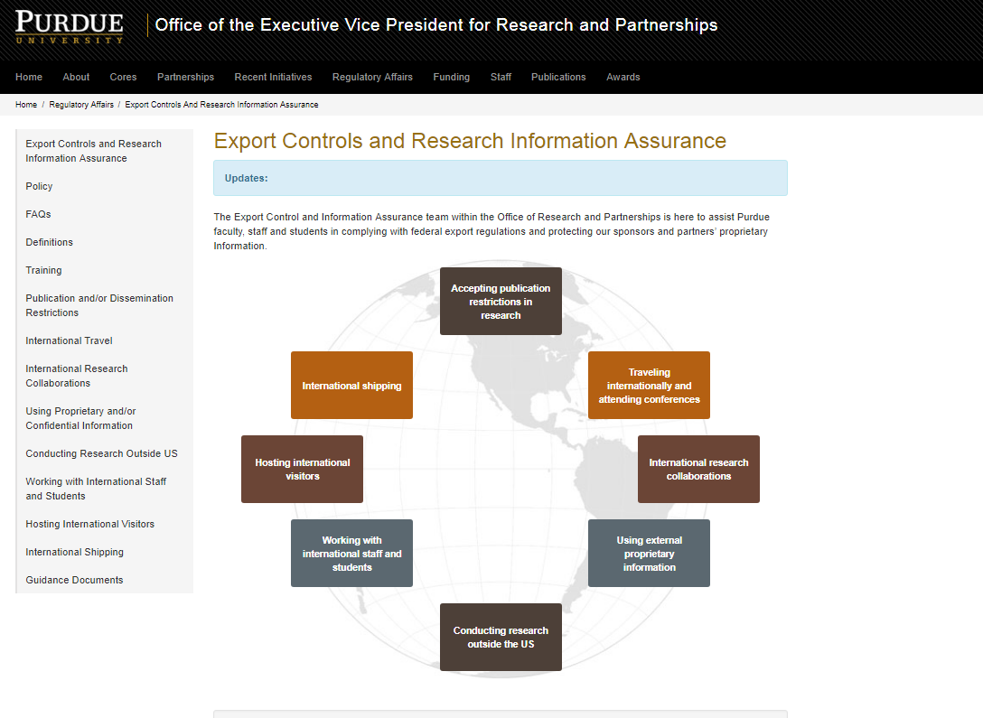
New Website

Slide 52
Contacts
Information/Export Control Team (within the EVPRP)
exportcontrols@purdue.edu; 494 - 9806
Mary Millsaps – Research Information Assurance Officer
Steve Riedel
Ken Suter
Jama Johnson
Sherri Neibert – Administrative support

