Slide 1
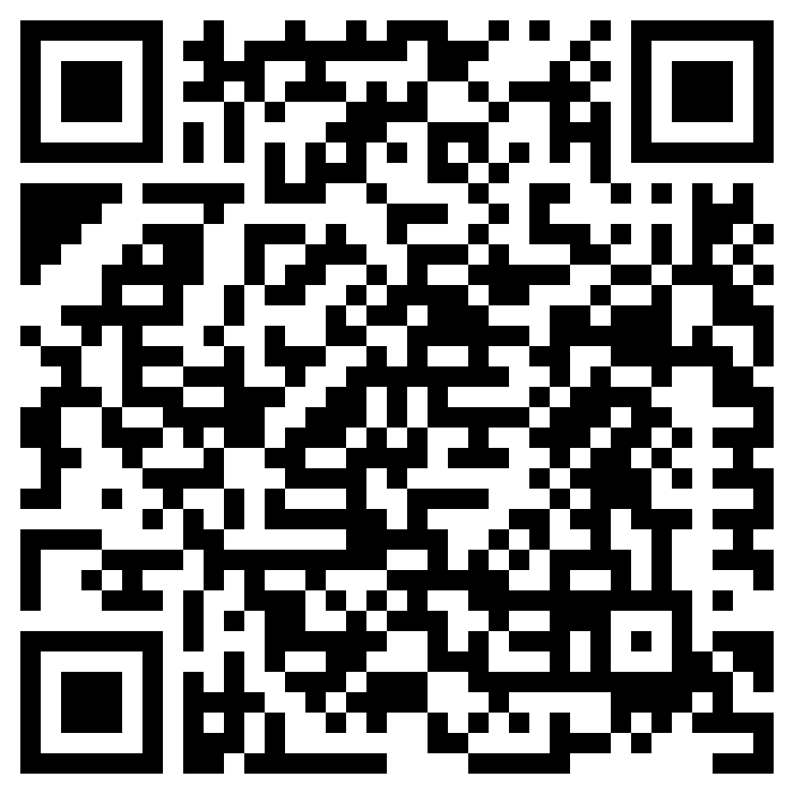

Wellness Coaching
Resources & Accountability for Your Goals
Meet with a RecWell Coach to improve your overall well-being. Sessions are free to students and provide accountability and information on how improve health and wellness.

Slide 2
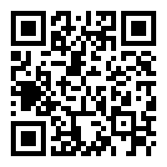
Student Legal Services
Legal Guidance and Resources
Did you know student have access to free legal advice. Student Legal Service scan help with landlord issues and even help you host a safe party.

Slide 3
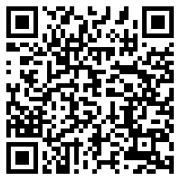
Nutrition Consultations
Trusted Nutrition Advice
You can meet with a RecWell dietitian to get guidance on your nutritional needs. A dietitian can help create a meal plan that helps you reach your wellness goals.

Slide 4
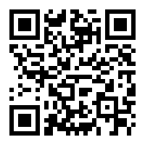
Boiler Financial Track
Build Your Financial Well-being
Did you know you have access to a financial advisor through Boiler Financial Track at RecWell. You can learn how to build credit, compare job offers, or simply create a budget.

Slide 5
Did you know?
68% of Boilermakers reported no binge drinking in the last two weeks.
Binge drinking defined as consuming 4 or more drinks in a row for females and 5 or more drinks in a row for males.
Party smart and know that others around you are making smart decisions too.
(Spring 2023 ICSUS Survey)

Slide 6
Did you know?
You might be overestimating how much other Boilermakers typically drink?
64% of Boilermakers report typically having 1-3 drinks when they drink. However, 60% of student perceive their peers drinking 4+ drinks. Be care of perceptions.
Party smart and know that others around you are making smart decisions too.
(Spring 2023 ICSUS Survey)

