Slide 1
Lunch & Learns – Spring 2018
Developing Programs for Students in Recovery
Eric Teske, MA, MS, CHWC
Assistant Director of Substance Abuse Prevention
IUPUI

Slide 2
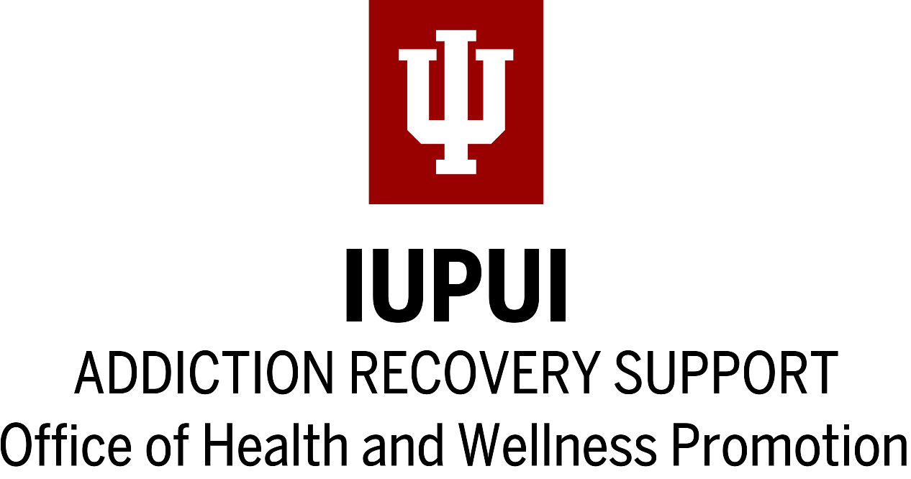

Slide 3
Setting the Stage
Increases in the number of adolescents admitted to treatment for SUD have outpaced admissions in the general population.

Slide 4
Setting the Stage
Relapse rates are compounded by recovery-hostile college environments, and periods of transition.

Slide 5
Setting the Stage
Post-treatment continuing support is effective at sustaining recovery.

Slide 6
Setting the Stage
The broader recovery movement is advocating for comprehensive access to services and support.

Slide 7
Defining Recovery
“A voluntarily maintained lifestyle characterized by sobriety, personal health, and citizenship.”
Betty Ford Institute Consensus Panel (2007)
“A process of change through which individuals improve their health and wellness, live self-directed lives, and strive to reach their full potential.”
SAMHSA’s Working Definition of Recovery (2012)
Notes:
SAMHSA’s working definition of recovery is a much larger document, you can read about it here https://www.samhsa.gov/recovery or download the full document here https://store.samhsa.gov/product/SAMHSA-s-Working-Definition-of-Recovery/PEP12-RECDEF

Slide 8
Defining Recovery
“You’re in recovery if you say you’re in recovery.”
Unknown

Slide 9
Beyond Treatment History
14.6 percent of the population are expected to develop a substance use disorder at some point in their lives.
Kessler et al. 2005
Only about 10 percent of people with a substance use disorder receive any type of specialty treatment.
2015 National Survey on Drug Use and Health
Notes:
Kessler, R. C., Berglund, P., Demler, O., Jin, R., Merikangas, K. R., & Walters, E. E. (2005).
Lifetime prevalence and age-of-onset distributions of DSM-IV disorders in the National
Comorbidity Survey Replication.
Archives of General Psychiatry, 62
(6), 593-602.
Center for Behavioral Health Statistics and Quality. (2016).
Results from the 2015 National Survey on
Drug Use and Health: Detailed tables
. Rockville, MD: Substance Abuse and Mental Health Services
Administration.

Slide 10
Identity & Behavior
It depends if you are asking about behavior or identity when you want to get prevalence numbers.
In HIV research you’d ask about MSM rather than “gay” or “bisexual” identities, because behavior is more important in this case.
With multiple pathways to recovery, surveying the identity eliminates the need to guess or anticipate how each individual arrived there.
Notes:
Kessler, R. C., Berglund, P., Demler, O., Jin, R., Merikangas, K. R., & Walters, E. E. (2005).
Lifetime prevalence and age-of-onset distributions of DSM-IV disorders in the National
Comorbidity Survey Replication.
Archives of General Psychiatry, 62
(6), 593-602.
Center for Behavioral Health Statistics and Quality. (2016).
Results from the 2015 National Survey on
Drug Use and Health: Detailed tables
. Rockville, MD: Substance Abuse and Mental Health Services
Administration.

Slide 11
Wording Matters
“Do you identify as someone in recovery from any of the following”
Illicit drugs or alcohol (1.5%)
Potential unhealthy behaviors (gambling, sex, food) (2.1%)
Other (3.2%)
All of the above (1.0%)
I do not identify as a person in recovery (92.1%)

Slide 12
What is a CRP?
“A collegiate recovery program (CRP) is a College or University-provided, supportive environment within the campus culture that reinforces the decision to engage in a lifestyle of recovery from substance use.
It is designed to provide an educational opportunity alongside recovery support to ensure that students do not have to sacrifice one for the other.”
Associate of Recovery in Higher Education

Slide 13
Early CRP’s
Brown University (1977)
Augsburg College (1997)
Rutgers University (1983)
Texas Tech University (1986)
Notes:
https://collegiaterecovery.org/the-collegiate-recovery-movement-a-history/

Slide 14
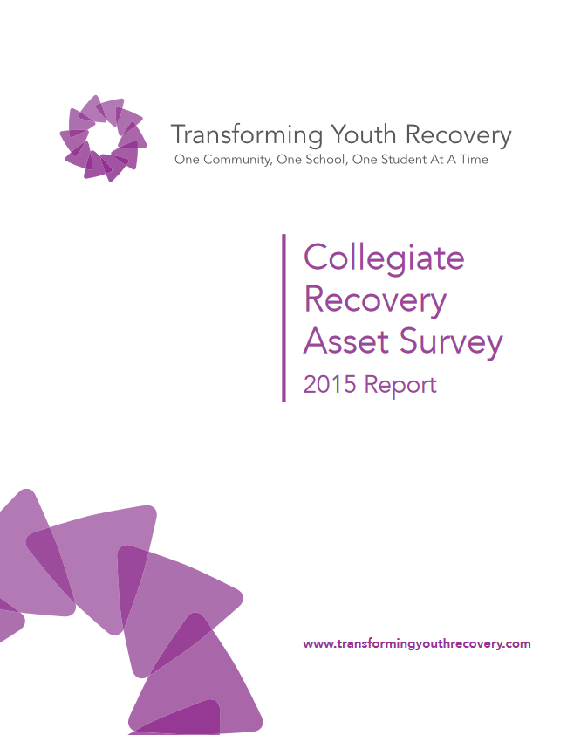
TYR Asset Survey
Benchmarking survey of 91 grant recipients
Program size, features, categories
Rank priority assets by program type
“The unshakable focus of this work is to offer a methodology for increasing the capacity of a collegiate community to make available those assets that students in recovery need to pursue academic, recovery and life goals.”
Notes:
http://www.transformingyouthrecovery.org/sites/default/files/TYR_Collegiate%20Recovery%20Asset%20Survey_2015%20Report.pdf

Slide 15
9 Critical Assets
Students in recovery who are interested in growing the recovery community on campus.
Individuals who are dedicated staff for a collegiate recovery program (full or part time).
Mutual aid support groups near or on campus for students in recovery.

Slide 16
9 Critical Assets
Individuals who are influential within the University and/or in the broader community and are interested in advocating for students in recovery.
Physical space for students to get together socially, soberly and safely (meals, social outings, venues).
Physical space that is dedicated for students in recovery to gather and meet.
“Someplace to go”
“Someplace to be”

Slide 17
9 Critical Assets
Organizations, departments and services that can refer students to a collegiate recovery program.
Individuals available for 1:1 recovery support (coaching, guiding, supporting, mentoring).
Organizations, departments and services that a collegiate recovery program can refer students to if they need outside services.

Slide 18
Program Stages
Notion
Establishment
Maturity
Sustainability
You are cultivating a small group of students to build a recovery community
You have a community of students in recovery and are making new relationships to support those students
You have a formalized collegiate recovery program and community
You have a formalized collegiate recovery program or community and are building coalitions to support that community.
Notes:
http://www.transformingyouthrecovery.org/sites/default/files/TYR_Collegiate%20Recovery%20Asset%20Survey_2015%20Report.pdf
Notion
You are cultivating a small
group of students to build a
recovery community.
Establishment
You have a community of stu-
dents in recovery and are
making new relationships to
support those students.
Maturity
You have a formalized colle-
giate recovery program and
community.
Sustainability
You have a formalized
collegiate recovery
program/community and are
building coalitions to support
that community.

