Slide 1
Student Immigration & Advising
By: Hailey Dady

Slide 2
Student Visas
F-1: I-20
Most Common
Self/Family Funding
J-1: DS-2019
Exchange Students
Non-Personal Funding
Example: Purdue or Home Government

Slide 3
Maintaining Status
Full-Time Status
12 credits
Incompletes and Withdrawal do not count
On-Campus Employment
20 hours per week
Paid by Purdue West Lafayette
J-1 must submit additional documents
Off-Campus Employment
Paid or Unpaid
Must have authorization CPT/OPT
Keep local address up-to-date
Update information of I-20 / DS-2019

Slide 4
Course Requirements
Full-Time Credits (Fall/Spring)
12 for undergrad
At least 9 credits in a seat
Summer Credits
First Semester – Full-Time Required
CPT Course – If CPT is Approved
Last Semester Requirement
Classes needed to graduate
At least 1 credit in a seat at Purdue
Other University Credits
Enrollment confirmation
Official Transcript

Slide 5
SEVIS Registration
Completed by ISS
Each Fall/Spring Semester
Required within 30 days of Semester start
*Student & Exchange Visitor Program

Slide 6
Adding Major / Dual Majors
Must be updated on I-20 / DS-2019
Same semester graduation
Keep at least 1 credit for each major
Minors do not count

Slide 7
Extension
Making progress towards degree
1-year maximum
Delay Reasons
Change of Major
Original length to short
Reasons for Declined Request
Minors
Off-campus employment
Students Out of Status
How much time is left to graduate

Slide 8
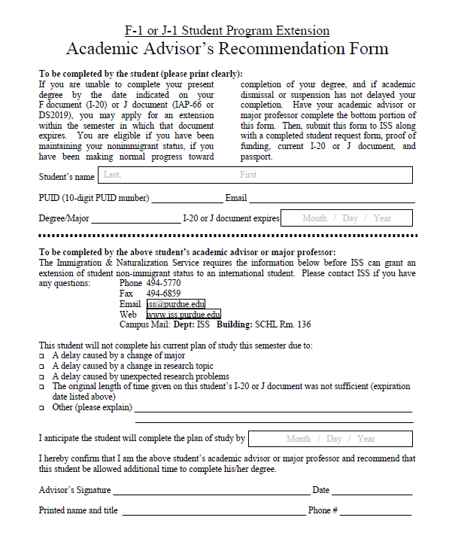
Extension

Slide 9
Departure Form
Gap in education
Military Service
Transferring to school outside U.S.
Ending Program

Slide 10
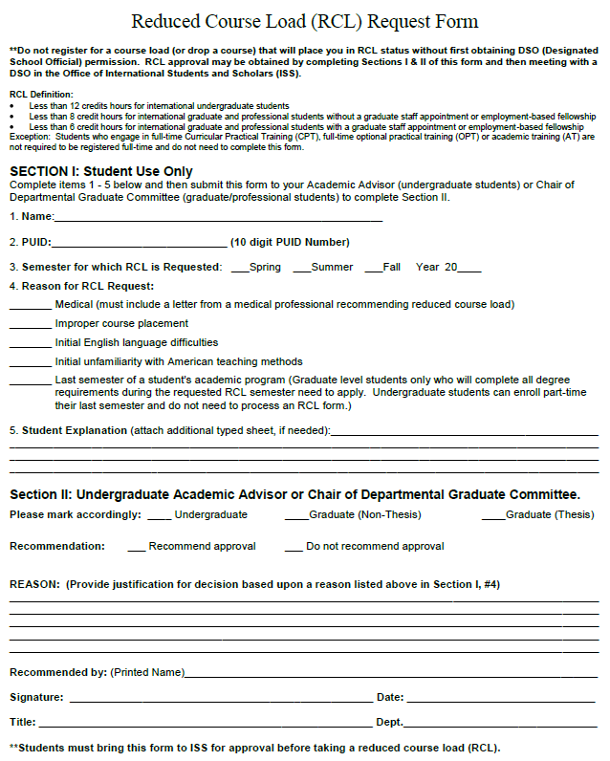
Reduce Course Load (RCL)

Slide 11
Curricular Practical Training (CPT)
Authorized off campus employment which is an “integral part of an established curriculum and is directly related to the student’s major area of study.”
8 C.F.R. 214.2(f) (10) (i)

Slide 12
Types of CPT
Full-Time: more than 20 hours per week
CPT course
Part-Time: 20 hours or less per week
Registered Full-Time

Slide 13
Eligibility
Must be lawfully enrolled full-time one full academic year
Valid F-1 status
Employment must be integral to the major field of study
Employment must be required or highly recommended for degree
CPT must take place before the program end date on I-20

Slide 14
How to Apply
Receive job offer
Complete online workshop: www.iss.purdue.edu/cpt
Schedule ISS Follow-up session
Meet with Academic Advisor
Attend Follow-up Session at ISS

Slide 15
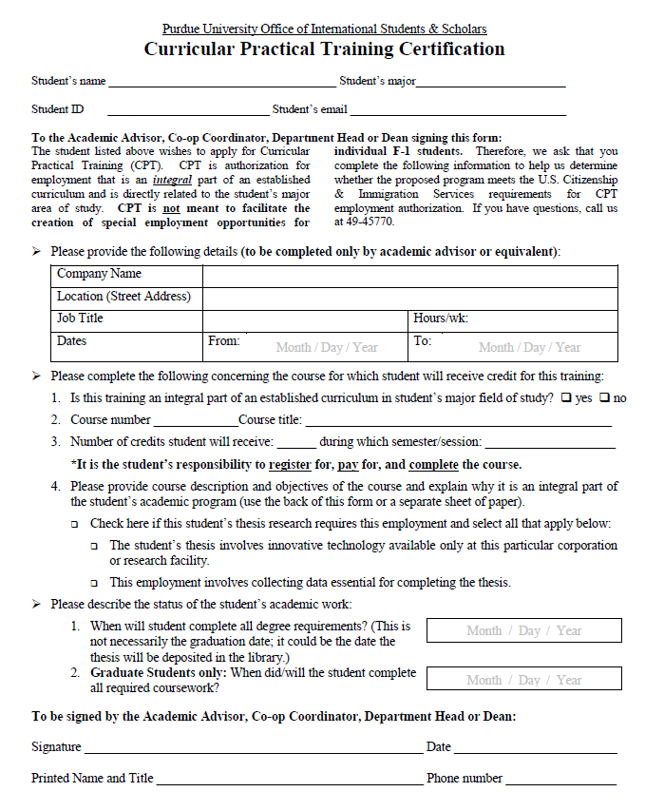
CPT Certification Form

Slide 16
CPT Certification Form

Slide 17
CPT Certification Form

Slide 18
CPT Certification Form

Slide 19
CPT Course
Must be an “experiential” type course
Appropriate course for degree level
Must be registered during the semester CPT authorization is granted
Must pay for the course
Must complete the course
Course must appear on transcript

Slide 20
CPT Certification Form

Slide 21
CPT Certification Form

Slide 22
Important Facts
Approved Semester by Semester
Paid/Unpaid Positions
Cannot be an independent contractor
International Employment
365 days of Full-Time CPT student will not be eligible for OPT

Slide 23
Optional Practical Training (OPT)
Pre-Completion OPT
Post-Completion OPT
OPT STEM

Slide 24
Pre & Post Completion OPT
USCIS Application
(United States Citizenship & Immigration Services)
12 months
Cost $380
Processing Time: up to 90 days

Slide 25
Post-Completion OPT - Eligibility
Maintaining F-1 status
Unexpired passport
Lawfully enrolled full-time for at least two consecutive semesters
Less than 12 months of full-time CPT
Within 90 days of completing degree requirements
Have not previously had OPT authorized at the same degree level

Slide 26
Application
Online Workshop
www.iss.purdue.edu/opt
Complete Paperwork
Advisor’s Form
Follow-up Appointment in ISS
Receive new I-20 (5 business days)
Prepare Application
Mail application to USCIS
Wait for EAD Card

Slide 27
Certification Form

Slide 28
Employment Authorization Document (EAD)

Slide 29
OPT - STEM
USCIS Application
Within last 90 days of Post Completion OPT
24 additional months
Cost $380
Processing Time: Up to 90 days
Company must be E-Verified
Provide Job Training Plan: I-983

Slide 30
Academic Training (AT)
J-1 Employment Benefit
Up to 18 months
Before/After Graduation
Approved By ISS Office

Slide 31
www.iss.purdue.edu

Slide 32
www.iss.purdue.edu

Slide 33
www.iss.purdue.edu

Slide 34
www.iss.purdue.edu
Maintaining Legal Status

Slide 35
F-1: Maintaining Legal Status

Slide 36
ISS Office Hours
Student Walk-in Hours:
Monday, Tuesday Wednesday, Friday:
9:00 - 11:30 and 1:30 - 4:00
Thursday: 1:30 - 4:00 only
Visiting Scholar Walk-in Hours:
Wednesday's 9:00 - 11:30
Friday's 1:30 - 4:00

Slide 37
ISS Contact Information
Office Hours:
Monday-Friday 8:00 AM - 5:00 PM
Schleman Hall - Room #136 Phone: 765-494-5770 iss@purdue.edu

