Slide 1
Degree Map Guidance for Purdue University
West Lafayette Academic and Faculty Advisors
Kelly Pistilli
Academic Advisor, College of Technology/PACADA Chair
Brenda Schroeder
Assistant Director, Office of Student Services, College of Pharmacy

Slide 2
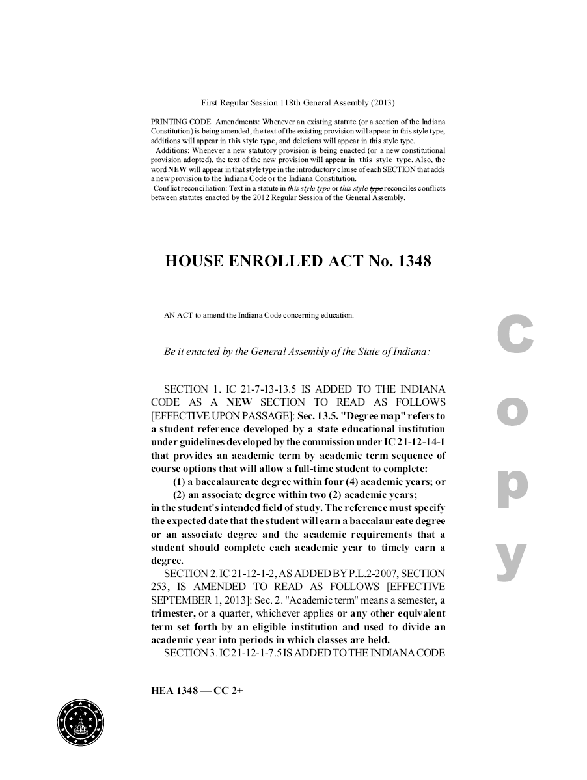
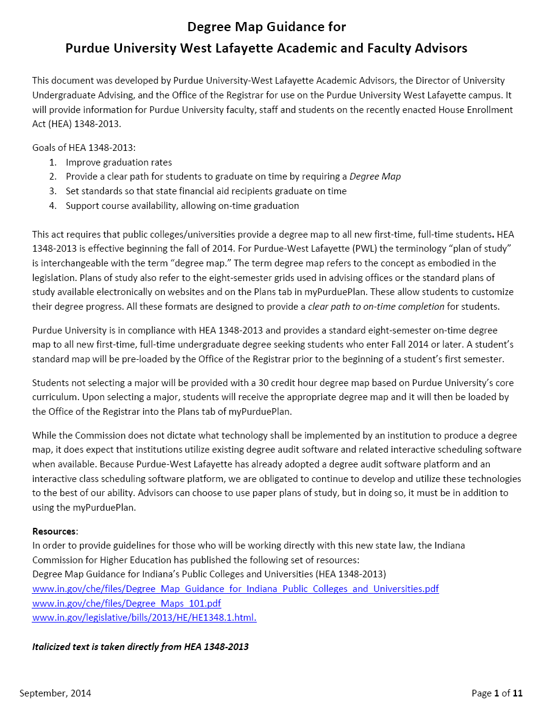
From State law to ICHE to Purdue
Indiana Commission for Higher Education Document
intended to provide guidance to Indiana College and Universities
Guidance for Purdue University Advisors – created by Purdue University Advisors!!
Indiana House Enrolled
Act No. 1348
(better know as HEA 1348-2013)

Slide 3
Purdue Timeline and Process
May 19, 2014
myPurduePlan Training Meeting
• Guests from PNC shared how advisors use Degree Works on their campus.
• Open discussion on how to incorporate DegreeWorks/myPurduePlan into the West
Lafayette advising across colleges.
• Decided to form an advisor task force to determine how to incorporate DegreeWorks/ myPurduePlan into WL advising practices.
June 9, 2014 Task Force
HEA 1384 Meeting
• Advisors meet with other key players to review documents, set up timeline, and determine process.
• Kelly Pistilli and Brenda Schroeder volunteer at co-chairs.

Slide 4
Purdue Timeline and Process
July 2014 – August 2014
SEP/Degree Map Advisor Task Force
• Task Force discusses issues and identifies need for separate smaller working sub- committees.
• State Law Interpretation/FAQs
• Advising Best Practices
• Sub-committees meet and develop Degree Map Guidelines.
September 2014 – October 2014
• Degree Map Guidance document is finalized with input from Advisor Task Force, Director of Undergraduate Advising and Registrar’s Office.
• Degree Map Guidance for Purdue University West Lafayette Academic and Faculty Advisors is distributed to Purdue Advising Community.

Slide 5
State Law Interpretation/FAQ Group
Beth Burnett | Veterinary Medicine
Lee Gordon | Management
Yvonne Hardebeck | Agriculture
Sandy Monroe | University Undergraduate Advising
Kelly Pistilli | Technology
Sandy Schaffer | Registrar
DaFran Ware | First Year Engineering
Cara Wetzel | Exploratory Studies
Mary York | Management

Slide 6
What is this new law and how does it affect us?
Goals of HEA 1348-2013:
Improve graduation rates.
Provide a clear path for students to graduate on time by requiring a Degree Map.
Set standards so that state financial aid recipients graduate on time. Support course availability, allowing on-time graduation.

Slide 7
Guidance from ICHE
Covers topics such as…
DEFINITIONS
PROCEDURES FOR GIVING STUDENTS A DEGREE MAP
ELEMENTS OF THE DEGREE MAP
HANDLING SPECIAL CIRCUMSTANCES
COURSE SCHEDULING AND AVAILABILITY
WHAT TECHNOLOGY IS REQUIRED?

Slide 8
State Law Interpretation/FAQ Group
Translates the State law and ICHE documents into Purduese.
Provides us with a common language.
Answers FAQs.
(Page 1 – 4 and 7-11 Degree Map Guidance for Purdue University West Lafayette Academic and Faculty Advisors)

Slide 9
Advising Best Practices Group
Jennifer Abbott | Exploratory Studies
Dennis Bowling | Liberal Arts
Vicki Cline | Engineering
Kristin Deckard-Dawson | Engineering
Jane Ann Dimitt | Education
Stacey Dunderman | Science
Nate Engelberth | Agriculture
Nancy Kester | Health and Human Sciences
Stout Lori | Management
Bobbie Molter | Health and Human Sciences
Brenda Schroeder | Pharmacy
Erin Schultz | Education
LeeAnn Williams | Agriculture

Slide 10
How do we incorporate this into advising?
Using Degree Maps to Guide Student Success at
Purdue University (PWL)
1. Give every student a standard degree map at orientation and registration.
2. Students can use a standard degree map to create a customized plan.
3. Reviewing and updating the student’s plan is integrated each semester into the academic advising session and the student’s registration processes.
(Page 5 – Degree Map Guidance for Purdue University West Lafayette Academic and Faculty Advisors)

Slide 11
How do we incorporate this into advising?
Best Practices for Advisors
Suggested Registration Process
Suggested Student Email Regarding Registration/Plans Template
Suggested Follow-Up Email Template
(Page 5 – 7 Degree Map Guidance for Purdue University West Lafayette Academic and Faculty Advisors)

Slide 12
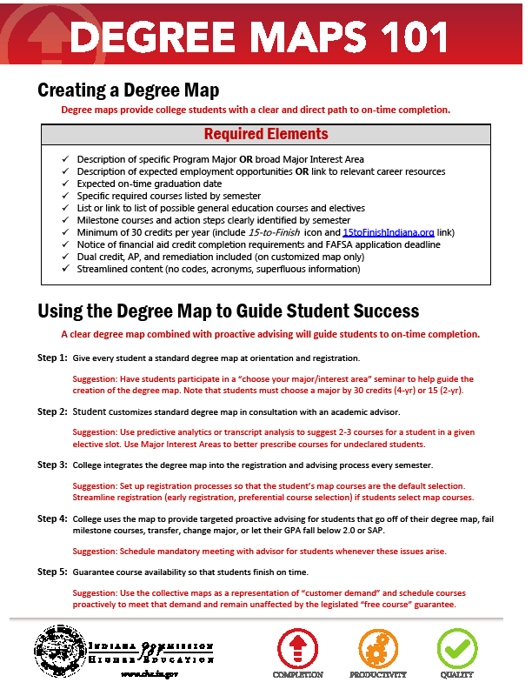
Purdue is in compliance!
Step 1: Give every student a standard degree map at orientation and registration.
The Office of the Registrar has already provided a standard degree map to all first-time, full-time students that began in Fall 2014.
Plans are available via the Plans tab in myPurduePlan.

Slide 13
Purdue is in compliance!
Step 2: Student customizes standard degree map in consultation with an academic advisor.
Advisors can assist students in customizing their plans by:
Providing resources (help page) explaining how to customize the plan.
Providing information sessions.
Meeting with advisees one-on-one.
Step 3: College integrates the degree map into the registration and advising process every semester.
During Registration Appointments, Advisors should review myPurduePlan worksheet(s) and plan(s) and make suggestions for updates at needed.

Slide 14
Purdue is in compliance!
Step 4: College uses the map to provide targeted proactive advising for students that go off of their degree map, fail milestone courses, transfer, change major, or let their GPA fall below 2.0 or SAP.
Advisors are already doing this! We meet with our students who are no longer on track, make recommendations and assist them in determining the best path towards graduation. Students will be able to customize their plans based on targeted proactive advising they receive.

Slide 15
Purdue is in compliance!
Step 5: Guarantee course availability so that students finish on time
The student has followed his or her degree map in each prior semester, including taking all required pre-requisite courses.
The student is unable to register for a course mapped for the current semester because it is not offered, offered only at the same time as another mapped course, or is full.
There is no other course substitution available for the required course.
For University Core Curriculum requirements with multiple options that meet degree requirements, all sections of eligible options must be full, not just the student’s preferred choice.
The student attempted to register for the course during their classification time ticket.
A revised degree map that incorporates the unavailable course in a future semester cannot be developed in consultation with the advisor without altering the graduation date.
The student is within 150 percent of the standard time to complete the degree.

Slide 16

What next?

