Slide 1

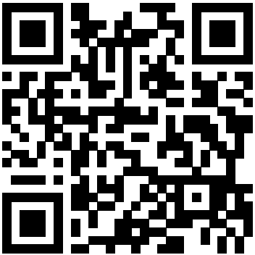
Love Data Week: Boiler Up, Hammer Data Challenge
Compete for cash prizes up to $500!
Showcase data viz skills
Challenge winner will advance to the BTAA Data Viz Championship
Submit your visualization by December 16th
Details: https://www.purdue.edu/idata/lovedata/
OR Scan

