Slide 1
Recording Time and Requesting Time Off
Purdue Webclock Users

Slide 2
Agenda
RECORDING TIME
  Policies & Concepts
  Time Entry Methods
  Timekeeping Process
  Accessing the Purdue Webclock
  Recording Time
  Fixing Missed Punches
  Viewing History
  Editing Time Pairs
  Adding Time Pairs
REQUESTING TIME OFF

Slide 3
Resources
Bookmark www.purdue.edu/timehelp!
Many resources are available:
    SuccessFactors Navigation
      Quick Reference Guides
      Cheat Sheets
      Video Demonstrations
    Entering Time
      Quick Reference Guides
      Cheat Sheets
      Video Demonstrations
    Requesting Time Off
      Quick Reference Guides
      Video Demonstrations

Slide 4

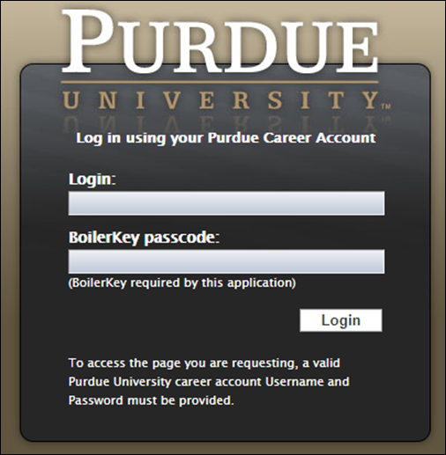
Accessing SuccessFactors
Visit the OneCampus Portal (one.purdue.edu)
Click Employee Launchpad
Log in using your Purdue Career Account ID and BoilerKey passphrase.
For assistance using or setting up BoilerKey, please contact ITaP at itap@purdue.edu or 765-494-4000.

Slide 5
Recording Time
Purdue Webclock

Slide 6
Policies & Concepts
Responsibilities
Employees
Supervisors
Accurately recording time worked
Selecting the appropriate job when recording time (if you record time for multiple jobs)
Proactively working with your supervisor to resolve issues as needed
Ensuring that time is recorded completely and accurately and submitted for supervisor approval following your final work day of each week
Proactively working with employees to resolve issues as needed
Reviewing/approving all time sheets for all of their employees by 12:00pm on the Tuesday following the end of each pay period
Proactively working with the business office /payroll center to update employee work schedules and report costing exceptions for employees’ time worked
Remember
The time entered into the system will be considered true and accurate as of the end of an employee’s pay period. It is the employee’s responsibility to review their time often (at least at the end of each shift and at the end of the pay period) to make sure the recorded hours are true and correct; and to review and confirm the accuracy of any changes that a supervisor makes to time entries.

Slide 7
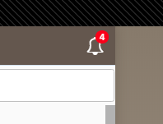
Policies & Concepts
Notifications
The WebClock provides a Notification Center for Employees (one Notification Center per position held).
Employees receive notifications when a time record is changed (edited/added), time pairs are approved, time pairs are rejected, and when punches are missed.
Supervisors do not receive notifications.

Slide 8
Policies & Concepts
Minutes Translated to Tenths
0:06 = .1
0:12 = .2
0:18 = .3
0:24 = .4
0:30 = .5
0:36 = .6
0:42 = .7
0:48 = .8
0:54 = .9
1:00 = 1.0
Rounding
The Webclock assesses the total time duration of the time pair to determine how to round.
  First, Webclock determines the total time duration for the time pair. Examples: 4 hours 7 minutes, 8 hours 5 minutes, etc.
If the total time duration does not correspond to a number of minutes representing a tenth of an hour (see Minutes to Tenths table below), Webclock will round the IN punch down (in the employee’s favor) so that the total time duration matches a tenth of an hour.
Punch Type | Punch Time | Duration | Rounded Punch Time | Final Duration
IN | 7:15 AM | 4 hours, 47 minutes | 7:14 AM | 4 hours, 48 minutes
OUT | 12:02 PM |  | N/A
IN | 1:54 PM | 2 hours, 50 minutes | 1:50 PM | 2 hours, 54 minutes
OUT | 4:44 PM |  | N/A
IN | 6:03 PM | 3 hours, 6 minutes | N/A | 3 hours, 6 minutes
OUT | 9:09 PM |  | N/A

Slide 9
Policies & Concepts
Overtime
SuccessFactors adheres to the University policy regarding overtime.
When a full time employee records over 40 Working Time hours in a workweek, the system will designated the time as overtime.
  “Working Time” in a work week consists only of hours actually worked. (Exception: Worker’s Compensation, University Holidays).
Overtime for employees with multiple positions will be charged to each position based on the ratio of hours worked across the employee’s positions for that week.

Slide 10
Policies & Concepts
Holidays, Moving Holidays, and Holiday Emergency Work
Holidays
Holiday premiums are auto-calculated when time is recorded.
Moving Holidays
Moving Holidays takes place within SuccessFactors Time Off tile. Individuals whose work schedule does not include a given University Holiday can use the time off feature within SuccessFactors to request Holiday on any day during the week (Monday through Sunday; Sunday through Saturday (dispatchers only)) of the holiday. Exception: Police and Fire may request Holiday leave at any time throughout the year.
Unplanned Work on a Holiday or During an Emergency
Per University policy, when an employee works during an emergency or unscheduled holiday work, they qualify for their hours to be paid at time and a half. In the event that an essential personnel are required to work during an emergency or unscheduled on a holiday, the employee or their supervisor must enter the time on the employee’s timesheet using time type Campus Service Disruption.

Slide 11
What Time Entry Methods Does Purdue Use?
Positive
Negative
Clocking
Employees enter the number of hours they worked for each work day, including Call Back if applicable.
Employees only enter time when they work outside of their schedule (Examples: Overtime, Call Back).
Employees use the Purdue Webclock to record “in” and “out” punches for each shift.
The employee is paid for the time that they are clocked in.
Employees are automatically paid for the hours in their standard schedule plus any exceptions they enter.
Employees are paid for the hours they enter.
Focus of this session

Slide 12
Timekeeping Process – Positive Time Entry
Employee clocks in and out for each shift worked.
- Overtime is automatically calculated
- Employees can designate Call Back (if applicable)
Supervisor reviews time pairs
- Work with employees to make corrections
- Must be approved by 12:00 PM on Tuesday after the pay period ends

Slide 13
Accessing the Purdue Webclock

Slide 14

Accessing the Webclock
The Purdue Webclock can be accessed via four different access points.
Your department will designate a best practice as far as which access method you should utilize.
OneCampus Portal Employee Launchpad SuccessFactors | OneCampus Portal Timekeeping System Webclock | Web Browser | Kiosk
Navigate to the One Campus Employee Portal (one.purdue.edu) Click Employee Launchpad. Log in using your BoilerKey. On the homepage, click the WebClock tile. | Navigate to the One Campus Employee Portal (one.purdue.edu) Click Timekeeping System. Log in using your BoilerKey. | On your computer or mobile device’s web browser, navigate to webclock.purdue.edu This link can be bookmarked or saved as a favorite for convenience. Log in your BoilerKey. | At the kiosk, swipe your Purdue ID Card through the card reader.

Slide 15
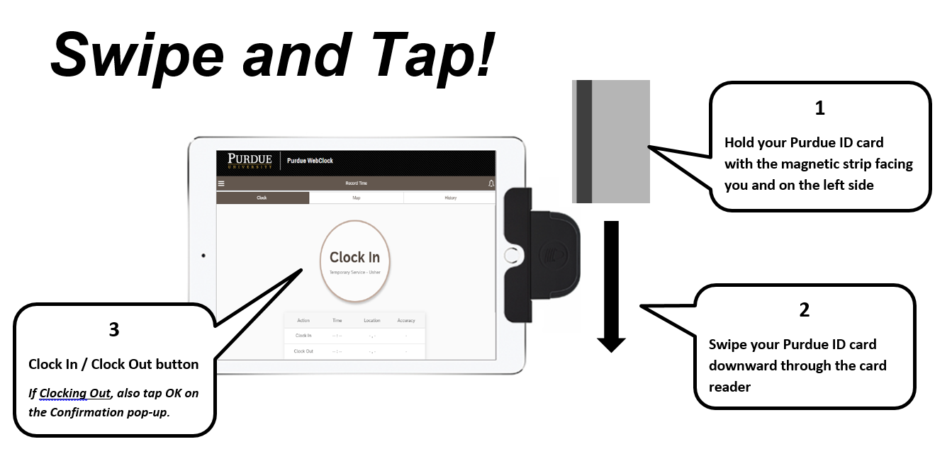
Accessing the Purdue Webclock
Kiosk Access Details

Slide 16
Recording Time

Slide 17
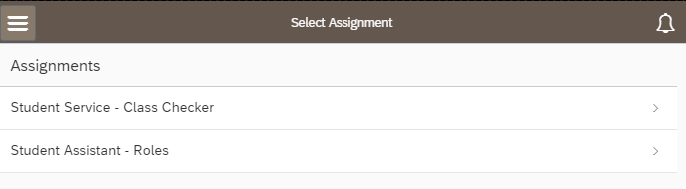
Recording Time
If you hold multiple positions that utilize the Webclock:
Choose the position for which you would like to record time

Slide 18
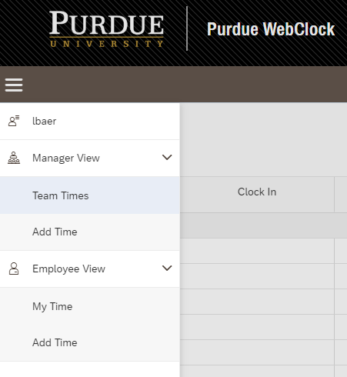
Recording Time
If you are a supervisor who uses the webclock to record time:
1. Click to open the menu in the upper left corner of the screen
2. Under Employee View, click My Time.
1
2

Slide 19
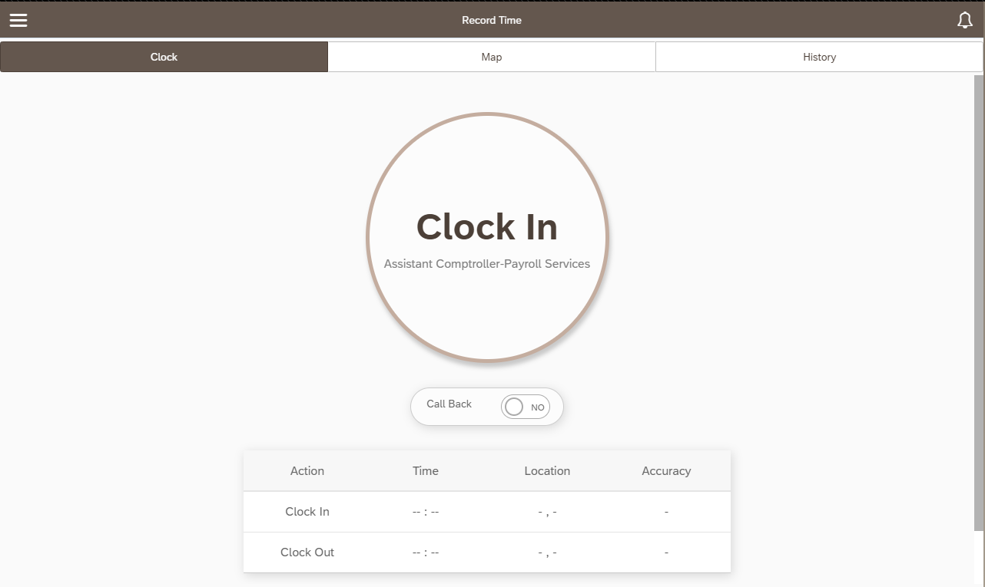
Recording Time
1. Call Back premium:
  If the time to be recorded is eligible for Call Back pay, tap the slider so that YES is displayed.
2. Click or Tap Clock In (or Clock Out)
    After Clock In has been clicked or tapped, the button will change to read Clock Out.
2
1
(if applicable)

Slide 20
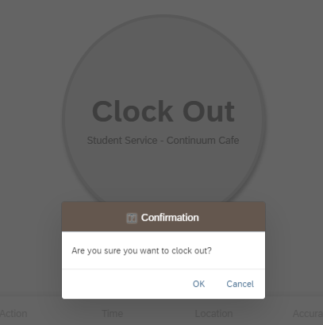
Recording Time
  Clocking Out
  After Clock Out, click or tap OK to acknowledge that you wish to clock out.
  On the Kiosk, users are automatically logged out after Clocking In or Clocking Out (and confirming the Clock Out)

Slide 21
Fixing Missed Punches

Slide 22
Fixing Missed Punches
Overview
If a punch is missed and is not corrected prior to the payroll deadline, time for that day will not be paid. Time for all other days in the pay period will be paid.
For current shift
  If Clock In was missed
    Clock In and then immediately Clock Out.
    Use Editing Time Pair steps to manually change the Clock In time.
      If a user Clocks In and does not Clock Out within 12 hours, a notification will display the next time the user accesses the system suggesting that a punch may have been missed.
  If Clock Out was missed
    Clock Out (to end the too-long time pair), Clock In (if applicable, to begin new shift).
    Use Editing Time Pair steps to edit the Clock Out time of the too-long time pair.
For previous shift
  If Clock In and Clock Out were missed
    Use Adding Time Pair steps to add the Clock In and Clock Out date and time.

Slide 23
Viewing History

Slide 24
Viewing History
If you hold multiple positions:
Choose the position for which you would like to view History

Slide 25
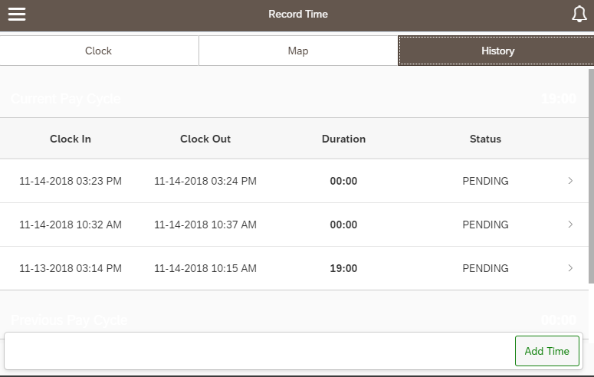
Viewing History
Select History from the menu bar
Time pairs for the current and previous pay periods are displayed.
Status column indicates whether or not supervisor has reviewed the time pair. (Possible statuses are PENDING, APPROVED, DECLINED)
A note for employees with multiple positions:
  If time is recorded toward the wrong position, the employee must request that the supervisor of the position for which time was incorrectly recorded decline the time pair.
  The employee must use then Add Time feature to add a time pair to the other position. See Adding Time Pairs steps for additional details.

Slide 26
Editing Time Pairs

Slide 27
Editing Time Pairs
Overview
Employees can edit time pairs at any time within the current and two previous pay periods.
Please select low-volume usage times if completing any of these tasks on a kiosk or other shared device.
Time Pairs are edited due to incorrect punches (early or late, in or out).
Newly edited pairs will in the supervisor’s queue as PENDING.
If editing time pairs after you suspect your supervisor has completed their final review prior to the Payroll deadline, please notify them that you have made a change so that they are prompted to review the change.

Slide 28
Editing Time Pairs
1
1. Select History from the menu bar
2. Select the line that lists the pair you wish to edit
2

Slide 29
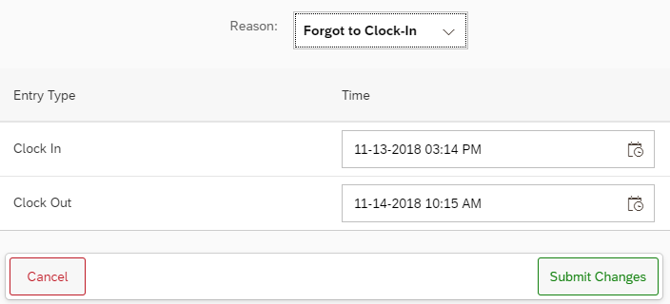
Editing Time Pairs
Use the drop-down menu to choose the reason for the edit
2. Tap or click the calendar icon on the appropriate line to edit the Clock In or Clock Out time.
1
2

Slide 30
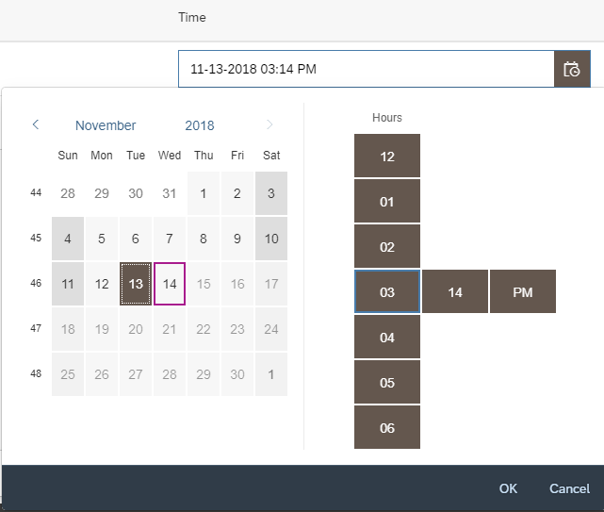
Editing Time Pairs
Use the calendar and time slider to indicate the adjusted date and/or time.
Click or tap OK

Slide 31
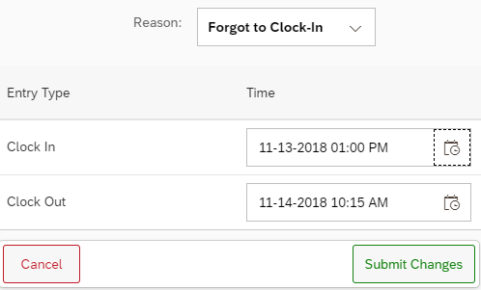
Editing Time Pairs
Click Submit Changes
The edit and reason selected will be visible to the supervisor when they approve your time.

Slide 32
Adding Time Pairs

Slide 33
Adding Time Pairs
Overview
Employees can add time pairs at any time within the current or two previous pay periods
Please select low-volume usage times if completing any of these tasks on a kiosk or other shared device
Time Pairs are added due to 1) missed punches and 2) when an employee with multiple positions erroneously records time toward the wrong position
    For employees with multiple positions, if time is recorded toward the wrong position, the employee must notify the supervisor of the position for which time was incorrectly recorded to decline the time pair. The employee must use the Add Time feature to add a time pair to the other position.
Newly added pairs will in the supervisor’s queue as PENDING
If adding time pairs after you suspect your supervisor has completed their final review prior to the Payroll deadline, please notify them that you have made a change so that they are prompted to review the change

Slide 34
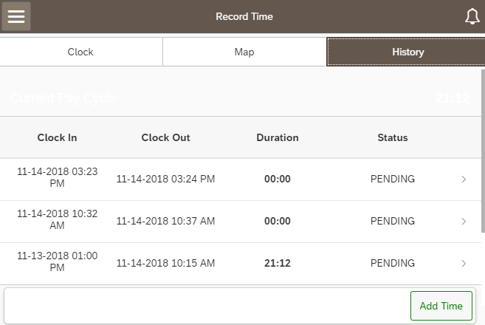
Adding Time Pairs
1. Select History from the menu bar
2. Select Add Time
1
2

Slide 35
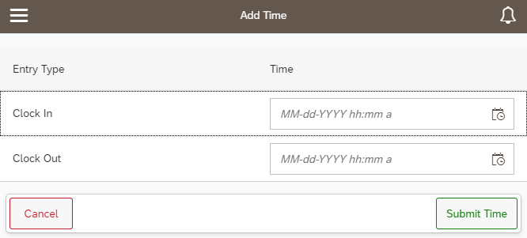
Adding Time Pairs
Select the calendar icon to edit the Clock In date and time

Slide 36
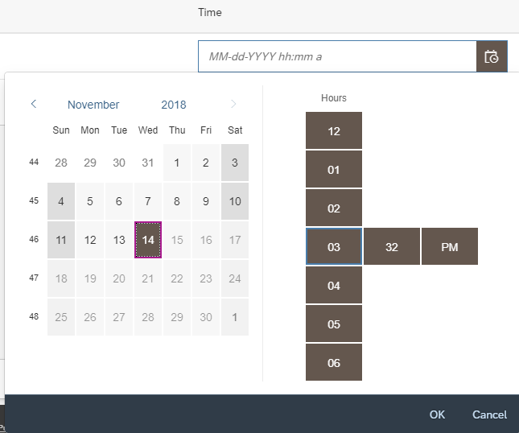
Adding Time Pairs
Use the time sliders to indicate the date and the “In” time.
Click OK
Repeat this process for the Clock Out field.

Slide 37
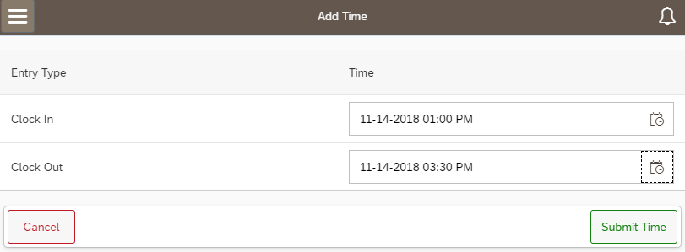
Adding Time Pairs
Click Submit Time
The added time pair and reason selected will be visible to the supervisor when they approve your time.

Slide 38
Requesting Time Off

Slide 39
Requesting Time Off
Time Off requests are submitted through the SuccessFactors Time Off tile
Time Off requests flow to your supervisor for approval
The Time Off request tool does not replace conversation/planning between you and your supervisor
Supervisors do not have access to edit or enter Time Off requests on behalf of their employees

Slide 40
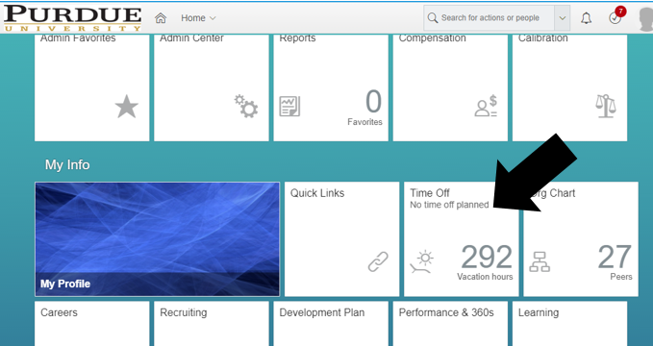
Requesting Time Off
Scroll down to the My Info section
Click the Time Off tile

Slide 41
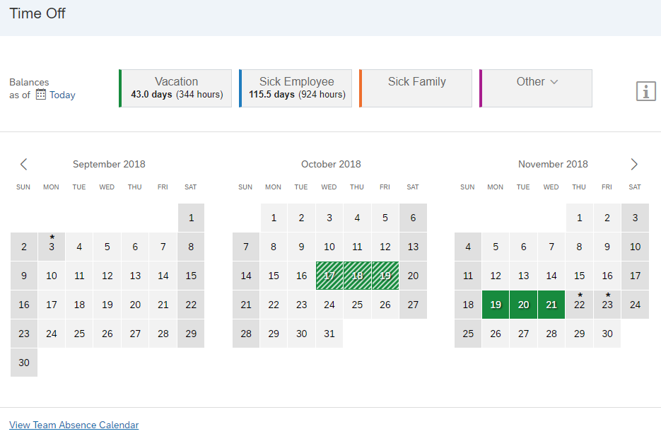
Requesting Time Off
Time Off Screen Overview
Balances as of <<date selection>> are shown across the top of the screen.
Note: If you have approved leave requests in the future, change the Balances as of date to a date past those approved leaves to view your “true” balances (less any future takings). Moving the date will not add to the balances due to projected accruals.
2. Use the Other drop down to view more leave types.
3. Use the Team Absence Calendar link to view approved Time Off requests for your peers and direct reports. It may be helpful to view your team’s absence calendar to schedule time off strategically in order to ensure coverage of work responsibilities.
1
2
3

Slide 42
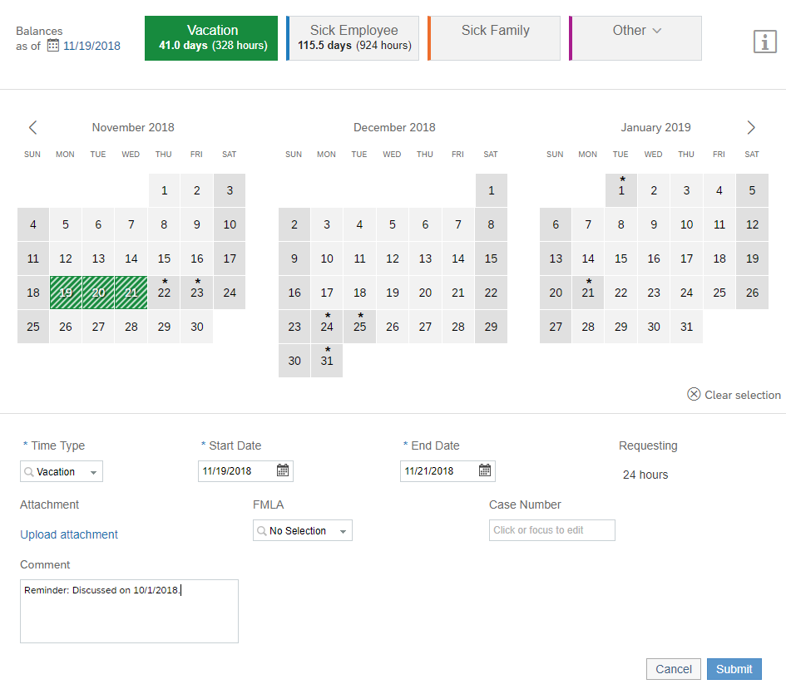
Requesting Time Off
Select Leave Type: Click on the box representing the leave type you would like to take
Dates: Use the fields beneath the calendar (or use the paint brush to indicate dates on the calendar boxes) to enter the dates.
  The system will not allow requests that exceed your current balance of the Time Off type selected.
  Time Off requests of less than a full day must be made separately. Example: Seth would like to request vacation for half of a day off on Wednesday and all of Thursday and Friday. Seth must submit one request for the Wednesday half day and one request for the full days, Thursday and Friday (together).
1
2
2

Slide 43
Requesting Time Off – Partial Days
Webclock Users
Partial day requests require the individual to enter a specific time for the leave (example: 10:00 – 12:00). The time is entered in military time.
If you wish to request Time Off for part of a day, it is recommended that the request be submitted after your Working Time has been recorded for that day.
The Time Off should still be discussed and agreed to with your supervisor in advance
The purpose of this process is to avoid errors and the need to cancel and resubmit requests if the time off used ends up being different than expected.
Examples:
  You requested 10:00 – 12:00 for an appointment, but the appointment ran long and took until 12:30 PM.
  You requested 13:00 – 16:00 for vacation, but ended up being asked to work an extra hour. The vacation request must be cancelled and resubmitted for 14:00 – 16:00.

Slide 44
Requesting Time Off
3. Upload Attachment: Can be used to add any supporting documentation (Example: Jury Duty summons, Military orders)
4. FMLA: Select YES in the FMLA drop-down field to request FMLA. Selecting YES will send a notification the HR Leaves Group.
If this is your initial FMLA request – The Case Number will be supplied to you by the HR Leaves Group once FMLA request is received. The case number should be left blank for the initial request.
For all future FMLA time off requests, include the case number.
5. Comment: Enter any information you would like to provide to your supervisor
6. Submit: Submits request to your supervisor for approval
3
4
5
6

Slide 45
Questions?
Don’t forget about the resources located at www.purdue.edu/timehelp!

