Slide 1



The totalitarian principle explains quantum correlations
  Adán Cabello
  University of Seville
Purdue Winer Memorial Lectures 2018: Probability and Contextuality,
Purdue University, West Lafayette, Indiana
November 9, 2018

Slide 2
The problem of the physical origin
of quantum correlations

Slide 3
The CHSH-Bell scenario

Slide 4
Is this behavior physical?

Slide 5
The KCBS contextuality scenario

Slide 6
Ideal measurements

Slide 7
Why “contextuality scenarios” are restricted to ideal measurements?

Slide 8
Why “contextuality scenarios” are restricted to ideal measurements?

Slide 9
Which behaviors are physical?

Slide 10
Which behaviors are physical?

Slide 11
Which behaviors are physical?

Slide 12
Why?

Slide 13

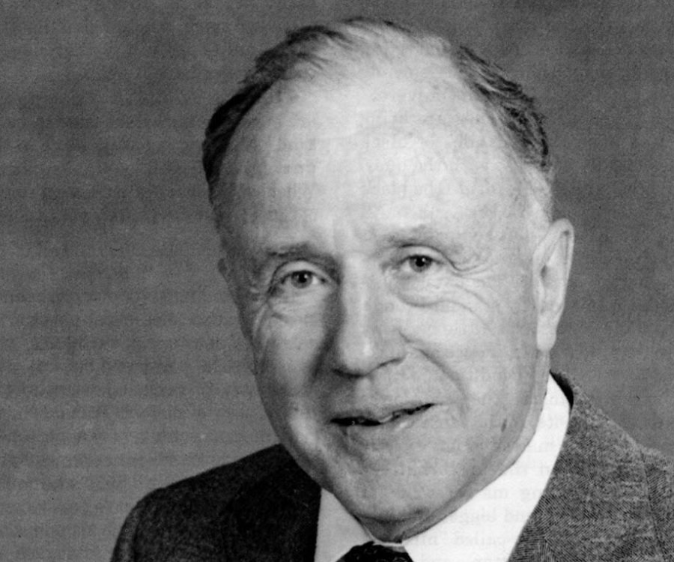
Axiom 1

Slide 14
Result

Slide 15
“The physical origin of quantum
nonlocality and contextuality”,
arXiv:1801.06347

Slide 16
Graph of exclusivity

Slide 17
Exclusivity is operational

Slide 18
Example 1

Slide 19
Exclusivity is operational

Slide 20
Exclusivity is operational

Slide 21
Probability assignment for an E graph

Slide 22
The set of probability assigments for an E graph

Slide 23
“Not inconsistent” behavior

Slide 24
“Not inconsistent” behavior

Slide 25
“Not inconsistent” behavior

Slide 26
Steps 1 & 2 of the proof

Slide 27
Steps 3, 4 & 5 of the proof

Slide 28
Step 3a: Identifying self-inconsistent distributions

Slide 29
Step 3a: Identifying self-inconsistent distributions

Slide 30
Step 3a: Identifying self-inconsistent distributions

Slide 31
Step 3a: Identifying self-inconsistent distributions

Slide 32
Step 3a: Identifying self-inconsistent distributions

Slide 33
Step 3a: Identifying self-inconsistent distributions

Slide 34
Step 3a: Identifying self-inconsistent distributions

Slide 35
Step 3a: Identifying self-inconsistent distributions

Slide 36
Step 3b: Identifying self-consistent distributions

Slide 37
Step 3b: Identifying self-consistent distributions

Slide 38
Step 4: Characterizing the set of “not inconsistent” assignments
for self-complementary E graphs

Slide 39
Complement

Slide 40
The pentagon is self-complementary

Slide 41
Step 4: Characterizing the set of “not inconsistent” assignments
for self-complementary E graphs

Slide 42
Step 4: Characterizing the set of “not inconsistent” assignments
for self-complementary E graphs

Slide 43
Step 5: Characterizing the set of “not inconsistent” assignments
for any E graph

Slide 44
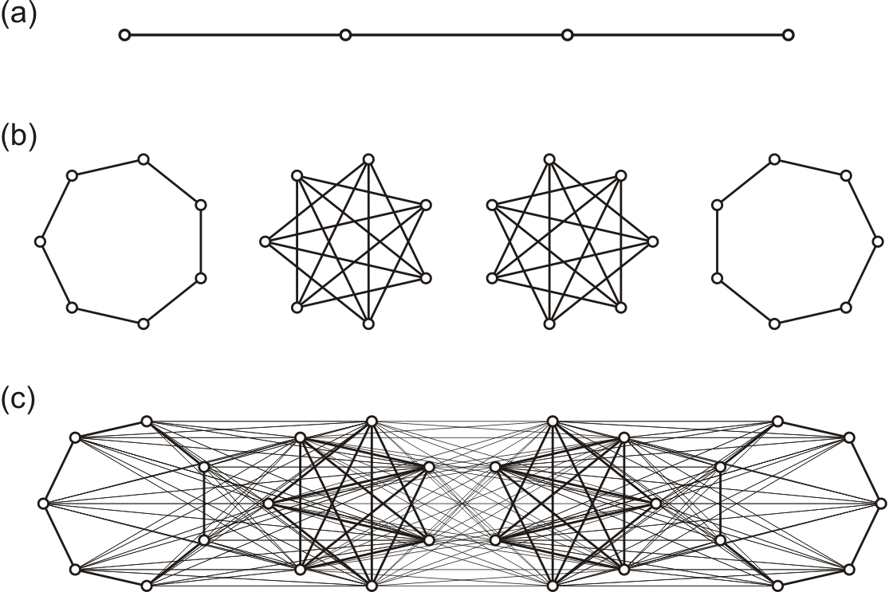
Proof (1)

Slide 45
Proof (2)

Slide 46
Proof (3)

Slide 47
Generalized composition

Slide 48
Proof (4)

Slide 49
H(G) is self-complementary

Slide 50
H(G) is self-complementary

Slide 51
Proof (5)

Slide 52
“Not inconsistent” assignments for any E graph

Slide 53
Step 6: Characterizing the set of “not inconsistent” behaviors
for any Bell and contextuality scenario

Slide 54
The E graph of the CHSH-Bell scenario

Slide 55
Being “not inconsistent” for the E graph implies

Slide 56
The restrictions that characterize the scenario

Slide 57
Example of an exclusivity constraint

Slide 58
Example of an exclusivity constraint

Slide 59
The E graph of the CHSH-Bell scenario

Slide 60
The E graph of the CHSH-Bell scenario

Slide 61
End

Slide 62
Where does quantum theory come from?
Notes:
The right view. There are many ways to look at QT. Each organized around a fundamental concept

Slide 63
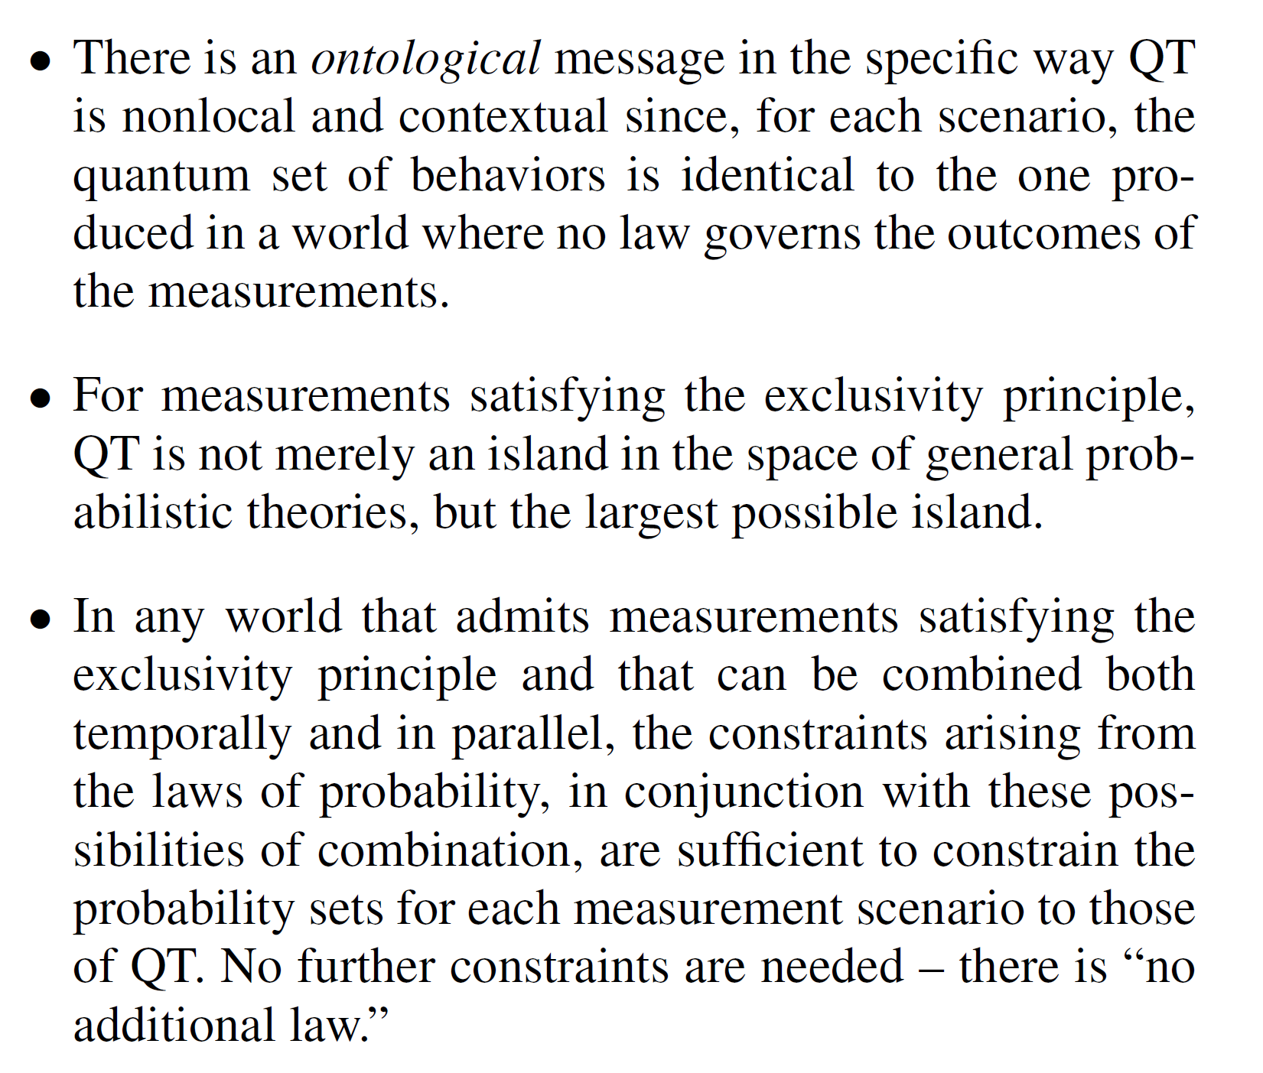
Conclusions

Slide 64
“The physical origin of quantum
nonlocality and contextuality”,
arXiv:1801.06347

