Slide 1
Engineering Design Process

Slide 2
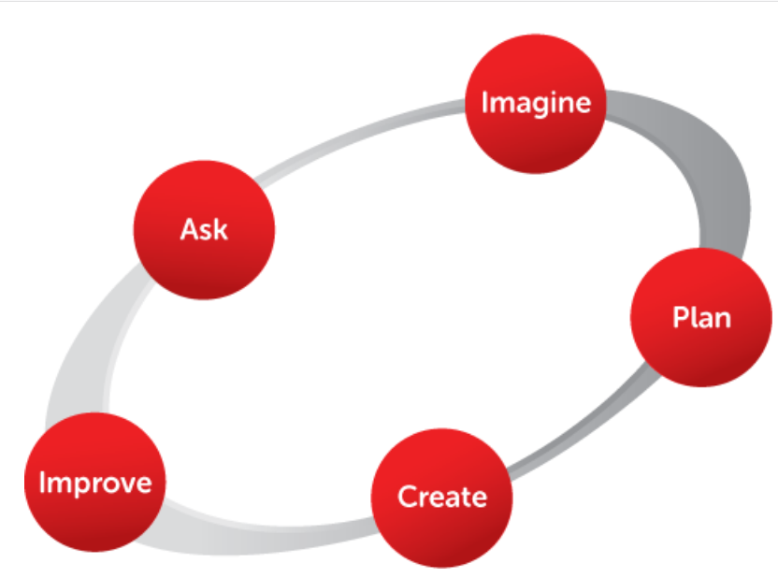
What is it?
The Engineering Design Process is a dynamic process used by engineers and designers to solve complex design problems. There is no one way that all engineers solve problems--there are multiple types of engineering design processes--but this is an example of a very basic, 5-step process. This process begins with Ask, and is an iterative process moving clockwise around the circle.

Slide 3
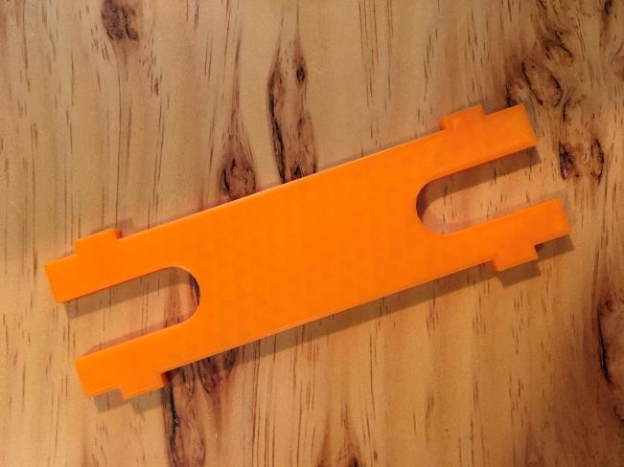
The Challenge
You are going to design the frame or chassis for a toy car chassis called an MSTEM Accel Car. As we walk through the Engineering Design Process step-by-step, you will use engineering tools to generate ideas. By the end of today you will have a 2D pencil sketch as a prototype.

Slide 4
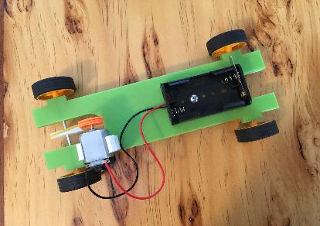
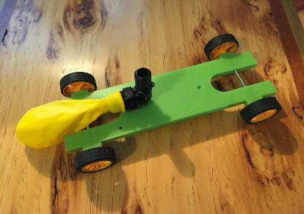
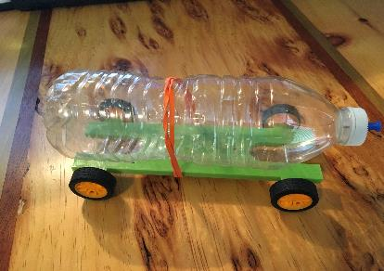
A Model Chassis Example
Electrical Energy
This is not necessary, however designing a topper for electrical components is highly recommended. Longer chassis designs could eliminate the need for a topper.
Potential Energy Components
This is not necessary, however designing a topper for electrical components is highly recommended. Longer chassis designs could eliminate the need for a topper.
Chemical Energy
The main focus of this lesson is to design the chassis/frame for your Micro Kart. Yours does not need to look exactly like this.

Slide 5
Chassis Constraints
Must be no wider than 2.25”
Must not be longer than 7”
Cannot be paper-thin (¼” thickness recommended)
Must allow for addition of pulleys on axle
Must allow for attachment of 1.5V-3V motor
Must allow for attachment of AA battery box
Profile must allow for attachment of 16oz water bottle
Will eventually be 3D printed
Will eventually need a replaceable “topper” that can be easily attached that will hold the micro electronics components

Slide 6
ASK
“The best scientists and explorers have the attributes of kids! They ask questions and have a sense of wonder. They have curiosity. 'Who, what, where, why, when, and how!' They never stop asking questions, and I never stop asking questions, just like a five year old.”
~ Slyvia Earle, marine biologist

Slide 7
Question Storming
Brainstorming is usually where a group of people sit down and generate a list of ideas. Question storming is when a group of people sit down and generate a list of questions.
WHY: We may take for granted many of the elements of a problem and not see all that is possible. To get us to stop assuming and open ourselves to more creativity, we need to ask questions. The more questions we ask, the more opportunities we have to find and create answers.
WHAT: With your group, generate a list of at least 15 questions that relate to the design of a MSTEM Accel Car chassis.
Notes:
Teacher: Students should write responses on a piece of paper that is either shared as a group or in an engineering notebook that is part of the class or even a shared whiteboard if available. The goal is to have students writing down questions about the problem. Such questions as, “What size does it need to be?” or “What will the MSTEM Accel Car carry or transport?” or “How fast will it go?” or “What materials are available to me?” are all important questions that you can share as examples. This activity should take 5-7 minutes for them to generate as many questions as they possibly can.

Slide 8
Imagine
“The best way to have a good idea is to have lots of ideas.”
~ Linus Pauling

Slide 9
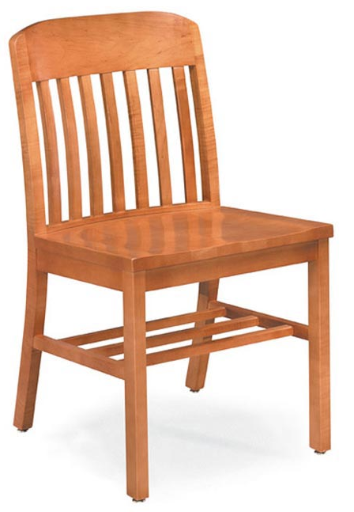
SCAMPER
SCAMPER is an acronym for several actions engineers and designers use to brainstorm ideas. For the next few slides, we will use a basic chair as an example of what you can do with SCAMPER. As we go on, quietly think to yourself of how you can use SCAMPER on your MSTEM Accel Car. Make a note of an idea if one comes to mind.
Notes:
Next few slide breakdowns should not take too long. The focus should be on explaining the behavior associated with the letter in the acronym and the driving questions that help elicit those behaviors. Each slide will have the identified letter in the acronym and what it means, driving questions, an explanation and how it relates to the chair. The chair concept was chosen as a simple object lesson. By using a chair, the basic principles of SCAMPER can be explained and visualized simply. It is left to the teacher to explain or offer ways that SCAMPER works for the Micro Kart as needed.
SCAMPER questions adapted from: Michalko, M. (2006). Thinkertoys: A handbook of creative-thinking techniques (2nd ed.). New York, NY: Ten Speed Press. Pages 72-108.
Chair photo credit: https://www.worthingtondirect.com/chairs/703a-emerson-armless-wooden-chair.htm

Slide 10
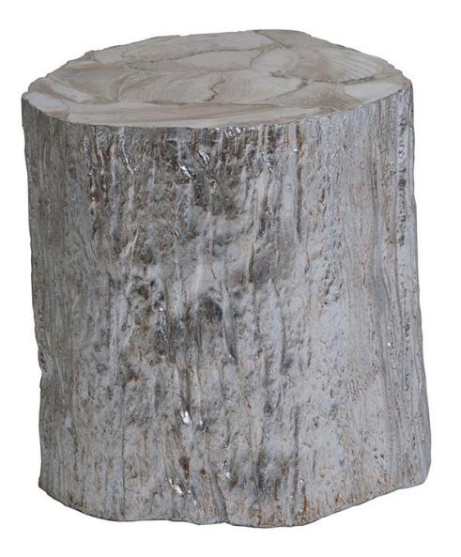
S - Substitute
Question(s): What can be used instead? What other part instead of this one? What can be replaced by something different?
Just like substitute teachers replace the actual teacher for the allotted time, engineers and designers seek to replace what is already present in a product with something more useful. If we were in the outdoors around a campfire, substituting a tree stump for a chair would be useful. There are many other situations in which this could work! As long as someone is trying to sit on the stump as they would a chair, they are engaged in substitution.

Slide 11
Question(s): What elements could be combined? What outside elements could be combined to make this better?
C - Combine
It is new combinations that make everyday materials become novel innovations. In the case of the chair, a designer has combined the chair with the exercise ball to form an entirely new product. Another combination would be to combine wheels with leg feet, thus making the chair mobile. Each part not novel in of themselves, but combining them makes the whole product new and useful.

Slide 12
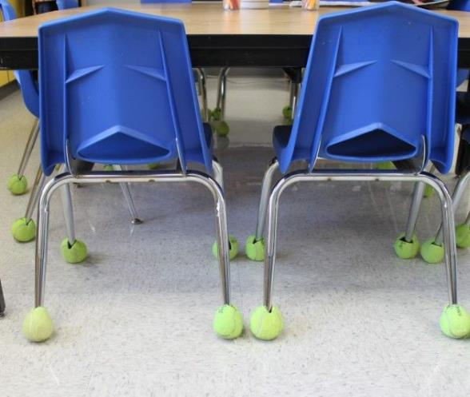
Question(s): What other process could be adapted? What different contexts can I put my concept in?
A - Adapt/Alter
Adapt can be hard because it’s not quite Combine or Substitute, but can be a little of both. The tennis balls were brought into this classroom to help with the sound of metal chairs on the floor. The process of quieting a chair was adapted. Typically that process entails putting sticky felt pads on the bottom of each leg, but they are cheap and do not hold up to the use of classroom chairs. We substituted pads for tennis balls, combined tennis balls with chairs, and adapted the process.

Slide 13
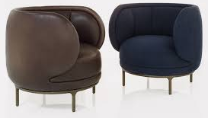
Question(s): What can be exaggerated? Larger? Extended? Made smaller? Less noticeable?
M - Magnify/Minimize
Sometimes it is simply the size that matters in design. The chairs, at right, underwent magnify and minimize alterations. The seat legs were made smaller. The chair backs were extended around to the front of the chair. The adaptation or change (last slide) of making things round exaggerated the effects. Thus, showing how SCAMPER actions can be both independent and interdependent of each other.

Slide 14
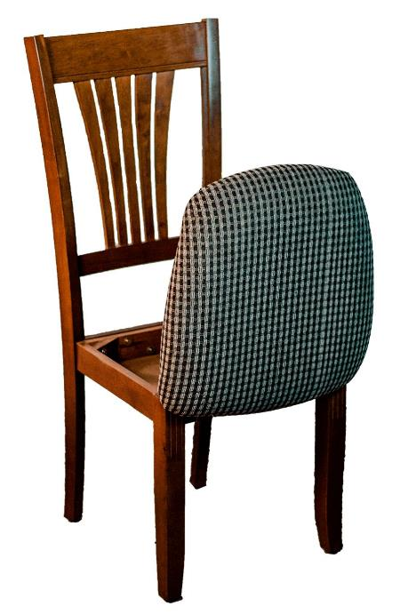
P - Put to Another Use
Question(s): What else can this be used for?
The question above takes what you already know about your product and helps you imagine what else can be done with it. In the case of the chair, a designer saw that the empty space created by the seat framing could be converted into a storage compartment (at right). Designers can put certain components to another use (like the chair seat) or the entire product. Such is true of the over-the-counter medication, Unisom, which was originally created as a sleeping pill and now has been recently used as an aid to help expecting mothers with decreasing morning sickness.

Slide 15
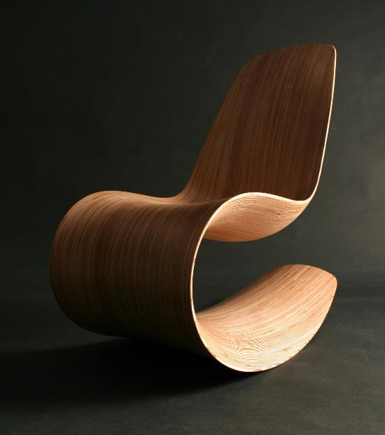
E - Eliminate
Question(s): What should you subtract or delete? What is not necessary?
Many solutions for problems have come from the question: “What do we not need?” In the case of the chair, this designer used only one piece of wood (thus eliminating the need for multiple pieces). They eliminated traditional legs, seat, and backing. Obviously, this does not eliminate manufacturing time (it increases). However, the answers to the questions yielded a viable result.

Slide 16
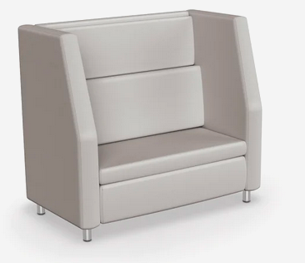
R - Rearrange/Reverse
Question(s): What other arrangements are there? What are the opposites?
Consider what elements of the concept can be rearranged or reversed to create new or different usefulness or to change up the design. In the case of the chair, this designer took the generally assumed dimensions and sloping of a large chair and rearranged the chair so that it sits on what would normally be the back, giving the chair a new look.
Typical chair view.
Rearranged design.

Slide 17
Now it’s your turn...
With your group, use the SCAMPER tool to help you generate as many possible designs of your Micro Kart as you can. Be creative!
S - Substitute
C - Combine
A - Adapt/Alter
M - Magnify/Minimize
P - Put to Another Use
E - Eliminate
R - Rearrange/Reverse
Notes:
The SCAMPER tool is easier if the students have a reference, like the chair, to work with and build off of. Have the student groups select one of the member’s chassis concepts from the last activity and go through the SCAMPER tool on their own using that concept. Students should sketch out each idea on a sticky note or piece of paper provided. Have the students complete this activity with each concept they chose as their “top picks” from the last activity. If student groups contains 3 individuals they would have 21 mini-sketches.

Slide 18
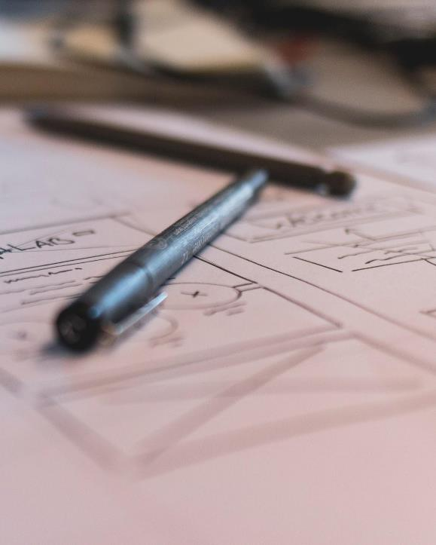
Plan
“I tell this story to illustrate the truth of the statement I heard long ago in the Army: Plans are worthless, but planning is everything.”
~ Dwight D. Eisenhowe

Slide 19
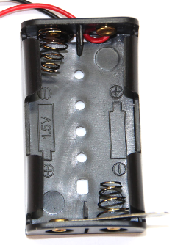
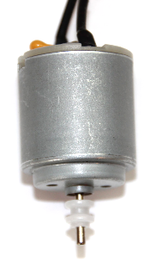
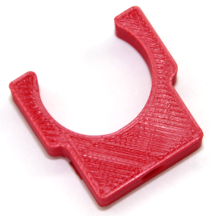
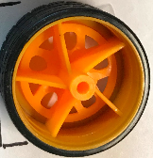
The Components
There are specific parts or components that will be added to your chassis. Make sure your chassis account for these. An additional “topper” or platform for these components is suggested, however, not necessary.
Create a List of components

Slide 20
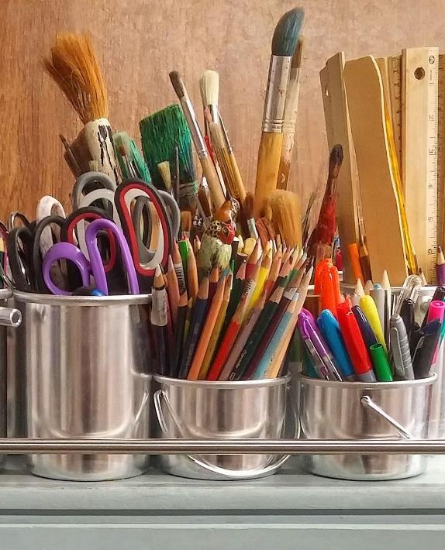
Create
“If a picture is worth a thousand words, a prototype is worth a million words.”
~ David Kelley

Slide 21
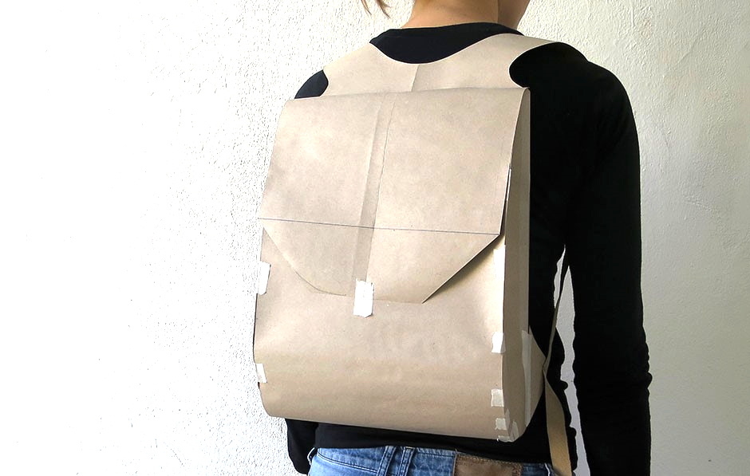
Rapid Prototype
A rapid prototype is a prototype that is made quickly with the materials lying around you. They are simple. They are rough and very cheap. Rapid prototypes are made to answer the question: “Should we even continue playing with this idea/design?” Here is an example of a rapid prototype for a new backpack:

Slide 22
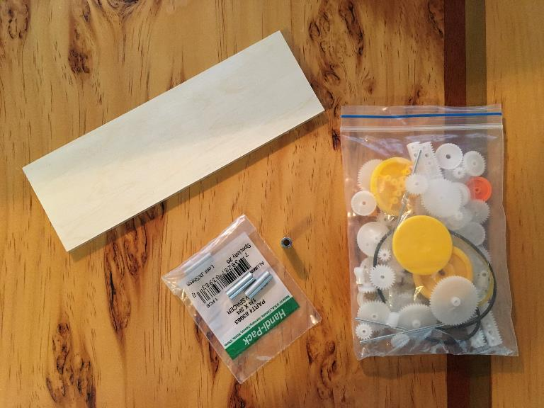
Rapid Prototype: Your turn...
You will construct a prototype using ¼” x 2.25” x 7” plywood.
4 - (¼” x ¾”) #6 Screw Spacers.
EUDAX 82pcs Plastic Gear Set with Wheels and Axles.

Slide 23
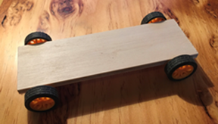
Prototyping Instructions
Use the tape measure to accurately measure 3/4 inch from each end 1/4 inch piece of plywood.
Use a miter saw to cut a shallow groove at each 3/4 mark. This groove will be used to insure the axle is square to the plywood.
Hot glue four # 6 screw spacers to the plywood. Two screw spacers will be located at one end of the plywood and the other two will be located at the other end. Set screw spacers in grove by applying firm pressure when gluing
Attach wheels and axles. The EUDAX 82 pcs plastic gear set comes with two 2-1/2 inch axle shafts and 4 wheels.

Slide 24
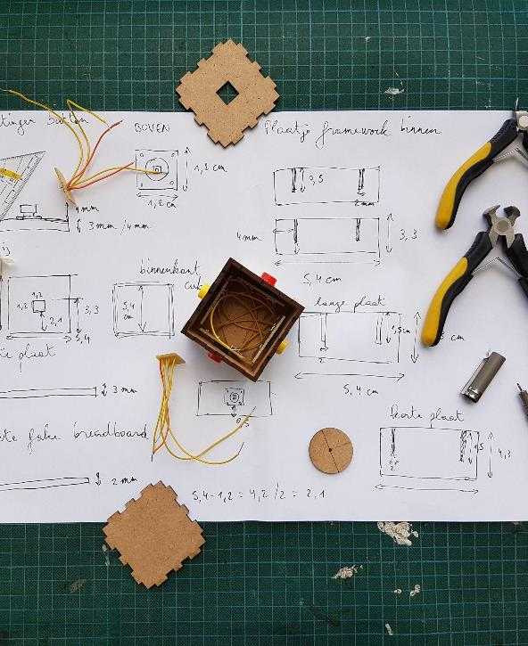
Improve
“The nature of design is to synthesize disparate perspectives and create a richer end product through collaboration and iteration.”
~ Jens Martin Skibsted, designer

Slide 25
Evaluate
In your teams, evaluate your final designs by using your rapid prototype and compare it against a checklist of final functional requirements as listed on the worksheet provided.
There is also a teacher sign-off where student teams are required to hand over the prototype to the teacher who will sign off on whether it meets the desired requirements.
Any prototypes that do not meet all the requirements should be redesigned.

