Slide 1
Engineering Tolerances

Slide 2
Variation
No two manufactured objects or parts are identical in every way. Some degree of variation will always exist.
Tolerances to part dimensions to reduce the amount of variation that occurs in manufacturing.

Slide 3
Tolerances
A tolerance is an acceptable amount of “wiggle-room” for a product’s dimensions that allows for certain variations in size. The acceptable “wiggle-room”--the tolerance--maintains a product’s ability to function correctly even with variation.

Slide 4
There are several different kinds of tolerances that are written on part design plans. Let’s look at a few...

Slide 5
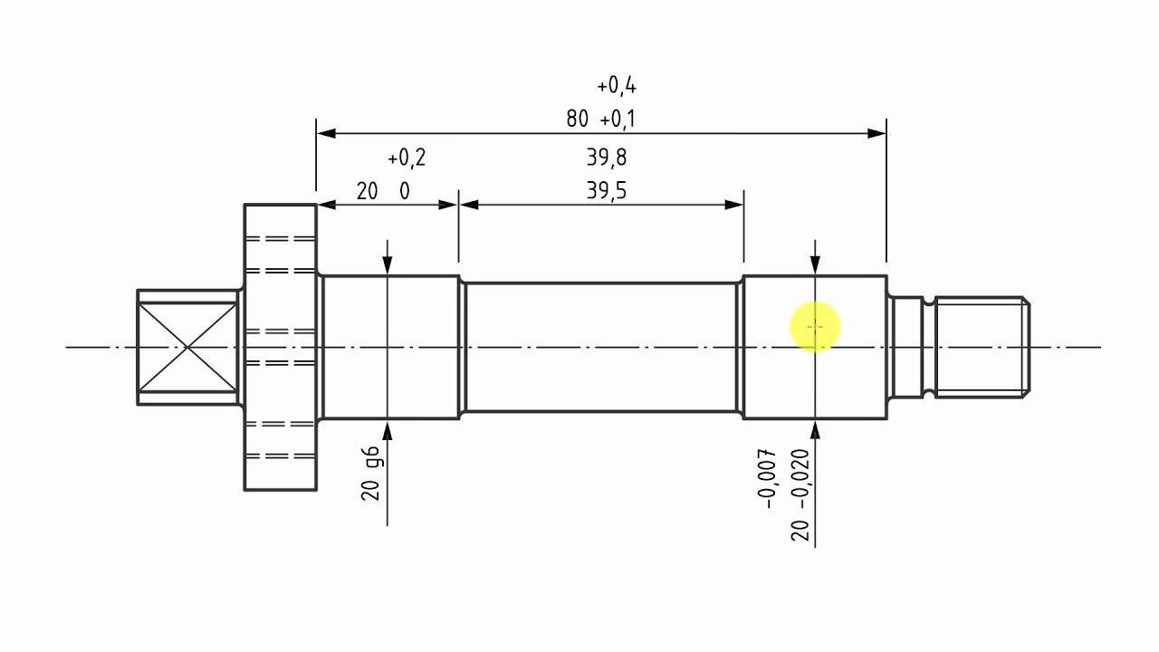
Limit Dimension
Two dimensional values that show the largest and smallest values allowed. They provide an acceptable range of variation. Typically, they are placed on top of one another in a part design plan. Below, the red oval highlights the limit dimensions. Again, any dimension within the two values is acceptable for manufacturing.

Slide 6
Unilateral Tolerance
A target dimension is given along with a tolerance that allows for variation in only one direction (be that bigger or smaller). In the red oval below, a unilateral tolerance is given. The +0.4 indicates that the dimension can allow for variations in size up to +0.4. Note that there is no negative tolerance. This suggests that you can only vary in one direction.

Slide 7
Bilateral Tolerance
A target dimension is given along with a tolerance that allows for variation in only both a positive and negative direction (meaning bigger or smaller). In the red ovals below, bilateral tolerances are given. These are two common ways to write bilateral tolerances. There is also a unilateral tolerance (blue square) shown as a comparison.
.50
+.003
-.001
+
+
+.03
.00
.66
3.00 + .04

Slide 8
General Tolerances
If no limit dimensions, unilateral, or bilateral tolerances are written on design plans, then general tolerances may be applied simply by controlling how many values beyond the decimal point a dimension can go. (Hint: The farther away a value from the decimal point, the smaller the tolerance).
.506
Linear Dimensions
x.x = + .020
x.xx = + .010
x.xxx = + .005
...and so on.
+
+
1.2
4.053

Slide 9
Total Tolerance
Simply, this is the value that describes the maximum or total amount of variation allowed for in a dimension. For example, our target dimension was .700. We then had a bilateral tolerance written as + .05 (shown in blue below). Our total tolerance would then be .10 (as shown in red below).
.10
.650
.700
.750
- .05
+ .05
This is the target dimension

Slide 10
As you may have noticed, applying tolerances can determine what kind of “fit” parts have when assembled together. Let’s now look at a few different kinds of fit...

Slide 11
Clearance Fit
The dimensions have applied a tolerance in such a way that there is always a type of clearance when assembling two parts together.

Slide 12
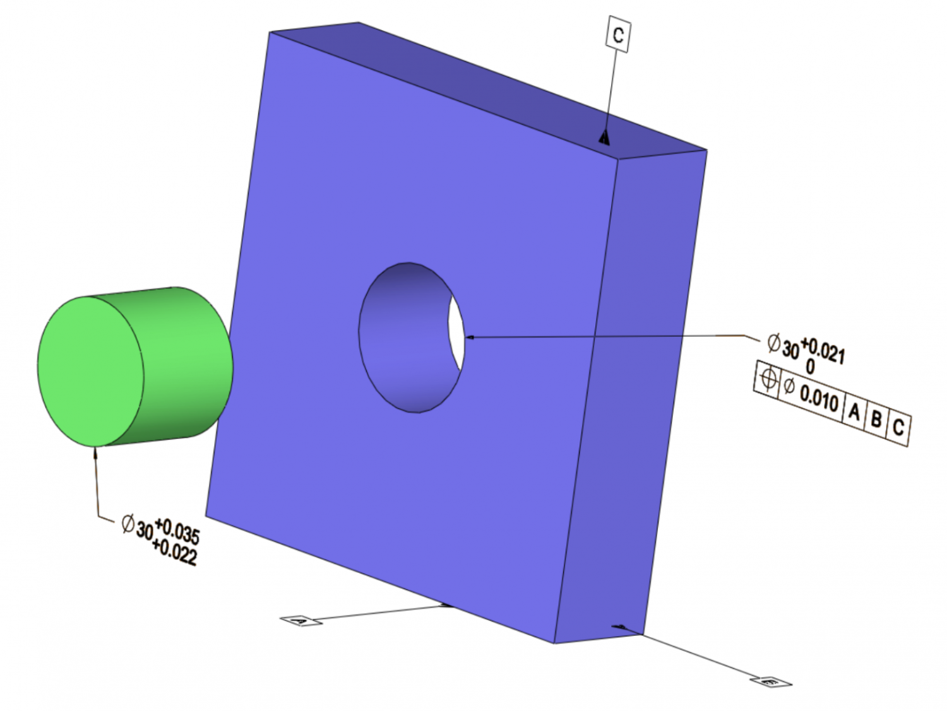
Interference Fit
This describes a fastening between two parts which is achieved by friction (or interference) after or while the parts are pushed together.

Slide 13
Transition Fit
Is a compromise between a clearance and interference fit. They are used for applications where accurate location is important but either a small amount of clearance or interference is permissible.

Slide 14
MSTEM Accel Car Component Addons
When finalizing your design, you will need to account for the dimensions of various components and apply tolerances as necessary.
See the worksheet for a list of components and dimensions.
Notes:
Hand out the Micro Kart Components Worksheet

