Slide 1
Work - That dirty little 4 letter word

Slide 2
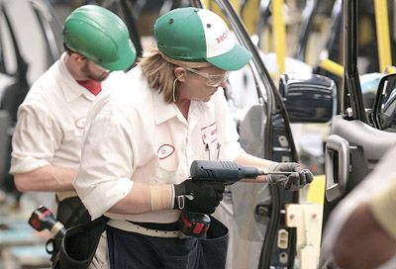
What is Work?

Slide 3
Defining Work
When a force acts upon an object to cause a displacement of the object, it is said that work was done upon the object.
There are three key ingredients to work - force, displacement, and cause.
In order for a force to qualify as having done work on an object, there must be a displacement and the force must cause the displacement.

Slide 4
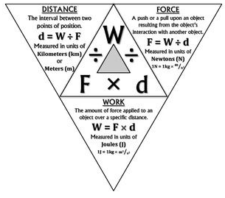
Work
We do work when we lift a load against Earth’s gravity. The heavier the load or the higher we lift it, the more work we do.
If the force is constant and the motion takes place in a straight line in the direction of the force, the work done can be calculated by the equation
W = F x d
Work = Force (N) x Distance (m)
1 N·m = Joule (J)

Slide 5
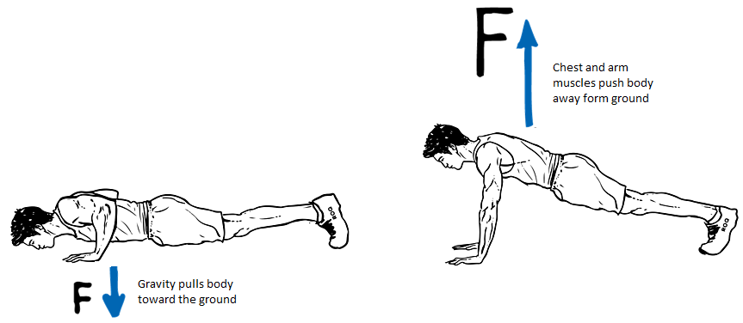
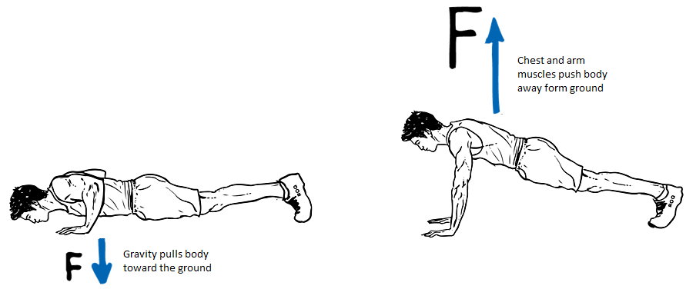
Work
Some work can be done against another force.
When you do push-ups, you do work against your own weight.
Some work can be done to change the speed of an object.
Bringing an automobile up to speed or in slowing it down involves work.
In both categories, work involves a transfer of energy between something and its surroundings

Slide 6
Work cont.,
Work Input: W_{input}
The work input is the work done on a machine
W_{input} = the force on machine x the distance through which that applied force acts (input distance)
Work Output: W_{output}
The work output is the work done by a machine
W_{output} = the force by machine x the distance through which the resistance force acts (output distance)
Work output can never be greater than work input.

Slide 7
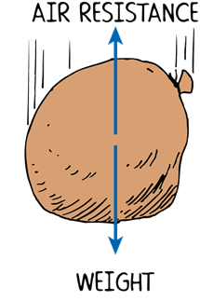
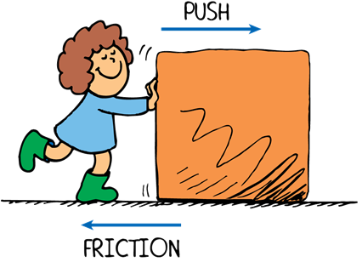
Force
Something that causes a change in the motion of an object is called a force.
A force is a push or pull upon an object resulting from the object's interaction with another object.
Whenever there is an interaction between two objects, there is a force upon each of the objects. When the interaction ceases, the two objects no longer experience the force.
Forces only exist as a result of an interaction.

Slide 8
Force cont.,
Input Force: F_{input}
The force input is the force applied to the machine
F_{input} = m_{input}a_{input}
or
F_{input} = m_{input}g
Output Force: F_{output}
The force output is the force applied by the machine
F_{output} = m_{output}a_{output}
or
F_{output} = m_{output}g

Slide 9
Manipulating the Work Equation
Work: The amount of force applied to an object over a specific distance.
Measured in units of Joules (J)
$$1J=1 N∙m$$
Force: A push or pull upon an object resulting from the object’s interaction with another object.
Measured in units of Newtons (N) $1N=1 kg\frac{m}{s^{2}}$
distance/displacement: The interval between two points of position.
Measured in units of Kilometers (KM or Meters (m)
W
W
=
=
=
F
F
d
d
x
x

