Slide 1
Causes of Motion
Balanced and Unbalanced Forces

Slide 2
Aristotle on Motion
Natural motion on Earth was thought to be either straight up or straight down.
  Objects seek their natural resting places: boulders on the ground and smoke high in the air like the clouds.
  Heavy things fall and very light things rise.
  Circular motion was natural for the heavens.
  These motions were considered natural–not caused by forces.

Slide 3
Aristotle on Motion cont.,
Violent motion, on the other hand, was imposed motion.
  It was the result of forces that pushed or pulled.
  The important thing about defining violent motion was that it had an external cause.
  Violent motion was imparted to objects.
  Objects in their natural resting places could not move by themselves.

Slide 4
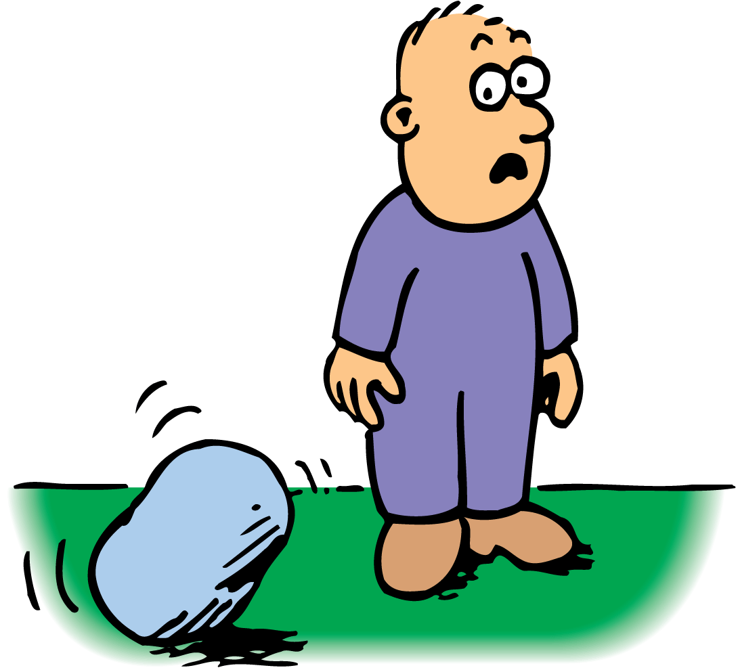
Boulders do not move without cause.

Slide 5
Galileo on Motion
One of Galileo’s great contributions to physics was demolishing the notion that a force is necessary to keep an object moving.
A resistive force acts between materials that touch and slide past each other.
  Resistance is caused by the irregularities in the surfaces of objects that are touching.
  Even very smooth surfaces have microscopic irregularities that obstruct motion.
  If resistance were absent, a moving object would need no force whatever to remain in motion.

Slide 6
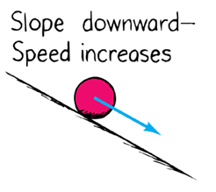
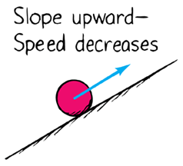
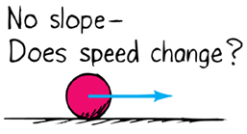
Galileo on Motion cont.,
Galileo tested his idea by rolling balls along an inclined plane tilted at different angles.
a. . b.
  A ball rolling on a smooth horizontal plane has almost constant velocity.
Galileo stated that if resistance were entirely absent, a ball moving horizontally would move forever. No push or pull would be required to keep it moving once it is set in motion.

Slide 7
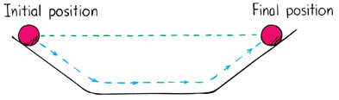
Galileo on Motion cont.,
Galileo’s supported his theory by describing two inclined planes facing each other.
  A ball released to roll down one plane would roll up the other to reach nearly the same height.
  Experimentation showed that the ball tended to attain the same height…

Slide 8
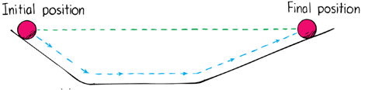
Galileo on Motion cont.,
… even when the second plane was longer and inclined at a smaller angle than the first plane.
The ball rolling down the incline rolls up the opposite incline and reaches its initial height.
and...
The ball rolls a greater distance to reach its initial height.

Slide 9
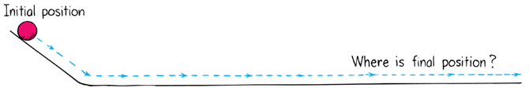
Galileo on Motion cont.,
If the angle of incline of the second plane were reduced to zero so that the plane was perfectly horizontal, only friction would keep it from rolling forever.
Galileo Concluded:
The tendency of a moving body to keep moving is natural and that every material object resists changes to its state of motion.
The property of a body to resist changes to its state of motion is called inertia.

Slide 10
Newton’s Law of Inertia
Newton’s first law, usually called the law of inertia, is a restatement of Galileo’s idea that a force is not needed to keep an object moving.
“An object in motion tends to stay in motion and an object at rest tends to stay at rest, unless the object is acted upon by an outside force.”
OBJECTS AT REST
Simply put, things tend to keep on doing what they’re already doing.
  Objects in a state of rest tend to remain at rest.
  Only a force will change that state.

Slide 11
Newton’s Law of Inertia cont.,
OBJECTS IN MOTION
Now consider an object in motion.
  In the absence of forces, a moving object tends to move in a straight line indefinitely.
  Toss an object from a space station located in the vacuum of outer space, and the object will move forever due to inertia.

Slide 12
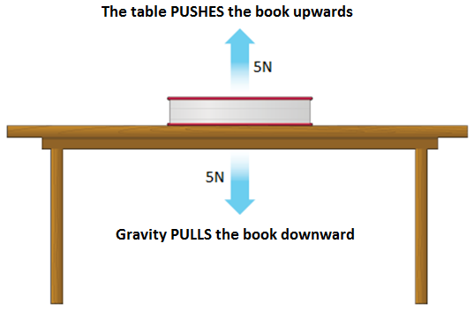
Balanced and Unbalanced Forces
A force is a push or pull on an object resulting in a change in the objects motion.
Forces occur in pairs and
can either be balanced or
unbalanced.

Slide 13

Balanced and Unbalanced Forces cont.,
When the two forces acting on an object are equal in size but are in opposite directions, they are said to be balanced.
Equal force (100N) in opposite directions (left vs. right)
=
Pushing the box to the right with a 100N force
Pushing the box to the left with a 100N force

Slide 14
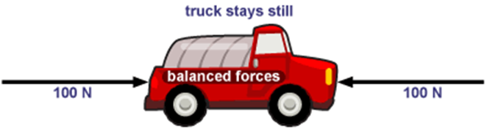
Balanced and Unbalanced Forces cont.,
The forces acting on an object can be shown using a force diagram.
In a force diagram, the force is shown with an arrow – the larger the arrow, the larger the force acting on the object
The direction the arrow is pointing shows the direction that the force is acting.
Often the arrow will be accompanied by a label indicating the size of the force in Newtons (N)

Slide 15
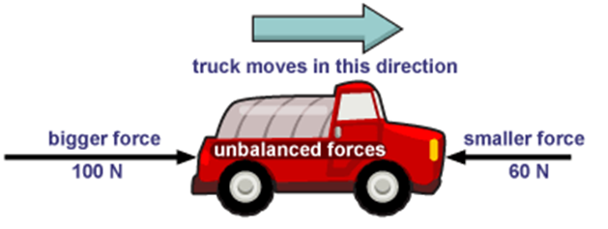
Balanced and Unbalanced Forces con.,
When two forces are acting on an object and are not equal in size we say that the forces are unbalanced
Unbalanced forces cause a change in motion by changing the objects velocity (speed or direction)

Slide 16
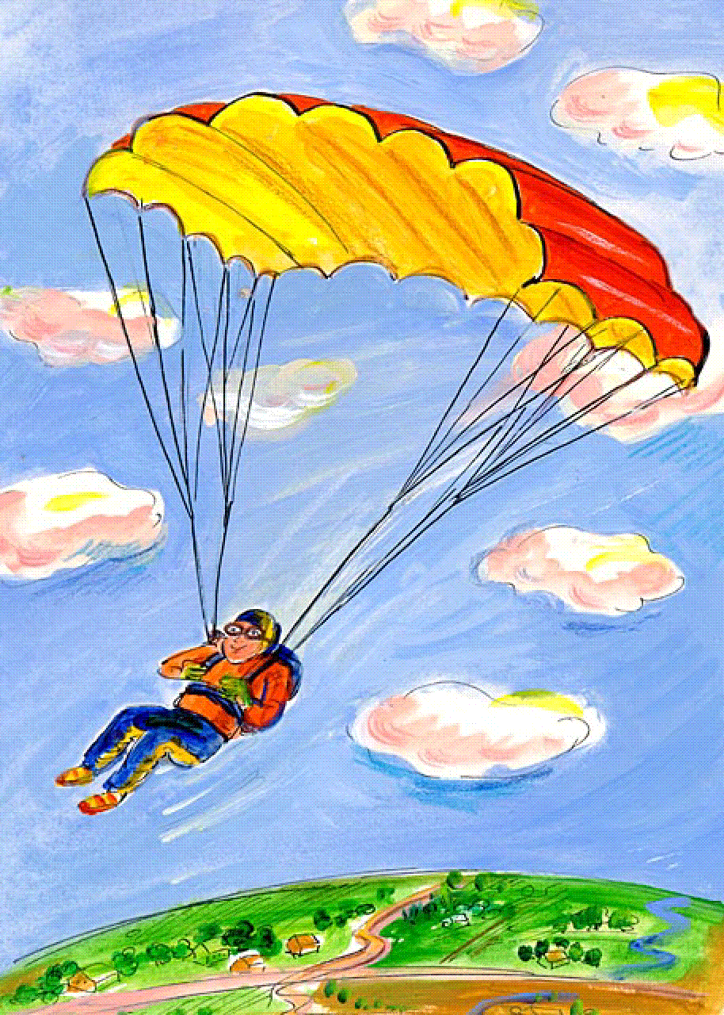
Force Diagrams
Air resistance is pushing upwards
The man and the parachute are slowly falling to the ground.
Which forces are acting on the parachute?
Which force is bigger?
How can you tell?
Force of Gravity and Air Resistance
Force of Gravity
The direction of motion is the same as the direction of the force of gravity
Gravity is pulling the man to the ground

Slide 17
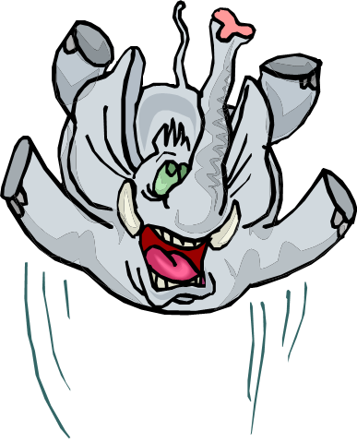
Force Diagrams cont.,
Air resistance is pushing upwards
The object in question is normally represented by a box.
Arrows indicating direction and magnitude of force are added
elephant
5N - F_{resistance}
elephant
Gravity is pulling downward
150N - F_{gravity}

Slide 18
Force Diagrams cont.,
Magnet pulling upwards
The paperclip is moving towards the magnet.
Which forces are acting on the paperclip?
Create a force diagram indicating the forces acting on the paperclip.
Are the forces balanced or unbalanced?
How can you tell?
Gravity pulling downward

