Slide 1
NISO welcome for Graduate Students
Fulbright and Boren to fund U.S. graduate student research abroad

Slide 2
Fulbright U.S. Student Program
Way more than just a funding mechanism

Slide 3
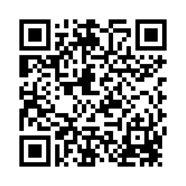
FULBRIGHT U.S. STUDENT PROGRAM
The largest U.S. international exchange program offering opportunities for students and professionals to undertake international advanced research, graduate study, or teach English worldwide.
1900 grants awarded each year to over 140 countries.
Funding for 9-12 months abroad
Grant provides:
Round-trip Airfare
Monthly Stipend
Accident & Sickness Coverage
Other Possible Benefits in some countries (dependent support, tuition, language lessons, disability-related accommodations)
Requires US citizenship
Scan this QR code or click this link to indicate interest in Fulbright: https://purdue.ca1.qualtrics.com/jfe/form/SV_6lfovWAuHKjdscl

Slide 4
Boren Fellowship
International Research, Language Acquisition, and National Security

Slide 5
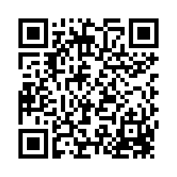
Boren Fellowship
Enables self-designed research, internship, and study programs. Fellows are also eligible to receive funding for domestic summer language programs immediately prior to their overseas study.
Grant provides up to $30,000 for:
12-52 weeks in a country deemed critical to national security
Research/study in areas critical to national security as defined broadly.
Must include study of a critical language
Required 1 year of US Federal Government Service after graduation
Requires US citizenship
Scan this QR code or click this link to indicate interest in Boren: https://purdue.ca1.qualtrics.com/jfe/form/SV_ePuaPHRX4VnL7Ap

Slide 6
We are excited you are Here and cannot wait to see the future of your research
Annual Information Sessions: NISO Week in September
Fulbright Week in February
Learn more on our website: www.purdue.edu/niso

