Slide 1
Graduate Professional
Development

Slide 2
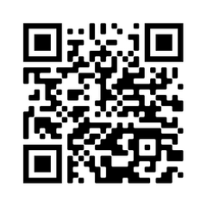
Workshops
300+ Free Workshops Annually
Topics Include:
Communication & Networking
Diversity & Inclusion
Mental Health
Teaching & Research
Industry & Academic Career Preparation
Grantsmanship & More!
SCAN FOR
WORKSHOPS!

Slide 3
Top 3 Workshops
Impostor Syndrome
Responsible Conduct of Research (RCR)
Thesis & Dissertation Prep

Slide 4
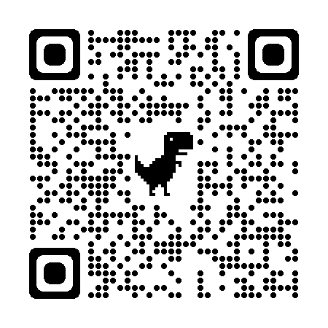
Boilers Work
Internship Program
Gain Work Experience, Refine Soft Skills, Establish Career Connections
$7,500 Stipend to Pursue an Unpaid Summer Internship
Deadline: April 5, 2024
LEARN
MORE!

Slide 5
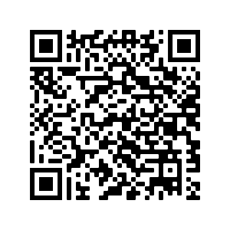
Say It In 6
Six Words, Your Story
$1,000 Prize
Capture Your Graduate Experience
Deadline: 02/23/24
SEE
MORE!

Slide 6
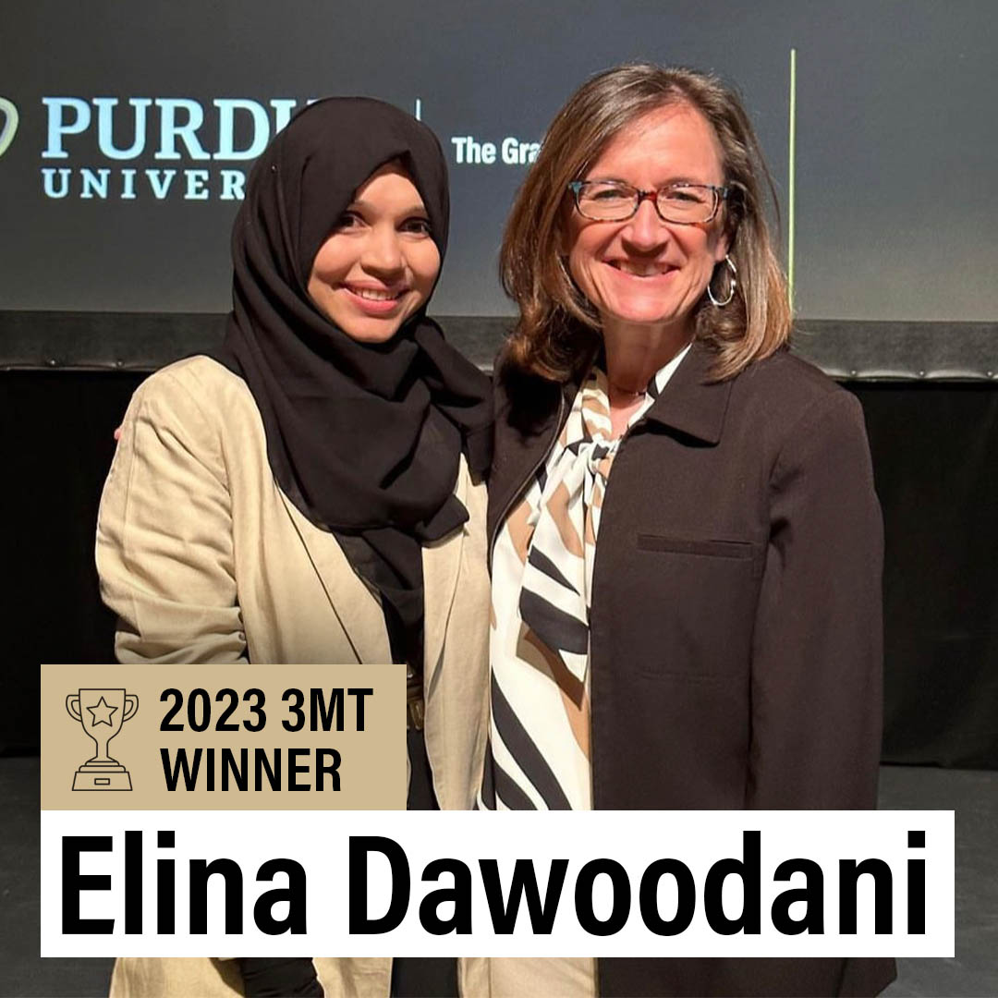
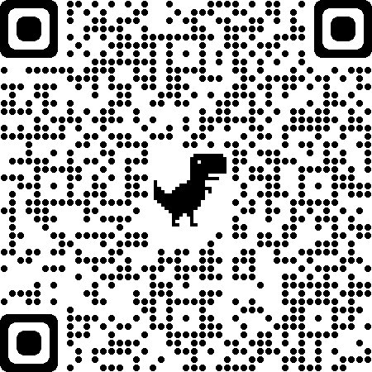
Three Minute Thesis (3MT)
Research Communication Competition
Three Minutes, One Slide, $4,000 Prize
Learn to share your research with a non-specialist audience!
Deadline: 02/09/24
LEARN
MORE!

Slide 7
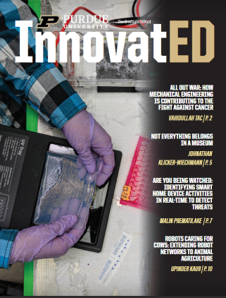
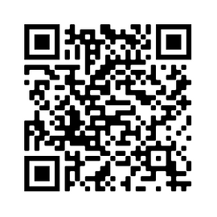
InnovatED
Graduate Research Magazine
Annual Publication
Learn to Write Popular Press Articles
Share Your Research
Monetary Awards
CHECK
IT OUT!

Slide 8
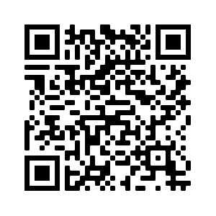
Thank you!
Office of Graduate Professional Development
profdev@purdue.edu
(765) 496-0475
ALL THINGS
PROF DEV

