Slide 1
MECHANICS OF MATERIALS
Fall 2025
ME 323- 002
Instructor: Shubhra Bansal
Lecture 41: Quiet Week Practice Problems

Slide 2
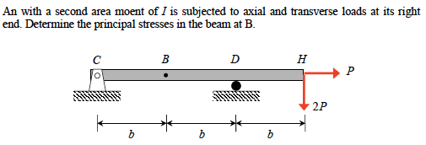
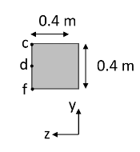

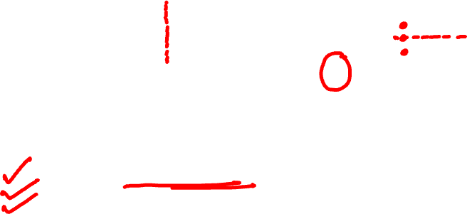
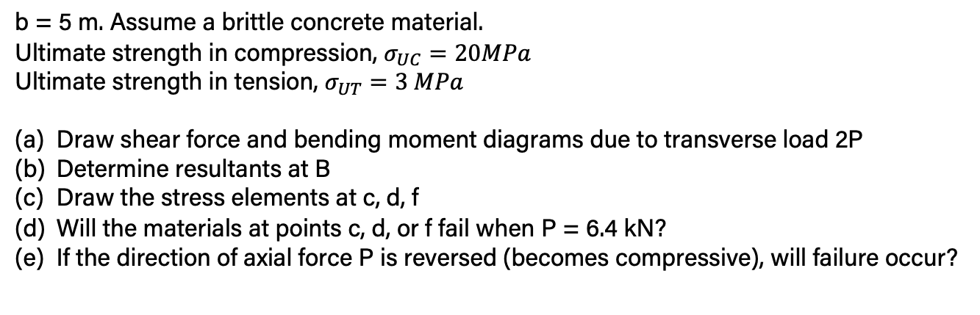

Practice Problem 1
b = 5 m. Assume a brittle concrete material.
Ultimate strength in compression, $σ_{UC}=20MPa$
Ultimate strength in tension, $σ_{UT}=3 MPa$
Draw shear force and bending moment diagrams due to transverse load 2P
Determine resultants at B
Draw the stress elements at c, d, f
Will the materials at points c, d, or f fail when P = 6.4 kN?
If the direction of axial force P is reversed (becomes compressive), will failure occur?

Slide 3
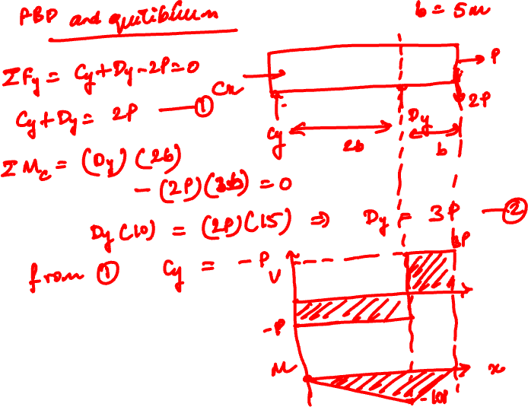

Slide 4
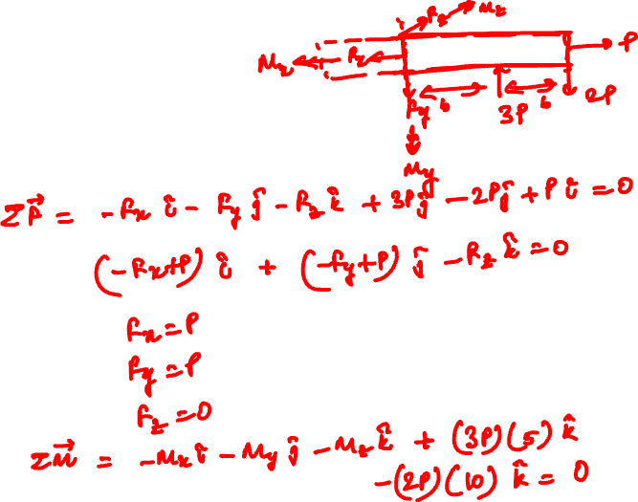

Slide 5


Slide 6
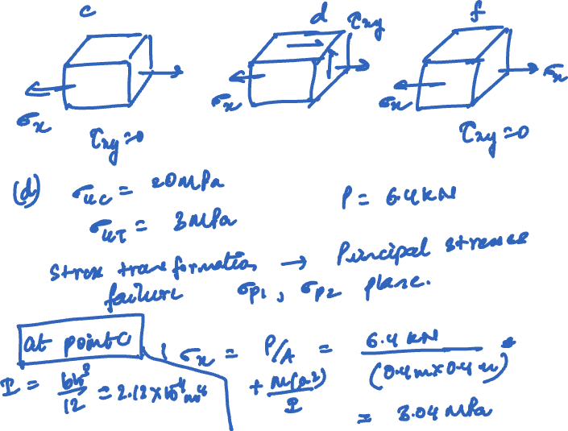

Slide 7
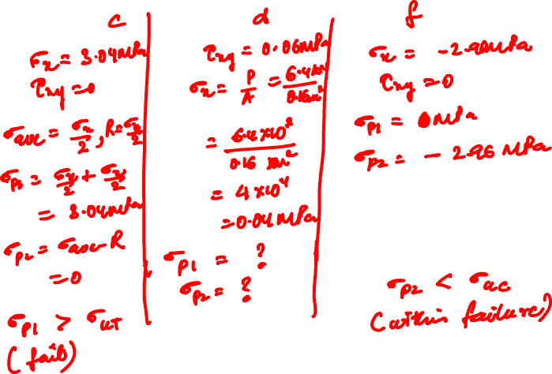

Slide 8
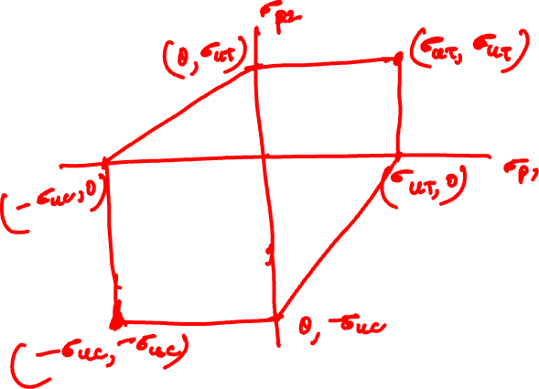

Slide 9
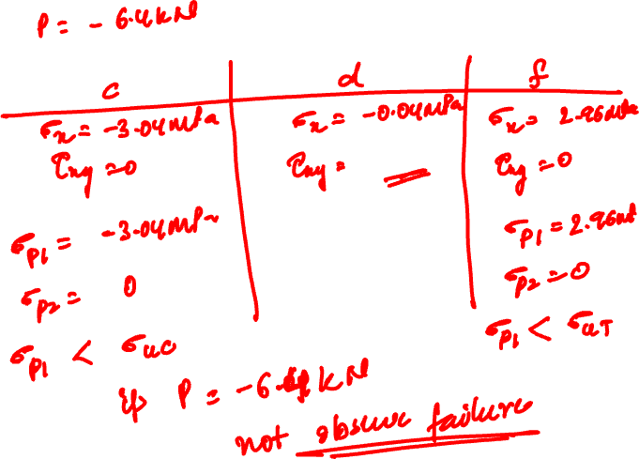

Slide 10
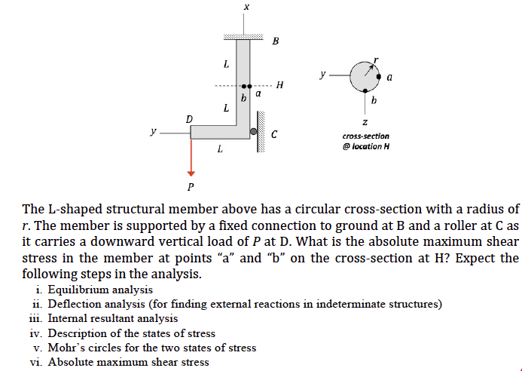
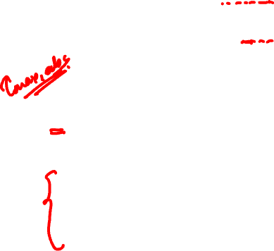
Practice Problem 2

Slide 11
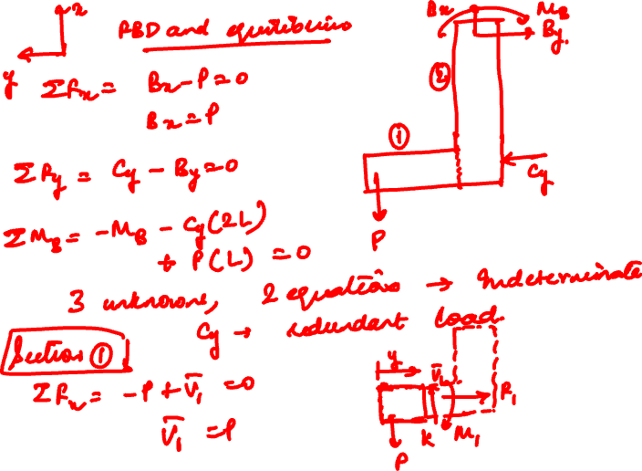

Slide 12
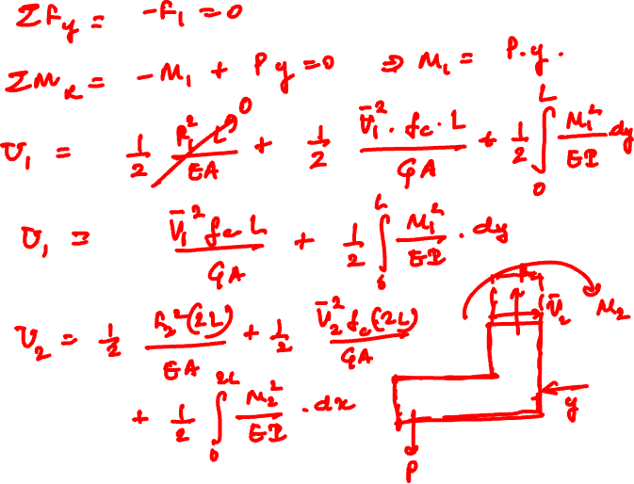

Slide 13
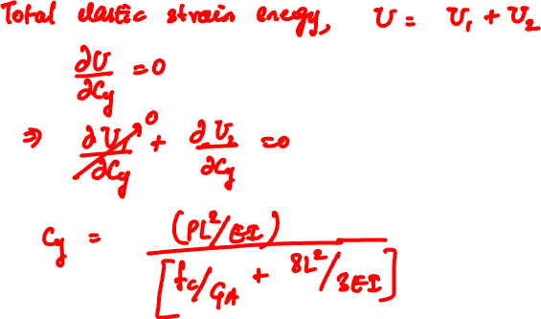

Slide 14
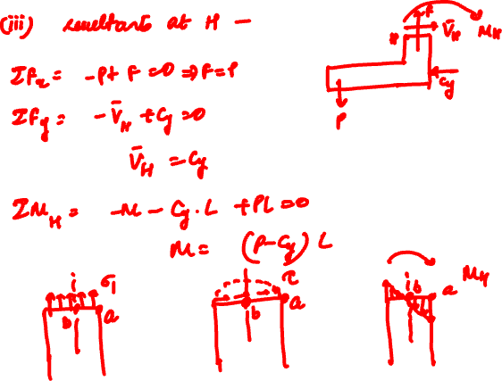

Slide 15
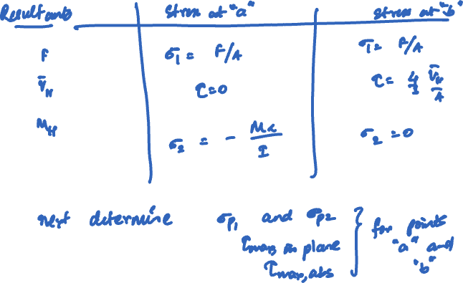

Slide 16
Thank You

