Slide 1
MECHANICS OF MATERIALS
Fall 2025
ME 323- 002
Instructor: Shubhra Bansal
Lecture 40: Quiet Week Practice Problems

Slide 2
Announcements
Complete course evaluations, send me an email with screenshot of completion, receive additional points towards Homeworks.
Dec 8 and 10: Practice with combined loadings and failure analysis
Dec 12: Course revision
Exam time/date: 7:00-9:00PM, Tuesday, December 16
WTHR 200
Exam coverage: Lectures 25-42 for full-length questions, and throughout entire course for conceptual questions

Slide 3
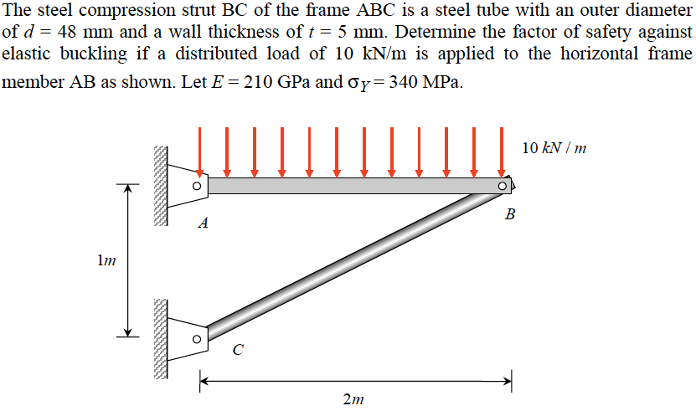
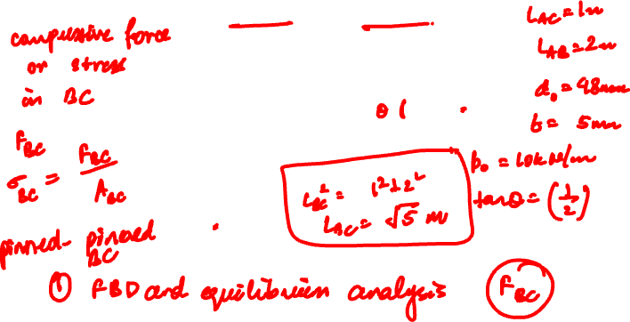
Example 18.2 from Lecturebook

Slide 4


Slide 5


Slide 6


Slide 7
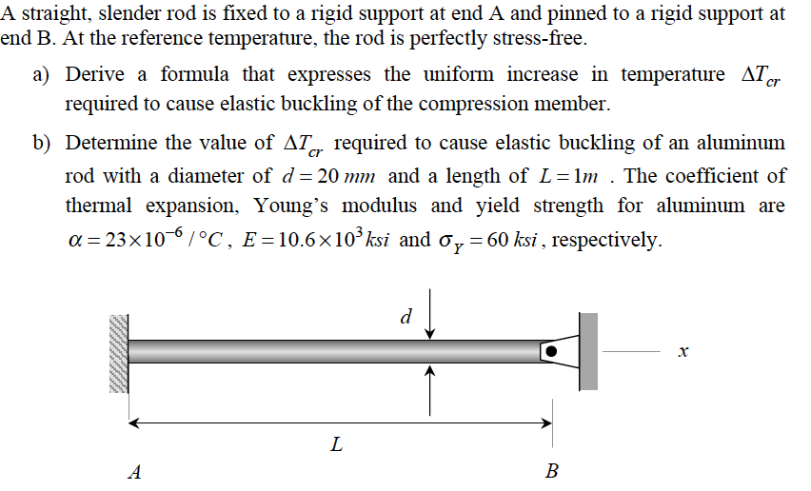


Example 18.4 from Lecturebook

Slide 8


Slide 9



Slide 10


Slide 11
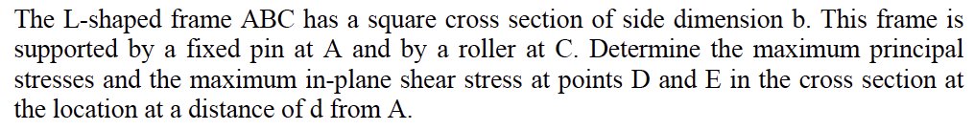
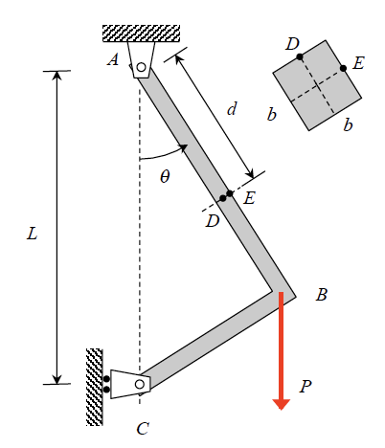

Practice Problem 1

Slide 12


Slide 13


Slide 14


Slide 15


Slide 16


Slide 17
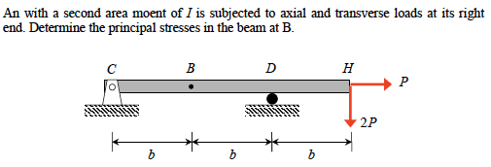
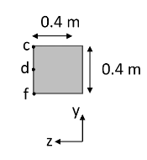

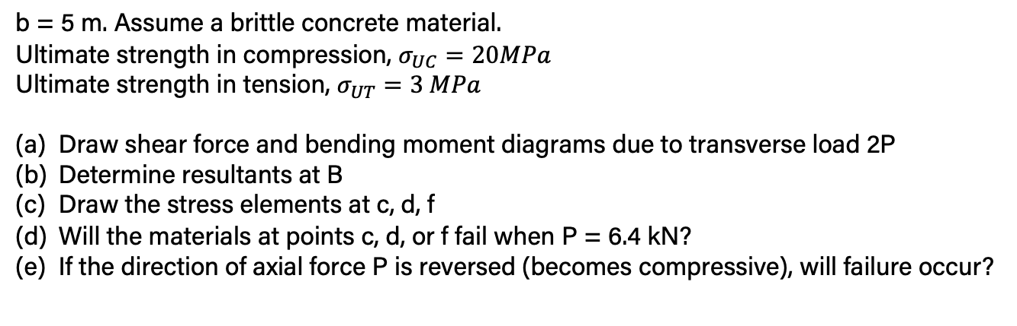
Practice Problem 2
b = 5 m. Assume a brittle concrete material.
Ultimate strength in compression, $σ_{UC}=20MPa$
Ultimate strength in tension, $σ_{UT}=3 MPa$
Draw shear force and bending moment diagrams due to transverse load 2P
Determine resultants at B
Draw the stress elements at c, d, f
Will the materials at points c, d, or f fail when P = 6.4 kN?
If the direction of axial force P is reversed (becomes compressive), will failure occur?

Slide 23
Thank You

