Slide 1
MECHANICS OF MATERIALS
Fall 2025
ME 323- 002
Instructor: Shubhra Bansal
Lecture 22 and 23: Energy Methods- Catigliano’s Method fpr Determinate and Indeterminate Structures

Slide 2
Announcements
Bansal on travel Oct 21-Oct 28 → will miss in-person Lectures 23, 24, 25
  Offering Sunday Zoom lessons to cover the missed lectures in a timely fashion
Suggested make-up (on Zoom) Plan:
  Sunday Oct 19 (Lectures 22, 23) → 90 min session
  Monday Oct 20- Lecture 24
  Sunday Oct 26 (Lecture 25) → 60 min session
  Send Zoom information
  Zoom recorded videos will be posted in ME323 website
  What time frame is preferred on Sunday? – voted 3pm on 10/19 and 10/26 in class
Resume regular lectures on Wednesday Oct 29

Slide 3
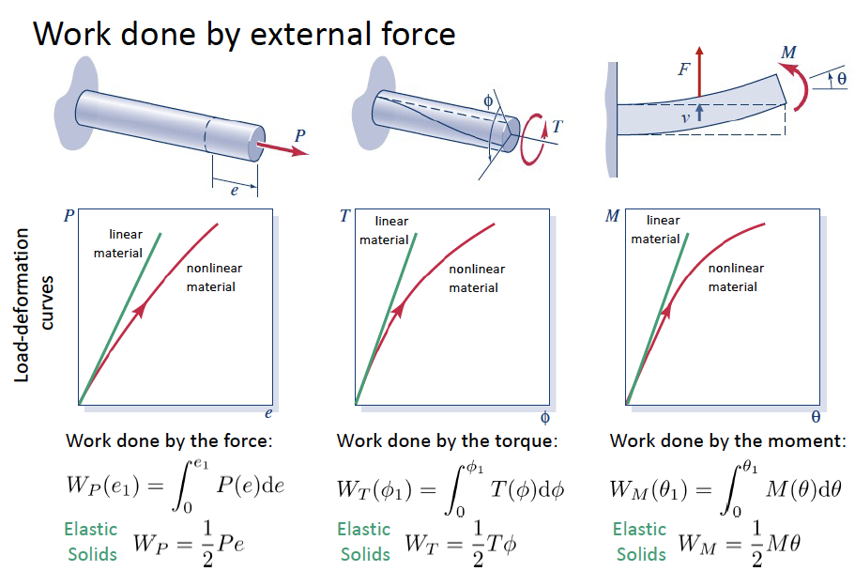
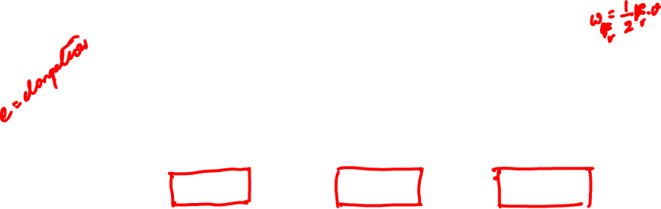
Work Done on Linear Elastic Bodies

Slide 4
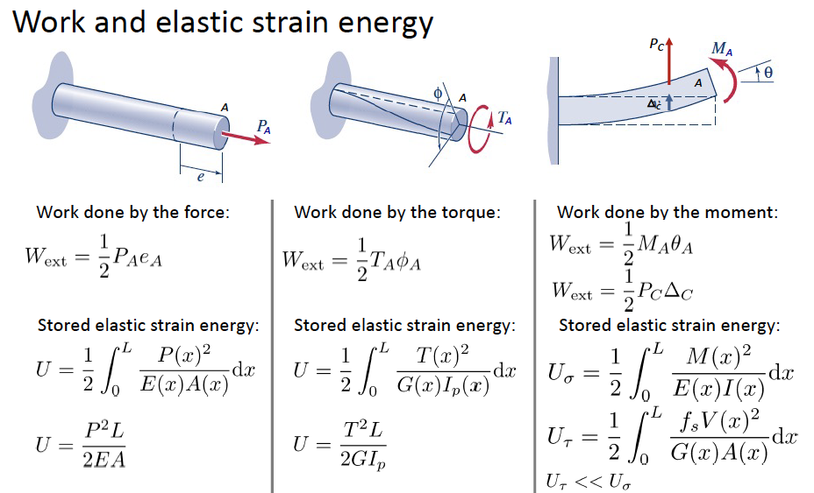


Energy Methods: Work-Energy Principle
Work Energy Principle: $W_{ext}=U$

Slide 5
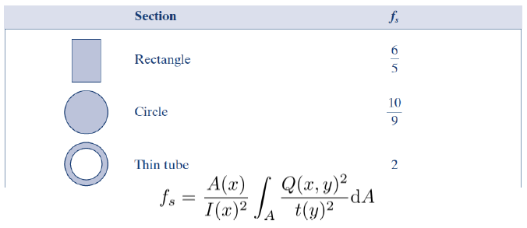

Form factor

Slide 6
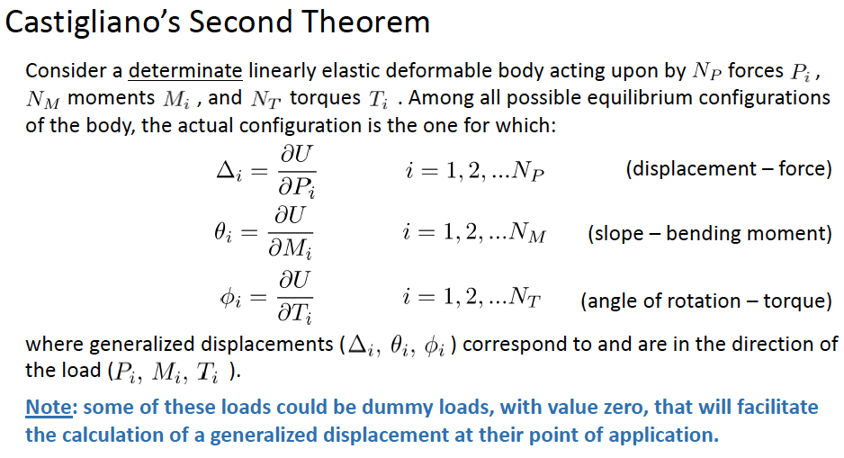
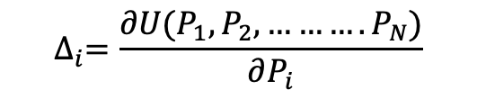
Energy Methods: Castigliano’s Second Theorem
$$∆_{i}=\frac{∂U(P_{1},P_{2}, ……….P_{N})}{∂P_{i}}$$

Slide 7
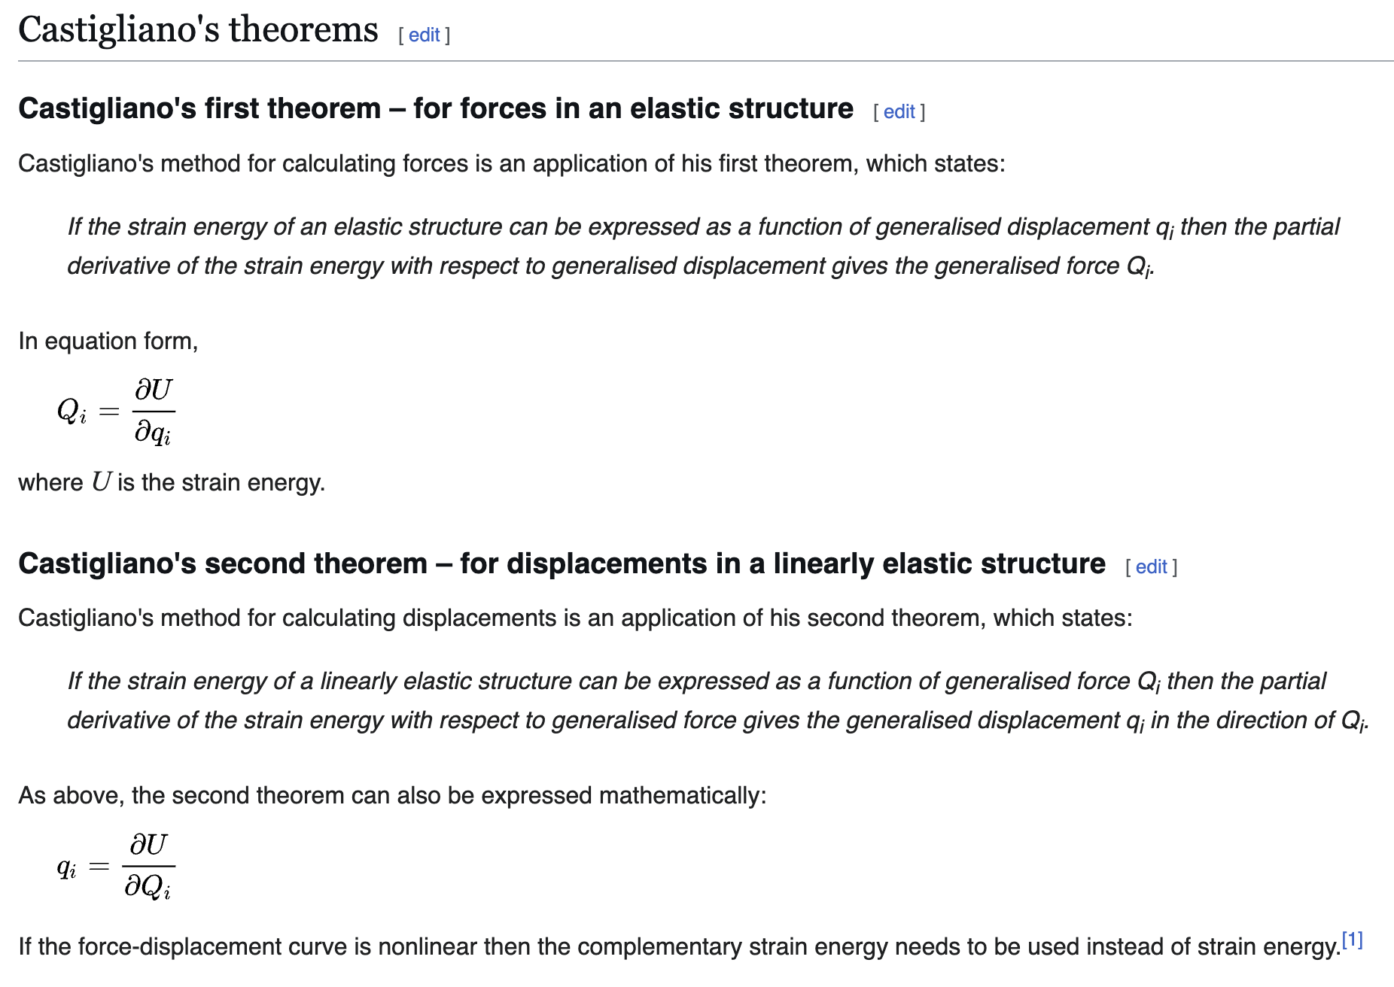
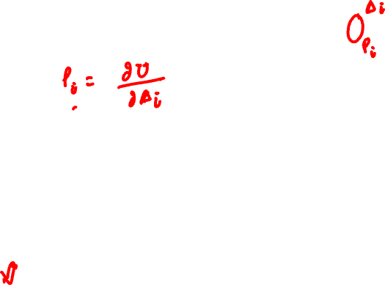
Source: Wikipedia

Slide 8
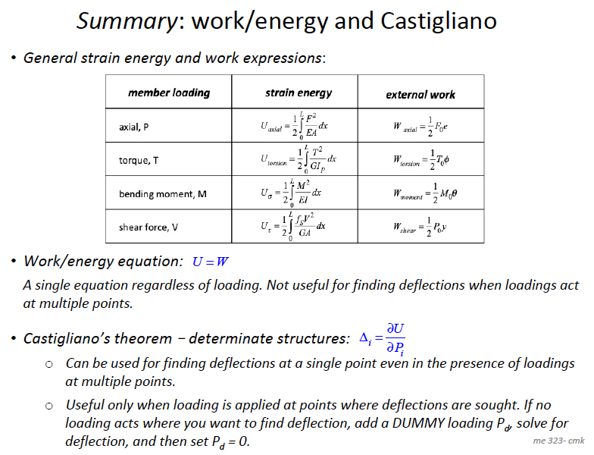
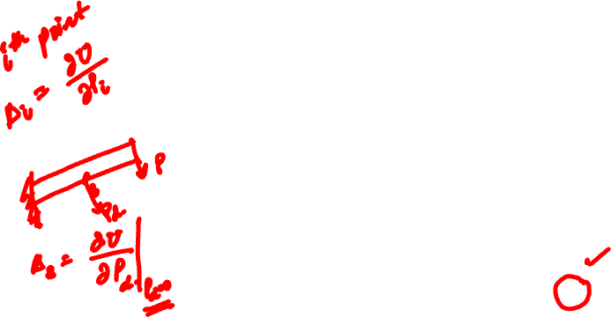


Slide 9
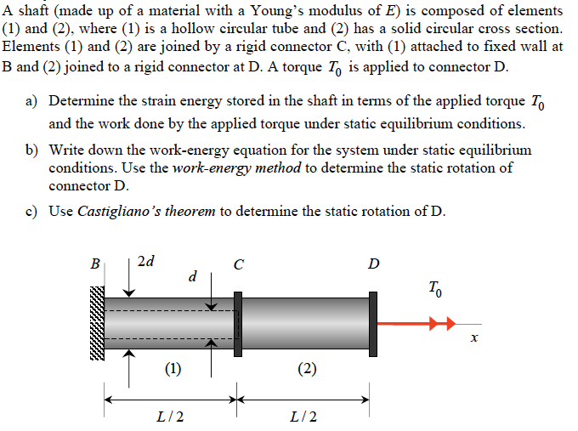
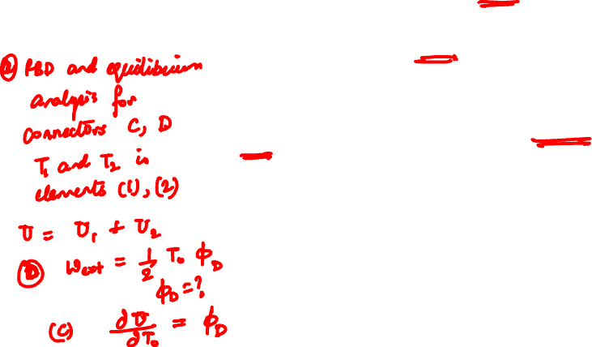
Example 16.2 from Lecture Book

Slide 10
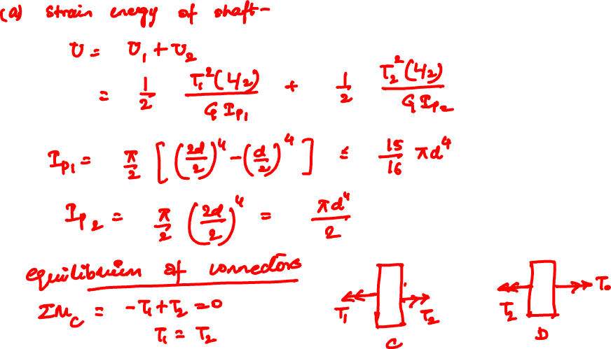

Slide 11
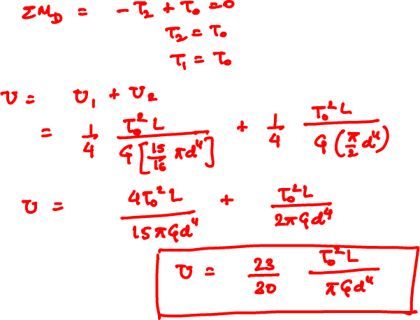

Slide 12
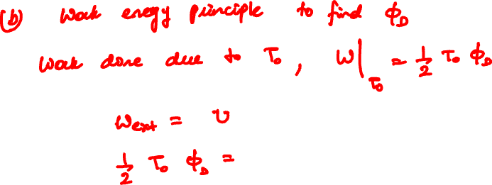
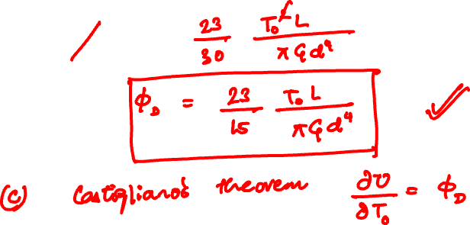

Slide 13
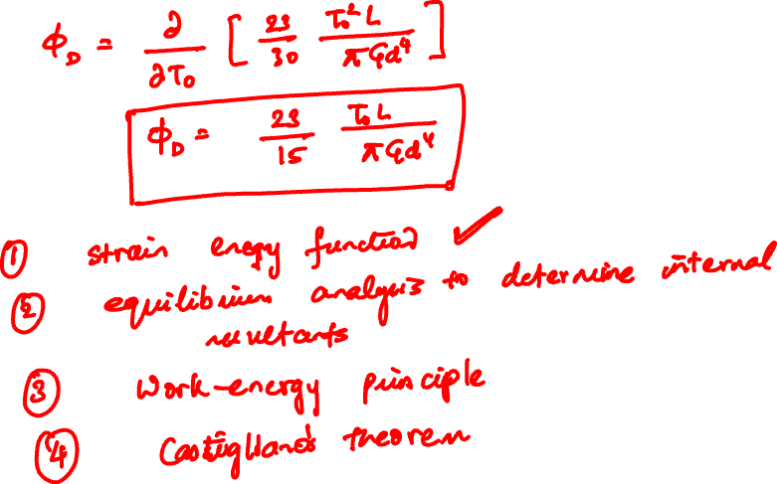

Slide 14
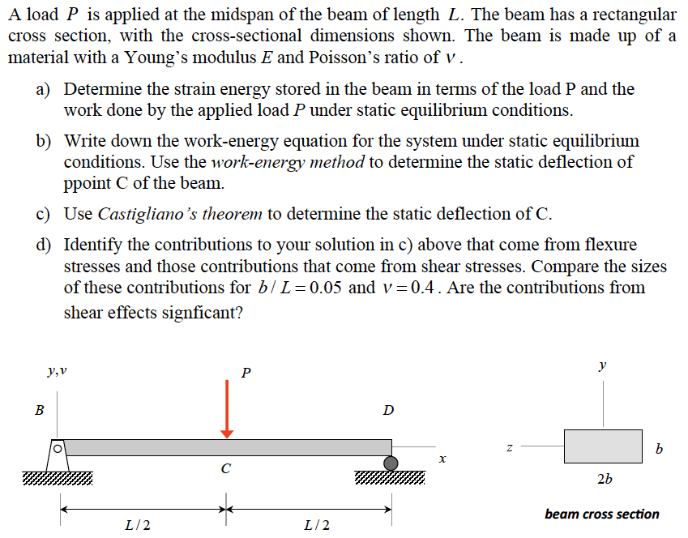
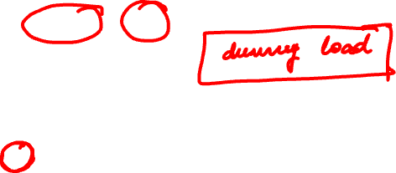
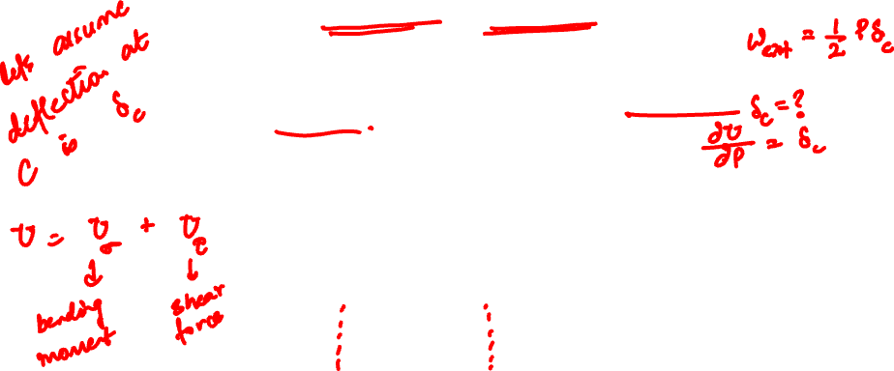
Example 16.3 (16.5) from Lecture Book

Slide 15
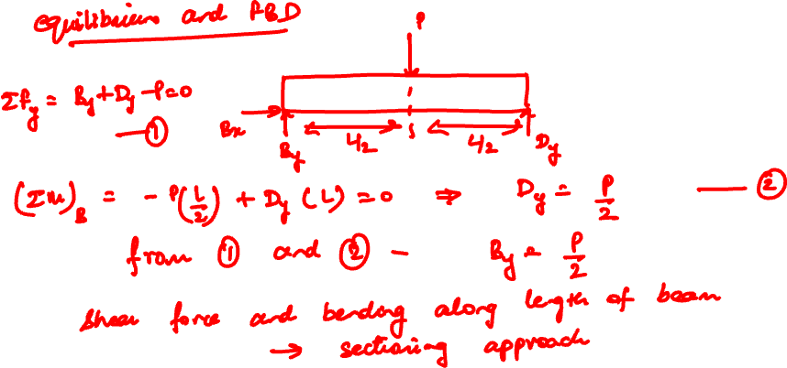

Slide 16
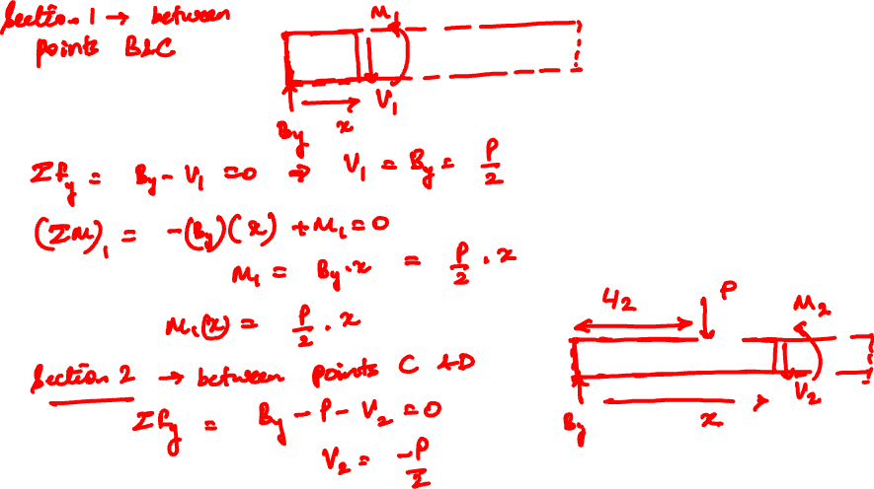

Slide 17
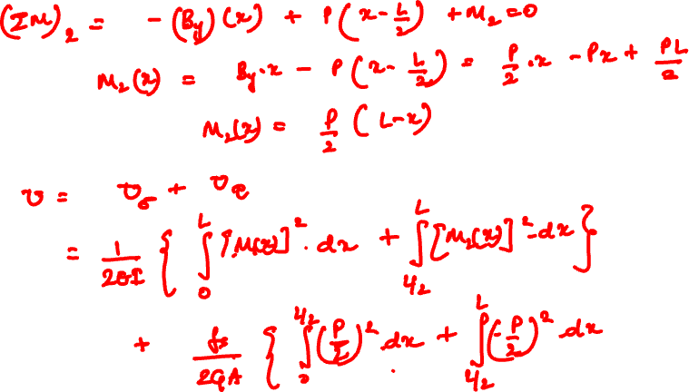

Slide 18
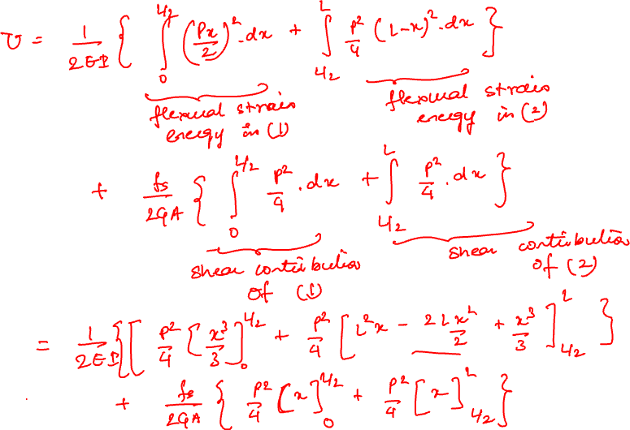

Slide 19
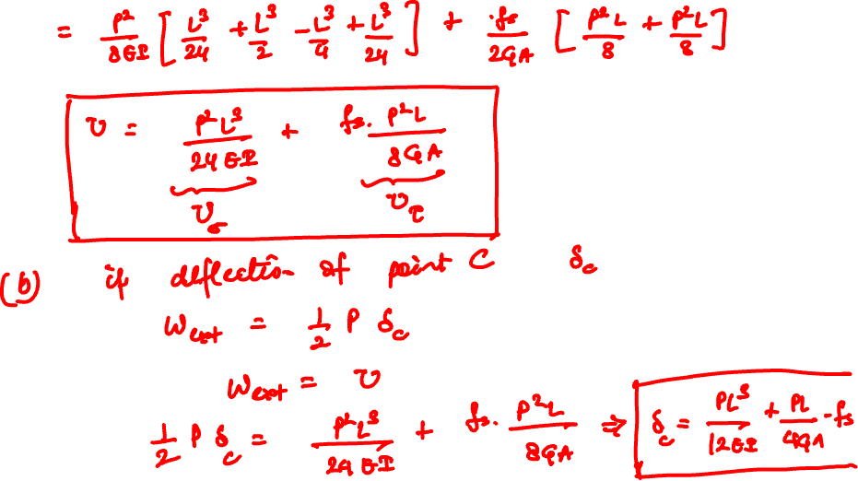

Slide 20
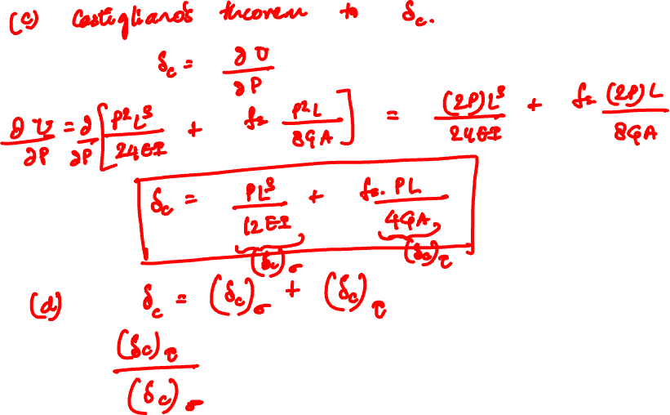

Slide 21
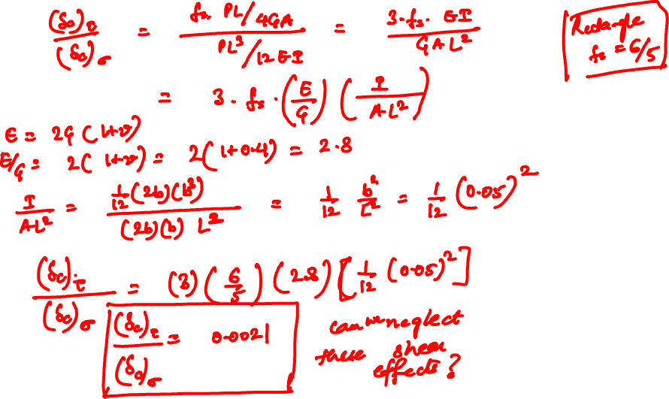

Slide 22
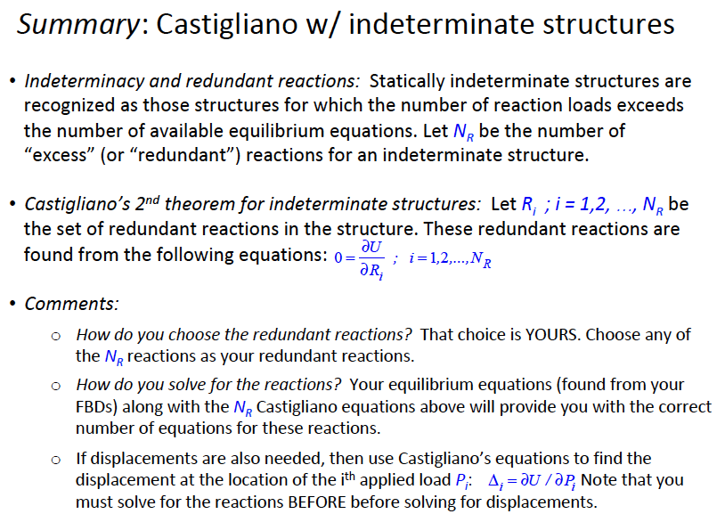
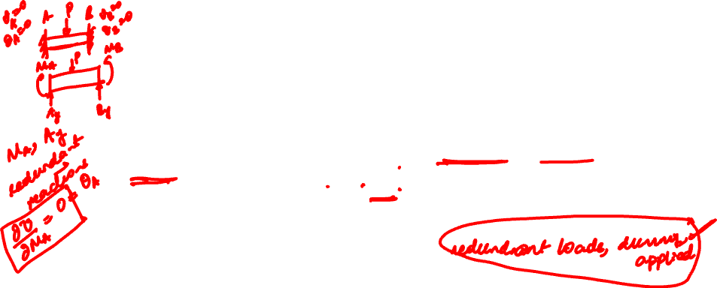
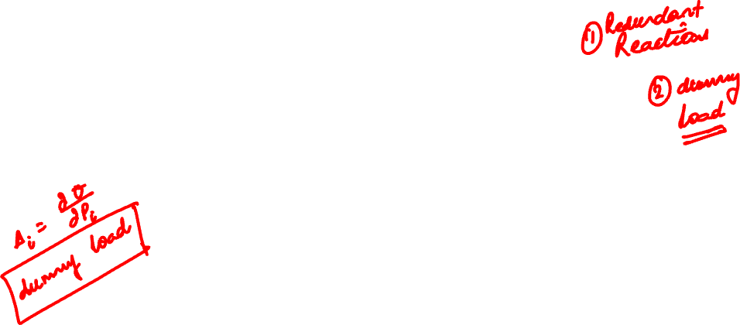
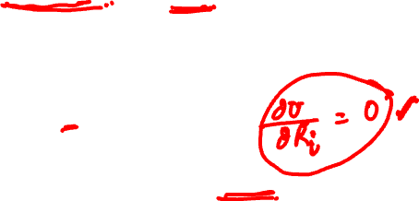

Slide 23
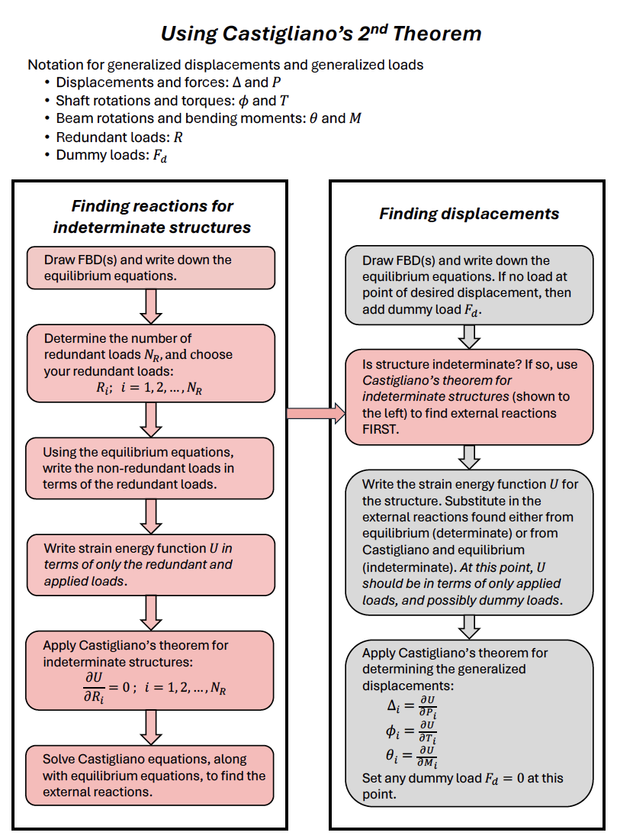
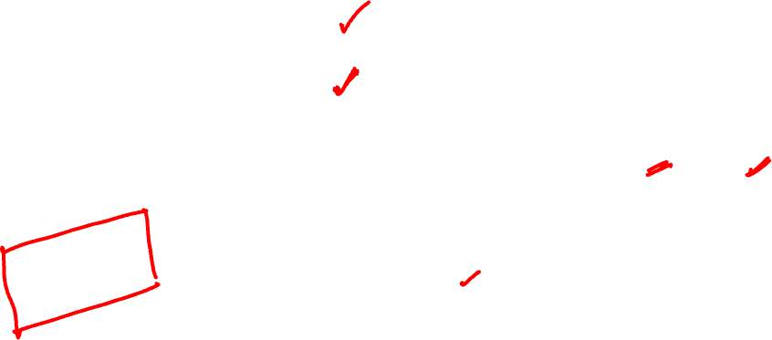
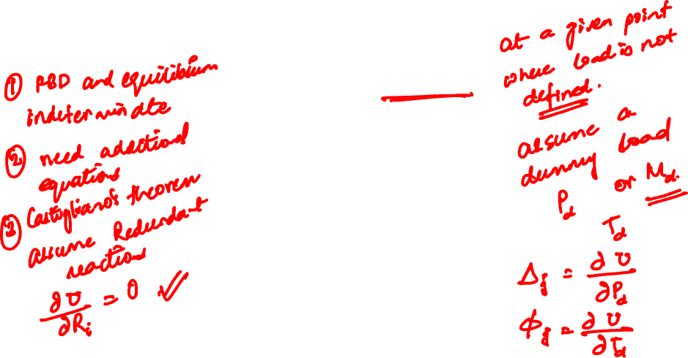

Slide 24
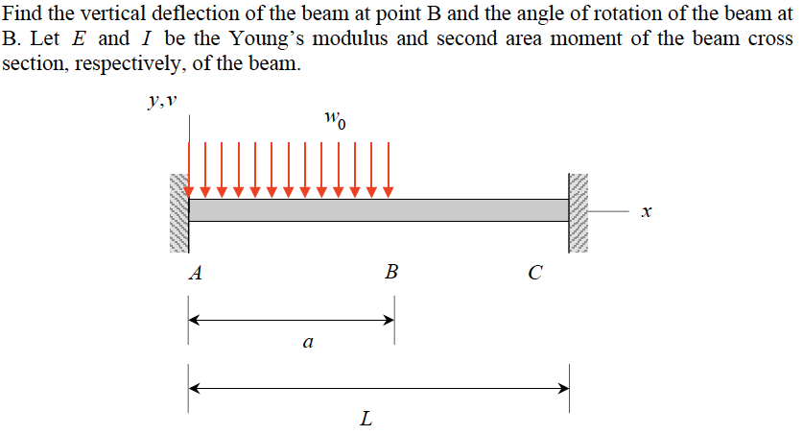

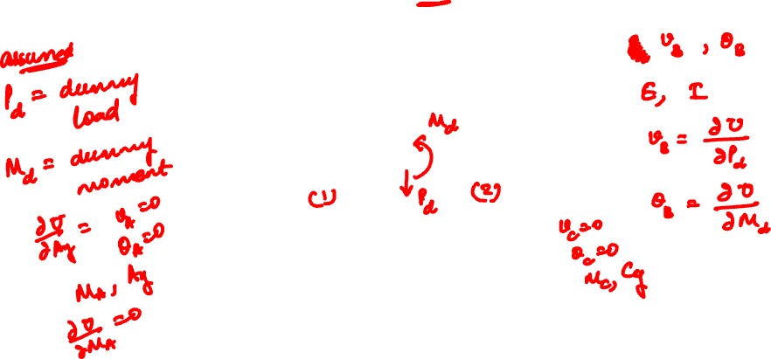
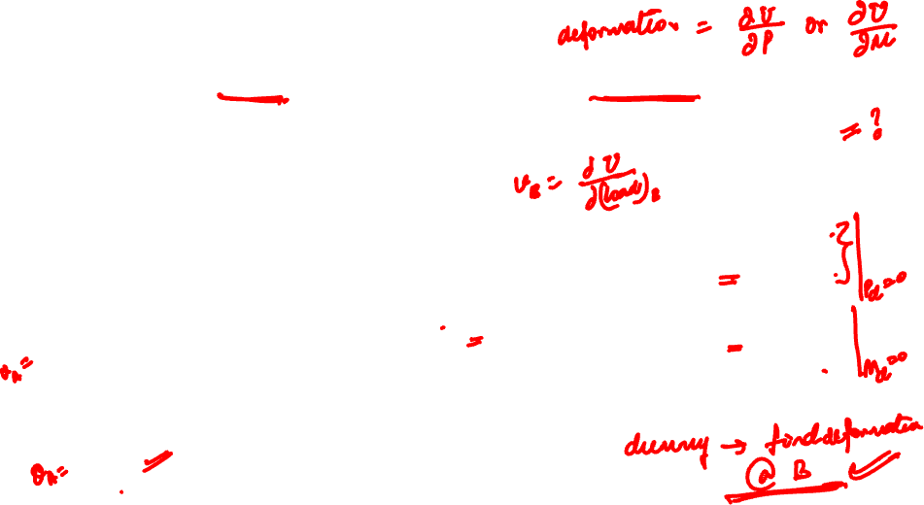
Example 16.8B from Lecture Book

Slide 25
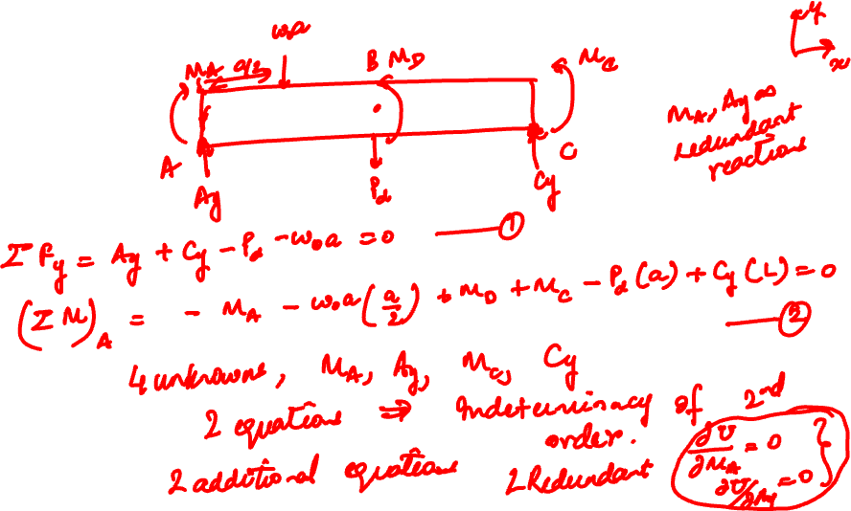

Slide 26
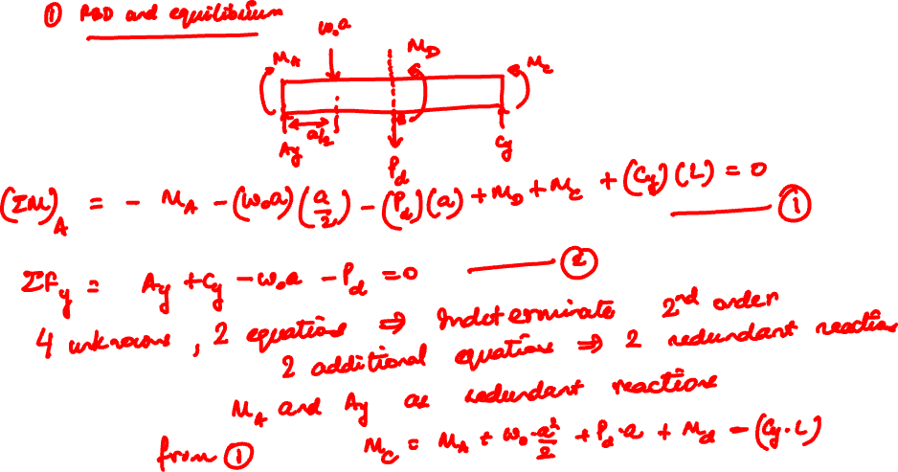


Slide 27
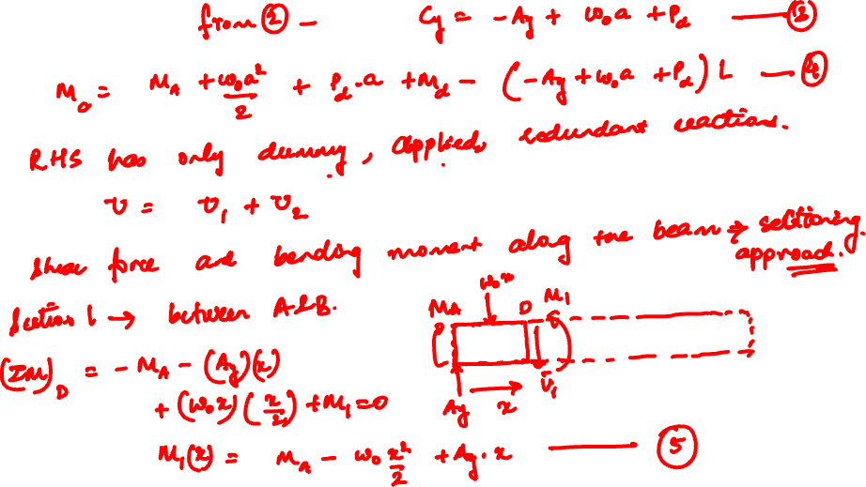


Slide 28
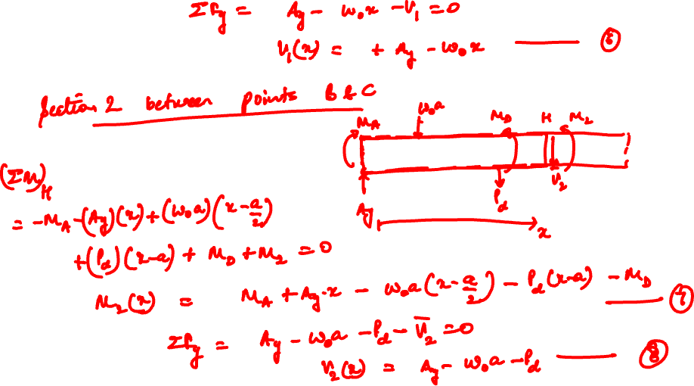


Slide 29
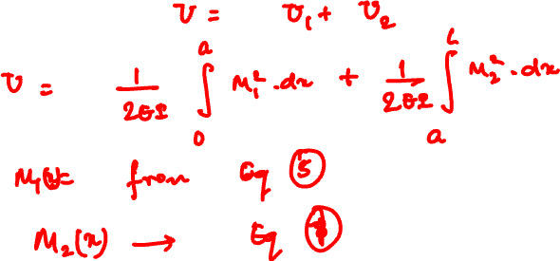
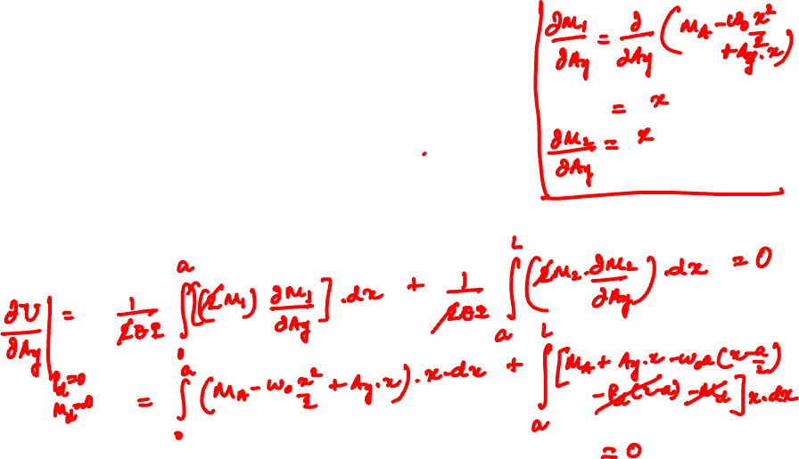

Slide 30
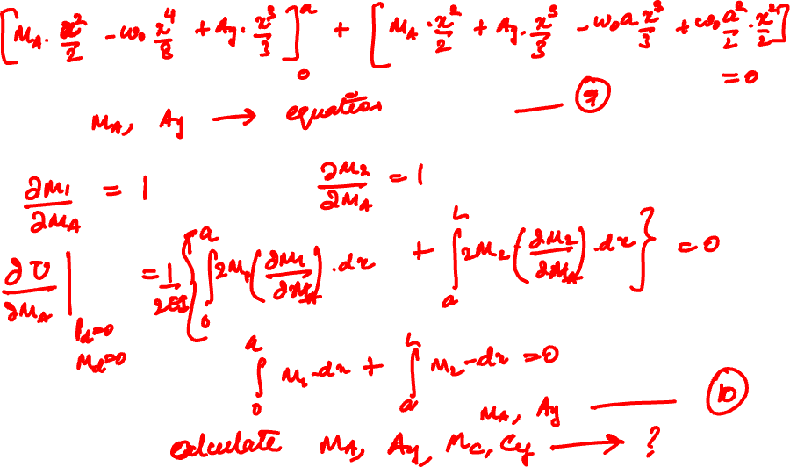

Slide 31
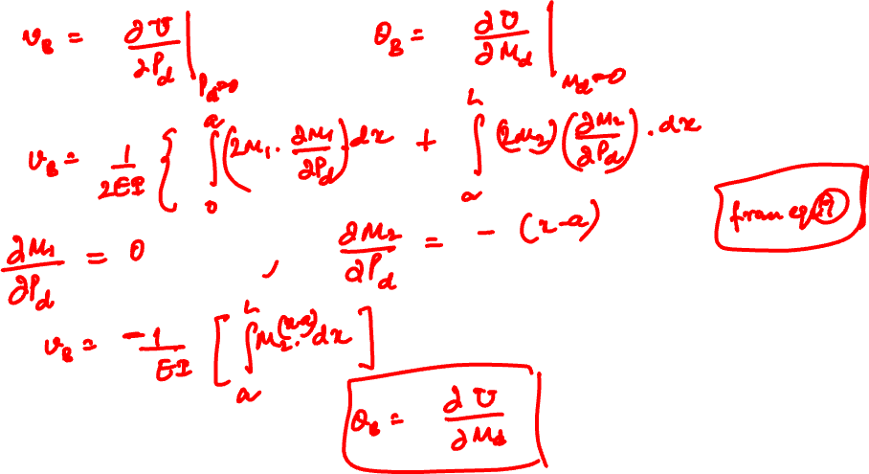

Slide 32
Thank You

