Slide 1
MECHANICS OF MATERIALS
Fall 2025
ME 323- 002
Instructor: Shubhra Bansal
Lecture 21: Energy Methods- Determinate Structures

Slide 2
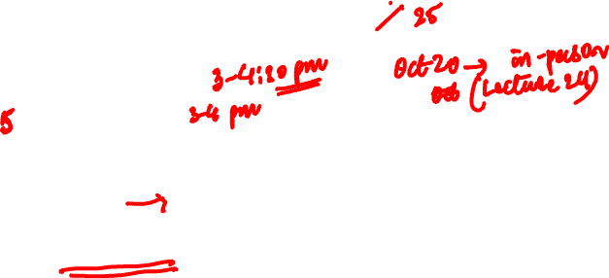
Announcements
Bansal on travel Oct 21-Oct 28 → will miss in-person Lectures 22, 23, 24
Suggested make-up (on Zoom):
Sunday Oct 19 (Lectures 22, 23) → 90 min session
Sunday Oct 26 (Lecture 24) → 60 min session
Send Zoom information
Zoom recorded videos will be posted in ME323 website
What time frame is preferred on Sunday?
Resume regular lectures on Wednesday Oct 29
Plan for lectures between Oct 21-28:
Lectures 22, 23: Sunday Oct 19 @ 3pm
Monday Oct 20: Lecture 24
Lecture 26: Sunday Oct 26
Resume regular class schedule Wednesday Oct 29

Slide 3
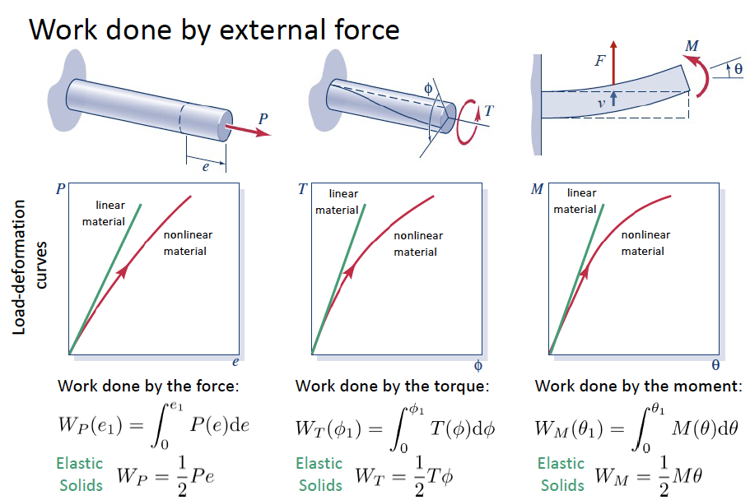
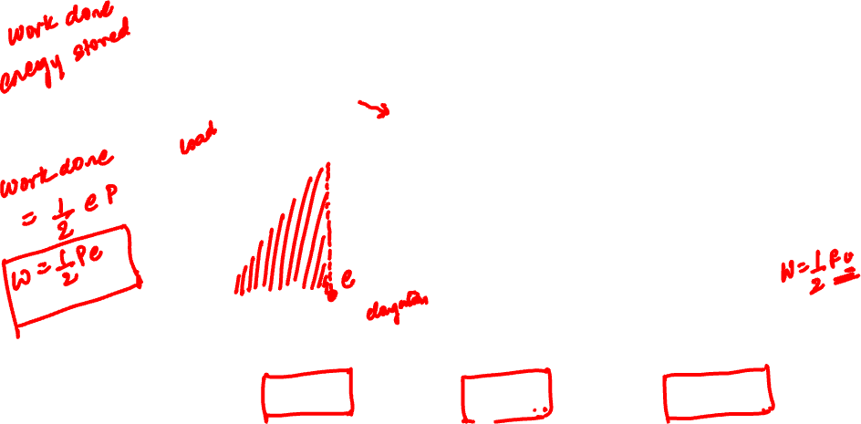
Work Done on Linear Elastic Bodies

Slide 4
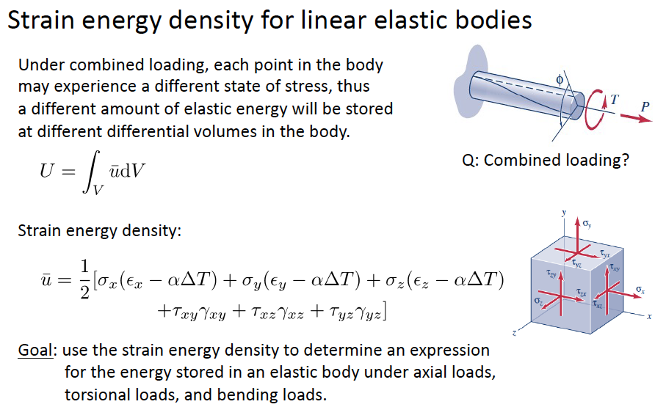
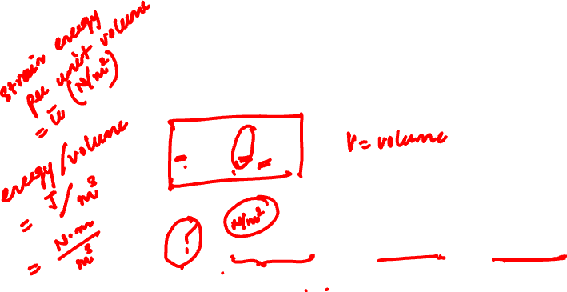
Elastic Strain Energy

Slide 5
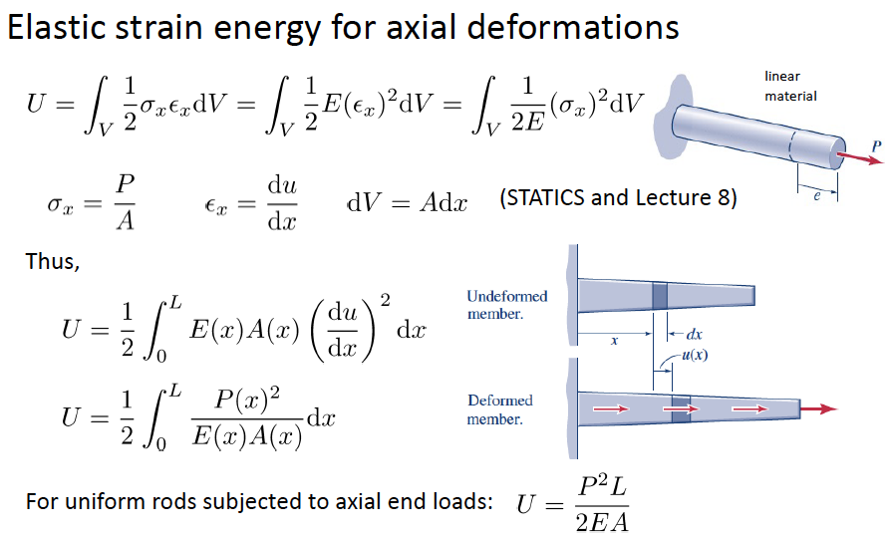
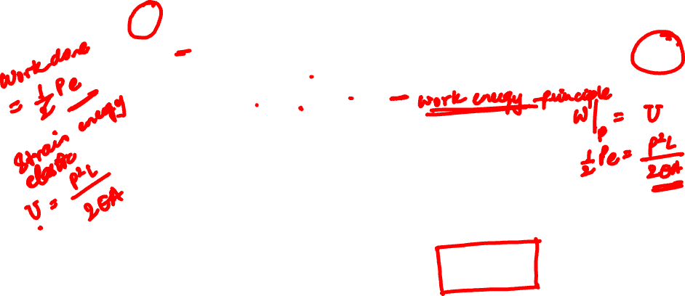
Elastic Strain Energy- Axial Deformation

Slide 6
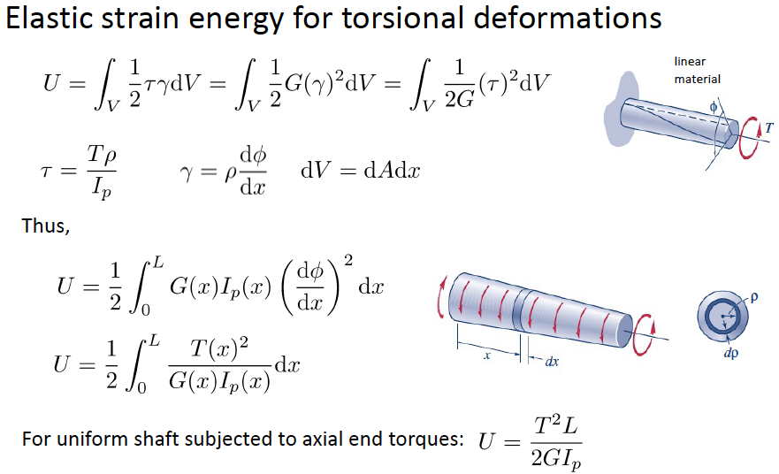
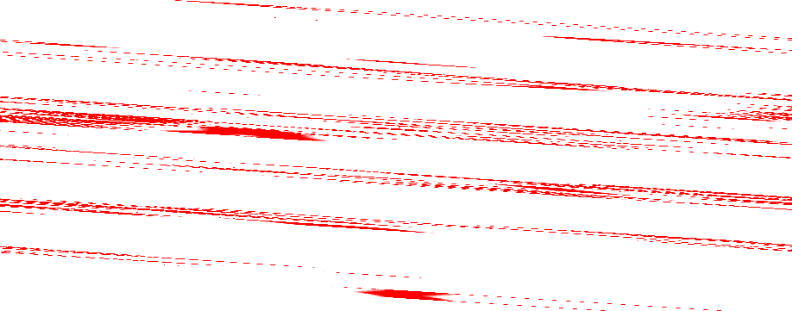
Elastic Strain Energy- Torsional Deformation

Slide 7
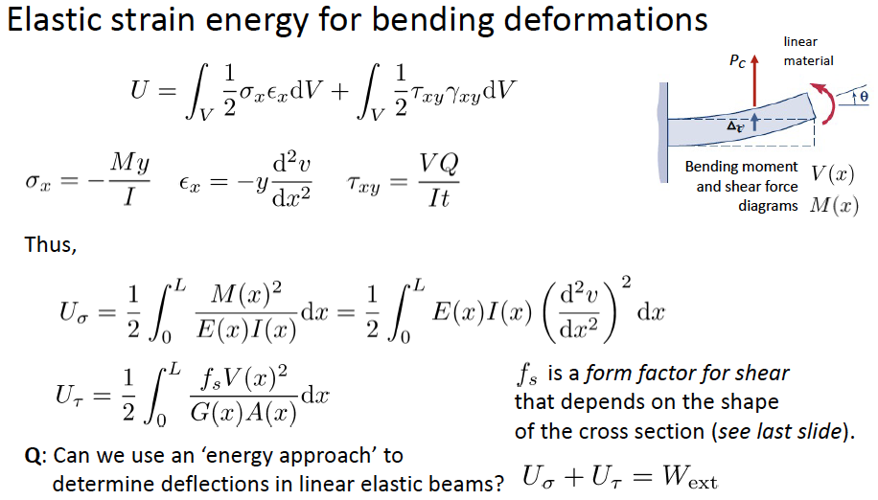


Elastic Strain Energy- Bending Deformation

Slide 8
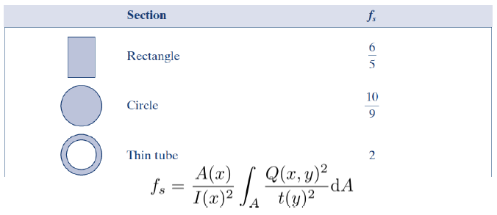

Form factor

Slide 9
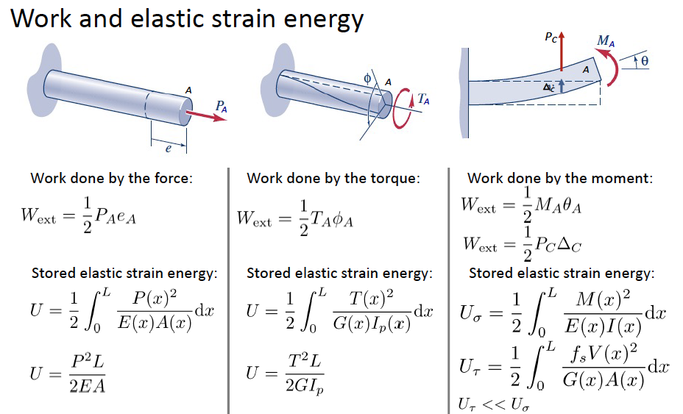


Energy Methods: Work-Energy Principle
Work Energy Principle: $W_{ext}=U$

Slide 10
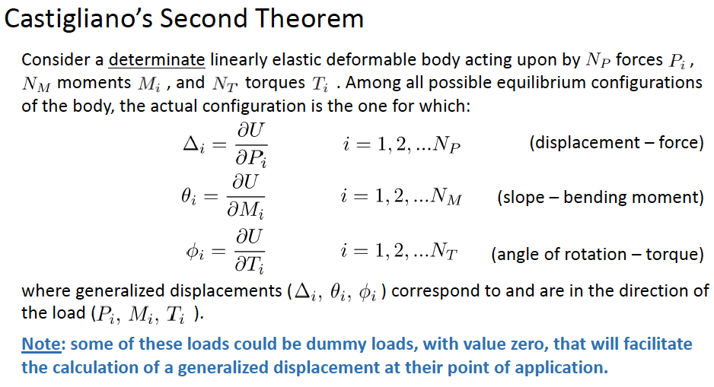
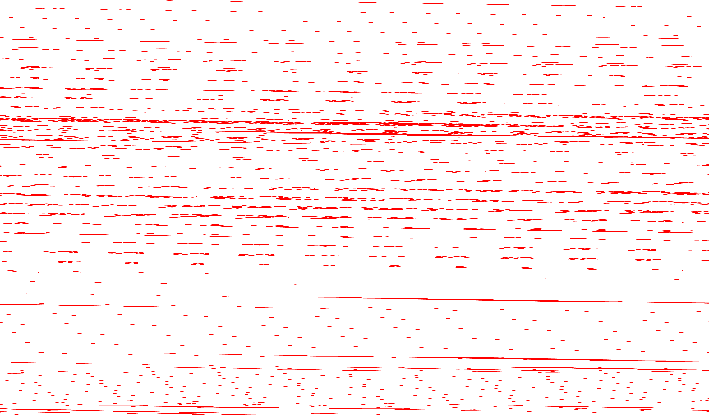
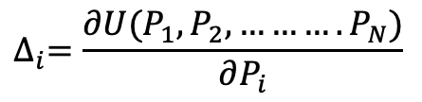
Energy Methods: Castigliano’s Second Theorem
$$∆_{i}=\frac{∂U(P_{1},P_{2}, ……….P_{N})}{∂P_{i}}$$

Slide 11
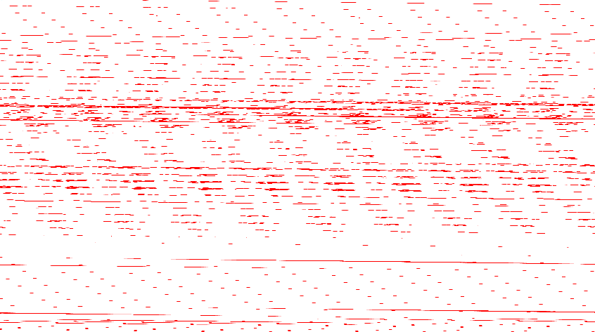

Slide 13
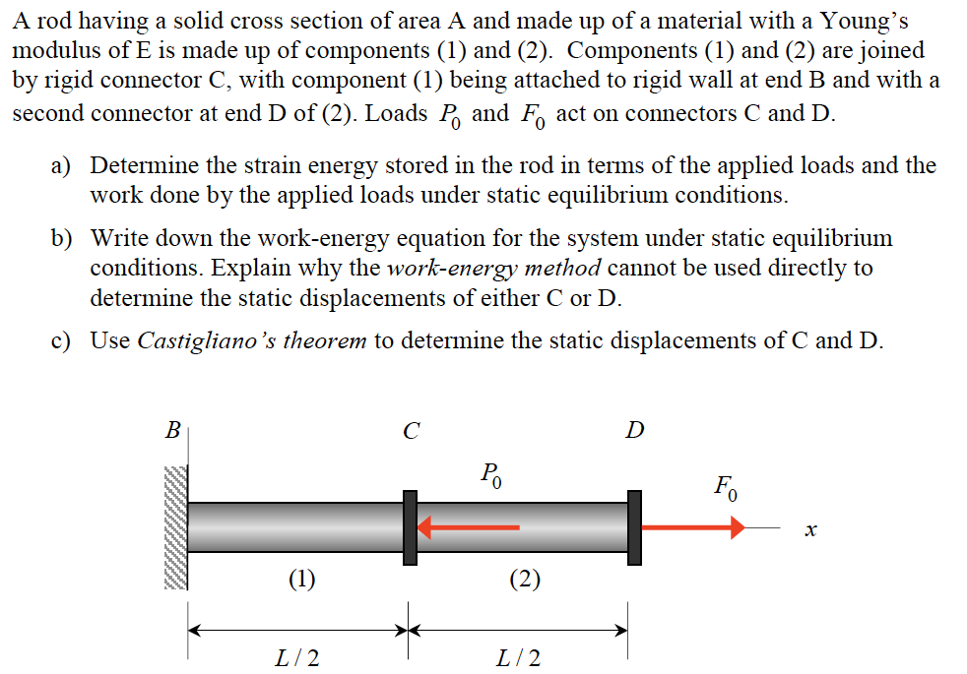
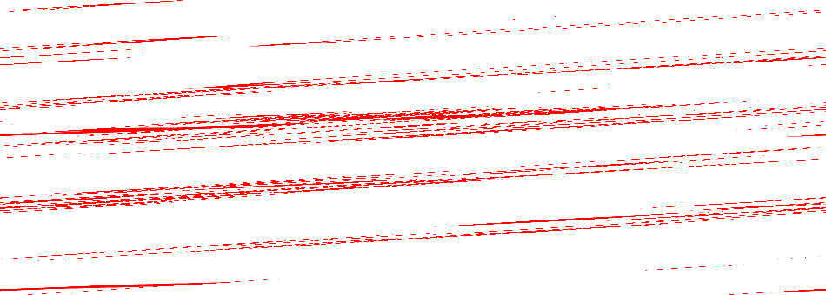
Example 16.1 from Lecture Book

Slide 14
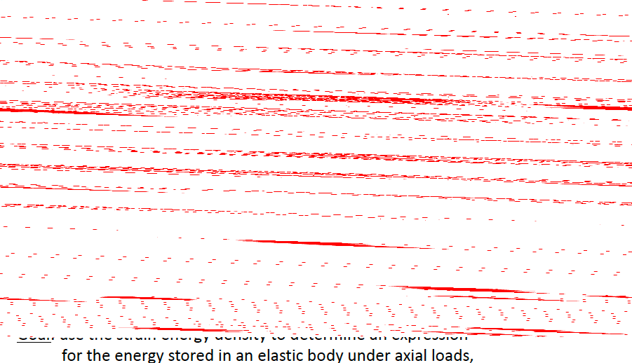

Slide 15
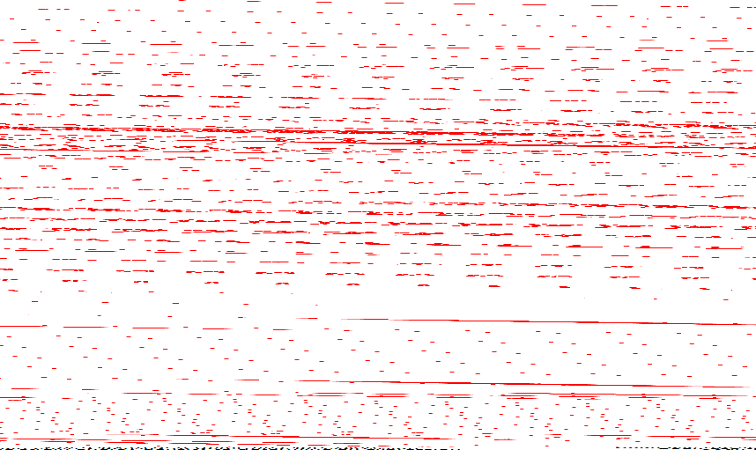

Slide 16


Slide 17
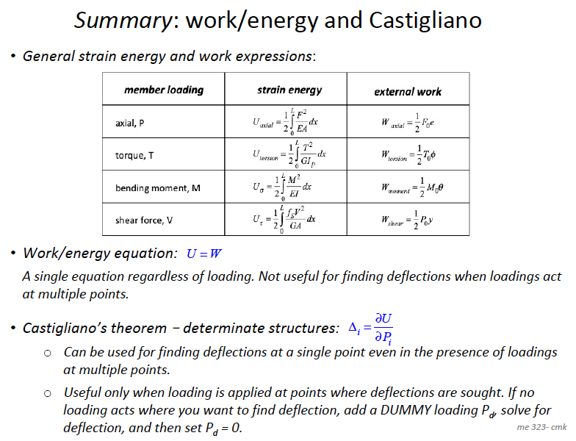

Slide 18
Thank You

