Slide 1
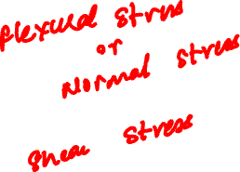
MECHANICS OF MATERIALS
Fall 2025
ME 323- 002
Instructor: Shubhra Bansal
Lecture 16: Stresses in Beams

Slide 2
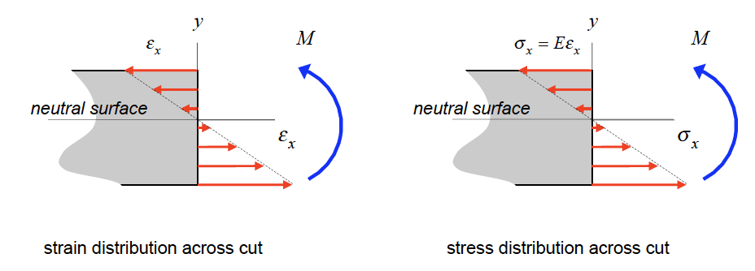


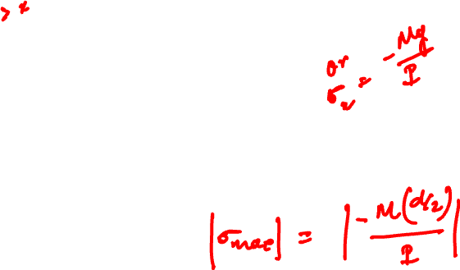
Flexural Stresses in Pure Bending in Beams
Axial Strain,
As a result of the above Euler-Bernoulli assumptions, it can be shown that the axial strain ε_{x} across a perpendicular cut in the beam where y is measured from the neutral surface of the beam and ρ is the radius of curvature of the deflection curve for the loaded beam.
For a linearly-elastic material for the beam, the normal stress distribution in y.

Slide 3
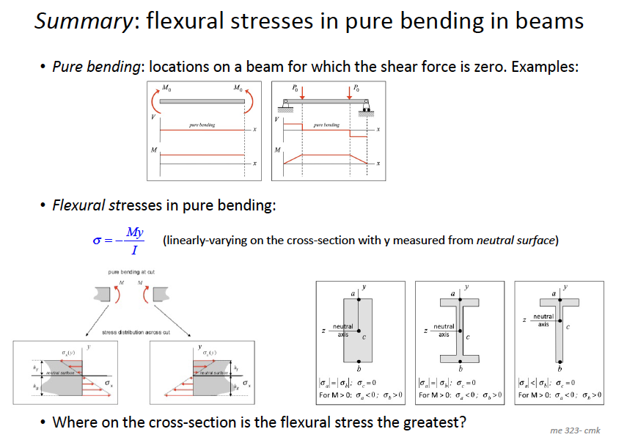
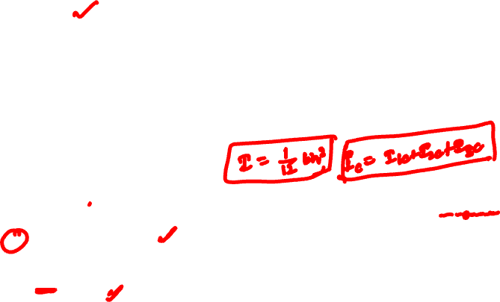

Slide 4
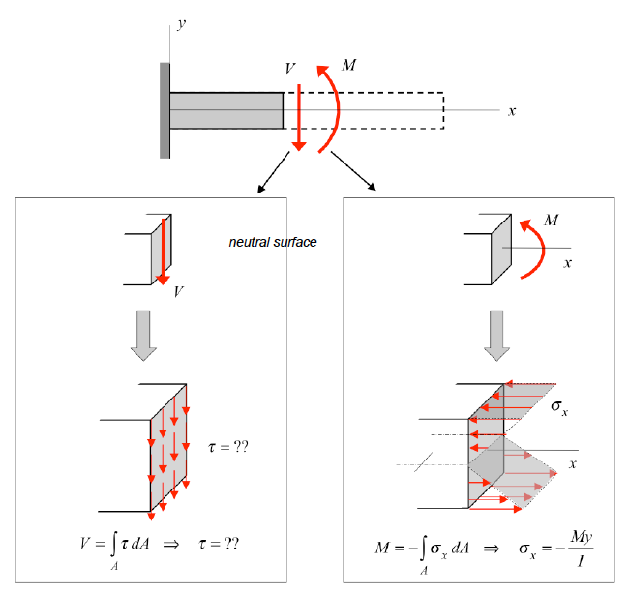
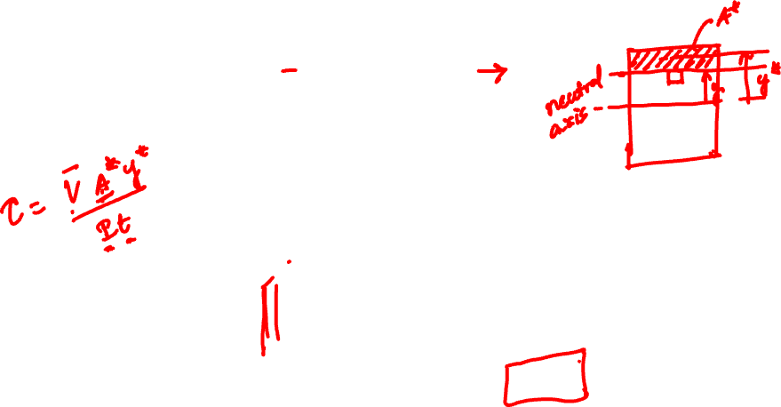
General Stresses in Beams

Slide 5
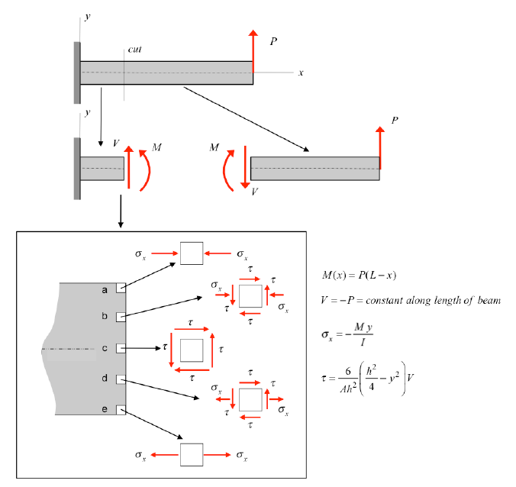
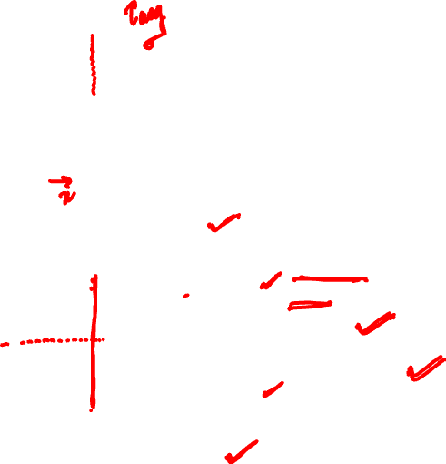

Slide 6
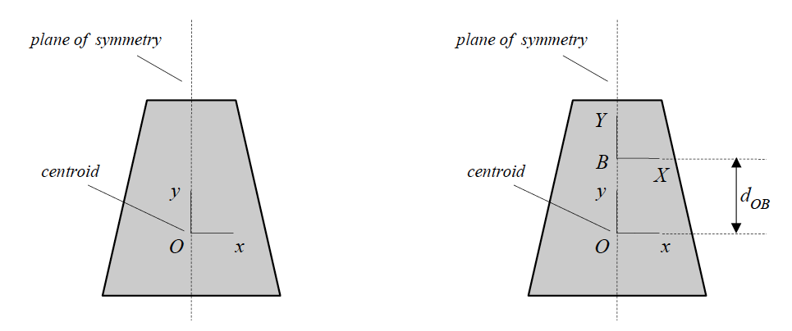



Calculation of Second Area Moment
Where, y = distance from centroid of the cross-section
Parallel-axis theorem
In order to determine the second area moment about an arbitrary point B on the plane of symmetry, simply add A*d_{OB}² to the centroidal second area moment I_{O}, where d_{OB} is the distance between O and B.

Slide 7
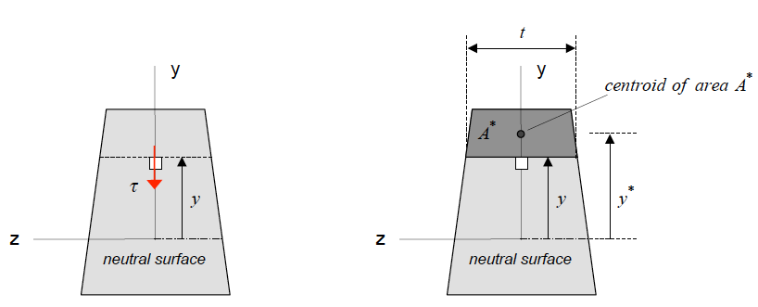
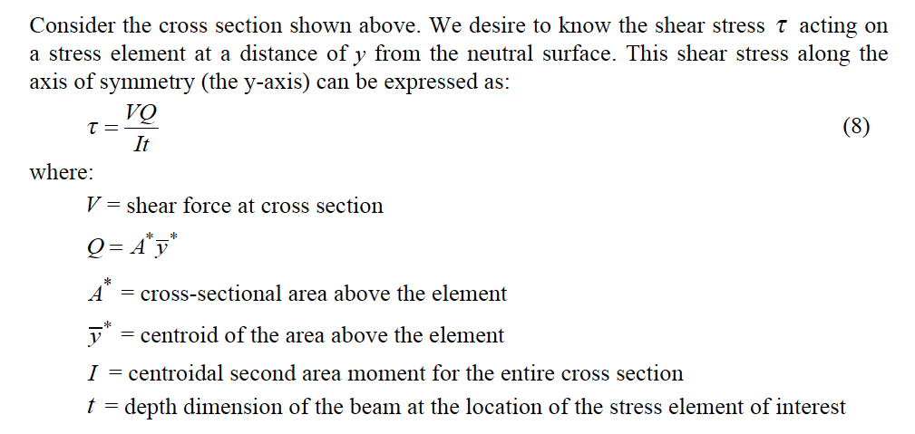
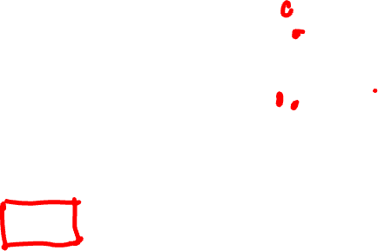

Slide 8
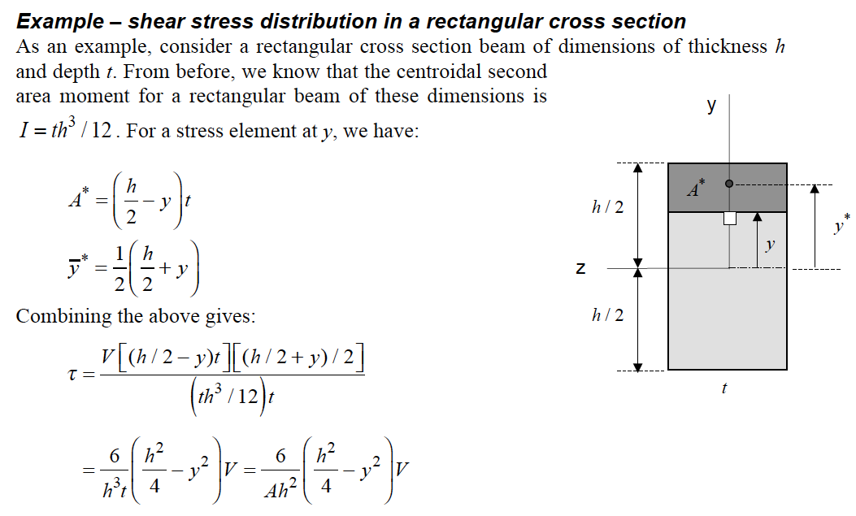
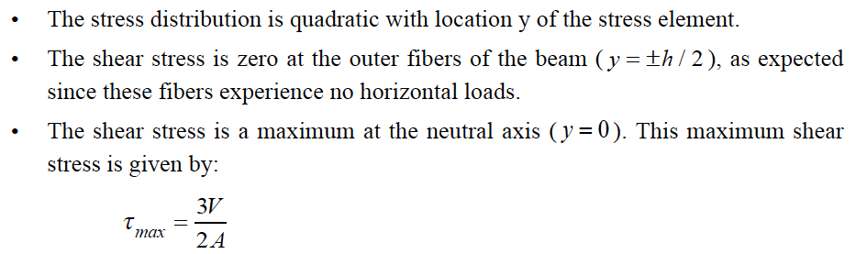
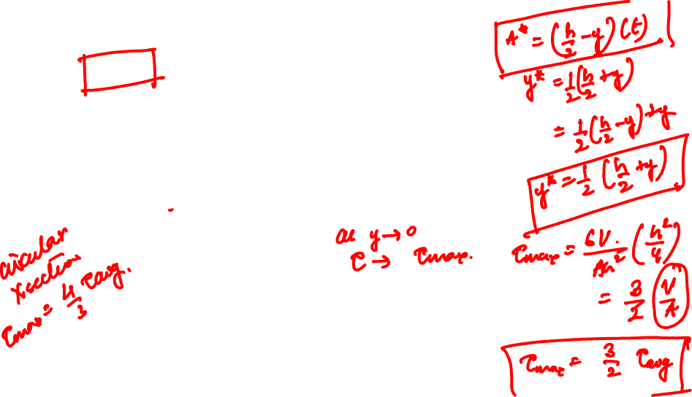

Slide 9
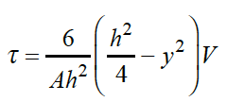
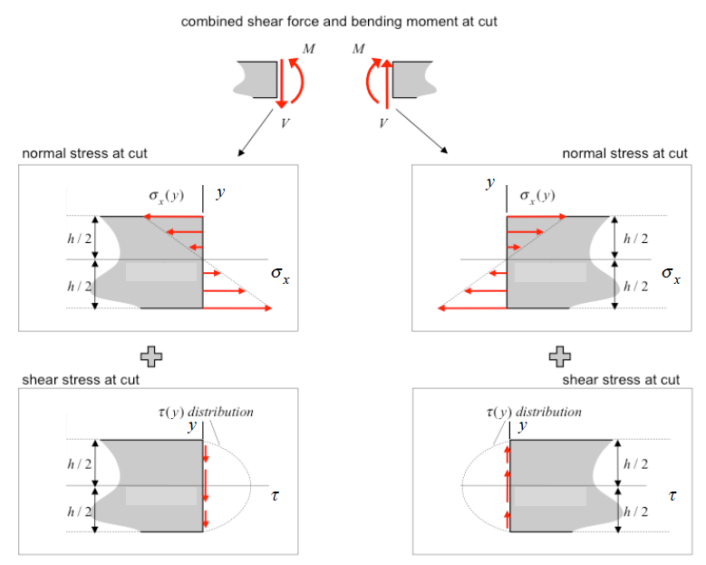
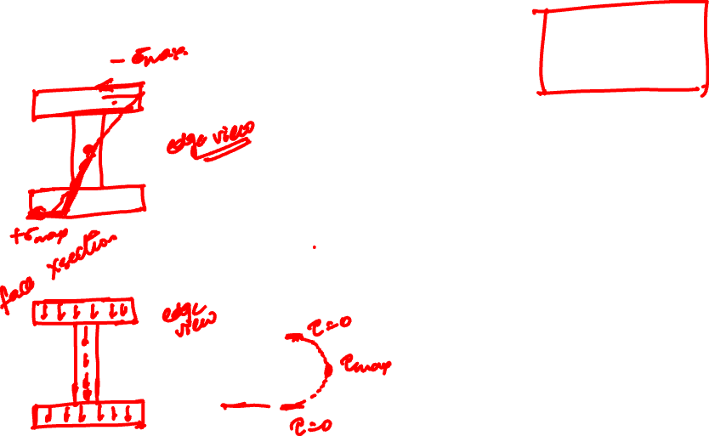

Slide 10
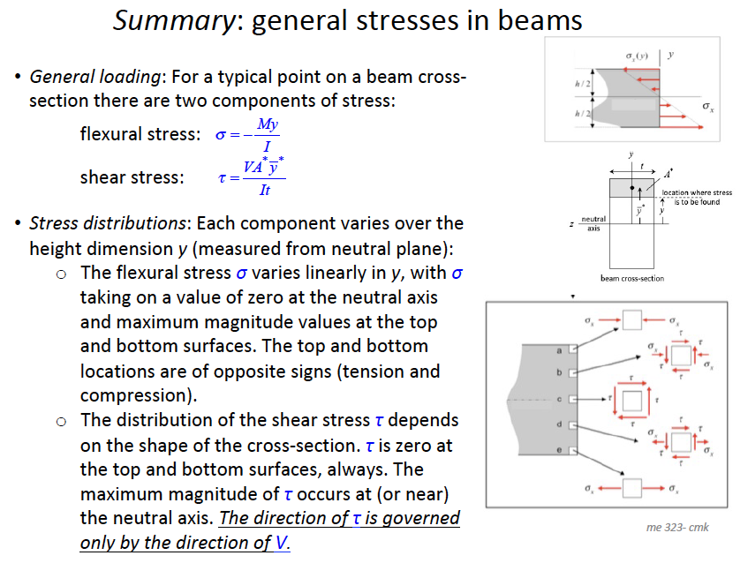


Slide 11
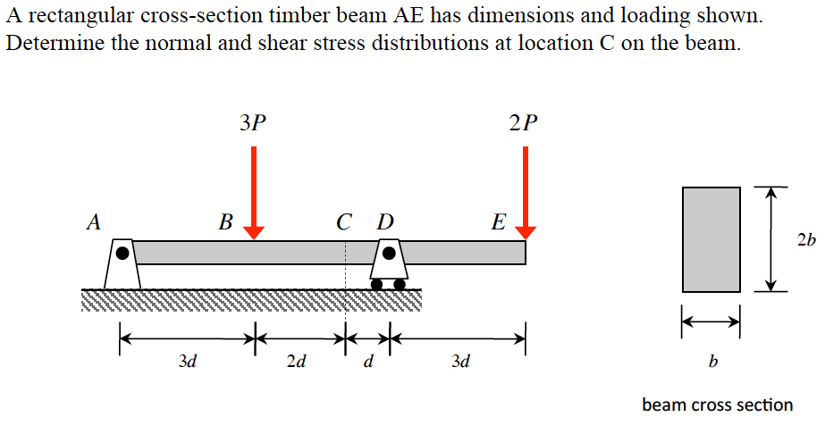
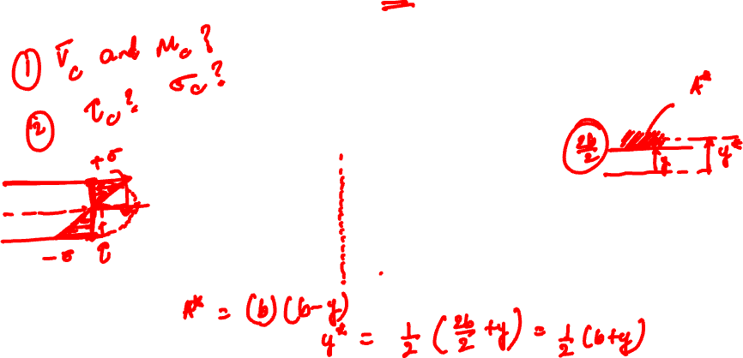
Example 10.7 from Lecture Book

Slide 12
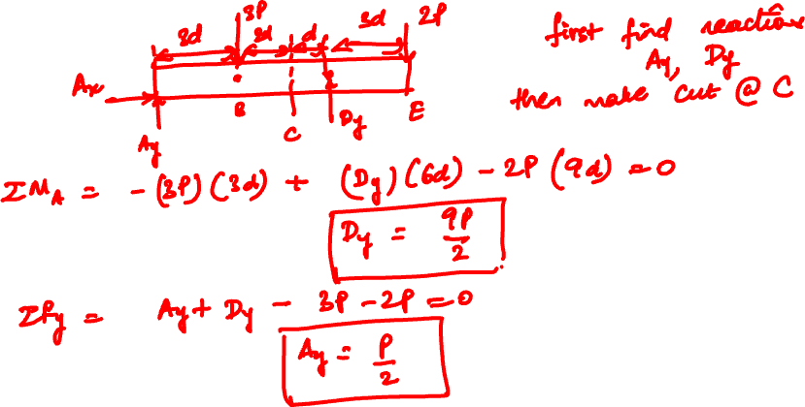

Slide 13
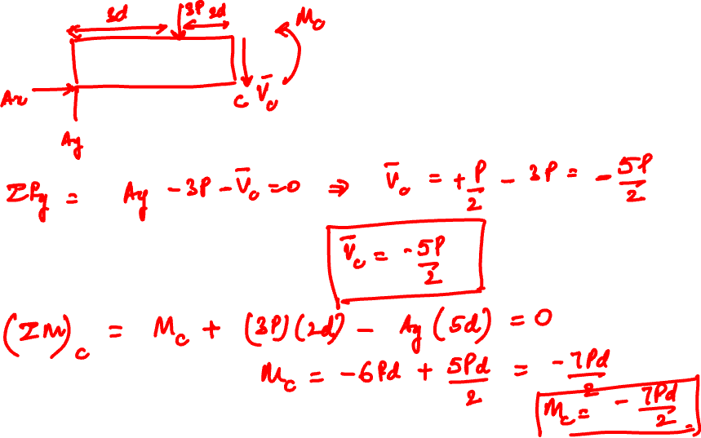

Slide 14
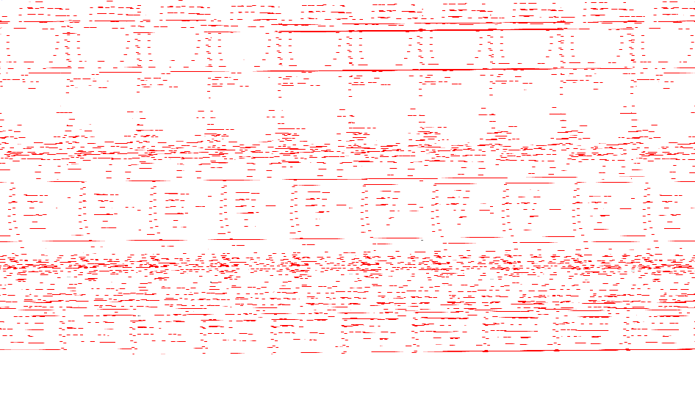

Slide 15
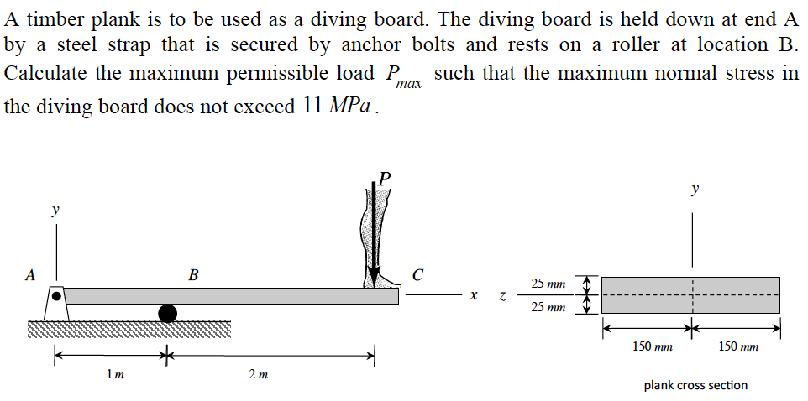
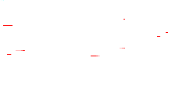
Example 10.10 from Lecture Book

Slide 16
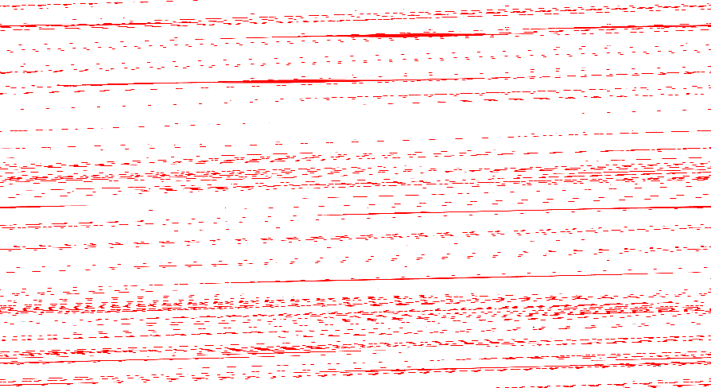
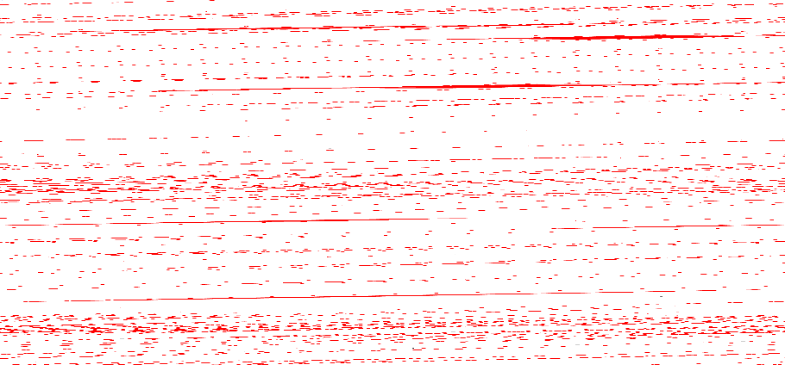

Slide 17


Slide 18
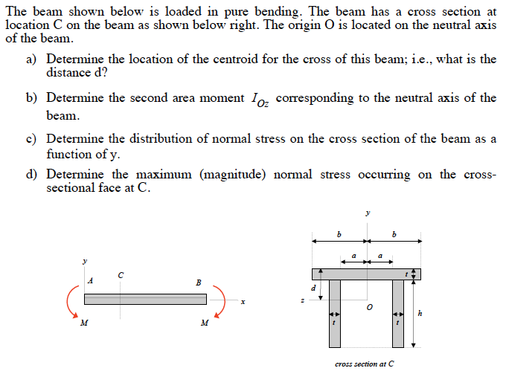
Example 10.6 from Lecture Book

Slide 19
Thank You

