Slide 1
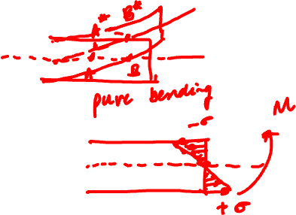
MECHANICS OF MATERIALS
Fall 2025
ME 323- 002
Instructor: Shubhra Bansal
Lecture 15: Beams- Flexural and Shear Stresses

Slide 2
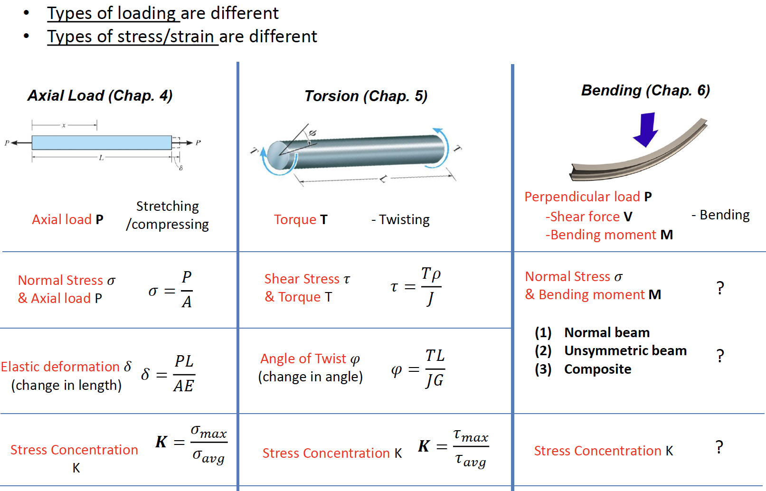
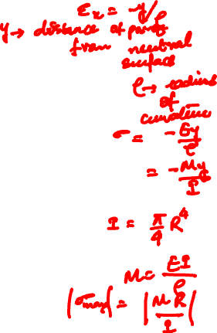
Axial Loading vs. Torsion vs. Bending

Slide 3
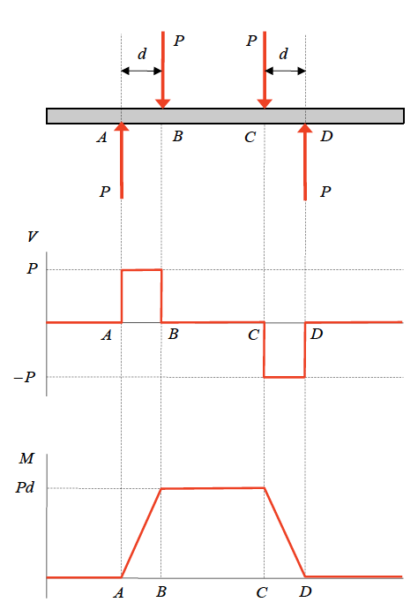
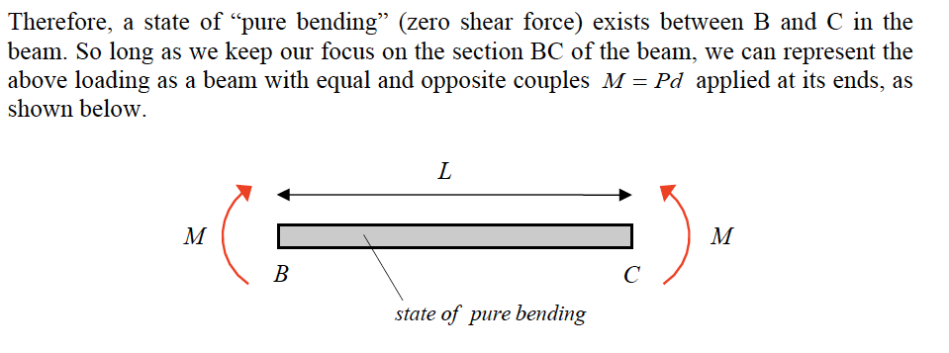
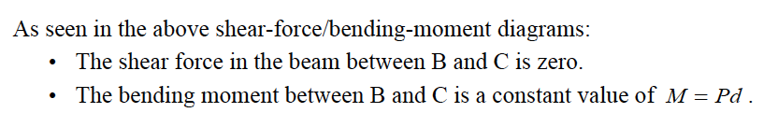
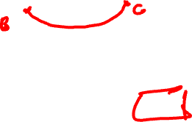
Shear Force/ Bending Moment Diagrams

Slide 4
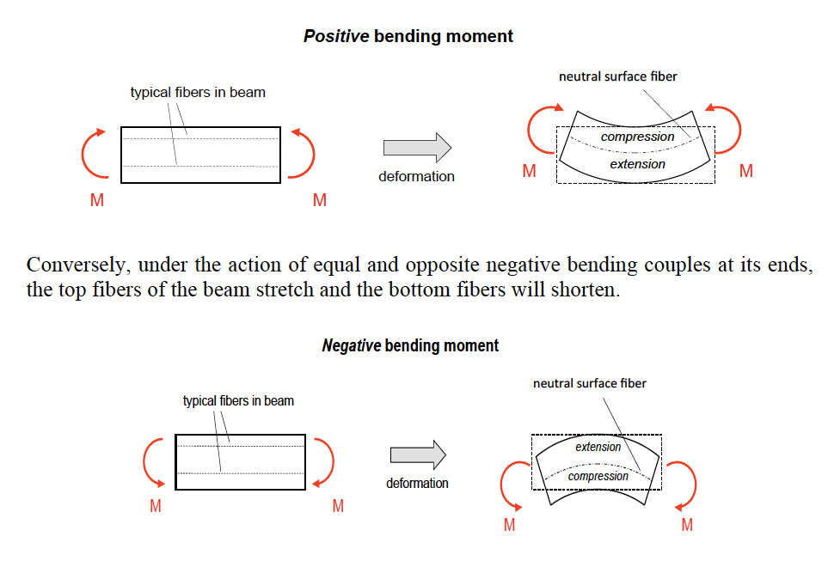
Strain for Pure Bending in Beams
The plane that divides the region of compression from the region of stretch is called “neutral surface” of the beam

Slide 5
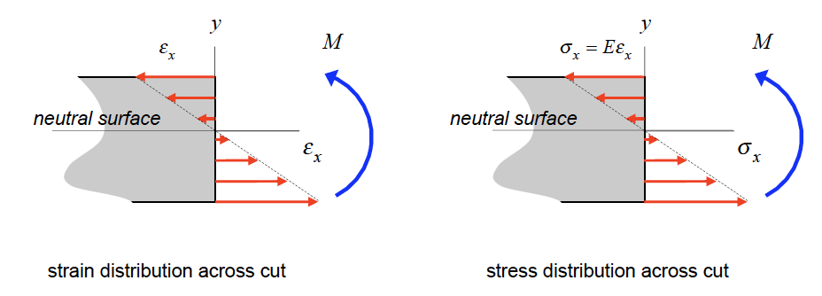



Flexural Stresses due to Bending
Axial Strain,
As a result of the above Euler-Bernoulli assumptions, it can be shown that the axial strain ε_{x} across a perpendicular cut in the beam where y is measured from the neutral surface of the beam and ρ is the radius of curvature of the deflection curve for the loaded beam.
For a linearly-elastic material for the beam, the normal stress distribution in y.

Slide 6
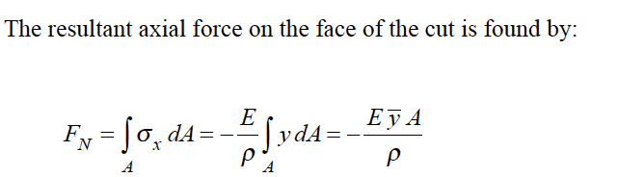
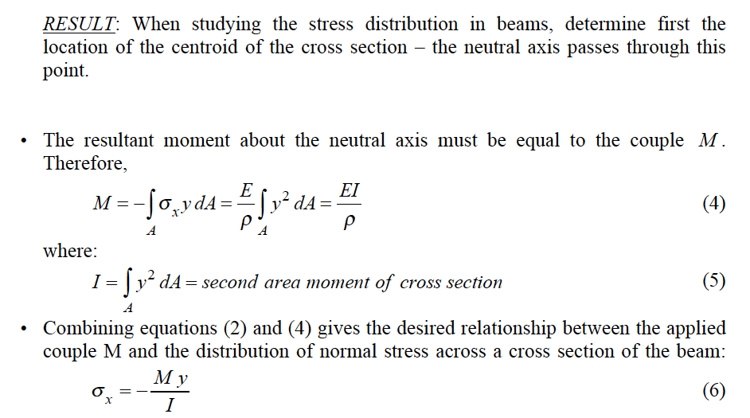
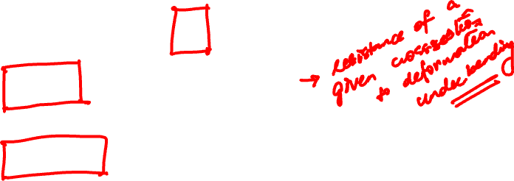

Slide 7
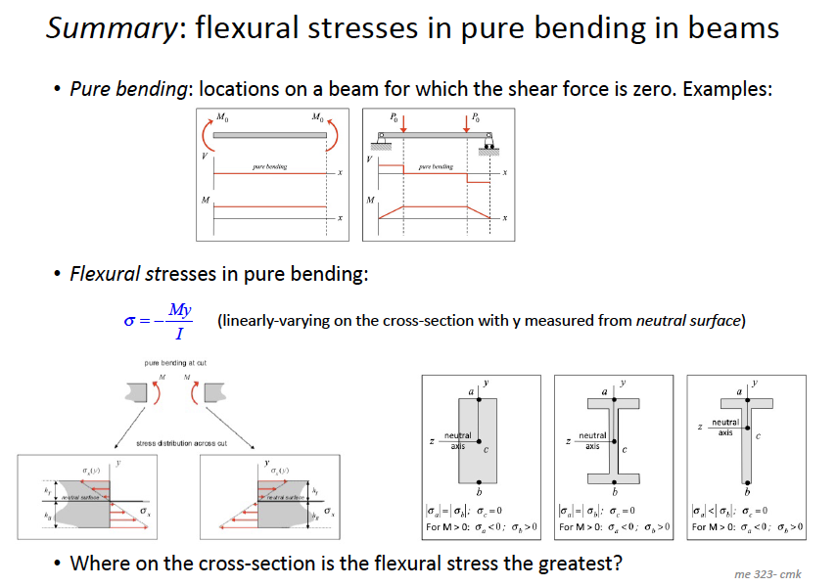
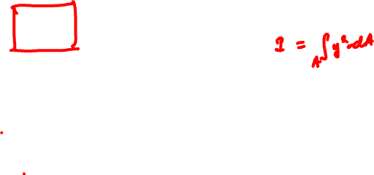

Slide 8
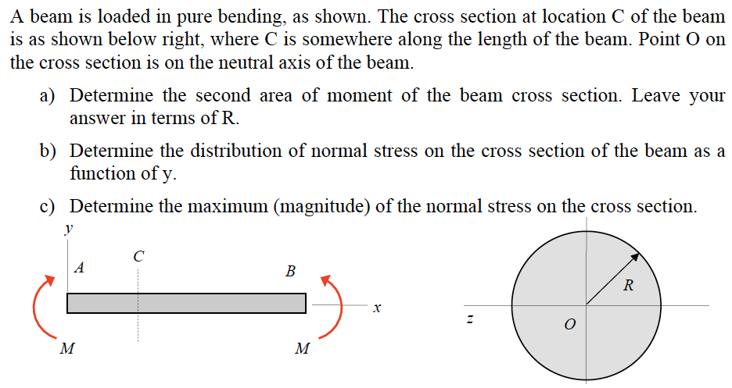
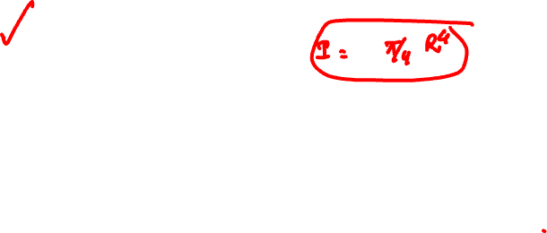
Example 10.2 from Lecture Book

Slide 9
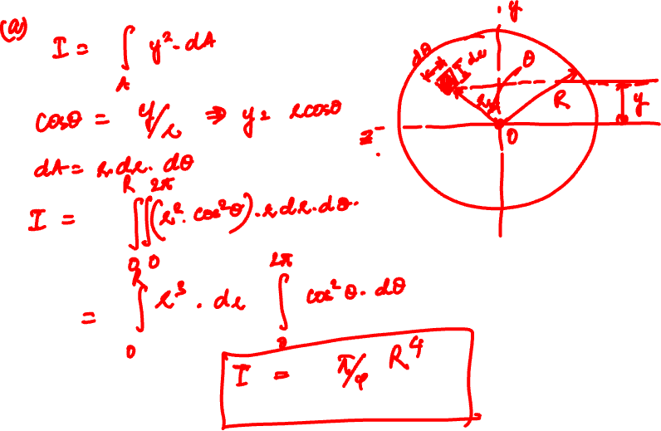

Slide 10
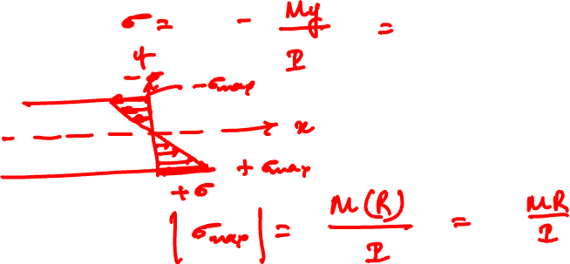

Slide 11
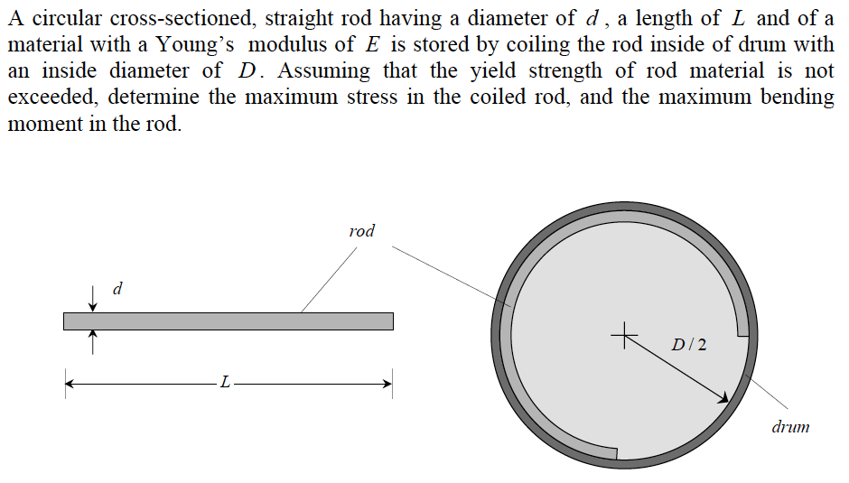
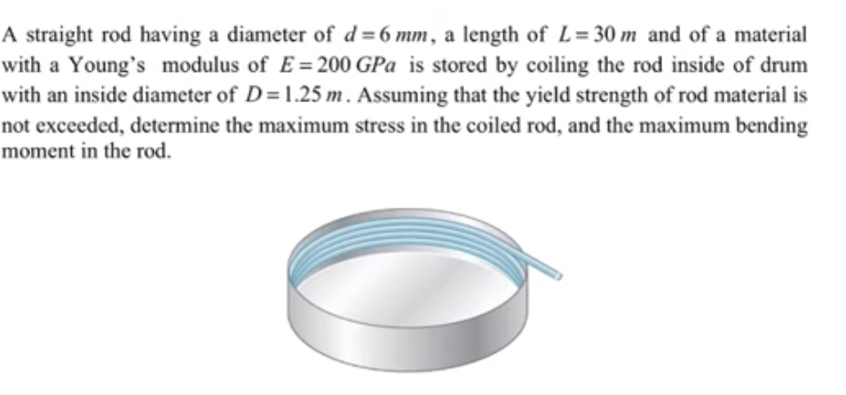

Example 10.4 from Lecture Book

Slide 12
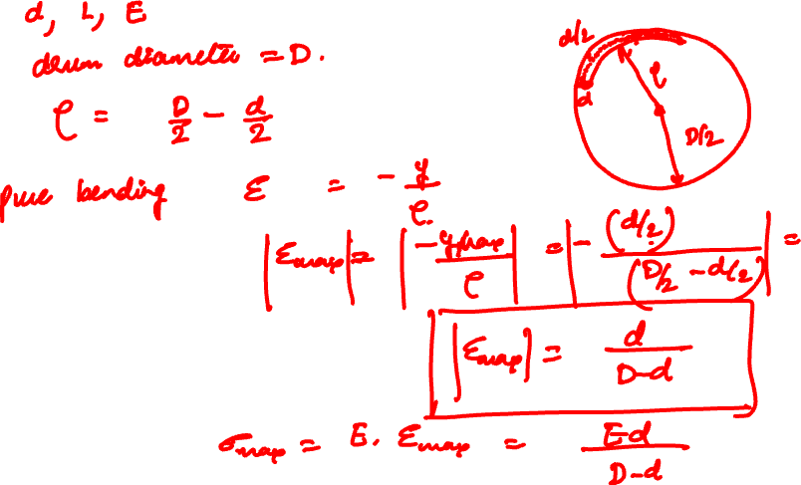

Slide 13
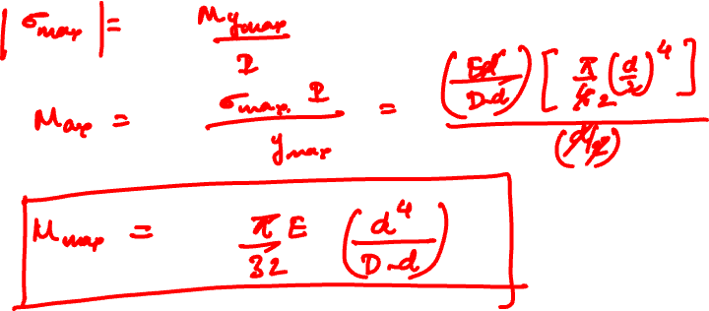

Slide 14
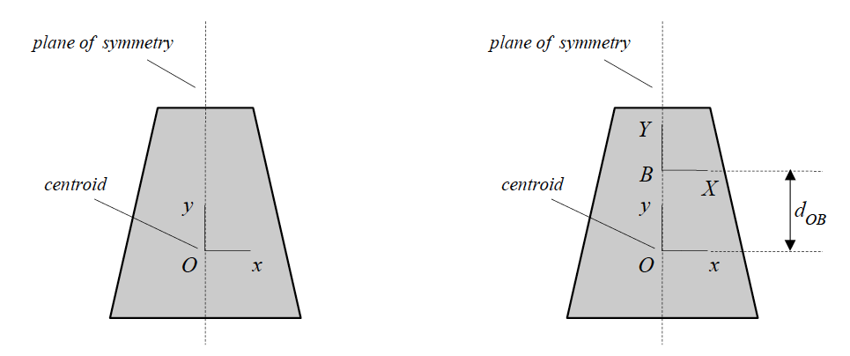



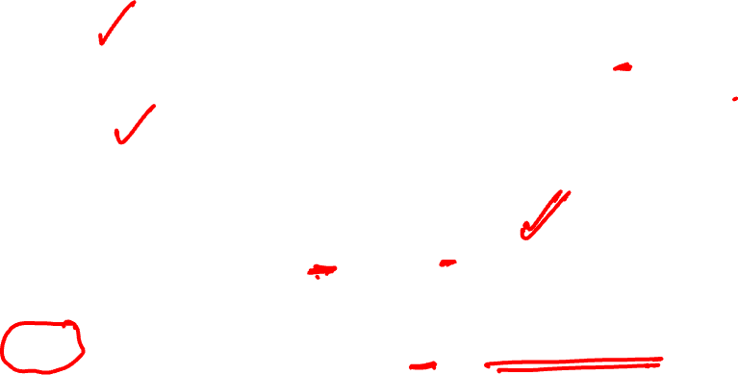
Calculation of Second Area Moment
Where, y = distance from centroid of the cross-section
Parallel-axis theorem
In order to determine the second area moment about an arbitrary point B on the plane of symmetry, simply add A*d_{OB}² to the centroidal second area moment I_{O}, where d_{OB} is the distance between O and B.

Slide 15
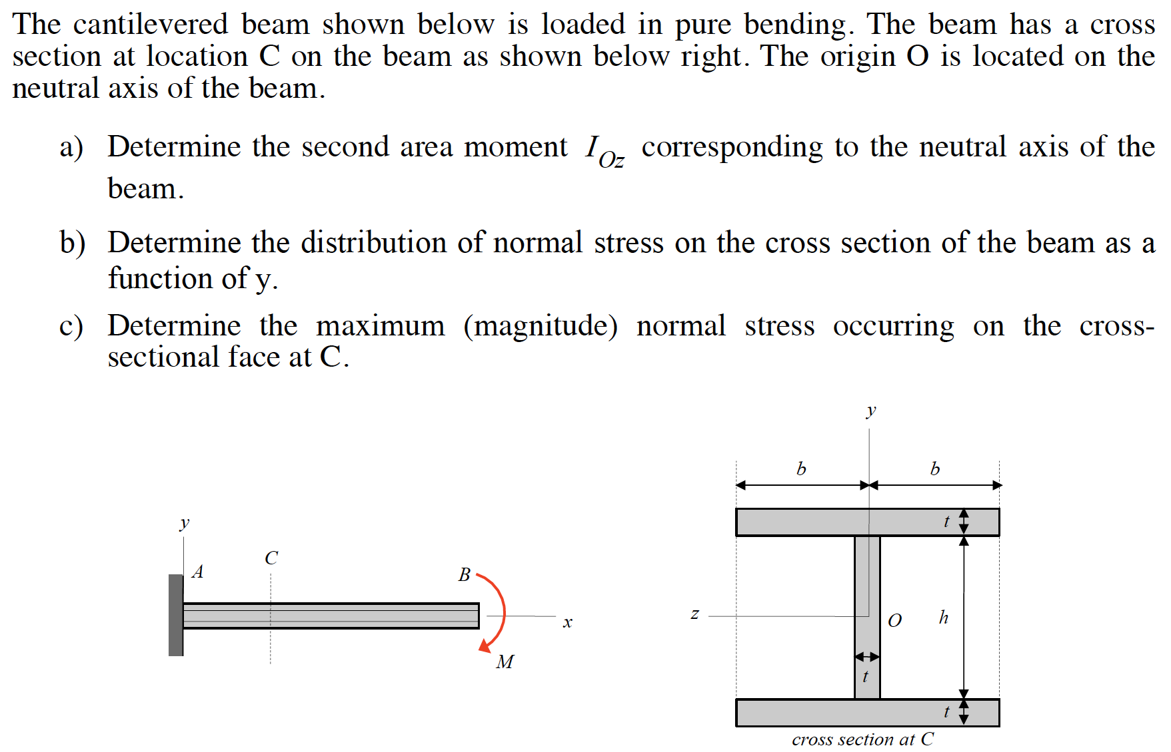
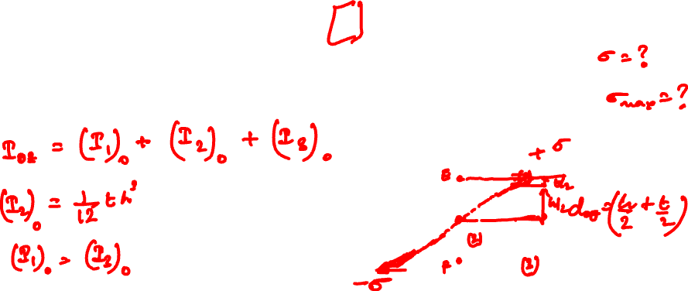
Example 10.5 from Lecture Book

Slide 16
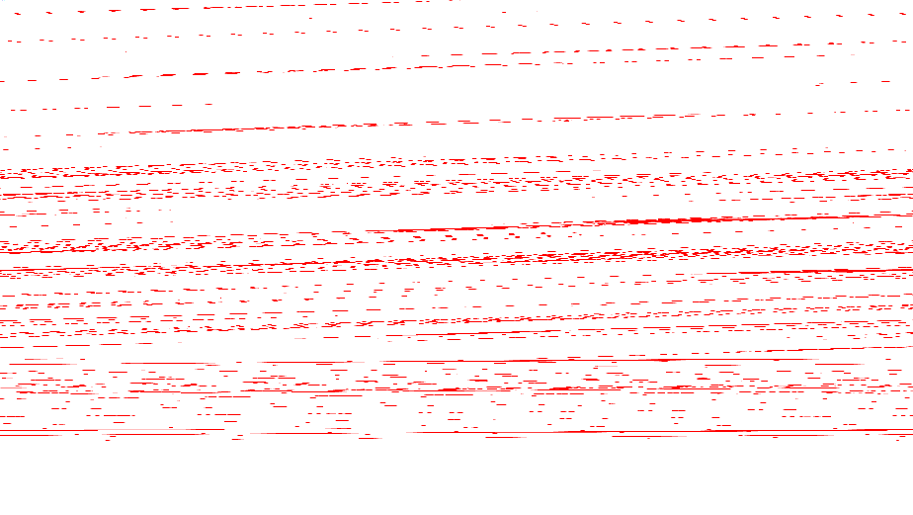

Slide 17


Slide 18
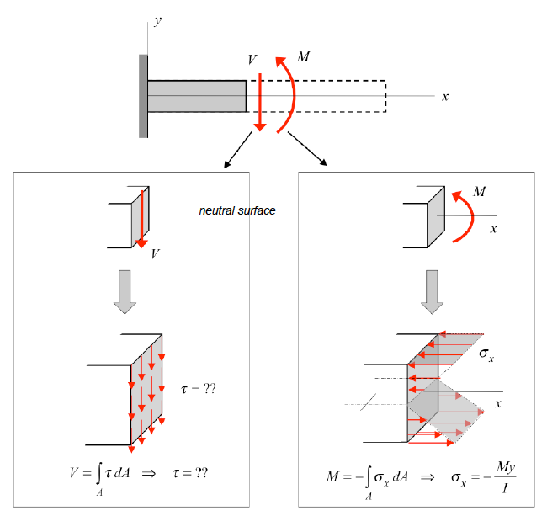

Couple Loading of Beams

Slide 19
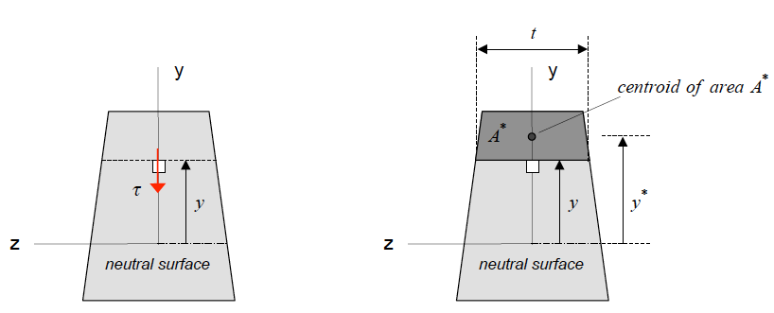
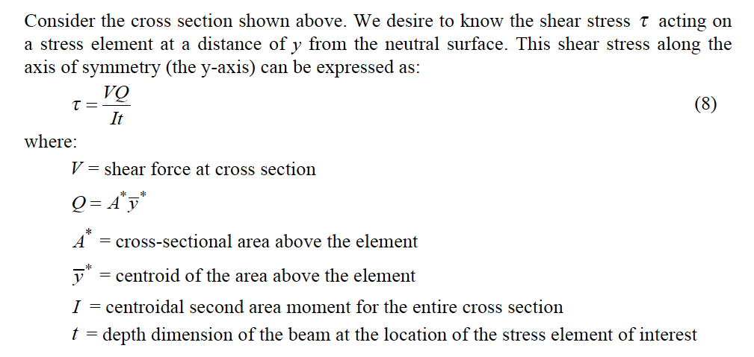
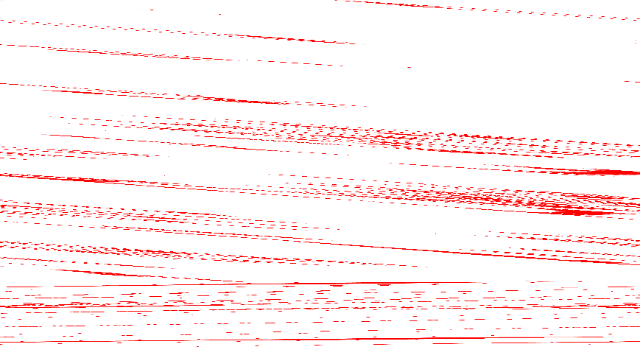

Slide 20
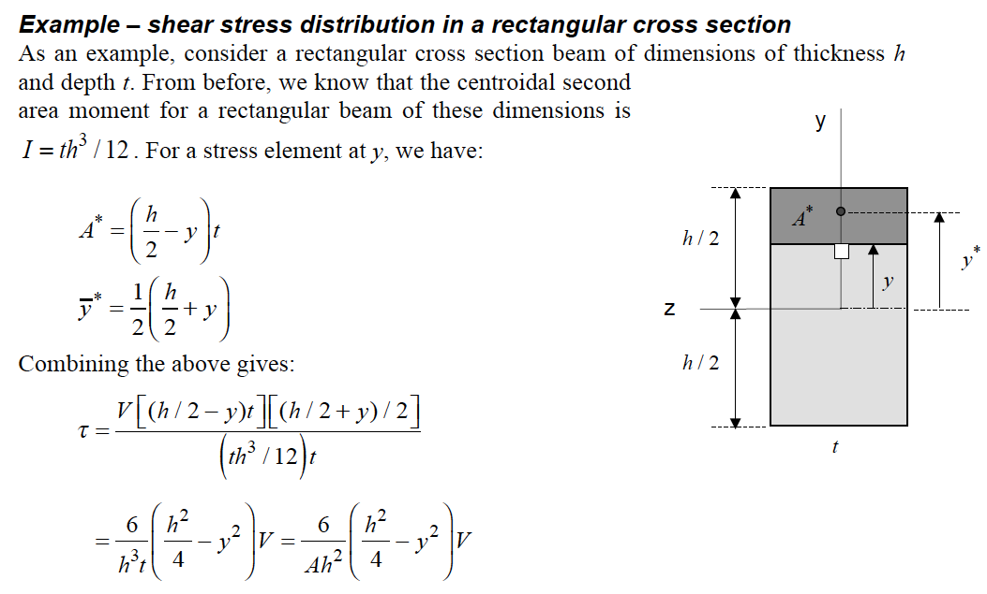
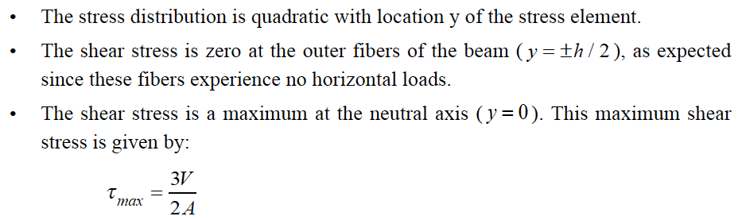
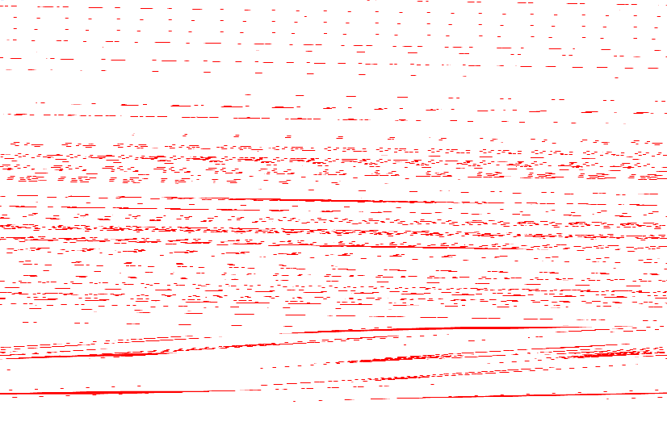

Slide 21
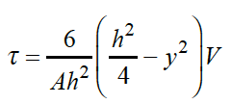
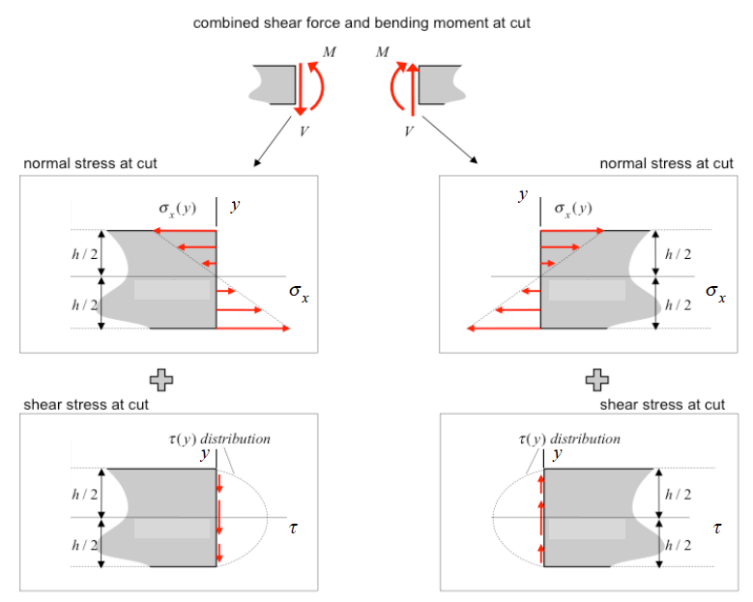

Slide 22
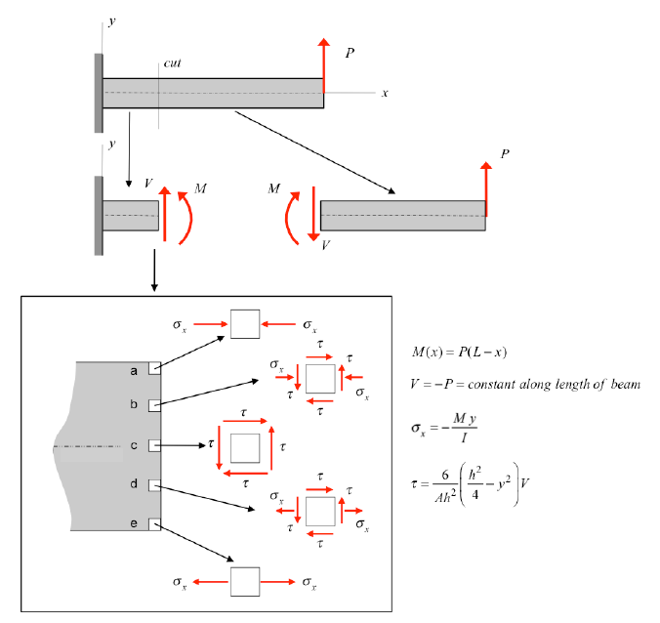

Slide 23
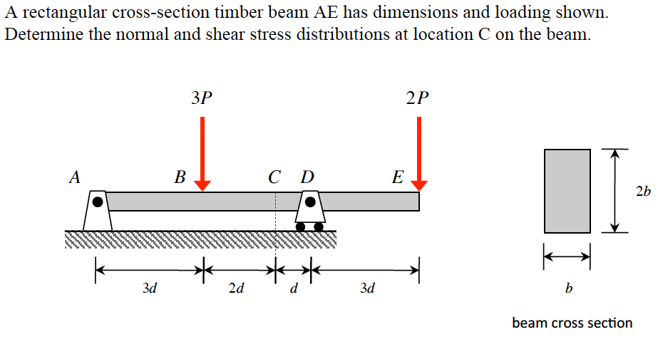
Example 10.7 from Lecture Book

Slide 24
Thank You

