Slide 1
MECHANICS OF MATERIALS
Fall 2025
ME 323- 002
Instructor: Shubhra Bansal
Lecture 14: Beams- Flexural and Shear Stresses

Slide 2
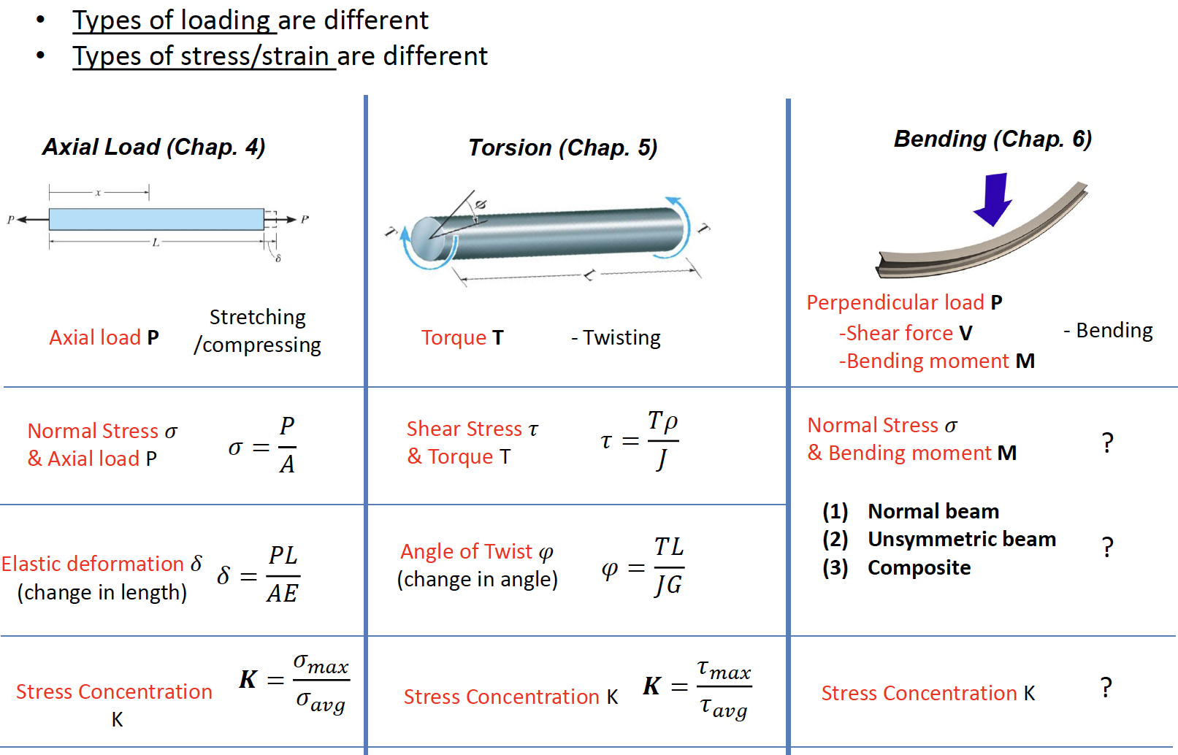
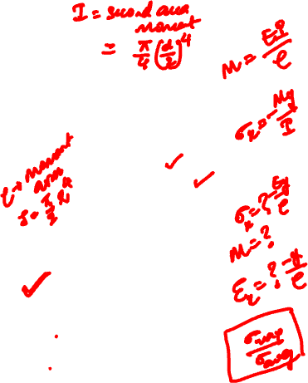
Axial Loading vs. Torsion vs. Bending

Slide 3
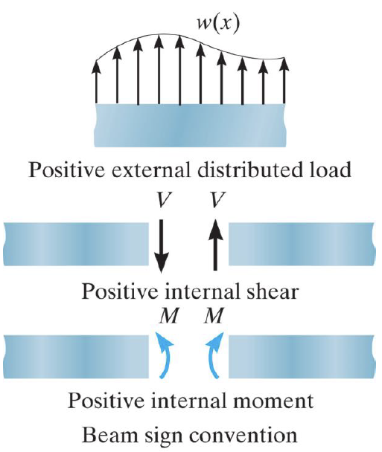
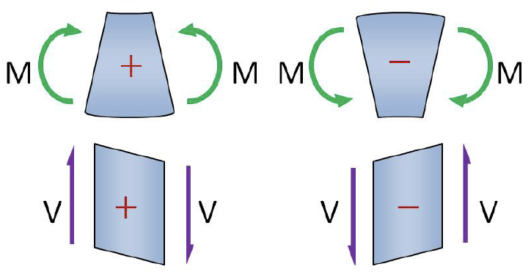
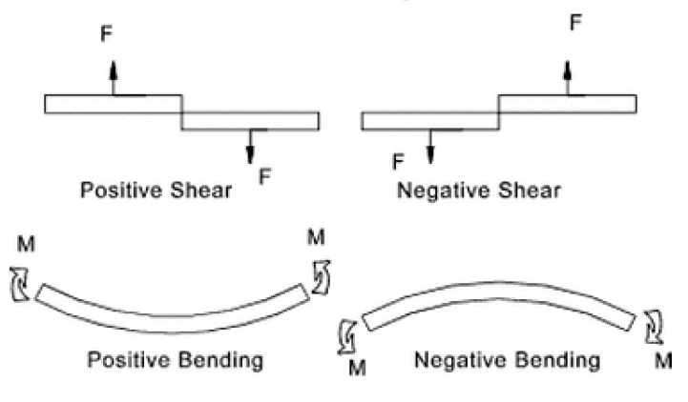
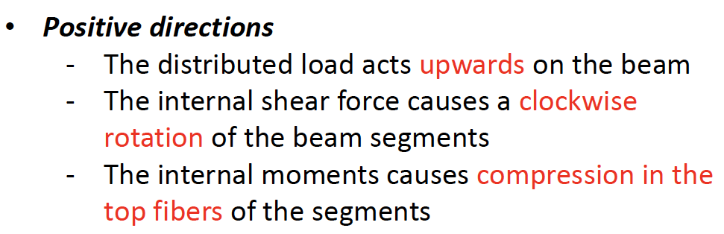

Beam Sign Convention

Slide 4
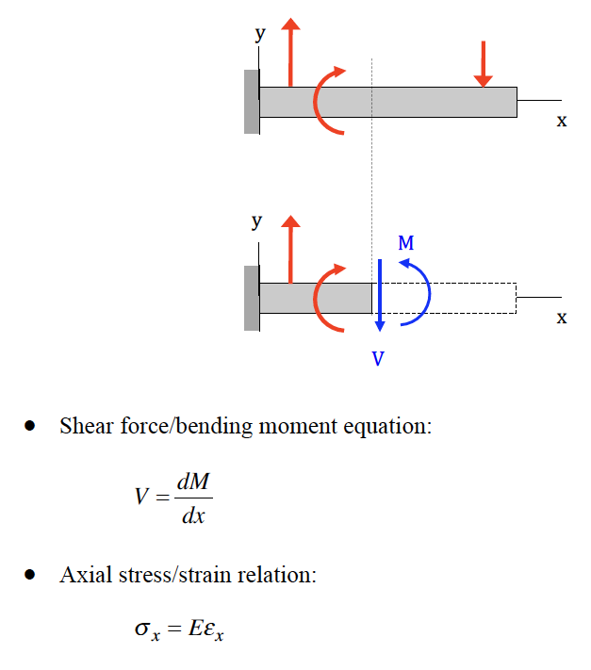
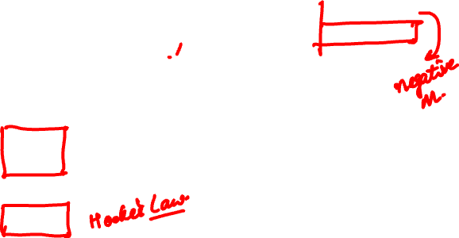
Shear Force/ Bending Moment

Slide 5
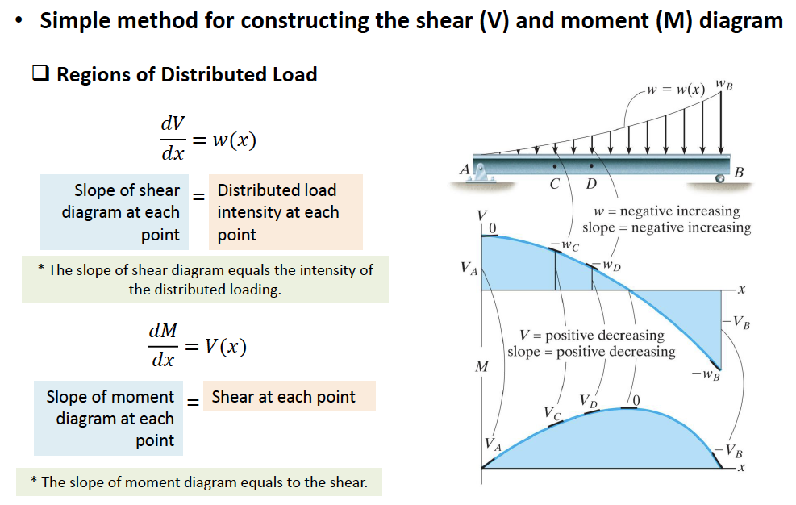
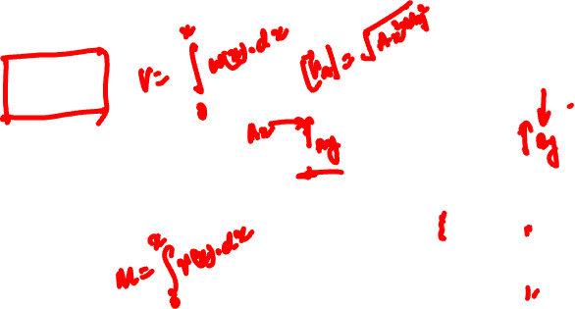
Shear Force/ Bending Moment Diagrams

Slide 6
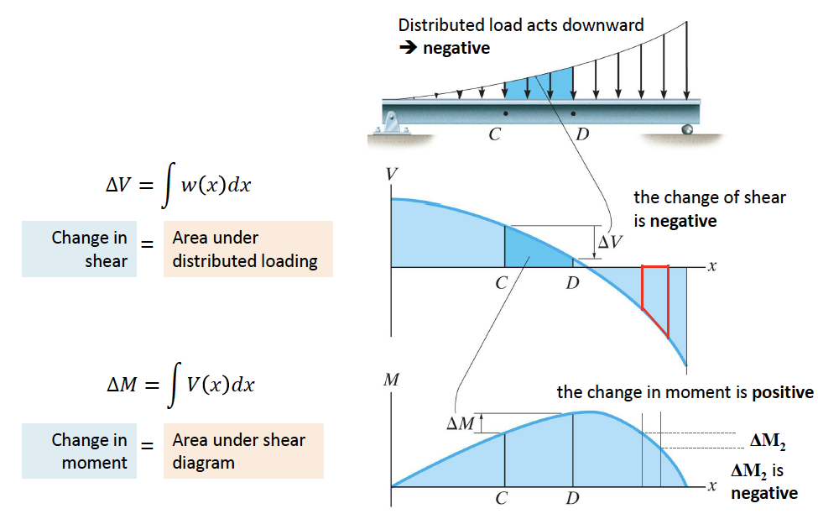
Shear Force/ Bending Moment Diagrams

Slide 7
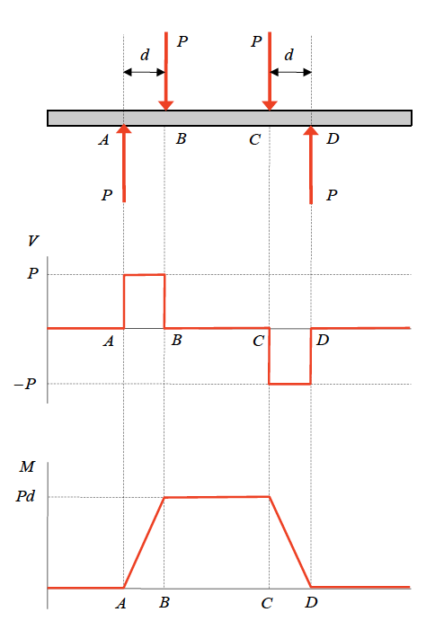
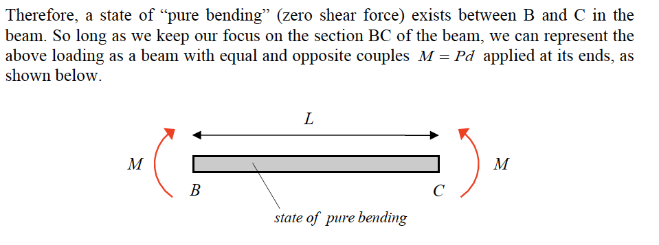
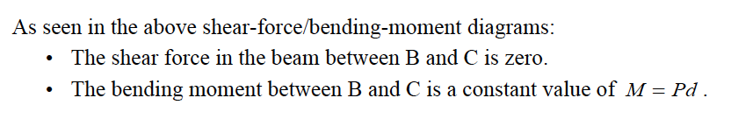
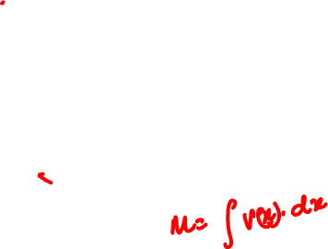
Shear Force/ Bending Moment Diagrams

Slide 8
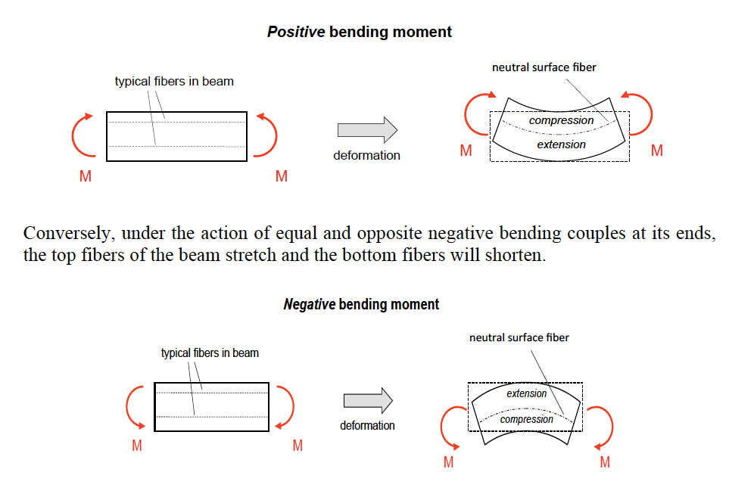
Strain for Pure Bending in Beams
The plane that divides the region of compression from the region of stretch is called “neutral surface” of the beam

Slide 9
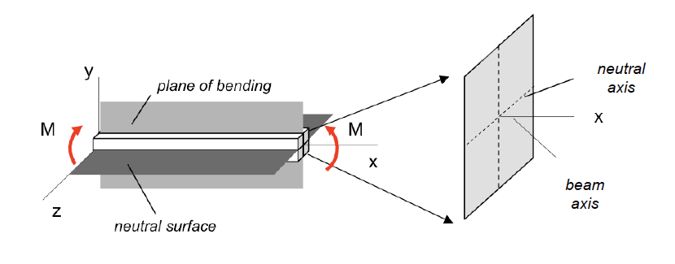
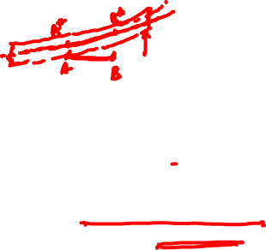
Euler-Bernoulli Assumptions for Thin-Beams (I)
The beam has a plane of longitudinal plane of symmetry (xy-plane as shown in following figure) called the “plane of bending”. Loading and supports for the beam are assumed to be symmetrical about the plane of bending.
The beam has a longitudinal plane (xz-plane as shown in following figure) perpendicular to the plane of bending on which there is zero longitudinal strain called the “neutral surface”. The intersection of the neutral surface with the plane of the cross section is called the “neutral axis” for the cross section.
The deformation of the initially-straight beam axis is known as the “deflection curve” of the beam.

Slide 10
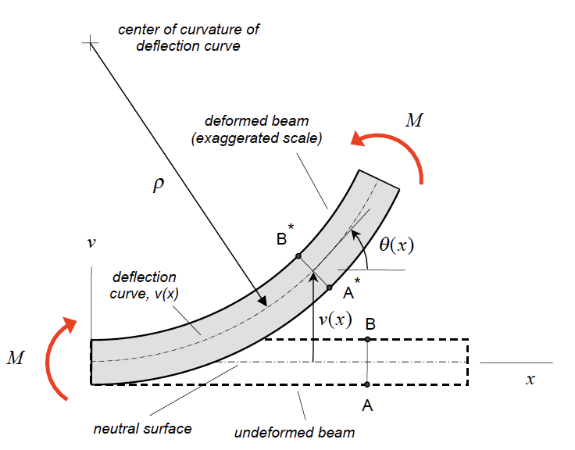
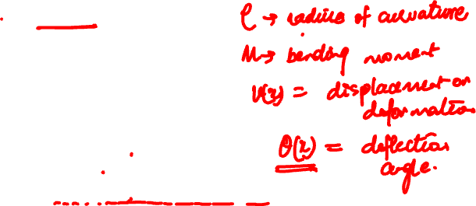
Euler-Bernoulli Assumptions for Thin-Beams (II)
As a result of the application of the bending moment M, cut A-B rotates in the counter-clockwise sense to produce A* − B* ; however, as a result of this assumption, A* − B* remains perpendicular to the deflection curve. Also, the radius of curvature of the deflection curve is denoted as ρ in the figure.

Slide 11
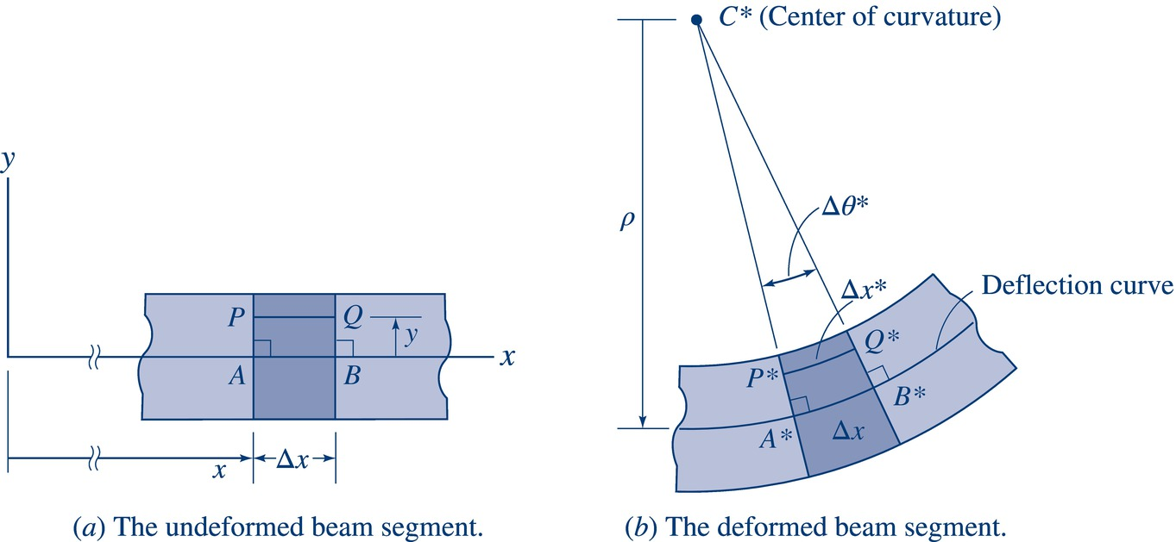
Longitudinal Strain Derivation
Euler-Bernoulli Beam Theory:
Cross-sections which are plane and are perpendicular to the axis of undeformed beam, remain plane and remain perpendicular to the deflection curve of deformed beams.
Deformation in the plane of a cross-section (i.e. transverse strains $ε_{y}$ and $ε_{z}$) may be neglected in deriving an expression for longitudinal strain $ε_{x}$.
Points A and P lie on the cross-sectional plane at co-ordinate $x$ in the undeformed beam
B and Q at $x+Δx$
AP and BQ lie on planes perpendicular to the neutral surface
Line segment PQ is parallel to x-axis and lies $+y$ from neutral surface
In undeformed beam AB and PQ are of length $Δx$
For deformed beam, A*P* and B*Q* still lie on planes perpendicular to neutral surface
$A^{∗}P^{∗}=AP=y$
$B^{∗}Q^{∗}=BQ=y$
$A^{∗}B^{∗}=Δx=AB=PQ$
$P^{∗}Q^{∗}={∆x}^{∗}$

Slide 12
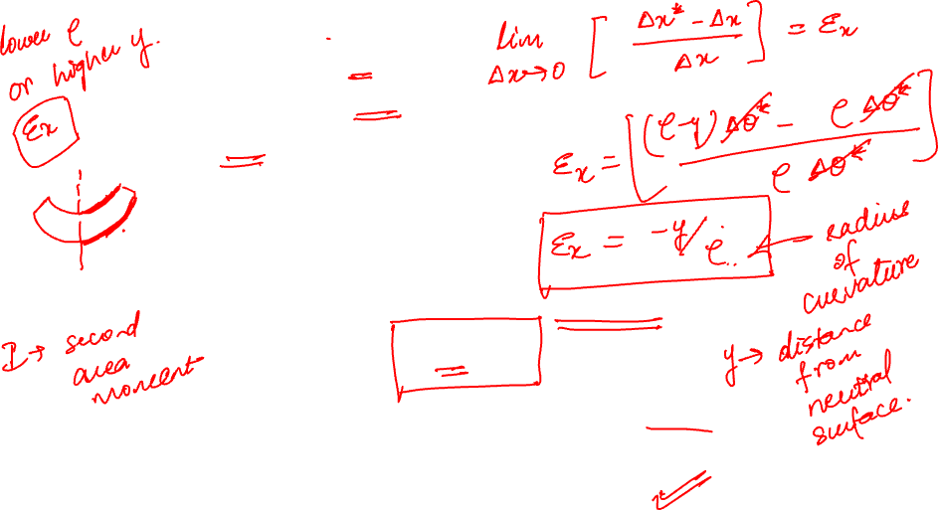
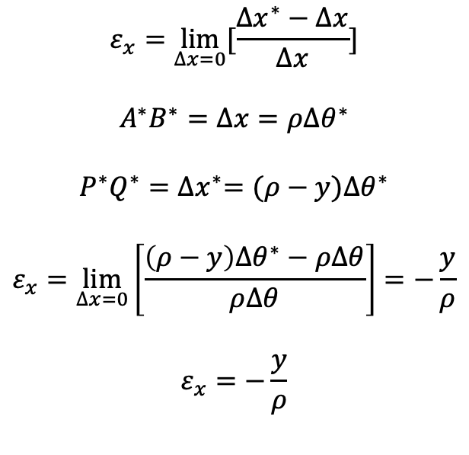
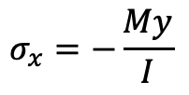
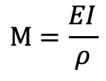
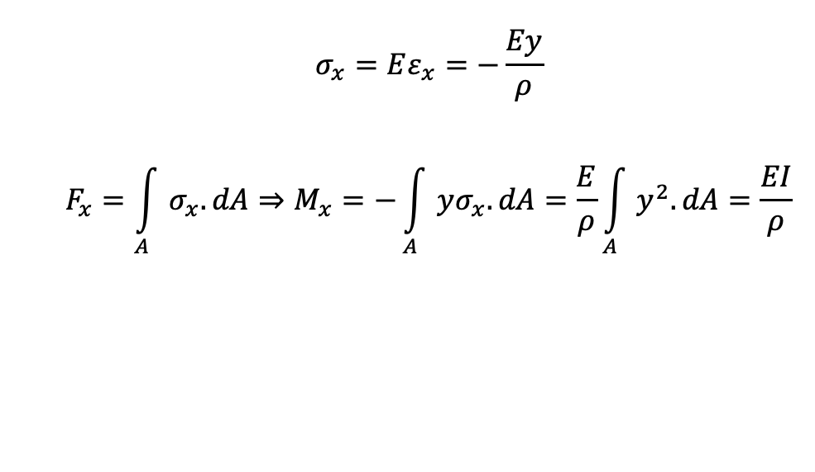
$$ε_{x}=\lim_{∆x=0}{[\frac{{∆x}^{∗}−∆x}{∆x}]}$$
$$A^{∗}B^{∗}=∆x=ρ{∆θ}^{∗}$$
$$P^{∗}Q^{∗}={∆x}^{∗}=(ρ−y){∆θ}^{∗}$$
$$ε_{x}=\lim_{∆x=0}\left[\frac{{\left(ρ−y\right)∆θ}^{∗}−ρ∆θ}{ρ∆θ}\right]=−\frac{y}{ρ}$$
$$ε_{x}=−\frac{y}{ρ}$$
$ε_{x}$ varies linearly with y and independent of material properties of the beam
$$σ_{x}=Eε_{x}=−\frac{Ey}{ρ}$$
$$F_{x}=\int_{A}{σ_{x}.dA}⇒M_{x}=−\int_{A}{yσ_{x}.dA=\frac{E}{ρ}}\int_{A}{y^{2}.dA}=\frac{EI}{ρ}$$
$$M=\frac{EI}{ρ}$$
$$σ_{x}=−\frac{My}{I}$$

Slide 13
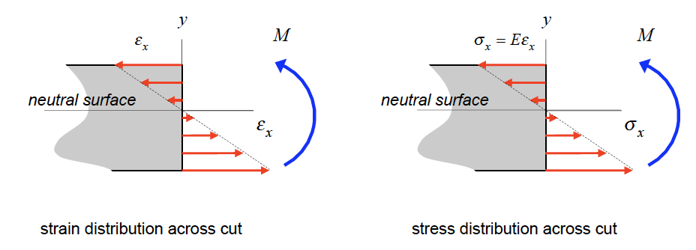


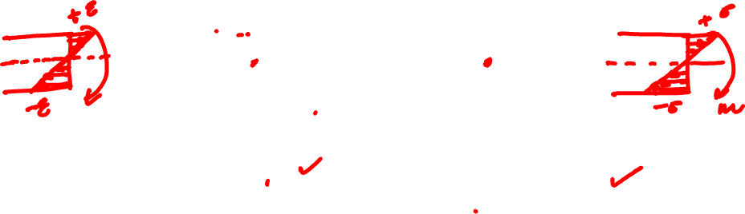
Flexural Stresses due to Bending
Axial Strain,
As a result of the above Euler-Bernoulli assumptions, it can be shown that the axial strain ε_{x} across a perpendicular cut in the beam where y is measured from the neutral surface of the beam and ρ is the radius of curvature of the deflection curve for the loaded beam.
For a linearly-elastic material for the beam, the normal stress distribution in y.

Slide 14
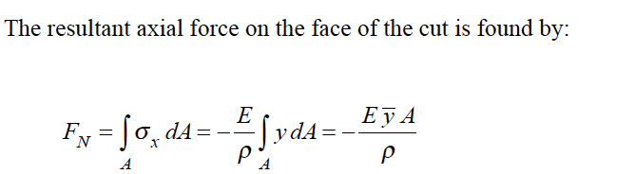
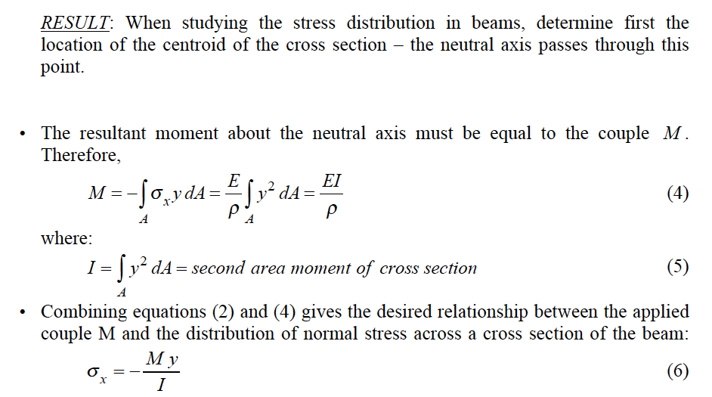
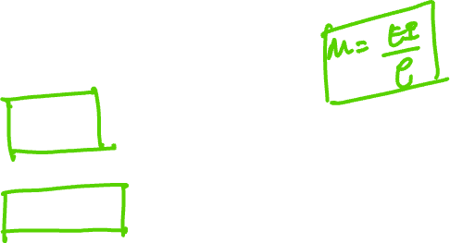

Slide 15
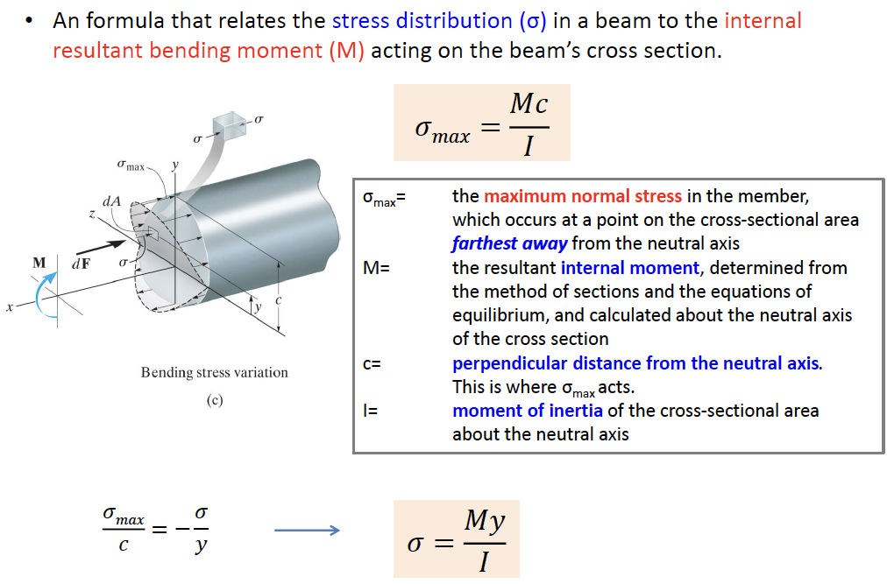
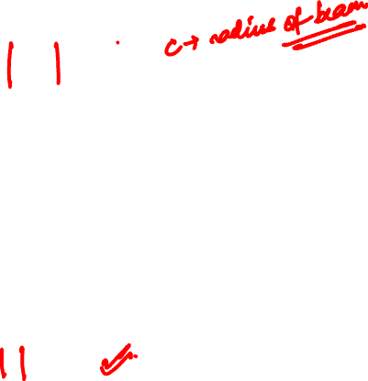
Flexural Stress Formula

Slide 16
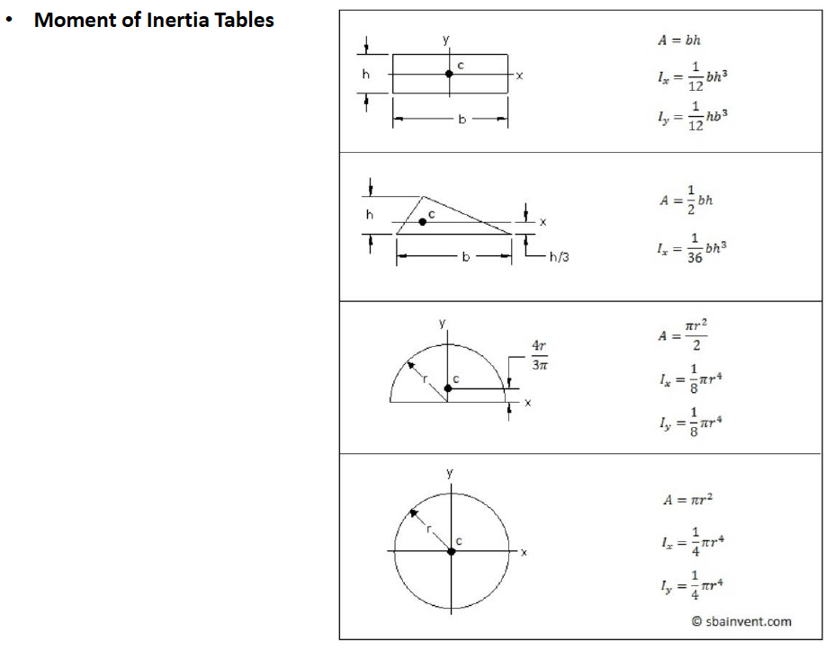

second area moment

Slide 17
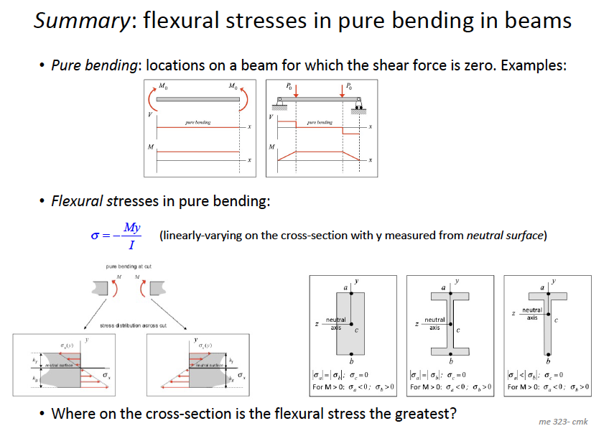
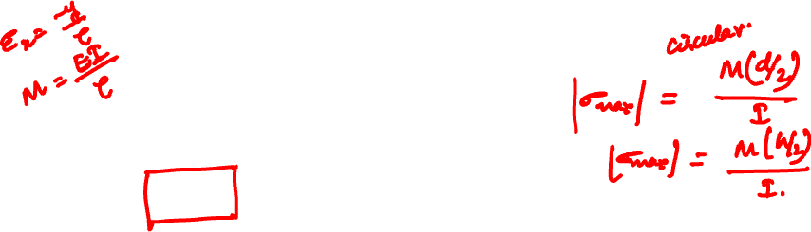

Slide 18
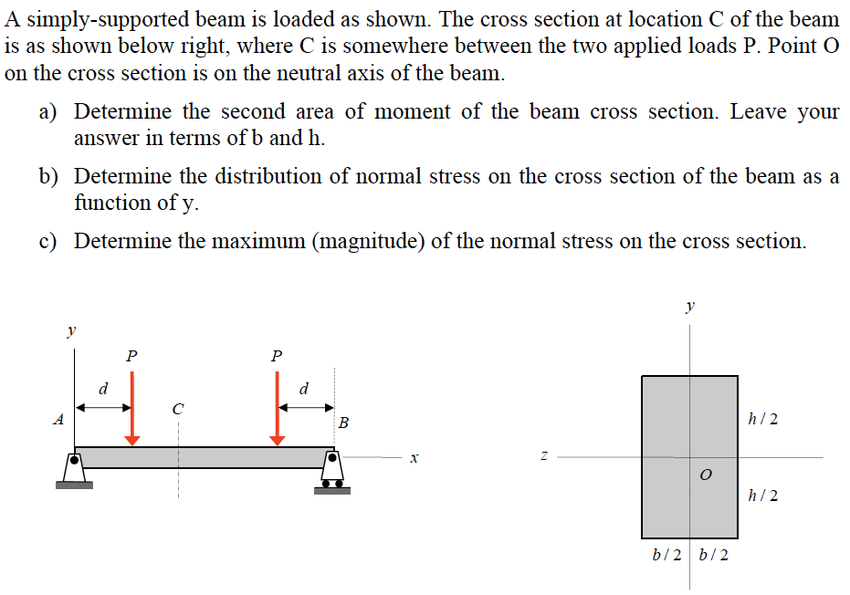
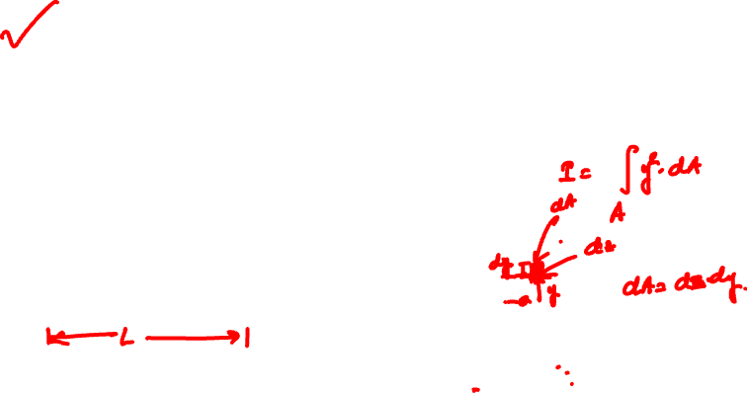
Example 10.1 from Lecture Book

Slide 19
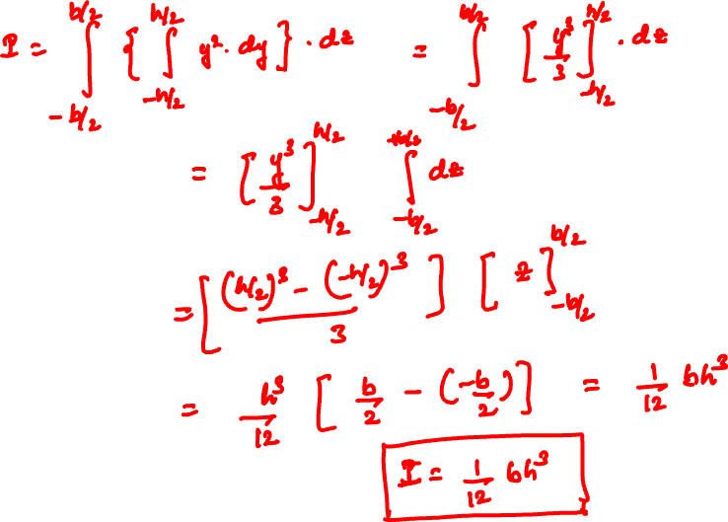

Slide 20
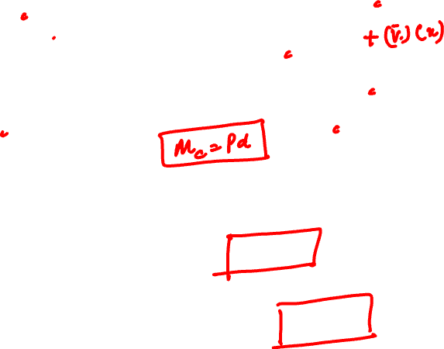
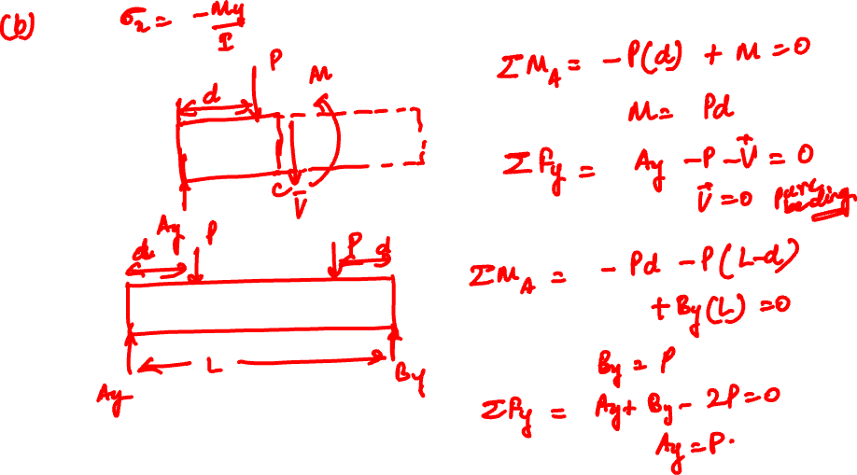

Slide 21
