Slide 1
MECHANICS OF MATERIALS
Fall 2025
ME 323- 002
Instructor: Shubhra Bansal
Lecture 4: Introduction to Design of Deformable Bodies

Slide 2

Announcements
Gradescope can be accessed through ME 323 freeform website: 6K4XW3
Lecture notes are also available through ME 323 freeform website
Course does not have Brightspace
Homework 1 is now available in Gradescope
No in-person class on Wednesday Sept 10

Slide 3


Slide 4
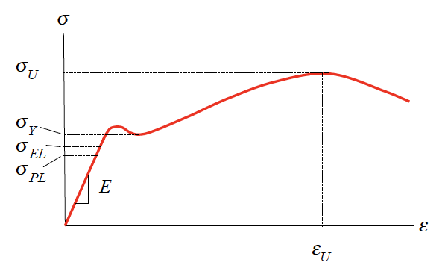
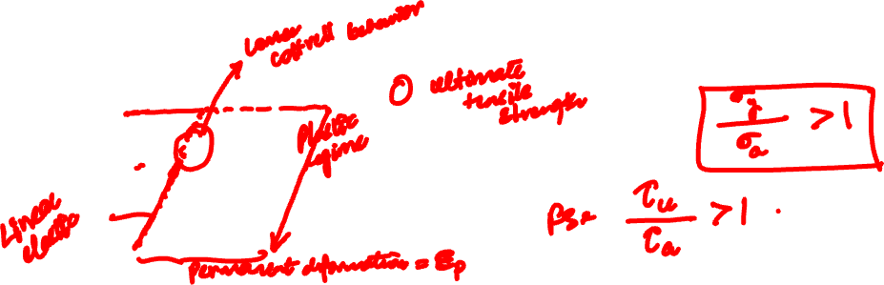
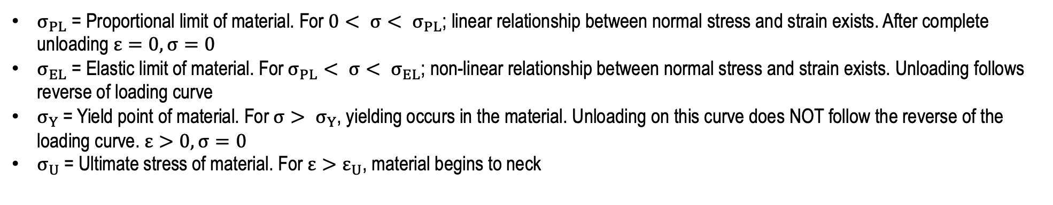
Axial Stress-Strain Relationship
Steel
$σ_{PL}$ = Proportional limit of material. For $0< σ< σ_{PL}$; linear relationship between normal stress and strain exists. After complete unloading $ε=0, σ=0$
$σ_{EL}$ = Elastic limit of material. For$σ_{PL}< σ< σ_{EL}$; non-linear relationship between normal stress and strain exists. Unloading follows reverse of loading curve
$σ_{Y}$ = Yield point of material. For $σ> σ_{Y}$, yielding occurs in the material. Unloading on this curve does NOT follow the reverse of the loading curve. $ε>0, σ=0$
$σ_{U}$ = Ultimate stress of material. For ${ε>ε}_{U}$, material begins to neck

Slide 5
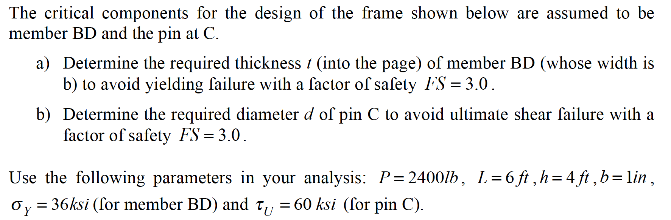
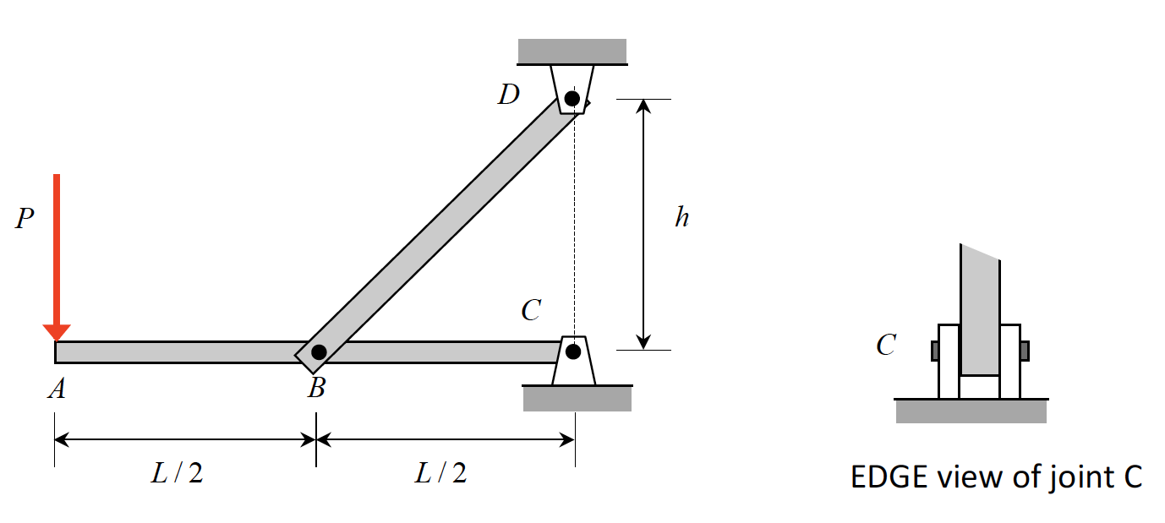
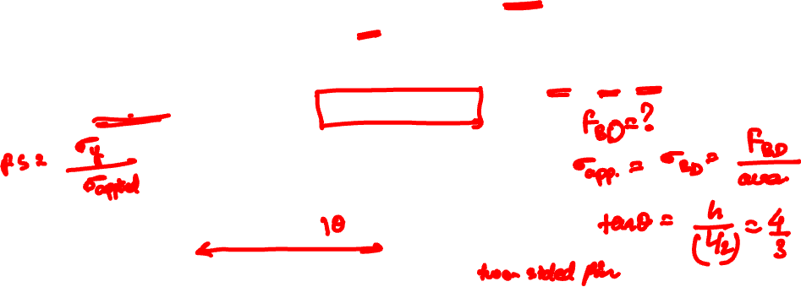
Example 4.1 from Lecture Book

Slide 6
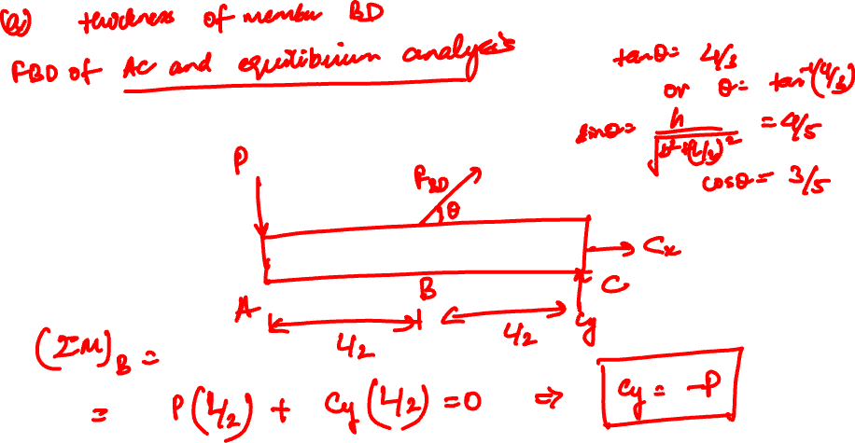

Slide 7
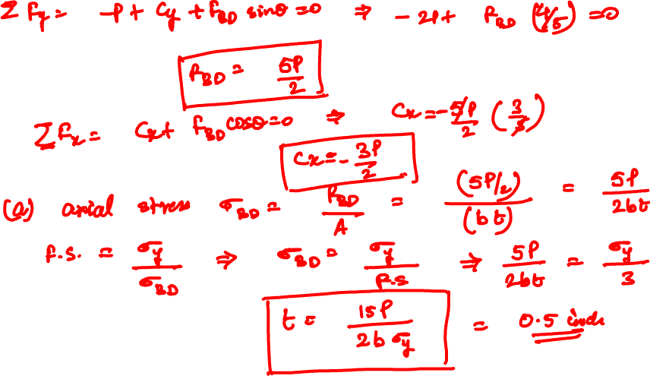

Slide 8
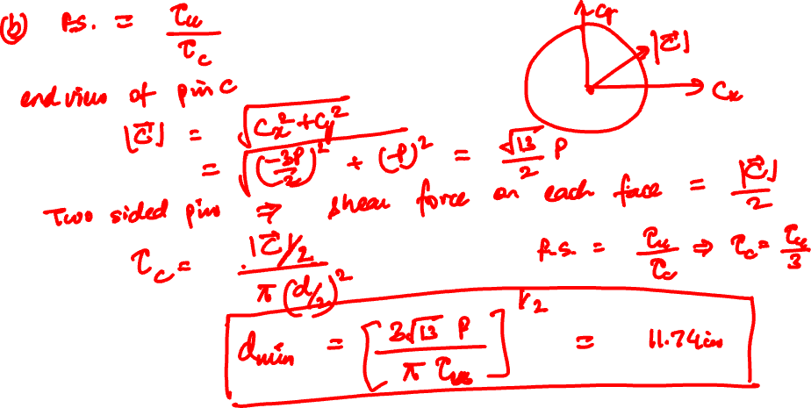

Slide 9
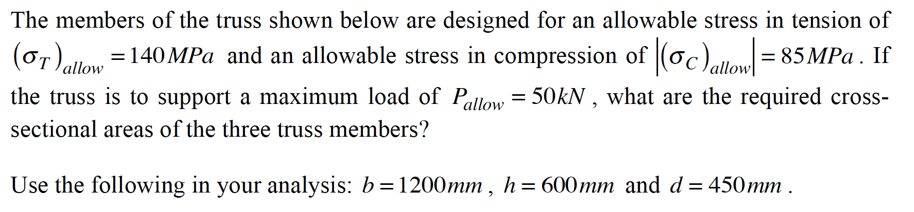
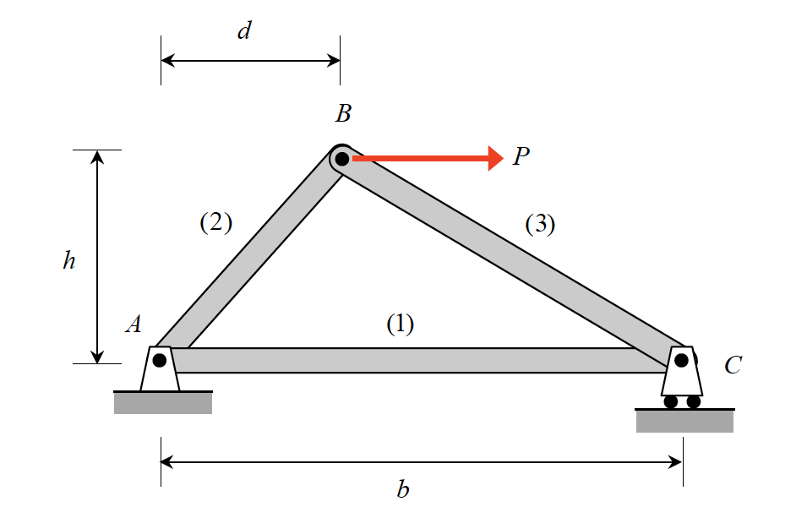
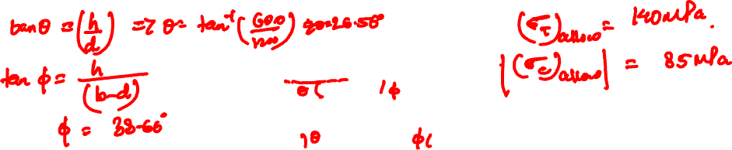
Example 4.2 from Lecture Book

Slide 10
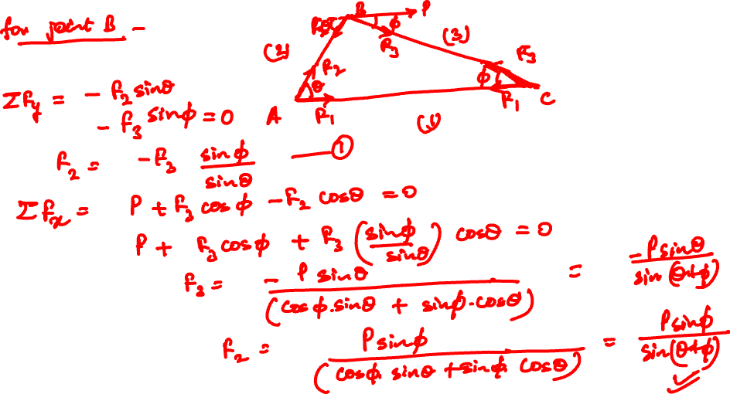

Slide 11
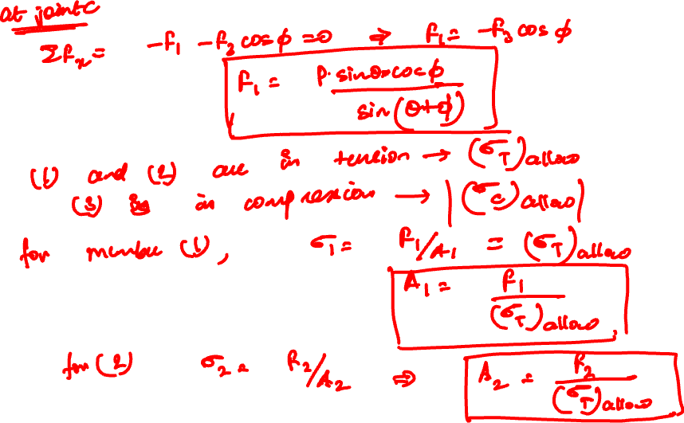
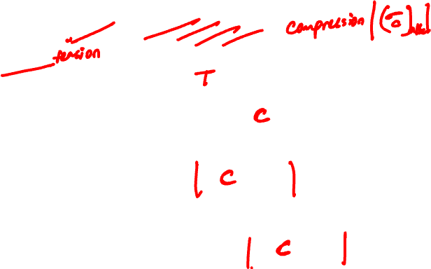

Slide 12
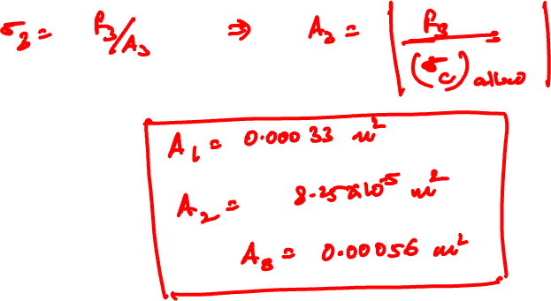

Slide 13
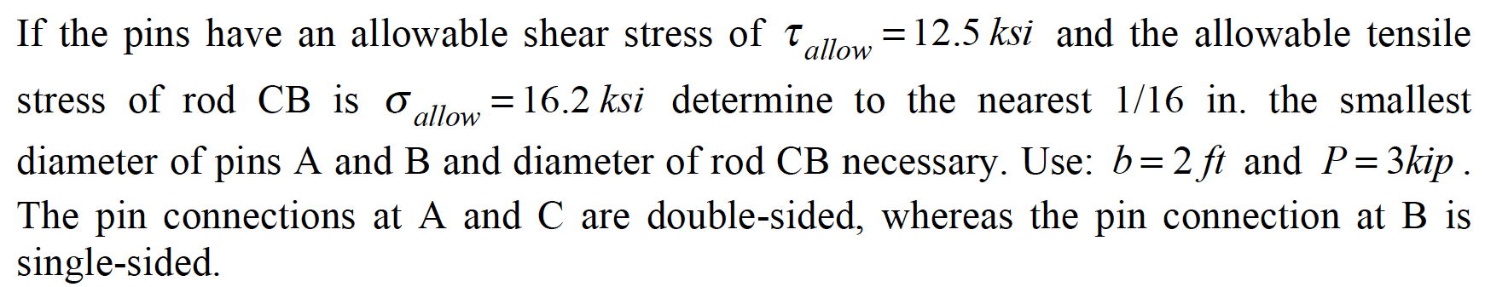
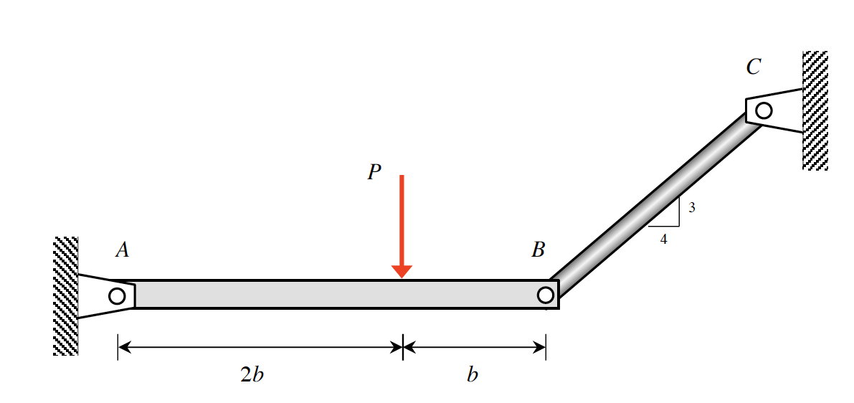
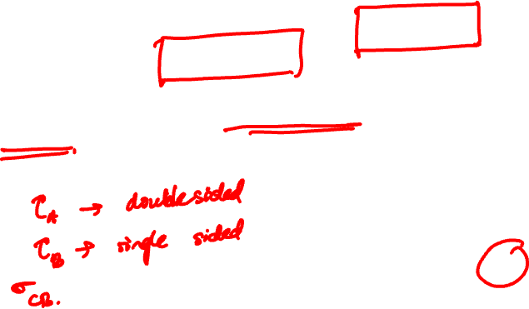
Example 4.3 from Lecture Book

Slide 14
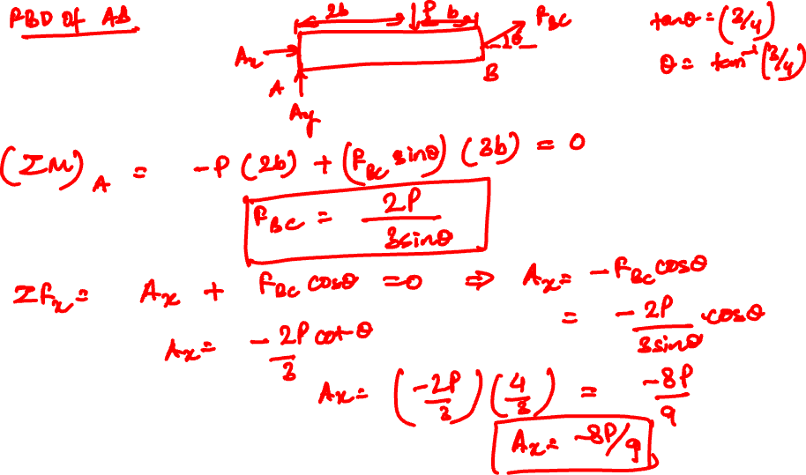

Slide 15
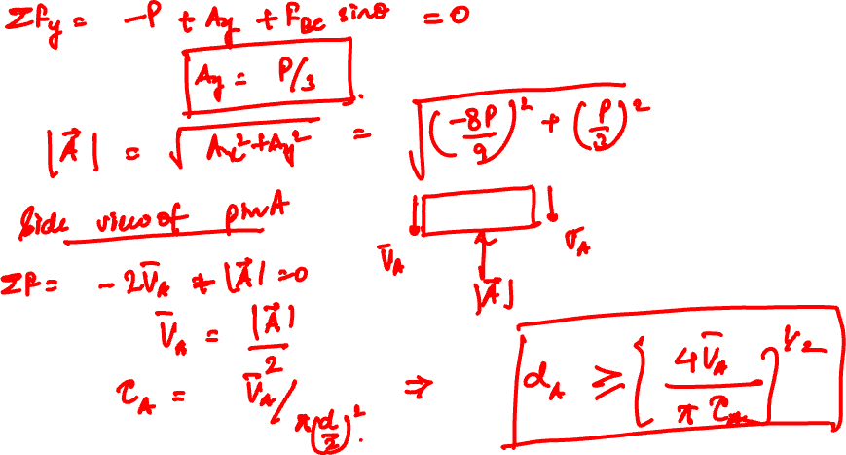

Slide 16
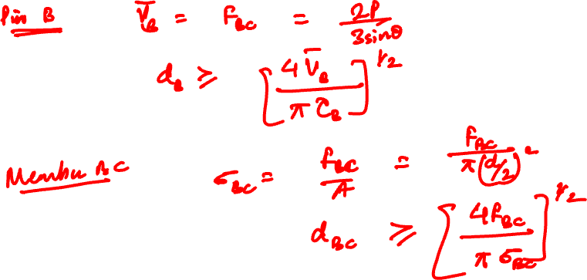

Slide 17
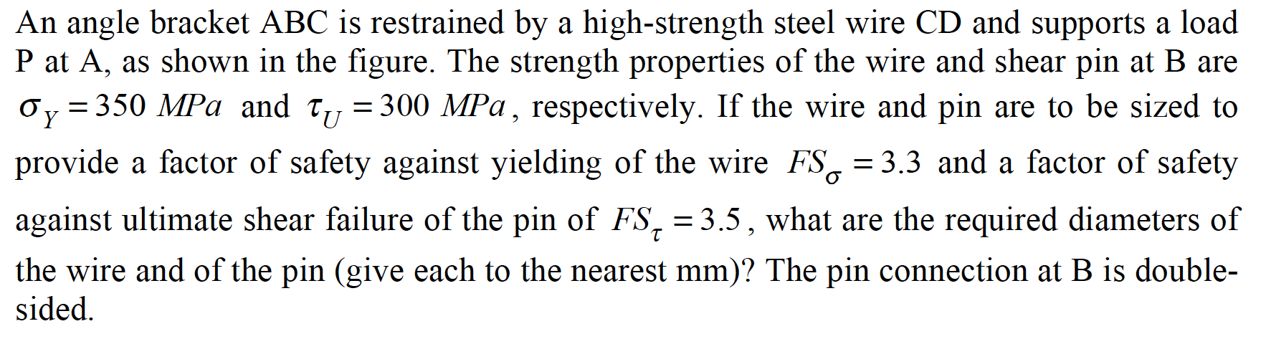
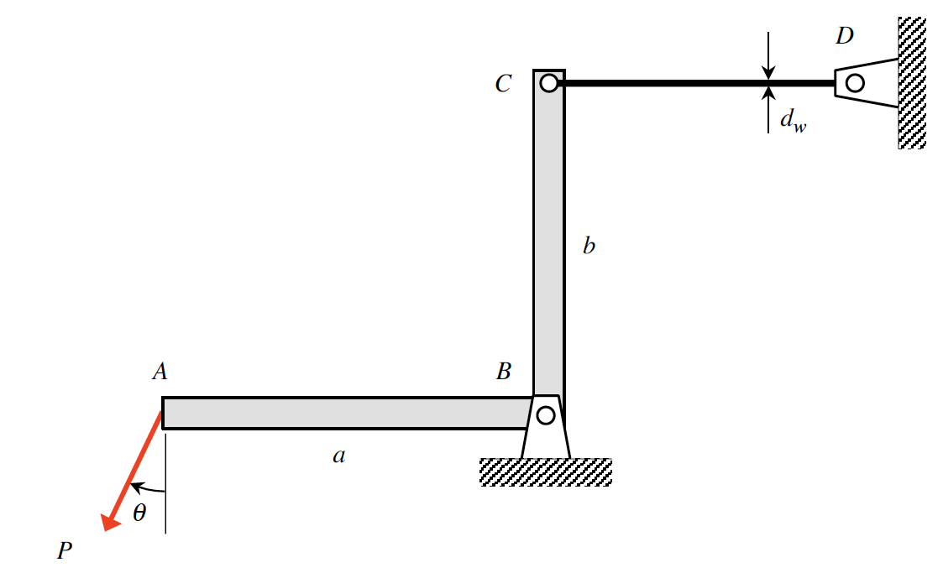
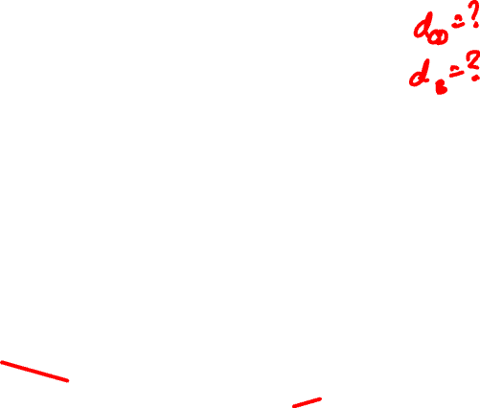
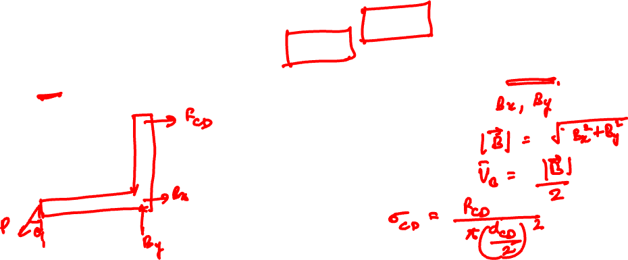
Example 4.5 from Lecture Book

Slide 18
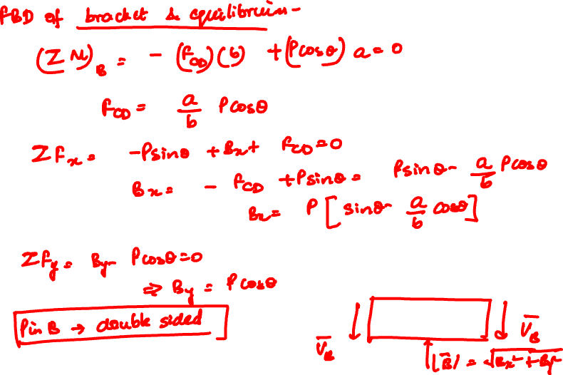

Slide 19
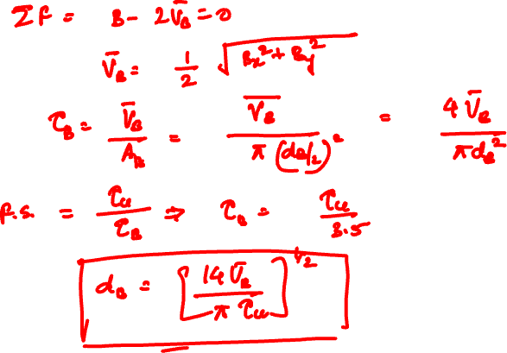

Slide 20
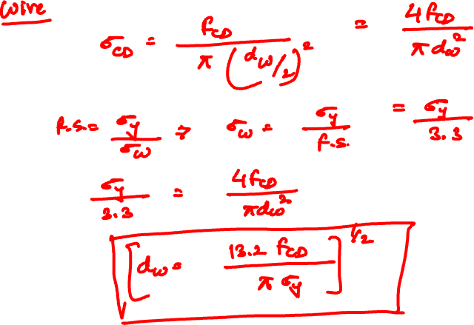

Slide 21
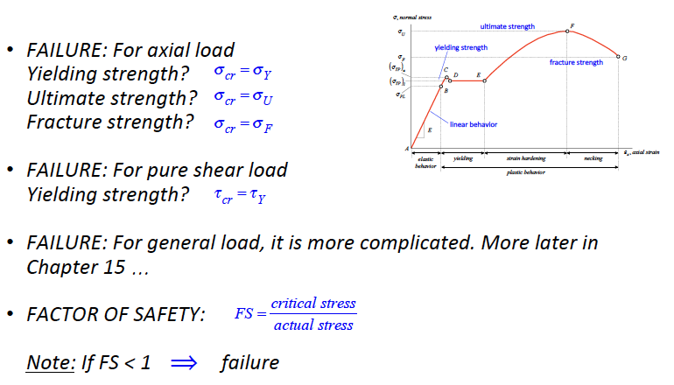
Lecture 4 Summary: Failure Analysis

Slide 22
Thank You

