Slide 1
MECHANICS OF MATERIALS
Fall 2025
ME 323- 002
Instructor: Shubhra Bansal
Lecture 3: Shear Stress
Shear Strain

Slide 2
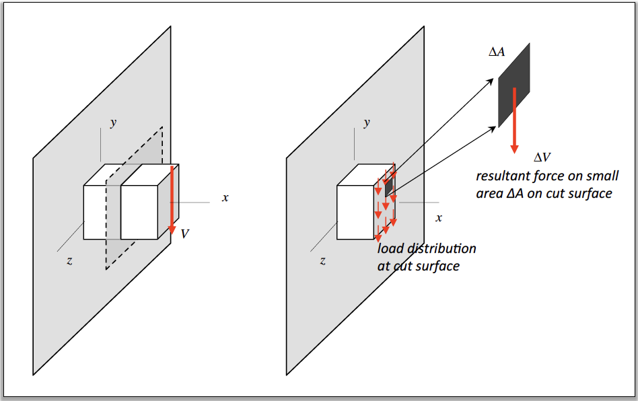
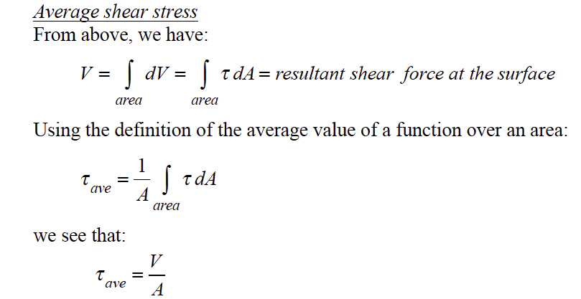

Shear Stress

Slide 3
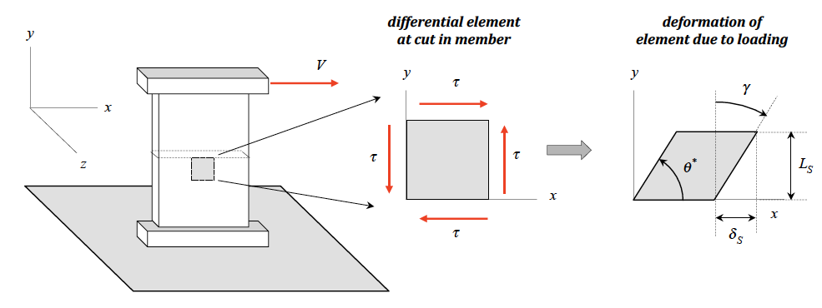
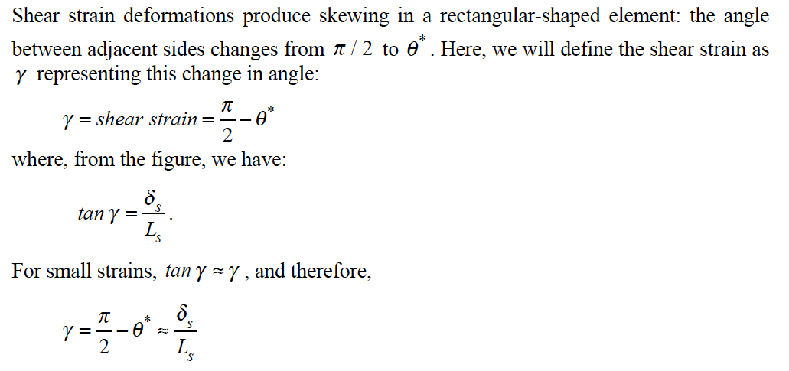

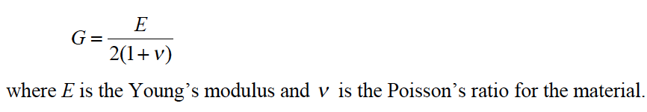
Shear Strain
G = shear modulus

Slide 4
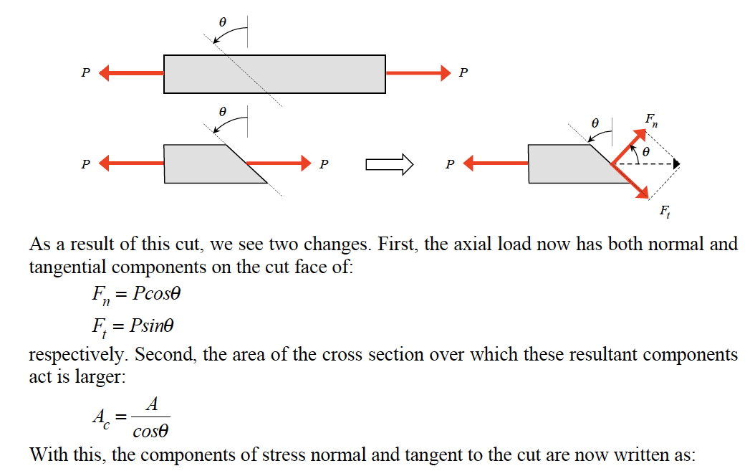
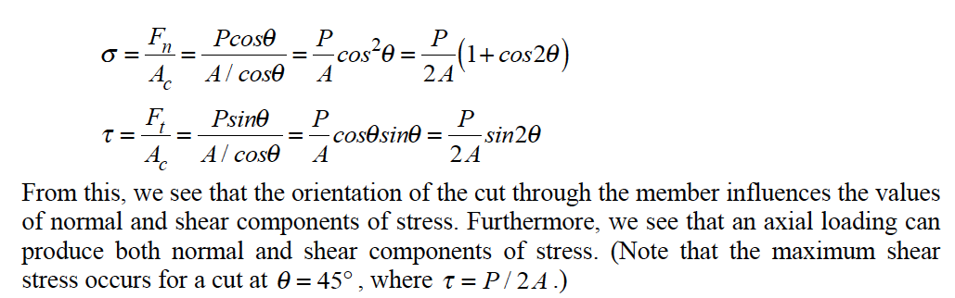
Normal Stress and Shear Components

Slide 5
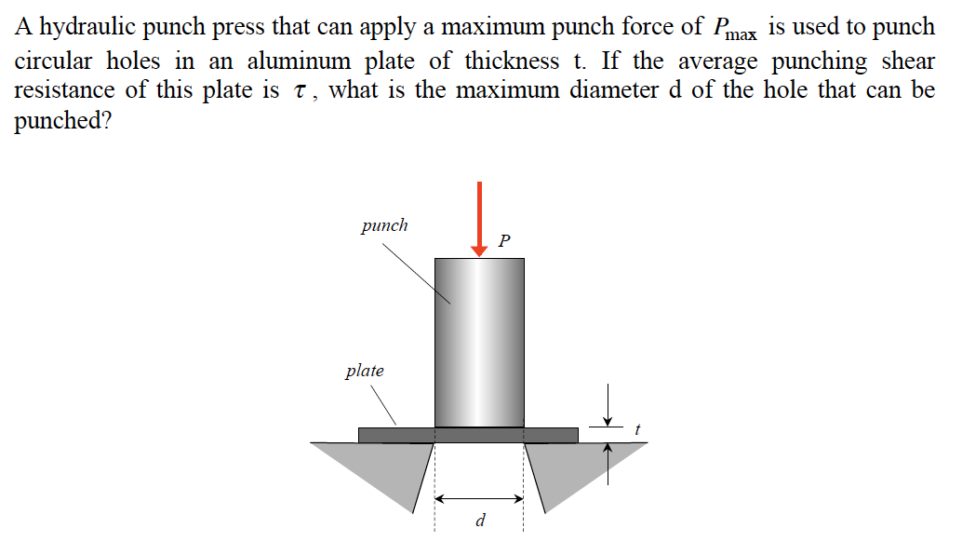

Example 3.1 from Lecture Book

Slide 6
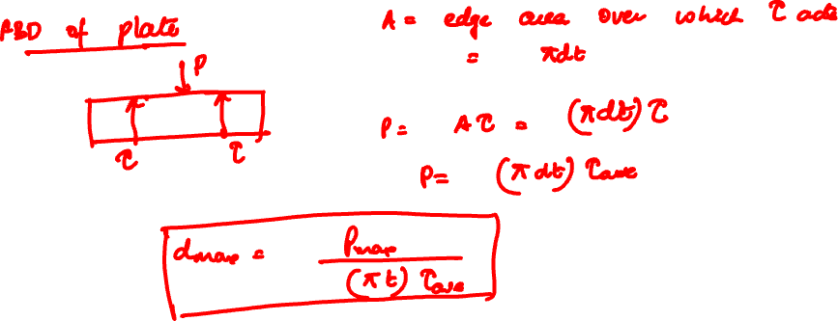

Slide 7
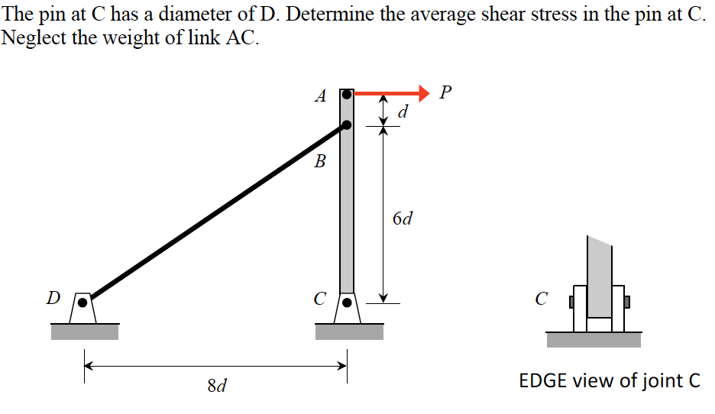
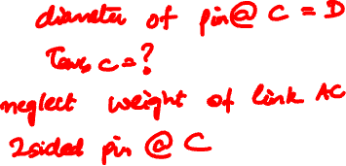
Example 3.3 from Lecture Book

Slide 8
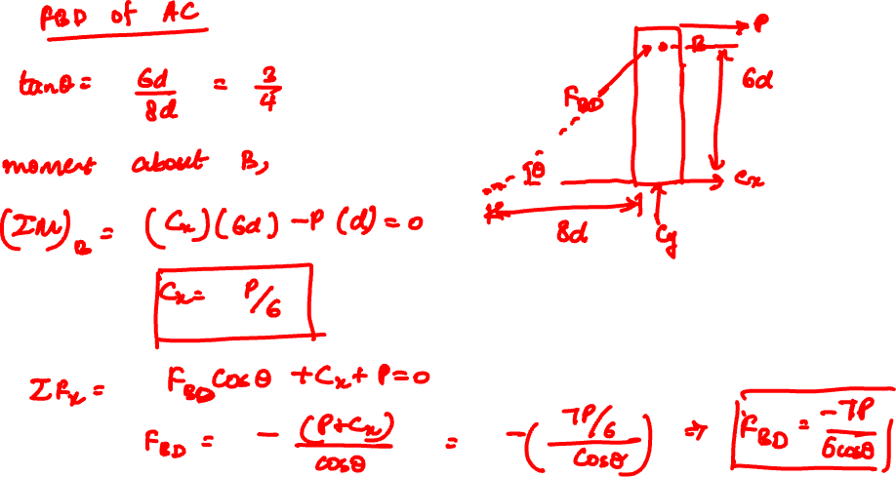

Slide 9
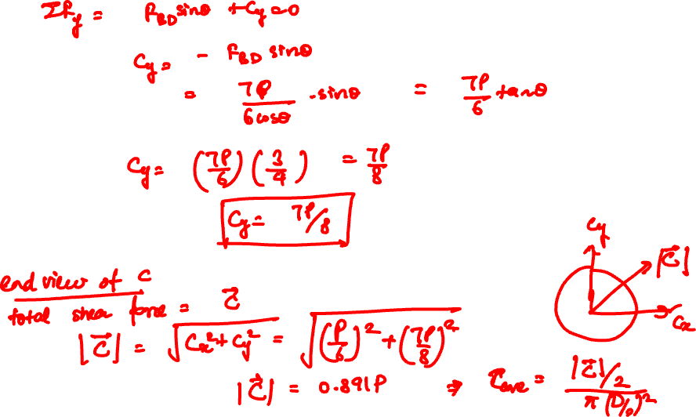

Slide 10
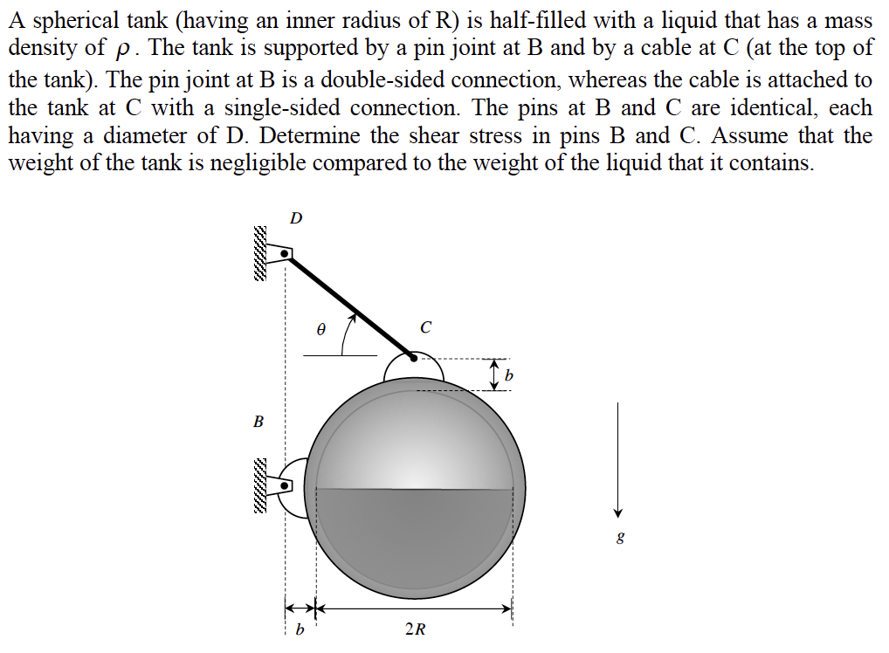
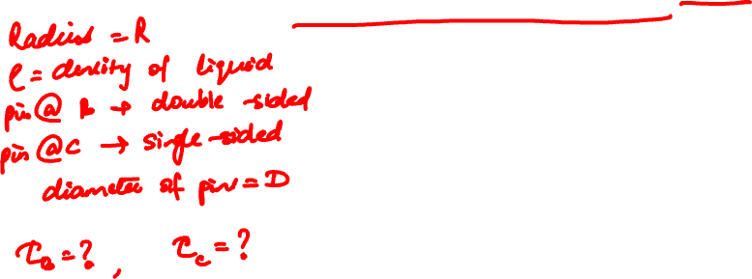
Example 3.5 from Lecture Book

Slide 11
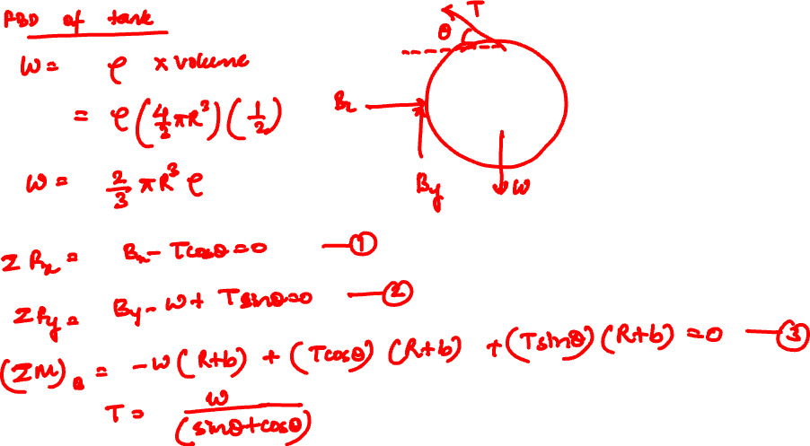

Slide 12
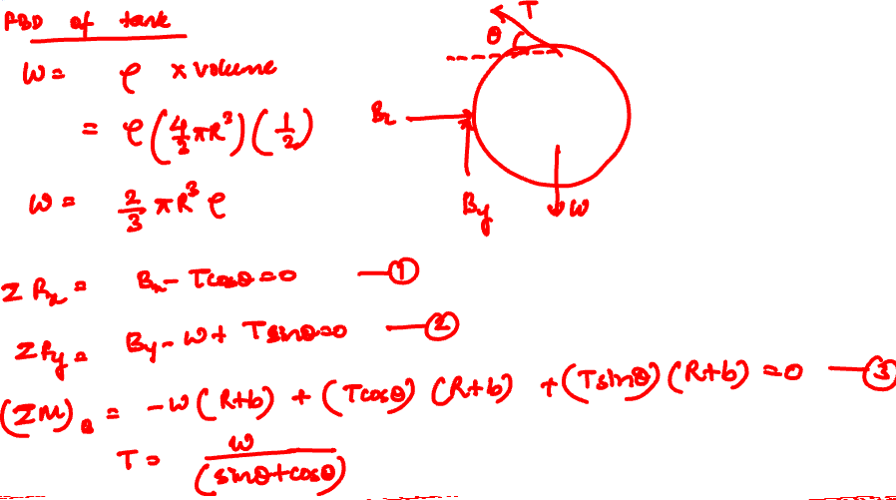

Slide 13


Slide 14
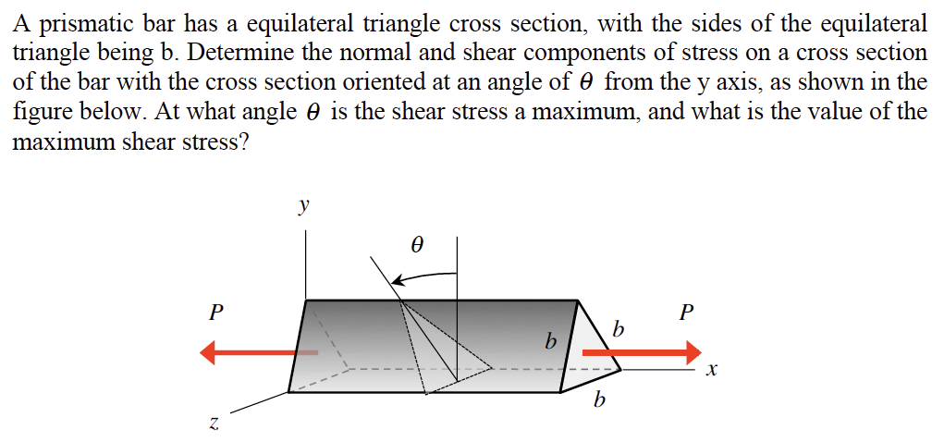

Example 3.6 from Lecture Book

Slide 15


Slide 16


Slide 17
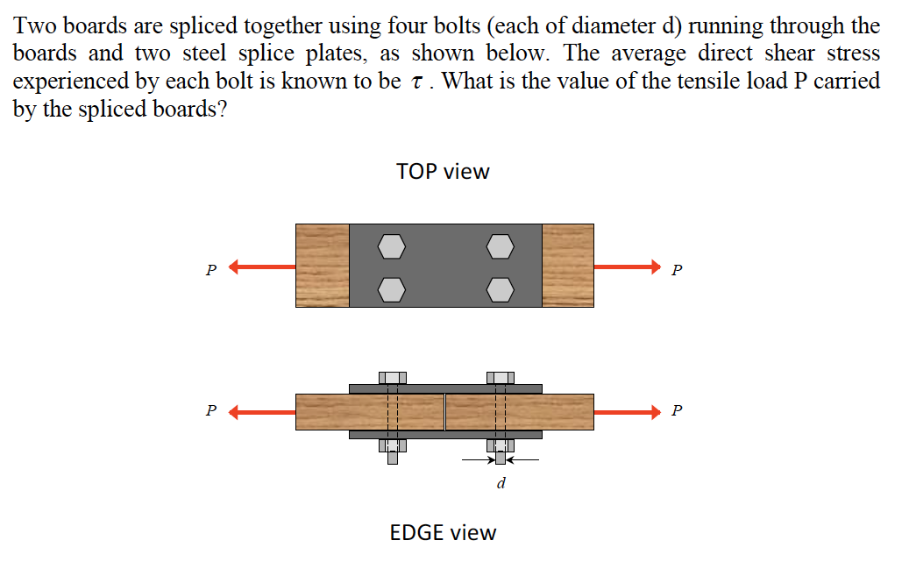

Example 3.2 from Lecture Book

Slide 18


Slide 19


Slide 20
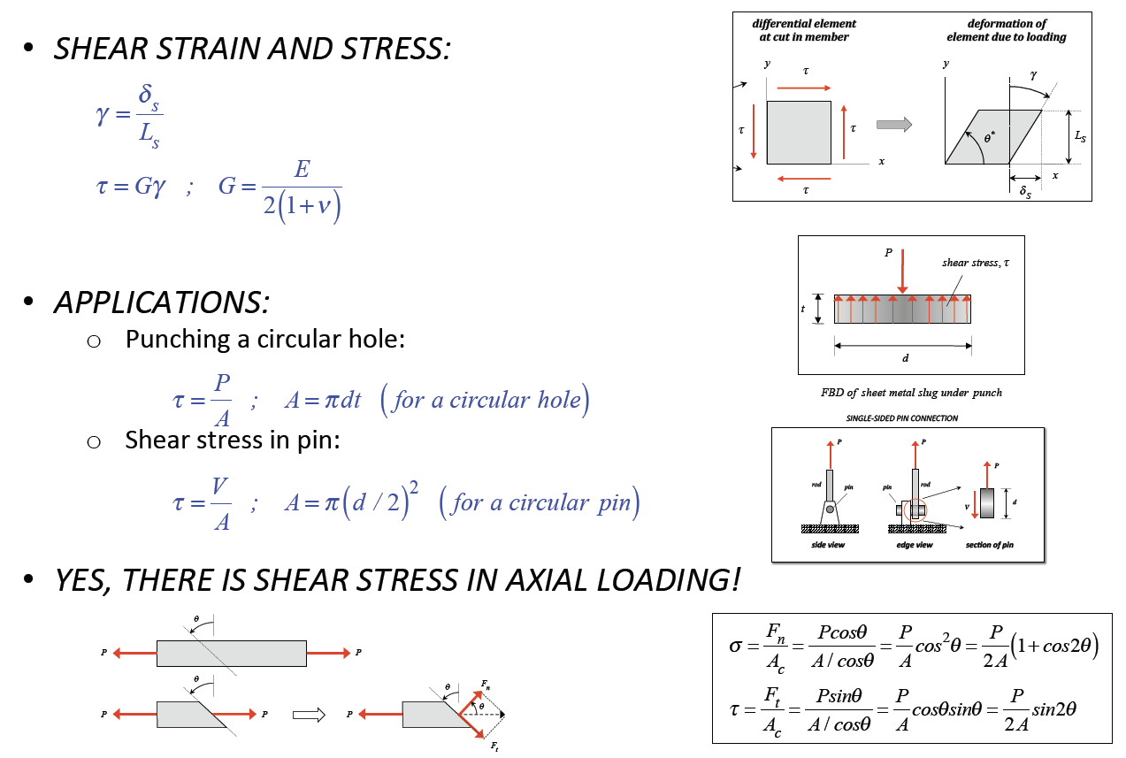
Summary

Slide 21
Thank You

